Slide 1
Punjab Ease of Doing Business (EODB)
DB 20-21
Industries, Commerce, Investment & Skills Development Department, Government of Punjab

Slide 2
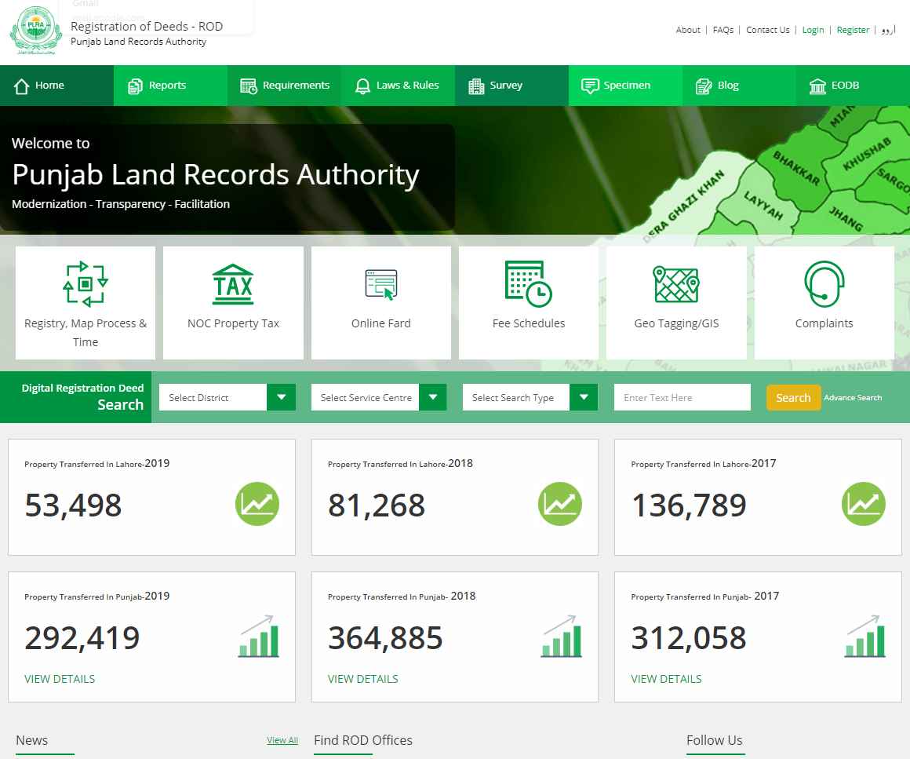
DOING BUSINESS INDICATORS
PROVINCIAL INDICATORS
Starting A Business
Registering Property
Dealing with Construction Permit
Enforcing Contract
Getting Electricity (Partially)
Paying Taxes (Partially)

Slide 3
STAKEHOLDERS
Provincial Government
Industries, Commerce & Investment Department – Lead Agency
Labour & Human Resource Department
Punjab Employee Social Security Institution
Excise & Taxation Department
Punjab Revenue Authority
Federal Government
Security and Exchange Commission of Pakistan (SECP)
Federal Board of Revenue (FBR)
Employees Old-Age Benefits Institution (EOBI)
National Database and Registration Authority (NADRA)
Beneficiaries
Business Entities
Tax/Business Consultants
Chambers of Commerce

Slide 4
PUNJAB EASE OF DOING BUSINESS REFORMS – COMPARATIVE ANALYSIS
# | Doing Business Indicators | No. of Reforms Completed from August 2018 to July 2020 | No. of Reforms Completed from July 2016 to June 2018
1 | Starting a Business | 3 | 3
2 | Paying Taxes | 4 | -
3 | Dealing with Construction Permits | 14 | 4
4 | Registering a Property | 7 | 7
5 | Contract Enforcement | 7 | 3
6 | Getting Electricity | 12 | -
Total |  | 47 | 17

Slide 5
Industries, Commerce, Investment & Skills Development Department, Government of Punjab
PROCESS / DAYS REDUCTION
Department | Registration | Time
 |  | Manual | Online
Labour & HR Department | Shops & Establishments Registration | 7 Days | 2 Working Days
Punjab Employee Social Security Institution (PESSI) | Initial Registration | 7 Days | 2 Working Days
Industries, Commerce, Investment & Skills Development Department (ICI&SDD) | AOP/ Firm Registration | 1-2 Days | 1 Working Day

Slide 6
REGISTRATION OF BUSINESS FRIMS UNDER PARTNERSHIP ACT 1932
Online business registration portal was launched in Lahore in Nov-2017
The portal has been replicated all over the Punjab in July 2020
Till date 24555 business firms have been registered through this portal with an average time of 19 Hrs & 3 Minutes i-e less than a day
Any person can submit his application for registration of firm through www.register.business.Punjab.gov.pk
Online fee payment is also made part of this portal since last one year

Slide 7
INSPECTION OF BOILERS/PRESSURE VESSELS THROUGH THIRD PARTIES
In order to minimize the interface of Govt Inspectors with industrial units, the Govt of the Punjab has outsourced the inspection work of pressure vessels to Inspection Authorities (3rd parties)
In this regard, Punjab Boilers & Pressure Vessels Safety Board, ICI&SD Department registered and authorized15-Inspection Authorities (3rd parties)
Since 01.04.2021, the Inspection Authorities have commenced the abovementioned work smoothly
The industrial owners directly apply to inspection authorities and get their pressure vessels registered without any intervention of Govt. Inspectors
It will help promote business, productivity and will create investment friendly atmosphere

Slide 8
INSPECTION FREE REGIME OF WEIGHTS & MEASURES
To introduce transparency and efficiency in business sector SOPs regarding Inspection of Weights and Measures in factories have been issued to field formation by Director General Industries, Prices, Weights & Measures.
Inspections of Weights and Measures at factory level have been halted and are instead carried out at retail level in public interest.
Entrepreneurs are encouraged to deposit Government fee in the treasury themselves on self assessment basis.
As a result of a special initiative taken by the Honorable Minister of Industries, Punjab Mian Aslam Iqbal the verification fee of Weights and weighing machines of upto 20 kg was exempted by the Government of Punjab and hence a relief was provided to almost 200,000 small vendors/shopkeepers of Punjab saving them from the black mailing of Repairers.

Slide 9
ONE WINDOW SERVICE CENTER (OWSC)
PIEDMC has established OWSC in Quaid-e-Azam Industrial Estate, Kot Lakhpat with Efficient and timely delivery of following services from land acquisition to start of production under one roof:
FIEDMC has established One Window Service Center at M3 Industrial City for Electricity and Gas connections
Allotment of Land | Transfer of Plot
Electricity Connection | EOBI & Social Security
Water Connection | Complaint Registration
Environmental Approval (Assistance) | Registration with SEP
Construction Plan / Building Approval | Services related to FBR
Change of Nature of Business | All Services related to SEZ Registration

Slide 10
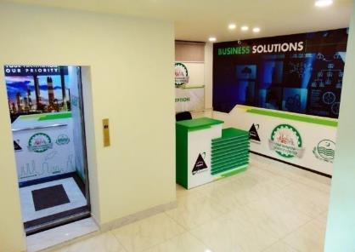
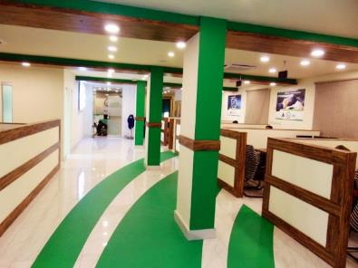
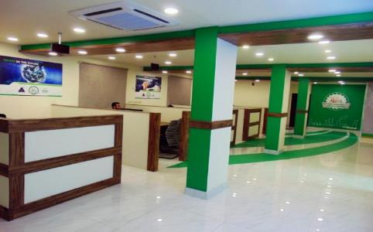
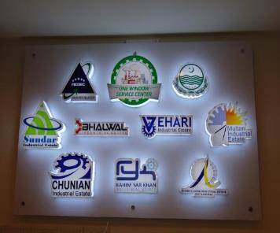
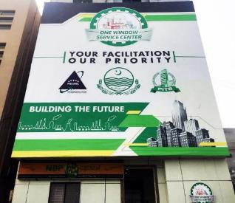
ONE WINDOW SERVICE CENTER AT PIEDMC

Slide 11
UPDATE ON CEMENT PLANTS IN PUNJAB
Industries Department is helping fast track establishment of cement plants in Punjab through proactive facilitation.
This includes; Online Application submission & Dedicated Portal; Dedicated Cell at ICS&SDD and WhatsApp group for active Liaison; Simplification of Procedures to Facilitate the Investors and; Robust Monitoring of Application processing through Steering committee. This resulted in Reduction of processing time from 270 to 90 days.
ICI&SDD had received 38 applications for establishment of new cement plants in the Punjab.
10 plants have received approval of the Cabinet and five more are in later stage.

Slide 12
UPDATE ON CEMENT PLANTS IN PUNJAB
A total estimated investment of around 250 – 300 Million$ is going to come into Punjab from just fifteen (15) new cement plants.
The total investment potential is around 4.5 Billion$ in this single sector over the next five (05) years.
Each new cement plant is expected to employee around 1000 - 1500 direct jobs while the indirect impact on the construction sector is well beyond. Total economic activity expected to be generated by establishment of these new Cement plants is around PKR: 2500 – 3000 Billion. This exponential growth in the domestic industry will enhance the exports and stabilize the trade gap between imports and exports.

Slide 13
EODB Reforms
Starting a Business
1 | Complete technical integration of SECP with Punjab Business Registration Portal
2 | Issuance of registration with Labour Department takes place on the same day and data is visible to SECP
3 | Online payment facility for paying business registration fee
Dealing with Construction Permits
4 | Reduced time/documents for completion certificate for low risk buildings/warehouse.
5 | Re-engineered business processes for all construction types to reduce time and procedures/documents for obtaining Water and Sewerage connections.
6 | LDA has provided facility of online payment of all dues to be paid to LDA (including WASA & TEPA).
7 | LDA has set up PLRA’s counter at OWC for issuance of fard.

Slide 14
EODB Reforms
Dealing with Construction Permits
8 | Automation of construction permits including electronic submission of applications.
9 | Mobile application for E-permit system launched by LDA (Insaaf Portal)
10 | Introduced legislation in Lahore on possible defect liability and introduced liability insurance requirement.
11 | Removed the requirement of obtaining NOC from Environmental Protection Agency by amending LDA building by-laws.
12 | Joint inspection will be carried out for water and sewerage connection.
13 | Reduction in cost of obtaining water & sewerage connection.
14 | LDA has outsourced field inspections to consultant(s) and inspection for completion certificate(s) to Architects, Town Planners and Consultants registered with LDA.
15 | LDA conducted risk based categorization of buildings study
16 | Removed the property valuation form (PT-1) as a requirement from WASA in Lahore for completion certificate
17 | Improved pre-screening of applications for construction permit

Slide 15
EODB Reforms
Registering Property
18 | Increased awareness raising efforts on recent reforms and clarified the legal requirements to avoid over-compliance and close implementation gaps.
19 | PLRA updates statistics on the number of land disputes at the economy level in the ﬁrst instance court on weekly basis.
20 | Time for execution of deed reduced to 8 days
21 | Automated process for issuance and payment of Fard
22 | Digital mobile application developed to access land records
23 | Automated process of payment of Stamp duties
24 | PLRA has reduced number of procedures from 7 to 4 and days from 56 to 11.
Getting Electricity
25 | Rolled out full online application system for obtaining electricity connection
26 | Made processes, guidelines and fees transparent by uploading details on website and placed cost calculator online
27 | Reviewed procedures to reduce time to submit application.

Slide 16
EODB Reforms
Getting Electricity
28 | Improve transparency of information index in Punjab by ensuring customers are notified ahead of billing cycle
29 | Online payment of demand notice
30 | Verification of test reports to be completed within 3 days by electric inspector.
31 | LESCO ensured that Test Reports are obtained after the building’s construction is complete.
32 | Introduced Geographic Information System (GIS) for the electricity distribution network.
33 | Reviewed procedures to reduce time to prepare estimates for issuance of demand notice.
34 | Take steps to reduce number of outages to be able to score on the reliability of supply and transparency of tariff index
35 | Enforced binding time limits on procedures to connect to the electricity grid
36 | Streamlined internal wiring inspection
Paying Taxes
37 | Over the counter payment facility for pension and social security contributions available at Bank of Punjab
38 | Online payment facility for pension and social security contributions.

Slide 17
EODB Reforms
Enforcing Contracts
39 | LHC established 3 specialized commercial benches in Lahore and one each in Multan, Gujranwala, Faisalabad and Rawalpindi.
40 | Introduced case management practices to address delays during the trial process
41 | Promotion of ADR system, operationalization of ADR by notifying ADR Rules
42 | Amendments made in CPC to reduce timelines for Trial & Judgement
43 | Court automation and Case Management System introduced at District & Session Court Lahore for use by Lawyers and Judges
44 | Four reports can be generated by the Case Management System i. time to disposition ii. Clearance rate report iii. Age of pending cases report iv. Single case progress report
45 | Dedicated Commercial Courts are being established in Punjab to reform the dispute resolution mechanism and ensure contract enforcement in a speedy manner as part of ease of doing business

Slide 18
THANK YOU!

Slide 19
STARTING A BUSINESS
Starting Business measures the number of procedures, time, cost and paid-in minimum capital requirement for a small-to-medium-size limited liability company to start up and formally operate in each economy’s largest business city.
Business Registration Portal developed and launched for registration of businesses with Labour & Human Resource Department, Excise, Taxation & Narcotics Control Department, Punjab Employees Social Security Institution and Registrar of firms through https://register.business.punjab.gov.pk/

Slide 20
EASE OF DOING BUSINESS RANKING
Provincial Doing Business Indicator (Partial / Full) | DB20 Rank | DB18 Rank | DB20 Score | DB18 Score
Overall - out of 190 economies | 108 | 147 | 61 | 52.78
Starting a business (Partial) | 72 | 142 | 89.3 | 76.60
Dealing with Construction Permits | 112 | 141 | 66.5 | 52.80
Getting Electricity (Partial) | 123 | 167 | 64 | 44.51
Registering Property | 151 | 170 | 48.6 | 41.36
Paying Taxes (Partial) | 161 | 172 | 52.9 | 46.42
Enforcing Contracts | 156 | 156 | 43.5 | 43.49

Slide 21
Industries, Commerce, Investment & Skills Development Department, Government of Punjab
DOING BUSINESS RANKING 2020
Indicator | DB20 Rank | DB19 Rank | DB20 Score | DB19 Score
Overall - out of 190 | 108 | 136 | 61 | 55.31
Starting a business | 72 | 130 | 89.3 | 81.89
Dealing with Construction Permits | 112 | 166 | 66.5 | 53.59
Getting Electricity | 123 | 167 | 64 | 44.75
Registering Property | 151 | 161 | 48.6 | 45.63
Getting Credit | 119 | 112 | 45 | 45
Protecting Minority Investors | 28 | 26 | 72 | 71.67
Paying Taxes | 161 | 173 | 52.9 | 47.05
Trading Across Borders | 111 | 142 | 68.8 | 60.12
Enforcing Contracts | 156 | 156 | 43.5 | 43.49
Resolving Insolvency | 58 | 53 | 59 | 59.86

