Slide 1




Medical devices
Introduction

Slide 2

Presenter’s Profile
Muhammad Waqas Ali
Expertise
Regulatory Affairs
Quality Management System,
Environmental management system
Occupational health and safety
Social Compliance
R&D and
Process validations
Qualification:
Masters English Literature
BSc Double Math & Physics
Various Business and Auditing Courses
Profession:
Working as MR in Global Tech International for the last 12 years

Slide 3
Table of Contents
Section 1: Definition of Medical Devices
Section 2: Major Groups of Instruments
Section 3: Classification Intend to risk factor
Section 4: Variants and Material information
Section 5: Examples of Process Validations

Slide 4

Definition of Medical Devices
General Definition
A medical device is any device intended to be used for medical purposes. Medical devices benefit patients by helping health care providers diagnose and treat patients and helping patients overcome sickness or disease, improving their quality of life.
Technical Definition
medical device’ means any instrument, apparatus, appliance, software, material or other article, whether used alone or in combination, including the software intended by its manufacturer to be used specifically for diagnostic and/or therapeutic purposes and necessary for its proper application, intended by the manufacturer to be used for human beings for the purpose of:

Slide 5
Technical Definition Continued
— diagnosis, prevention, monitoring, treatment or alleviation of Disease, alleviation of or compensation for an injury or handicap,
— investigation, replacement or modification of the anatomy
and which does not achieve its principal intended action in or on the human body by pharmacological, immunological or metabolic means.

Slide 6
Major Groups of Instruments
There are Six major groups of Instruments
  Surgical Instruments
  Dental & Orthopedic Instruments
  Ophthalmology Instruments
  Implants
  Diagnostic Instruments
  Electrosurgical Instruments

Slide 7
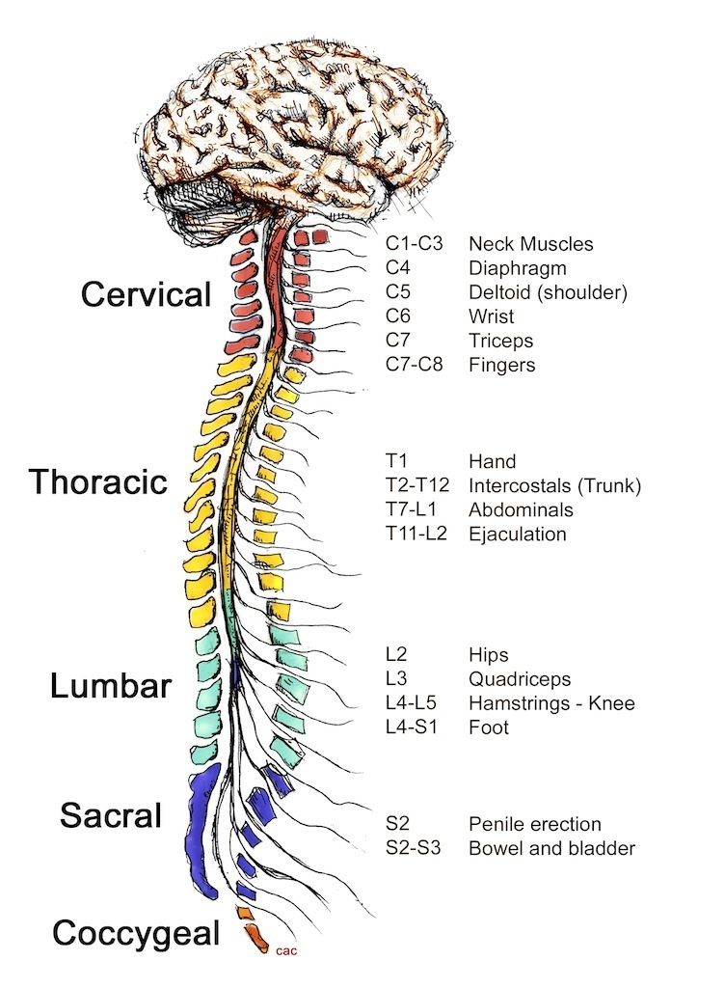
Anatomy Wise Categories
There are four main categories of instruments / devices
  Central Nervous System
  (Neurological Instruments)

Slide 8
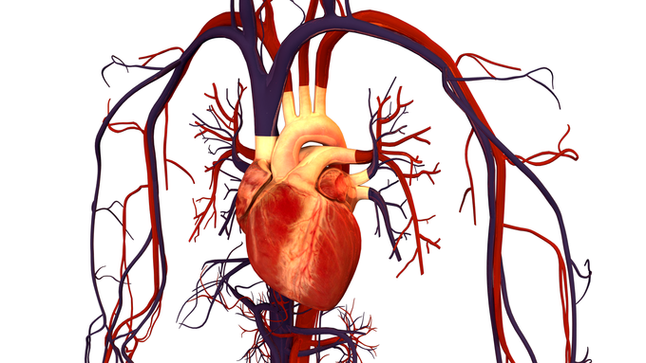
Anatomy Wise Categories
Central Circulatory System
(Cardiovascular Instruments)

Slide 9

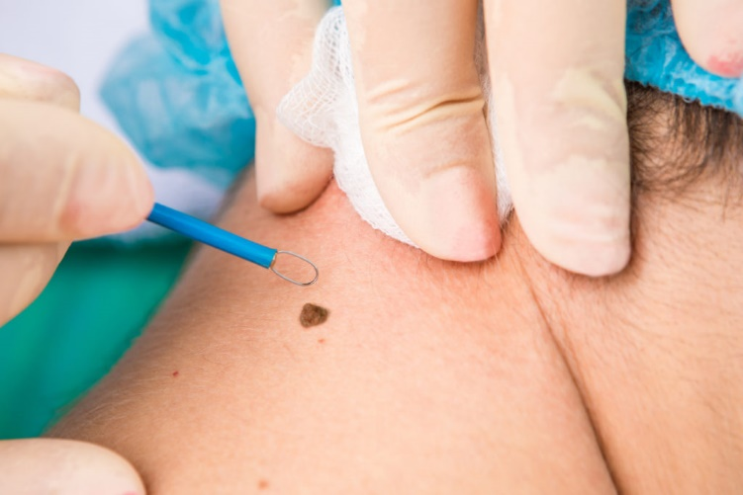
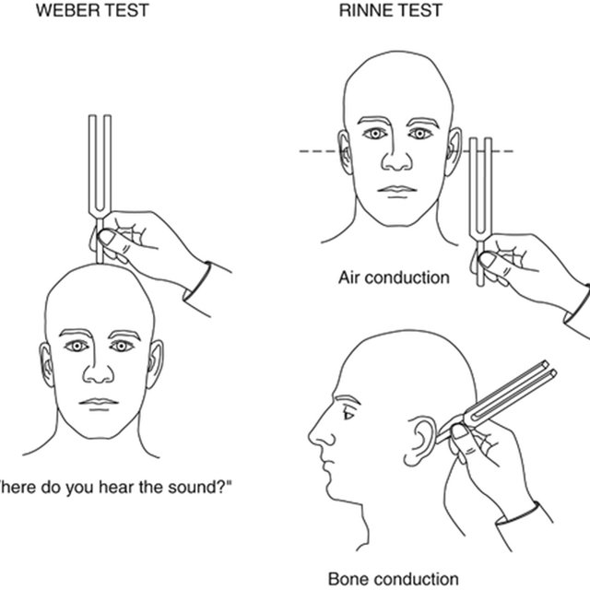
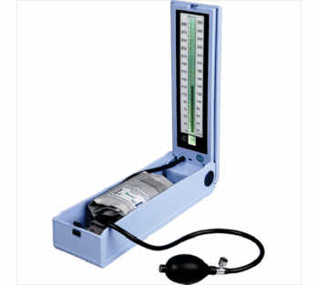
Types of Treatment
Surface contact medical devices

Slide 10
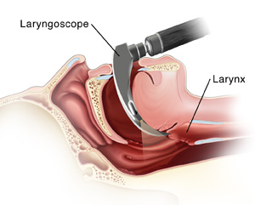

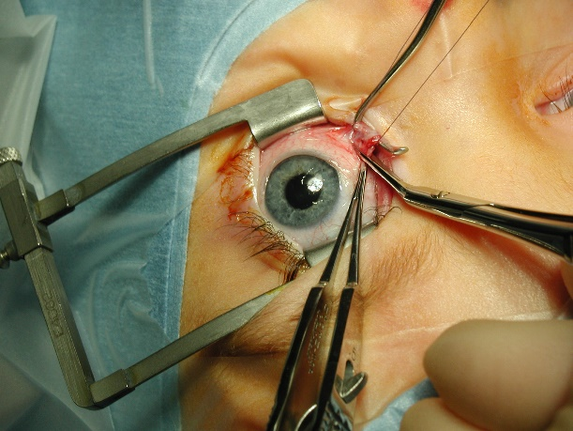
Types of Treatment
Via Body Orifice (Eyes, ENT, Gynecology, Anal )

Slide 11
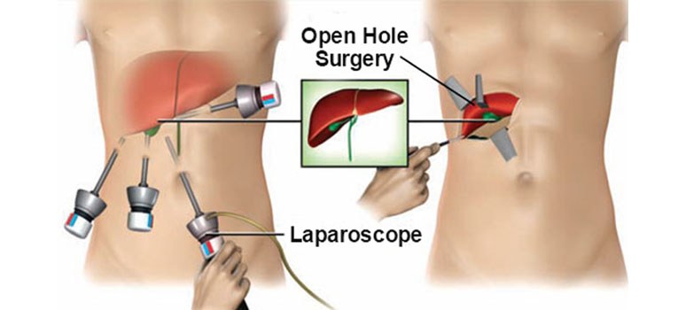
Types of Surgery
Minimal Surgery and Open Surgery

Slide 12
Classification intend to risk factor
Product Type | Duration of use | Contact with active devices | Risk Class
Central Nervous System | Transient to Long | Any | Very High
Central Circulatory System | Transient to Long | Any | Very High
Active Implantable Devices | Short to Long | Any | Very High
Implantable Devices | Short to Long | Any | Very High and High
Active Medical Devices | Transient | Any | High
Non Active Medical Devices (Surgically Invasive) | Transient | If contact: If not contact: | Medium Low
Non Active Medical Devices (Invasive via bodily orifices) | Transient | If contact: If not contact: | Medium Low
Non Active Medical Devices Surface Contact | Transient | If contact: If not contact: | Medium Low

Slide 13
Variants
and
Material information

Slide 14
Requirements for product Variants
  Surgical Forceps/Scissors/Retractors etc.
  Construction of devices shall be similar
  Intended use shall be similar
  Anatomy for use shall be similar
  Risk factors shall be similar
  Acceptability Criteria

Slide 15
Materials Information
Medical Grade Stainless Steel 300 and 400 series
Polymers & Rubbers
Material Selection Requirements:
Material shall meet the composition or specifications of any international harmonized standards i.e. ASTM / ISO.
Material shall be Biocompatible ISO 10993-1
Material shall be compatible with applicable cleaning agents
Material shall meet the requirements of Sterilization ISO 11135 / ISO 17665
Material shall meet the requirements of claimed shelf-life

Slide 16
Process Validations
Product quality in the context of process validation means that product performance is consistent from batch-to-batch and unit-to- unit.
  Identify the internal and external critical manufacturing processes.
  Adopt risk based approach (Low-medium-high)
  Targeted expectation (output)
  Process approach (Money, material, machine and manpower)
3 Main phases of Validation:
IQ: Installation Qualification
OQ: Operational Qualification
PQ: Performance Qualification

Slide 17
THANK YOU

