Slide 1
Introduction to SBP Schemes
Jawad Saeed
Retail Lending

Slide 2
IAQs
How many Schemes SBP is currently offering?
What is the Objective / Purpose of SBP Schemes?
What value does SBP schemes offer to Banks?
What value does SBP schemes offer to customer?

Slide 3
Export Refinance Scheme
Long Term Financing Facility
Refinance Facility for Modernization of SME
M&G Facility for Rice Husking Mills in Sindh
SBP Scheme for Renewable Energy
R&G Scheme for Women Entrepreneurs
FFSAP
Refinance Scheme WCF for SEs &
LE-MEs
CGS for Small and Rural Enterprises
EFS
PMYBL

Slide 4
Refinance Facilities
Refinance facilities are targeted loans from State Bank of Pakistan (SBP) to support exports and industrial growth with the ultimate objective of promoting overall economic development of the country.
Over the years, SBP has introduced special schemes under its refinance window to ensure adequate supply of financing to the value added industries at competitive rates for enhancing their production capacity and meeting working capital requirements.

Slide 5
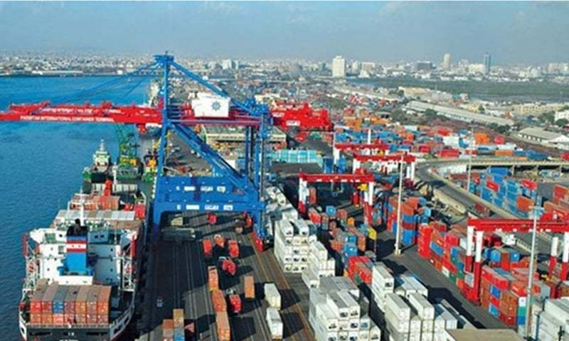
Export Refinance Scheme

Slide 6
Export Refinance Scheme
A short term (180 days) financing facility for working capital of exporters
Consists of two parts:
        Part-I (Transaction Based)
        Part-II (Performance Based)
    All sectors are eligible except those mentioned in the negative list
    Prevailing rate for exporters is 3%
    0.5% -1.5% performance based markup rebate under EFS Part-II
    Banks’ spread is 1% higher in case of lending to SMEs under scheme
    The financing facility is also available under Islamic mode

Slide 7
Scope of the Scheme:
All sectors are eligible except those mentioned in the Negative List.
    Negative list is mainly to achieve the objective of EFS and consists of raw or non value added items.
Apart from conventional Sectors of Textiles, edibles, leather and leather garments, sports goods, surgical goods, machinery, metal products etc. are eligible
Requirement of Overdue Export proceeds Not more than 5% of Last year exports.

Slide 8
Export Refinance Scheme Markup Rates
Year | Rate of refinance | Spread | Total
Nov’09 | 7.0% | 1.0% | 8.0%
Jan’10 | 7.5% | 1.0% | 8.5%
July 10 | 8.5% | 1.0% | 9.5%
Jan.,11 | 10.0% | 1.0% | 11.0%
Sept., 12 | 8.5% | 1.0% | 9.5%
April 13 | 8.4% | 1.0% | 9.4%
July, 2014 | 6.5% | 1.0% | 7.5%
Feb., 2015 | 5.0% | 1.0% | 6.0%
July, 2015 | 3.5% | 1.0% | 4.5%
July, 2016 | 2.0% | 1.0% | 3.0%
Effective March 04, 2014, Banks’ spread for SMEs is 2%

Slide 9
Incentives for SME Exporters under EFS:
0.5% increase in performance based markup rebate for each level of higher export performance.
1% increase in banks’ spread against lending to SMEs
Minimum 10% limit utilization by banks for SMEs

Slide 10
Mechanism of Extending Funds:
Grant of limits by SBP to the banks based on SBP internal criteria’
        Bank’s request,
        Bank’s Demand & Time liabilities
        Bank’s Financial Health
        Previous utilization
Banks to evaluate financing requests of their borrowers within their own lending policies-
Credit risk of loans under EFS is born by the bank

Slide 11
ERF Part-I (Transaction Based)
Facility is available to Direct Exporters (DE) (including commercial exporters, trading companies) and Indirect Exporters (IDE) against confirmed export order/ LC / Contract.
Facility available at both Pre & Post Shipment stages to DEs.
Facility available to IDEs at Pre-Shipment stage only.
Performance required against every transaction.
Claiming Refinance:
Submit Form D and DP Note (executed by the exporter) to concerned SBP BSC.
If documents are in order, SBP BSC will provide refinance within 48 hours

Slide 12
Documents submitted by Exporter in EFS Part-I
Export order/LC/Contract
Application
Undertaking
DP note
Duplicate copy of E-Form
Bill of Lading/ Airway Bill
EPRC within 210 days from the date of shipment or such extended time allowed under FE regulations.

Slide 13
Submission of Shipping Documents
For Exporter 30 days from the date of expiry of loan to submit Shipping Documents to concerned bank.
For bank 7 days for Annexure-D from the expiry of the period = [Total 37 days]
EPRC within 30 days of the receipt of proceeds or expiry of period prescribed by EPD.
Non submission of EPRC will attract Fine of Rs.20,000. Further, 25% of this fine (i.e.Rs.5,000) would be non refundable even on late submission of EPRC (c.f. SMEFD Circular Letter No.02 of 2010).
If Annexure-D not submitted within 37 days SBP BSC will recover non shipment fine
  The exporter is entitled to refund of fine, subject to submission of documents subsequently.
  After retaining fine for delayed/short shipment and delayed submission of shipping documents.

Slide 14
Repayment by the Exporter & Banks
180 days after the date of disbursement.
Earlier, if export proceeds are realized before the expiry of the 180 days period.
Banks have to repay refinance within 3 working days in case of early realization/repayment.
Fine is charged on late adjustment.
Mark up payment on quarterly basis.

Slide 15
Facility of Substitution
Under Part I (pre-Shipment), exporter has the option of substitution.
Bank shall ensure that in case of substitution,
    new commodity/contract is also eligible under EFS.
    No refinance has been obtained against it.
Shipment is to be made within the maximum prescribed period of the loan.
The bank, on its own, can allow the substitution, the exporter has to mention in Annexure D.
Would not report any Form – E already utilized under Part-II of the EFS.

Slide 16
ERF Part-II (Performance Based)
  Limit based on Performance.
  Exporters are allowed a revolving limit equivalent to 50% of their total value of goods realized in the previous year.
  Entitlement is determined on the basis of EE-1 Statement (that includes export proceeds from exports of eligible items in previous year under both parts of EFS.)
  The exporter is free to avail this facility within his entitlement for the whole year, however, maximum period of a specific loan is 180 days.

Slide 17
Performance Based Lower Markup Rates
Performance Requirement | Mark-up Rate for Borrower |  | Reimbursement Benefit to Borrower
 | Corporate | SMEs | Corporate | SMEs
2.00 to 3.00 times | 3.0% (Standard EFS Rate) | 3.0% | NIL | NIL
3.01 to 4.00 times | 2.5% | 2.0% | 0.5% | 1%
4.01 to 5.00 times | 2.0% | 1.5% | 1% | 1.5%
Above 5.0 times | 1.5% | 1.0% | 1.5% | 2%

Slide 18
Documents submitted by Exporter in EFS Part-II
To avail the Facility:
Exporter has to submit following documents to its bank and the bank will submit the same to concerned SBP BSC office to claim refinance:
  Application
  Duplicate EE-1 Statement
  D.P Note
  Undertaking
B) To show Performance:
FEOD verifies EE-1 & EF-1 at the end of relevant FY.
EF-1 Statement to be submitted duly verified by FEOD through banker of the exporter.
Verified DUPLICATE of EF-1 Statement is to be submitted to Refinance Unit of SBP-BSC before 31st August.

Slide 19
Irregularities and Fines
Non Performance
If an exporter fails to perform, fine for non performance is charged.
Short Performance
If an exporter fails to perform partly, it attracts fine for short performance.
Fine for Excess Availment
The exporters are allowed to avail their previous year limit after June every year for a period of two months provided that their borrowing does not exceed their previous years’ limit, otherwise it attracts fine for availing excess finance.

Slide 20
Rates of Fine Under EFS Part-I
Nature of Irregularity. | Rates of Fine
Non –Shipment | Paisa 37/day/ Rs.1000 or part thereof
Short / Delayed Shipment | Paisa 28/day/ Rs.1000 or part thereof.
Late adjustment of funds by a bank against repayment made to it. | Paisa 42/day/ Rs.1000 or part thereof
Delayed submission of shipping documents by the exporters | Rs.2000 for the default, Rs.100/day for each day of default
Rates of Fine Under EFS Part-II
Nature of Irregularity. | Rates of Fine
Short-fall in performance | Paisa 28/day/1000 in case of showing at least 50% of the prescribed level of performance, otherwise Paisa 37/day/1000 of the product of shortfall.
Any other default by the exporter/bank | Paisa 37/ day per Rs.1000.
Misreporting / entry in statement (EF-1, EE-1, EP and Annexure-D) required to be submitted to SBP. | Rs.100 / wrong entry.

Slide 21
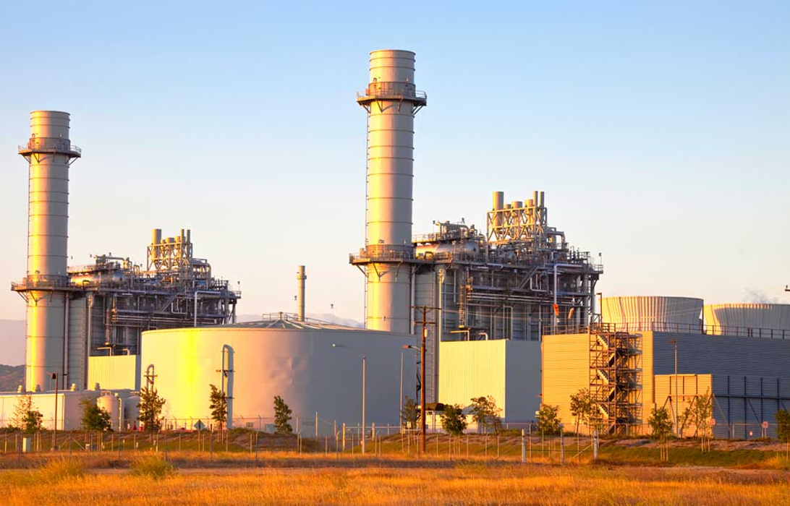
Long Term Financing Facility (LTFF)

Slide 22
Long Term Financing Facility (LTFF)
Long term local currency finance for imported and locally manufactured new plant and machinery
Available to the export oriented projects only if their annual export is equivalent to US $5 million or at least 50% of the sales whichever is lower
Financing shall be available through banks / DFIs approved as PFIs
Maximum borrowing limit for a single export oriented unit is Rs 1.5 billion
Financing shall be available for a maximum period of 10 years including a maximum grace period of 2 years.
The Scheme is also available in Islamic mode.
Tenor based bank’s spread
Period of financing | Rate of Refinance | PFI Spread | End User’s rate
Up‐to 3 years | 4.50% | 1.50 % | 6.00%
3‐5 Years | 3.50% | 2.50 % | 6.00%
5‐10 Years | 3.00% | 3.00 % | 6.00%

Slide 23
Eligible Categories under LTFF
Core Categories
Textile & Garments
Rice Processing
Leather & Leather products
Sports goods
Carpets & Wools
Surgical Instruments
Developmental Categories
Fisheries
Poultry & Meat
Fruits/Vegetable & Processing, Cereals
I.T. – Software & Services
Marble & Granite
Gems & Jewelry
Engineering Goods
Generators / Captive Power Plants
Ethanol
Furniture and Pharmaceutical
Regeneration of Textile Waste
Glass Sector
Dairy Sector
Soda Ash
Fabrics
Spinning & Ginning
Garments
Towels
Made up
Art silk & synthetic textile

Slide 24
Terms & Conditions - LTFF
Financing is available against Letter of Credit only, to the extent of the C&F value of imported machinery and ex-factory / showroom price of locally manufactured machinery
The cost of insurance, transit insurance, erection and commissioning charges and other incidentals (including transportation charges, in case of locally manufactured machinery) etc.; shall not be financed under the facility.
PFIs may also consider financing requests of new projects and expansion of existing projects on the basis of projected exports, keeping in view the provisions of SMEFD Circular Letter No. 05 of 2010 & SMEFD Circular Letter No. 05 of 2011 respectively”
Export oriented SME borrowers may purchase imported machinery from the commercial importers or authorized dealers of the foreign manufacturers in Pakistan and authorized suppliers in case of locally manufactured machinery and plant

Slide 25
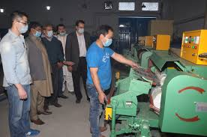
Refinance Facility For Modernization of SMEs

Slide 26
Refinance Facility For Modernization of SMEs
Financing shall be available to wide range of SME Clusters / Sectors
Only SME borrowers, as defined in Prudential Regulations for SMEs, shall be eligible to avail financing facilities under the Scheme
Financing shall be available for purchase of new imported/local plant & machinery for BMR of existing units and setting up of new SME units
Financing shall also be available for import / local purchase of new generators up‐to a maximum capacity of 500 KVA
Financing facilities shall be available through all commercial banks and Development Finance Institutions (DFIs).
Maximum period ten years including a maximum grace period of six months

Slide 27
Refinance Facility For Modernization of SMEs
Rate of Service Charges
The rate of service charges once fixed shall remain locked‐in for the entire duration of the loan
In cases where the loan amount has not been disbursed in full during the validity of an applicable rate, the un‐disbursed amount shall attract the new rate of finance
Tenor | Rate of Refinance | Banks’/DFIs’ Spread | End Users’ Rate
Up‐to 10 years | 2.0% | 4.0% | 6.0%

Slide 28
Illustrative List of SME Clusters/Sectors
Rice Husking
Cotton Ginning
Power Looms
Dairy & Livestock
Cutlery & Stainless Utensils
Surgical Instruments
Marble & Granite
Engineering Goods, (Electronic)
Fisheries
Packaging / Processing of Fruits / Vegetables
Furniture
Gems & Jewellery
Sports Goods
Agro‐based Industry
*IH&SMEFD Circular no.9 of 2019 , July 23, 2019 …… Expansion in the Scope.

Slide 29
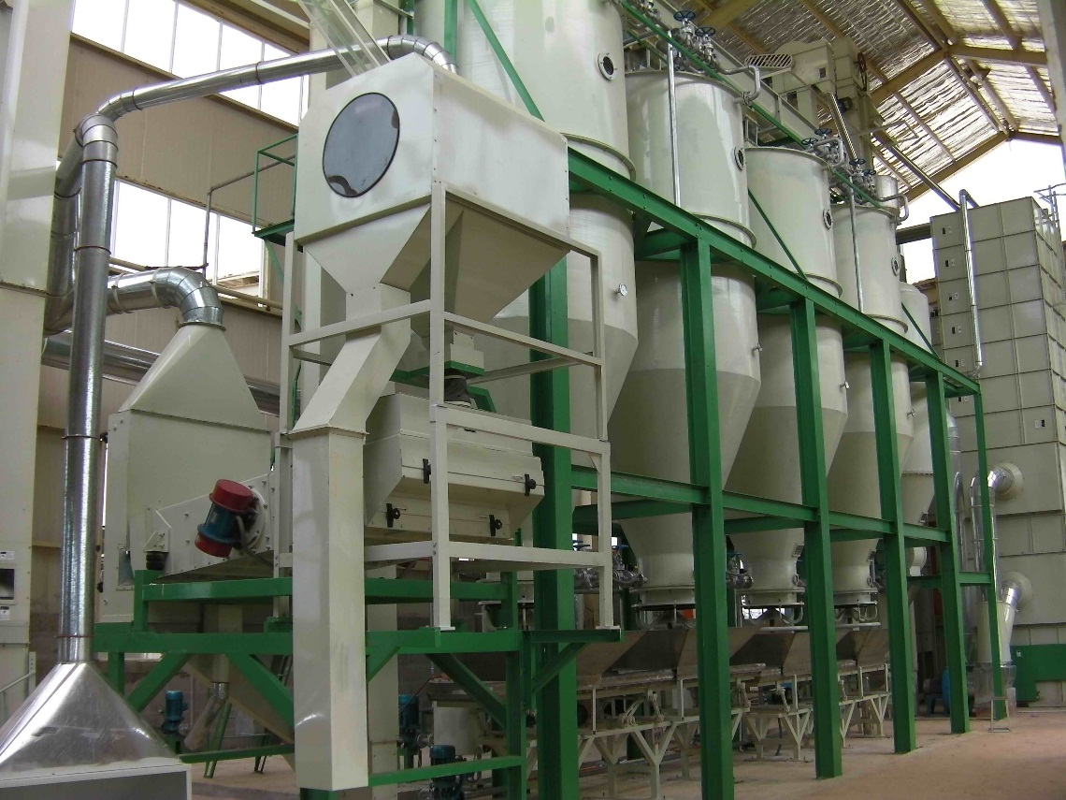
Markup Subsidy & Guarantee Facility for Rice Husking Mills in SINDH

Slide 30
Markup Subsidy & Guarantee Facility for Rice Husking Mills in SINDH
The Sindh Enterprise Development Fund (SEDF) in collaboration with SBP, has offered subsidy on the use of funds under the Scheme to the rice‐husking mills in Sindh
SEDF provides partial credit guarantee cover of 30% to banks through SBP against their outstanding loans (principal portion only)
The loan facility under the Scheme will be available for establishment and BMR of Rice Husking Mills in Sindh Province.
Financing shall be available for a maximum period of 5 years including a maximum grace period of six months
Maximum loan size for a single borrower is Rs. 10 million but for those mills that want to add mechanized dryers the financing limit is Rs 16 million.
End user rate is 2%. In addition to this 2%, PFIs receive an additional 2.75% from SEDF (SBP's refinance rate of 2% is also borne by SEDF).

Slide 31
Procedure to avail the Facility:
Banks will forward loan case of eligible borrower to SEDF with the request to issue letter of comfort for sanctioning of the facility.
To obtain facilities for eligible borrowers under this Scheme, concerned bank will forward its request for guarantee and subsidy facilities along with Letter of Comfort provided by SEDF to the e Development Finance Support Department (DFSD) through SBP, BSC (Karachi, Hyderabad, and Sukkur).
The SBP BSC offices will subsequently also intimate approval of refinance to the DFSD
DFSD shall assess compliance with terms of the Scheme in light of the documents submitted by the concerned SBP BSC office/bank
The DFSD shall, however, have the right to withdraw its confirmation of guarantee and subsidy if it is identified through inspection/ verification that the borrower was not eligible
The DFSD shall convey issuance of guarantee and subsidy facility for a loan to the concerned bank through relevant field office of SBP BSC (Bank) within 7 working days
SBP will recover its outstanding principal amount on due dates from the banks’ accounts maintained with it

Slide 32
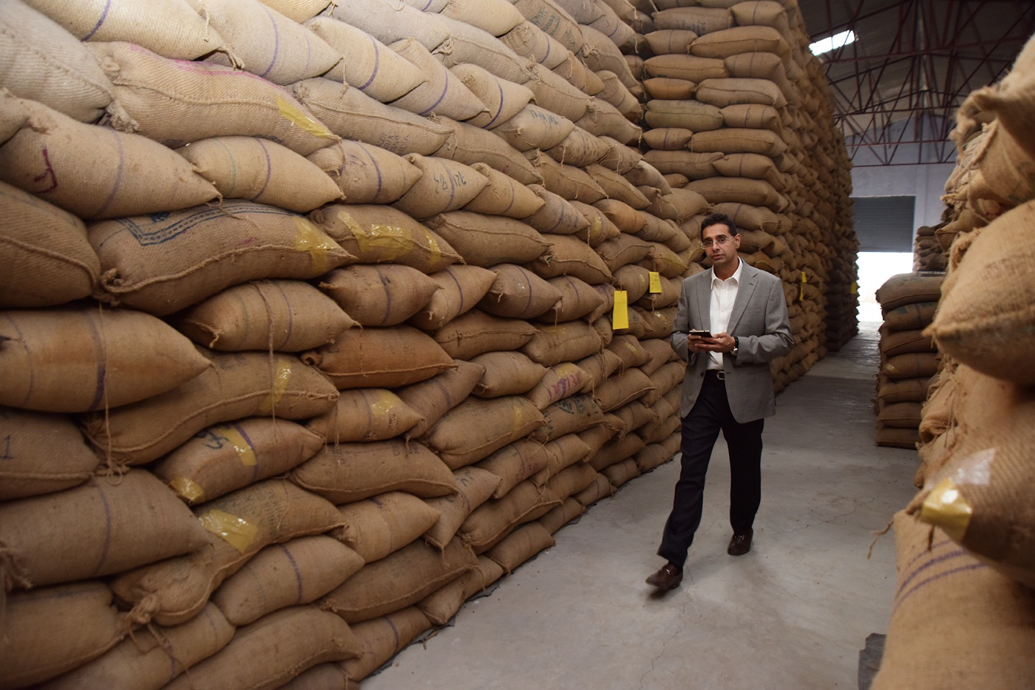
Financing Facility for Storage of Agriculture Produce (FFSAP)

Slide 33
Financing Facility for Storage of Agriculture Produce (FFSAP)
To encourage Private Sector to establish Silos, Warehouses & Cold Storages
Financing is available for establishment / expansion / BMR of Silos, Warehouses & Cold Storages facilities for storing agricultural produce. Financing for local purchase / import of new machinery, equipment accessories, generators thereof used in Steel/metal/Concrete Silos, warehouses and cold storages. Further, up to 65% cost of civil works is also eligible under the Scheme
Maximum financing to a single project is Rs. 500 million under the Facility
Available through all commercial banks and DFIs
Maximum period of seven years including a maximum grace period of six months. Effective June 1, 2017, banks'/DFIs' spread increased to 4% only for SME borrowers. Moreover, maximum tenor of loan also increased to 10 years for SMEs borrowers only.
For civil works financing the bank shall monitor it as per its own mechanism that the funds are utilized strictly for the construction purpose as per approved plan.Only against LCs in case of financing against imported plant & machinery / raw material to be used for construction of the Silos/Cold Storage

Slide 34
FFSAP - Rate of Service Charges
SMEs
Tenor | Rate of Refinance | Banks’/DFIs’ Spread | End Users’ Rate
Up‐to 10 years | 2.0% | 4.0% | 6.0%
Non - SMEs
Tenor | Rate of Refinance | Banks’/DFIs’ Spread | End Users’ Rate
Up‐to 3 years | 3.50% | 2.50% | 6.0%
3 to 5 years | 3.25% | 2.75%
5 to 7 years | 2.50% | 3.50%

Slide 35

SBP Financing Scheme for Renewable Energy

Slide 36
SBP Financing Scheme for Renewable Energy
The objective of the scheme is to lend support in addressing dual challenge of energy shortage and climate change through promotion of renewable energy.
The validity of the scheme has been extended till June 30, 2022.
The Scheme is available under three categories i.e. Producers, Consumers & suppliers:
  Category – I: Prospective sponsors, desirous of setting up renewable energy power projects with a capacity ranging from more than 1 MW and up-to 50 MW for their own use, selling of electricity to the national grid (including distribution companies) or combination of both.
  Category – II: Prospective sponsors, desirous of installing renewable energy source based projects/ solutions for generation of electricity up-to 1 MW.
  Category – III: Vendors and suppliers certified under AEDB Certification Regulation 2018 for installation of wind and solar systems on lease basis or selling of electricity to ultimate owners/users.
Maximum Loan Amount
Category - I | Category - II | Category – III
PKR 06 Billion (for a single project) | PKR 400 Million (for a single borrower) | PKR 01 Billion (for a single vendor)

Slide 37
SBP Financing Scheme for Renewable Energy
SBP Refinance:
Category – I | SBP Refinance shall be up-to 100% of total financing (debt) of an eligible RE project of upto 20 MW and up-to 50% of financing (debt) of an eligible RE Project of more than 20 MW.
Category – II | SBP Refinance shall be up-to 100% of financing to the eligible borrowers.
Category – III | SBP Refinance shall be up-to 100% of financing to the eligible borrowers.
Service Charges & Rates for End Users:
 | Refinance Rate | Bank / DFI Spread | End User Rate
Category – I | 3.0% | 3.0% | 6.0%
Category – II | 2.0% | 4.0% | 6.0%
Category – III | 3.0% | 3.0% | 6.0%

Slide 38
SBP Financing Scheme for Renewable Energy
Tenor of Financing:
Category – I | Maximum twelve (12) years, including maximum grace period of two (02) years.
Category – II | Maximum ten (10) years, including maximum grace period of two (03) months.
Category – III | Maximum ten (10) years
Repayment of Financing:
Category – I | • Principal repayable in quarterly or half yearly installments • Mark-up repayable on quarterly basis.
Category – II | • Principal repayable in monthly, quarterly or half yearly installments. • Mark-up repayable on monthly or quarterly basis.
Category – III | • Principal repayable in monthly, quarterly or half yearly installments. • Mark-up repayable on monthly or quarterly basis.

Slide 39

Refinance & Credit Guarantee Scheme for Women Entrepreneurs

Slide 40
Refinance & Credit Guarantee Scheme for Women Entrepreneurs
Financing shall be available to women entrepreneurs in the underserved areas for a period of up to 5 years, including maximum grace period of up to six months
Maximum financing limit under the scheme will be Rupees one and a half million (Rs. 1.5M)
Financing under the scheme should be provided for setting up of new business enterprises or for expansion of existing ones.
Financing under the scheme should be provided to women borrowers preferably under the personal guarantee of the borrower
Such loans will also be eligible for 60% risk coverage under SBP’s Credit Guarantee Scheme for Small and Rural Enterprises.
Rate of mark-up rate for end user under the facility will be up to 5% per annum (p.a.). SBP will provide refinance to PFIs at 0%.
The scope of the scheme has been expanded & its now available across the country.

Slide 41

Refinance Scheme for Working Capital Financing of Small Enterprises and Low-End Medium Enterprises

Slide 42
Refinance Scheme for Working Capital Financing of Small Enterprises and Low-End Medium Enterprises
Financing is initially available to meet the working capital requirements of selected Sector
SEs: Up to Rs 25 million , LE-MEs: Up to Rs 50 million
All small enterprises (SEs)as per SBP’s PRs and Medium Enterprises (MEs) with annual sales of Rs 300 M.
Tenor is upto 1 year (Rollover option not available)
End user rate is 6% with banks’ spread of 4%
Scheme is available for targeted segments as prescribed by SBPs.

Slide 43
Target Segments
Information Technology
(IT)
Furniture
Surgical Goods
Dates Processing
Gems & Jewelry
Leather Industry
Fruits, Vegetables, Food P&P
Printing & Packaging

Slide 44
Credit Guarantee Scheme (CGS) for Small & Rural Enterprises
SBP launched Credit Guarantee Scheme (CGS) for Small and Rural Enterprises in March 2010 in collaboration with UK’s Department for International Development (DFID).
Under this scheme, risk coverage of upto 60% is provided against credit losses of participating financial institutions on their lending to small, micro and rural enterprises.
The extent of risk coverage is linked with the level of loan collateralization. The lower the loan collateralization, the higher is the risk coverage extended under the scheme:
Clean Lending 60% risk coverage
Collateral up to 100% of loan value 40% risk coverage
Collateral more than loan value 20% risk coverage
Risk coverage of 60% is provided against all loans extended to women borrowers, start-up businesses and small, rural and micro enterprises operating in the underserved areas of the country.

Slide 45
Credit Guarantee Scheme (CGS) for Small & Rural Enterprises
The scope of CGS is being extended through inclusion of low-end medium enterprises (MEs) as eligible entities for financing under CGS.
Medium enterprises with annual sales turnover of upto Rs 300 million are eligible
Maximum financing limit for medium enterprises under CGS is Rs 50 million.
Maximum financing tenor is five years
Only first time ME borrowers will be eligible under CGS. First time borrowers refer to those MEs which have not already availed any financing facility from any financial institution.
Eligible low-end medium enterprises which do not have the collaterals more than the value of the loan can avail risk coverage of 40% under this facility.
Maximum 20% of the allocated credit guarantee limit can be availed against financing to medium enterprises under CGS. However, this does not restrict Participating Financial Institutions (PFIs) to use entire allocated limit for small, rural and micro enterprises.

Slide 46
Prime Minister’s Youth Business Loan (PMYBL) Scheme
Uplifting the youth and providing them opportunities of financial independence through self employment
Financing Limit is up to Rs. 2,000,000/-
Under the scheme subsidized financing is available to unemployed youth particularly the educated youth aged between 21 and 45 years for establishing new business or extending existing business enterprises
Risk Sharing is up to 5% of loan portfolio basis
Maximum financing tenor is 8 years with maximum grace period of one year
End user rate is 6%. The rate of return for lending banks is one year KIBOR+500 bps. Difference of KIBOR+500 bps and borrowers’ rate (6%) is absorbed by the Federal Government
Currently financing under the scheme is available through 18 commercial banks

Slide 47
CHEERS ☺

Slide 48
For any support, queries & concerned … I can be reached via following:
CISCO: 16968
Mobile: 0313 – 2386389
Email: jawad.saeed@hbl.com

