Slide 1
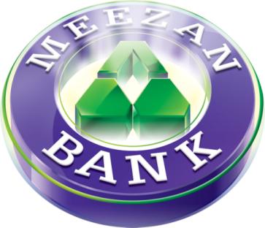
Not Just a banker. Believer
Introduction to Islamic Finance & Clearing doubts

Slide 2
All Praise and gratitude be to Allah (SWT) on the blessing of Islam which suffices as a blessing.
O’ My Allah, open my chest; ease my task for me and remove the impediment from my speech so that they may understand what I say

Slide 3
Outline
Overview
How does a bank function?
Why is there a need for Islamic Banking?
Definition of Riba
What Islamic banking cannot do
How do Islamic bank make profit
What distinguish Islamic and Conventional bank
Clearing misconceptions

Slide 4
Overview
For centuries Muslims have conducted business in ways consistent with Islamic law.
The classical system of Islamic finance has remained intact
Now the entire system of Islamic finance and business is undergoing a revival; the potential of this sector is real and deserving of serious attention.
But unfortunately, today for many interest is more than a way of life, it is fact of life.

Slide 5
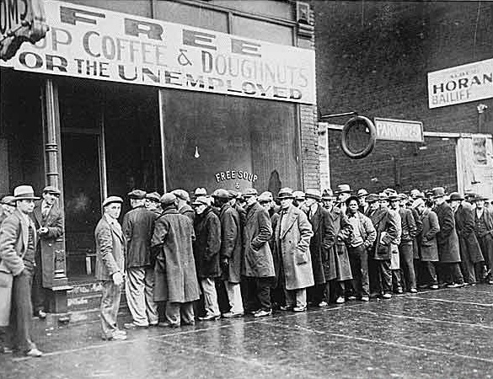
Overview
Present Day World Situation
The downward spiral in 2008 the US and Western Europe is described by financial experts as deleveraging .
21st century version of the Great Depression
Asian Development Bank estimated that loss of worldwide market in 2008 was $50 trillion.

Slide 6
Concept of Banking
Banking is the most important sector of the modern day economy.
It provides an opportunity to the household with surplus capital to select the best mix of investments in terms of return and tenors & security.
It provides an opportunity to businesses and Governments to finance their activities through obtaining surplus funds.

Slide 7
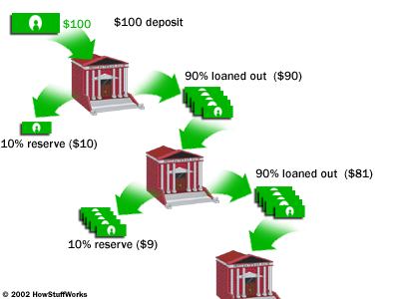
How Bank work
A Bank functions because of our trust.
We give a bank our money to keep it safe for us, and then the bank turns around and gives it to someone else in order to make money for itself.
Banks accept deposits and make loans and derive a profit from the difference in the interest rates paid and charged, respectively.
Banks are critical to our economy.

Slide 8
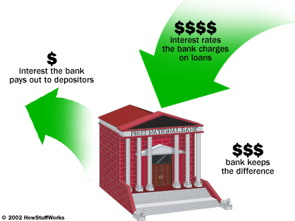
How Bank work
Loaning money is also inherently risky. A bank never really knows if it'll get that money back. Therefore, the riskier the loan the higher the interest rate the bank charges.
Banks also charge fees for services like checking, ATM access and overdraft protection.

Slide 9
Why Islamic Banking?

Slide 10
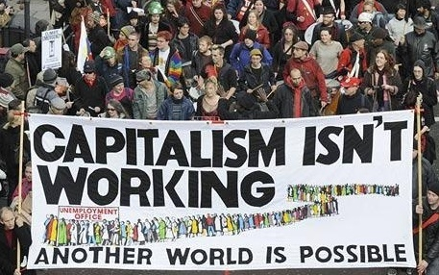
Can Islamic Finance Help?

Slide 11
Way Out: Islamic Banking
The solution lies in a shift to equity-based/Asset based financing, which is the primary characteristic of Islamic Finance.
Islam is not just a Madhab it is a Din, a way of life
Islamic banking is not optional, it is a farz
The global credit crisis presents the $3 trillion Islamic finance industry with an opportunity to expand its appeal beyond Muslim investors.

Slide 12
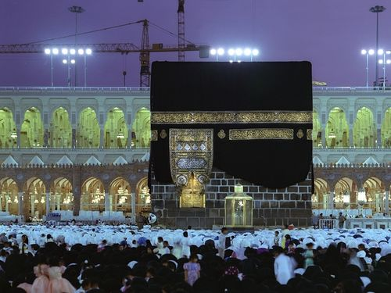
PROHIBITION OF
RIBA IN QURAN
Notes:
I have tried to meet these prerequisites. You don’t have to be a rocket scientist or a person of high intellect or a person of super natural powers, anyone can meet these prerequisites as long as he is aware and make an effort.
To me Quran now is a book of deep wisdom. It is a complete guidance. I enjoy it immensely and would strongly suggest you give this approach a try and let the miracle of Quran relieve itself to you. Ameen

Slide 13
Al Baqarah 275
“Those who devour Riba shall rise up before Allah like men whom Shaitan has demented by his touch; for they claim that trading is like usury. But Allah has permitted trading and forbidden usury. He that receives an admonition from his Rabb and mends his ways may keep what he has already earned; his faith is in the hand of Allah. But he that pays no heed shall be among the people of fire and shall remain in it forever.”

Slide 14
Al Baqarah 278 - 279
“O you who believe, Fear Allah and give up what remains of your demand for Interest, if you are indeed a believer. If you do not, then you are warned of the declaration of war from Allah and His Messenger; But if you turn back you shall have your principal: Deal not unjustly and you shall not be dealt with unjustly.”

Slide 15
Ahadith
From Hazrat Jabir Ibn-e-Abdullah (RA):
The Prophet, peace be on him, cursed :
The receiver and the payer of interest,
The one who records it and
The witnesses to the transaction
And said: "They are all alike [in guilt]."
(Muslim, Tirmidhi and Musnad Ahmad)

Slide 16
Definition of Riba
Every Debt that pulls any kind of gain is Riba
Riba means any excess compensation over and above the principal which is without due consideration. Its a premium paid to the lender in return for his waiting as a condition for the loan.

Slide 17
What Islamic Banking Cannot Do
Cannot give or take interest
Cannot invest in highly speculative transactions
Cannot invest in any business which is physically or morally hazardous for the society.

Slide 18
How Do Islamic Banks Make Profit?
Islamic banks have devised ways to make profit from financing businesses. Instead of demanding interest, they buy the asset outright on behalf of the borrower, add their profit and sell it to them on deferred payment.
Alternatively, the Bank buys the asset and gives it on rent. The borrower pays off the loan (the principle) and a fee for using the asset (rent) until the amount is repaid and ownership transfers to the borrower.
Thus create wealth and wellbeing in the society
For depositors, putting money with an Islamic bank is more like being a shareholder. Rather than interest, depositors get a cut of any profits.

Slide 19
What distinguishes Islamic banking from conventional banking

Slide 20
What Distinguishes Islamic Banking
Transactions are asset-based
It is socially-responsible banking because it operates under Shariah restrictions
Does not permit financing of prohibited goods / Industries
It starves evil out of the society
Ethics and moral values play a major role in investment decisions. Not a choice but a must
Transactions like short selling, forward, derivatives, discounting of debt or where risk is excessively high like gambling, cannot be undertaken

Slide 21
Key Misconceptions

Slide 22
Key Misconceptions
“Some people claim that there is no concept of banking in Islam”
The use of the word banking does not make any institution halal or haram, rather it is the underlying scope & nature of activities that are being conducted which makes it halal or haram.
Concept of banking based on pooling of excess funds of depositors and channeling them towards those who require it for investing activities is not only approved but encouraged by Islam.
But the concept to lending and borrowing on the basis of interest in not allowed in Islam.

Slide 23
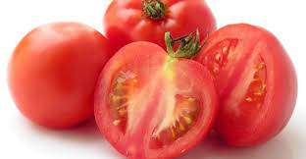
Key Misconceptions
“Islamic banking looks the same as conventional banking”
The validity of a transaction does not only depend on the end result but rather the steps followed in reaching the end..
Same is also true for Islamic and Conventional banking. Former is halal being based on Islamic principles while latter being based on interest is haram.

Slide 24
Key Misconceptions
“A fixed rate of return is not permitted under Islamic Shariah”
Fixed return does not make a transaction halal or haram
For example:
Profit on trading
Rent on property

Slide 25
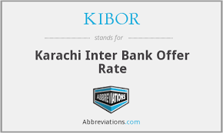
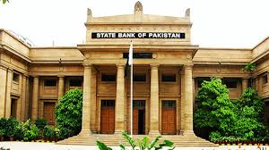
Key Misconceptions
“Can Interest rate be used as a Bench Mark?”
Using Interest Rate benchmark for determining the profit in halal transactions does not render the transaction as invalid or haram.
The nature of transactions determines the validity of the transaction.

Slide 26
Key Misconceptions
“What is the ruling on pledging a security?”
Pledges derives their legitimacy from the following Quranic verse: “if you are on a journey, and cannot find a scribe, a pledge with possession (may serve the purpose)”.(Baqarah V283)
And the practice of the prophet (peace be upon him) since it is known that the prophet (Peace be upon him) died while his shield was still held as security for a mortgage.(Bukhari 3/1068).
Moreover a pledge encourages performance and thus prevents the contract from being breached. And this security also justifies its legitimacy.

Slide 27
Murabaha
Clearing doubts
Increase in price based on deferred payment resembles interest based transaction.
Correct position
Money is only a medium of exchange, whereas commodities have intrinsic utility, owner is at a liberty to sell at a price higher than market rate
When a seller can sell his commodity at a higher price in cash transaction, he can also charge a higher price in credit sales.

Slide 28
Over due payment
Penalty cannot be charged on delay in payment
Response
Once the murabaha /lease rent has become due
It is a loan payable by the client to the bank and is subject to all rules prescribed for debt.
The amount due cannot be increased to compensate for delay in payment. However, the client may be asked to pay a penalty (as charity) to the bank which the bank should deposit into a charity account.

Slide 29
Clearing Doubts
“Riba as practiced during the days of the Prophet (SAW) was only usury”
Islam when prohibiting something does not only prohibit the prevalent form, but all forms that might erupt in future. The changed state does not change the ruling.
E.g. Liquor, Pork, Corruption/Immorality: Today’s modern and sophisticated form do not change their rulings.
The same applies to interest.

Slide 30
Clearing Doubts
“Commercial interest did not exist in the days of Prophet (SAW).”
This claim is incorrect as both forms of interest existed in Islamic and pre Islamic history. Some examples:
The tribe of Thaqeef advanced cash as well as commodities on interest to the natives of Taif, the tribe of Mughairah and the business community of Makkah.
H.Abbas and H. Khalid bin Waleed (RA) formed a company with joint capital whose prime business was cash advancement on interest.

Slide 31
“Mudarbah based profit sharing structure in Islamic Banks”
Depositors
Rab-ul-Mal Profit share
Islamic Bank
Weightage System
Deposits
Mudarib
Profit Share
Gross Profit
Pool of Funds
Profits
Financing
Businesses/Corporates

Slide 32
Products based on Islamic Modes

Slide 33
The Way Forward
Islamic banking is a viable alternative – however it is still in the development stage and has to go a long way
It needs to be supported in its mission to eliminate the curse of riba from our societies.
Positive criticism is always welcome but we also need to gain knowledge about the concept before commenting
Should be viewed with an open mind and we need to be cautious in passing judgments without sufficient knowledge.
We also need to understand the fact that disagreement about any operational item or any difference of view in various schools of thought do not make the whole process of IB invalid or in any way similar to Riba.

Slide 34
The Fall of Muslim Empire
The printing press was invented by Johannes Gutenberg in 1439 CE and spread globally
Sultan Baye and successors of Ottoman Empire prohibited it using, Introduction with imposing death penalty
After an unforgivable delay of 290 years printing press was permitted in Egypt, it took another century to adopt
During this period millions of books were produced in rest of the world
Hopefully that will not happen to Islamic Banking

Slide 35
جزاكم الله خيرا

