Slide 1
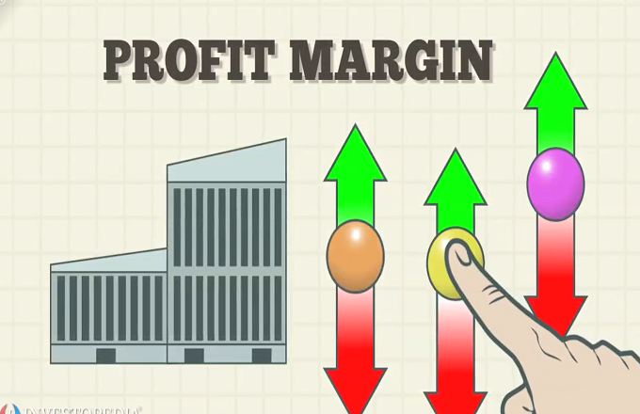
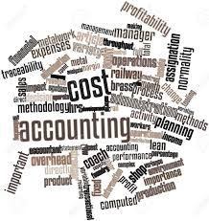
BASIC COST ACCOUNTING
BUSINESS EXECUTIVE COURSE
PRESENTED BY
ASAD NASEER MALIK, FCA, FPFA

Slide 2
PRESENTER’S PROFILE
ASAD NASEER MALIK, FCA, FPFA
Principal, SKANS School of Accountancy
Mng Director, DTC Group
Ex. Chairman Pakistan Gloves Manufacturers & Exporters Association
Vice Chairman, KMSMC & Allied Hospitals

Slide 3
WHY YOU OPTed TO BE EXPORTER?

Slide 4
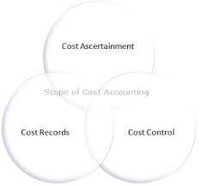
WHY IS COSTING IMPORTANT
the recording of all the costs incurred in a business in a way that
can be used to improve its management.
YOU CAN QUOTE YOUR PRICE
YOU CAN CONTROL YOUR COST
FOR DECISION MAKING
FOR INVESTMENT APPRAISEL
FOR PLANNING, CONTROL, REPORTING & BUDGETING

Slide 5
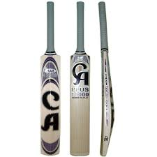
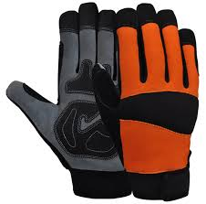
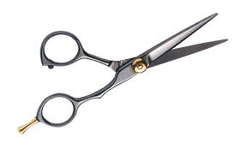
CALCULATION OF COST ACTIVITY
Soccer Ball
Scissor
Mechanics Gloves
Boxing Gloves
Cricket Bat
Sports Wear

Slide 7
Classification of cost
Material Cost
Labour Cost
Manufacturing Expenses
Selling Cost
Distribution Cost
Administration Cost
Financial Costs
Research Costs

Slide 8
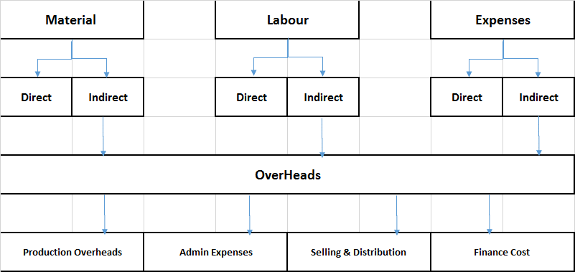
SUBDIVISION OF PRODUCT COST

Slide 9
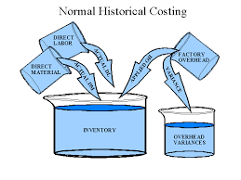
OVERHEADS
FIXED COST
VARIABLE COST
MIXED COST

Slide 10
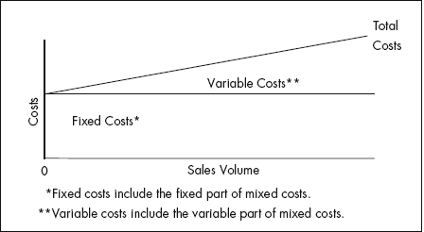
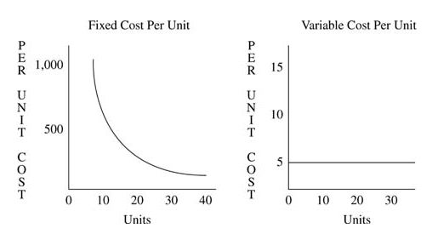

Slide 11
PRODUCT COST
PERIOD COST

Slide 12
PRICING & DECISION MAKING

Slide 13
PRICING STRATEGIES

Slide 14
CONTRIBUTION
Sales – Variable Costs = Contribution
Fixed costs are most of the time irrelevant for production decision.

Slide 15
BREAK EVEN POINT
Break Even Point = Fixed cost / Contribution per unit
Contribution = Sales – Variable Cost

Slide 16
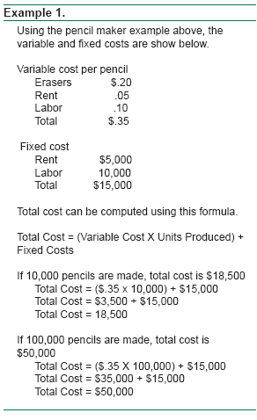

Slide 19
ECONOMIC ORDER QUANTITY
Economic Order Quantity (EOQ) is the order quantity that minimizes the total holding costs and ordering costs. It is one of the oldest classical production scheduling models. The framework used to determine this order quantity is also known as Wilson EOQ Model, Wilson Formula or Andler Formula.
Q = \/2DK/h Q= Order Qty; D= Annual Demand; K=Fixed cost per order h= Holding cost per unit

Slide 20
DECISION MAKING
BUDGETING
INVESTMENT APPRAISAL

Slide 21
Thank you very much

