Slide 1
Amazon Payment Procedures
Module 03
Urva Hassan Zubairi

Slide 2
Outline
Amazon Fee Structure
Payment Method for Sellers in Pakistan
Payment Processing Time
SBP Regulations and Procedures
2

Slide 3
Amazon Fee Structure

Slide 4
Selling Plans
Selling Plans
Individuals ($0.99/Item Sold) + additional selling fees
You sell fewer than 40 units a month
You're still deciding what to sell
You don't plan to advertise or use advanced selling tools
Professionals ($ 39.99/month)
You sell more than 40 units a month
You want to advertise your products
+additional selling fees
4

Slide 5
Referral Fees
Fees
Shipping Fees
Amazon deducts the applicable referral fee percentage calculated on the total sales price, excluding any taxes calculated through Amazon tax calculation services. The total sales price is the total amount paid by the buyer, including the item price and any delivery charges or gift wrapping charges.
Amazon charges shipping rates based on the product category and shipping service selected by the buyer.
A percentage of the selling price and vary depending on the product’s category
Standard Shipping from Asia: 10-16 days
5

Slide 6
Fulfillment Fees
Fulfillment Fees For FBA Orders
Monthly inventory storage fees
Fulfillment Fees
Long-term storage fees
Removal order fees
Amazon (FBA) fee is a per-unit fee charged to fulfill items to customers for purchases in the Amazon store. The fee varies depending on an item’s category, size and weight.
For products that Amazon fulfills for you (known as Fulfillment by Amazon, or FBA), there are fees for order fulfillment, storage, and optional services.
Returns processing fees
Unplanned service fees
6

Slide 7
Other Fees/Cost
High-volume listing fee ($0.001 per eligible SKU)
Refund administration fee
7

Slide 8
Cost Calculator
8

Slide 9
Payment Method for Sellers in Pakistan

Slide 10
Bank Account Details
Name on Bank Account Statement is the same as official identified Name in Amazon Seller Account
Bank Statement clearly mentions Bank name and Bank Logo
Bank statement should be dated within last 180 days/ 6 months
If your bank statement is rejected due to some reason, 30 days’ time period is given for upload by Amazon Seller Account.
You can visit your respective bank website to generate an online bank statement.

Slide 11
Making Hyperwallet Account on Amazon
Log in to Seller Central.
Choose Settings > Account Info.
On the Seller Account Information page, go to the Payment Information section and click Deposit Methods.
Click Assign or Edit when a bank account is already registered.
Select the country of your bank account in the Bank Location drop-down menu.
Click on Sign up for Hyperwallet to apply for a Hyperwallet deposit account. You will be re-directed to Hyperwallet’s website where you can apply for a Hyperwallet account using your Amazon Seller credentials.

Slide 12
Step 1: Login with Amazon

Slide 13
Step 2: Activate Hyperwallet Account

Slide 14
Step 2: Activate Hyperwallet Account

Slide 15
Step 2: Activate Hyperwallet Account

Slide 16
Step 3: Enter Bank Details

Slide 17
Step 4: Enter Deposit Details in Amazon Account

Slide 18
Hyperwallet Fees
Source: https://sellers.hyperwallet.com/hw2web/consumer/page/show.xhtml?page=userAgreement

Slide 19
Payment Processing Time

Slide 20
Payment Processing Time

Slide 21
Payment Processing Time
Amazon payments are made to sellers’ accounts every 14 days by either initiating a payment to your bank account, if you have a positive seller account, or charging your credit card, if your account is negative

Slide 22
Standard Payment Processing time
Every 2 Weeks
Time/ 14 Days
Seller Bank Account

Slide 23
Payment Report

Slide 24
Payment Report

Slide 25
SBP Regulations and Procedures

Slide 26
Exports Documentation Procedures
E-commerce Module of the WeBOC will issue
Filled by Courier on behalf of
exporter
Seller/Exporter Request ADs(Bank)
Receipt of Request
Annexure A undertaking
Register Exporter in E-commerce WeBOC
Exporters in Pakistan (Govt. Notification No. I(6)-ECS/48 dated July 1, 1948
Exporter shall submit export consignments with details to courier of their choice
Courier handling shipment shall file
Goods Declaration form
House Airway Bill Number
Value must not exceed USD 5000
Export Proceed Realization Certificate (Less than 5% pending realizations)
Monthly Reconciliation Statement by exporter to ADs
Full export value of goods exported from Pakistan and declared to Customs

Slide 27
B2B2C Exports Documentation Procedures
AD will obtain documentary evidence of the exporters registration with International Platforms (Amazon)
Shipping documents in the name of “Consignee”-(foreign market place or company’s own warehouse/third party warehouse)
E Form issued with remarks as B2B2C
Realization of Export Proceeds
The value of exports proceeds, as declared by exporters on goods declaration/declaration filed in/with WeBOC/PSW, can be received from abroad by an Authorized Dealer through i) banking channel directly; ii) International payment scheme/gateway; iii) In Pakistan Rupee from repatriable account of a non-resident.
Full Value of Export Realisation in 180 days
In case of non-realization within 270 days from date of shipment, AD shall report to FEOD SBP BSC
AD issues a certificate as per AppendixV12-A

Slide 29
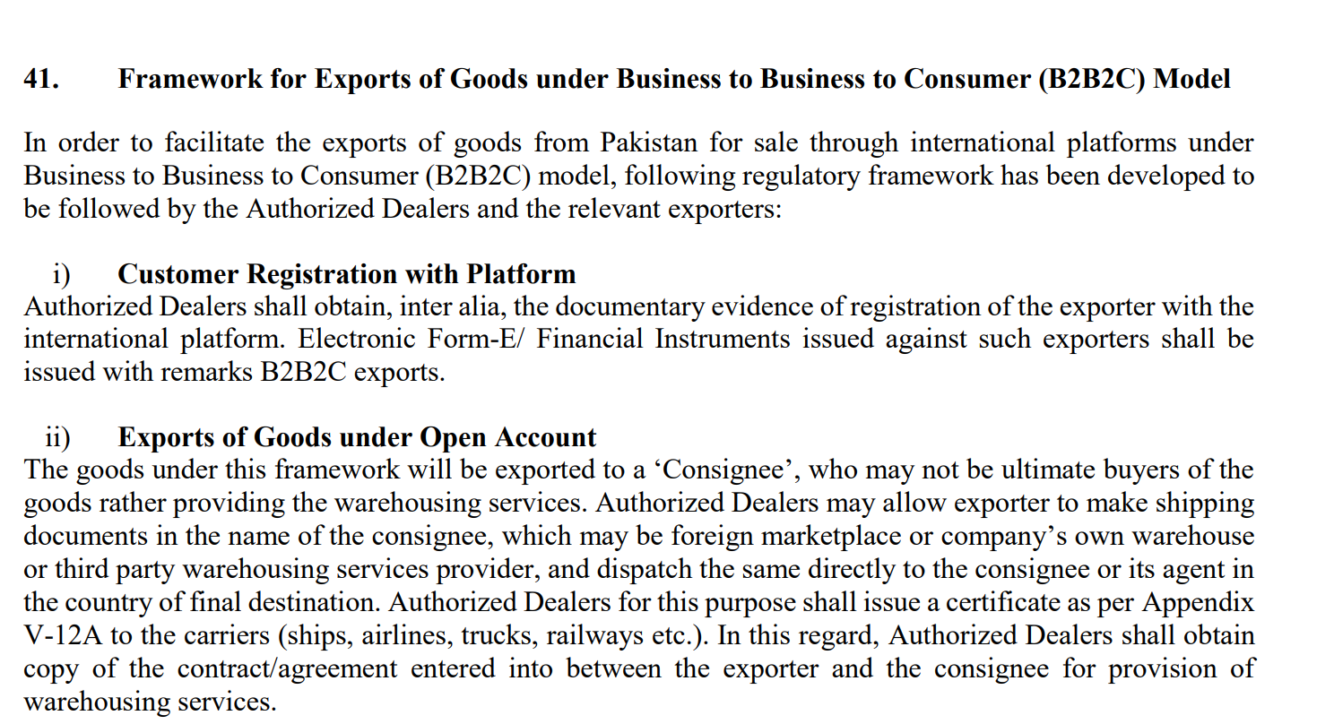

Slide 31
Foreign Exchange Regulations on E-commerce
New exporters with no export history or exporters having exports less than USD 250,000 during the past 3 years may be allowed to avail the above facility provided shipment’s value is up to USD 100,000/- and the total export overdues do not exceed 5% of the previous year’s total exports value.
The exporter availing this facility shall have to provide a certificate to Authorized Dealers on the prescribed format (Appendix V-12B) showing bank-wise consolidated position of outstanding overdue export bills, as of quarter end, as a percentage of the total exports proceeds realized during the preceding financial year.
Source: https://www.sbp.org.pk/fe_manual/pdf/2018/Chapter-12.pdf

Slide 32
SBP circulars
State Bank of Pakistan (sbp.org.pk)
State Bank of Pakistan (sbp.org.pk)

Slide 33
Thank you!

