Slide 1
http://www.iccwbo.org/
ICC Headquarters
Location : Paris Founded : 1919 Membership: Business interests in over 140 countries

Slide 2
www.iccpakistan.com.pk
ICC Pakistan V.M. House, P.O. Box 4050, West Wharf Road, Karachi-74000 Pakistan ICC Member : 1955

Slide 3
What are Incoterms®?
The term, Incoterms®, is an abbreviation for International Commercial Terms.
These are also known as Delivery Terms, Transportation Terms Shipping Terms and Trade Terms.
A set of rules which define the responsibilities of sellers and buyers for the delivery of goods under sales contracts for domestic and international trade.
Published by the International Chamber of Commerce (ICC).
Widely used in international commercial transactions.
The first Incoterms® were issued in 1936 by the ICC.
The most recent version of Incoterms®, is Incoterms® 2010, were launched in September 2010 and became effective January 1, 2011.

Slide 5
Ex-work - (EXW-Sialkot) Transportation all modes
Seller is responsible only for making the goods available at his designated premises.
Buyer is responsible for pick up at designated transportation carrier.
Buyer is responsible for all costs and risks of transportation including custom clearance.
Variations on the this term ex works include ex factory, ex mill, ex plant, ex refinery, ex site, ex warehouse, etc., depending upon the type of origin facility at which goods will be delivered to the buyer by the seller.

Slide 6
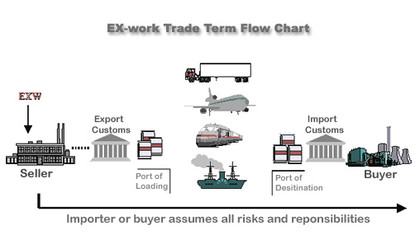

Slide 8
FREE CARRIER (FCA ..named place.,)– All Modes
Seller is responsible for handing over the goods, cleared for export, to a transportation carrier named by the buyer at a named location.
Seller is responsible for inland freight.
Seller is responsible for export custom clearance.
The seller is not responsible for the cost of unloading the conveyance at the named destination point, nor for transfer of the goods to the on-carrier.
The Buyer is responsible for insurance.
The Buyer is responsible for all costs from the point of unloading from the first carrier to the final destination.

Slide 9
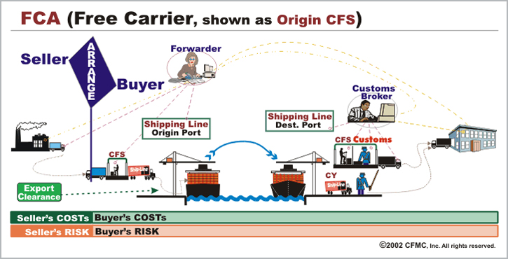

Slide 10
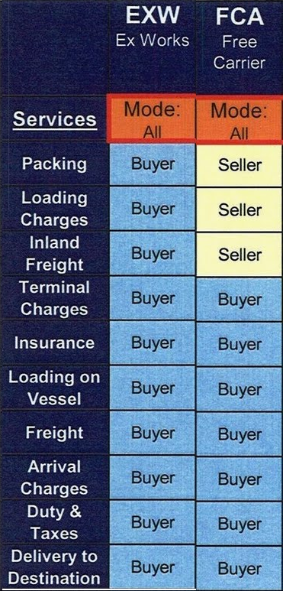

Slide 11
FAS - FREE ALONGSIDE SHIP…Named port (sea mode)
Seller is responsible for arranging transportation of the goods to a named ocean or inland waterway port and placing them “alongside” the vessel which the buyer has arranged to transport the goods.
The seller is also responsible for export clearance (under pre-2000 versions of Incoterms, this was the buyer’s responsibility).
Buyer is responsible for insurance and all costs from the point of loading till final destination.
Note: This term is used for shipment via ocean and inland water transportation only and is different from FOB in that the seller is not responsible for placing the goods on the vessel.

Slide 12
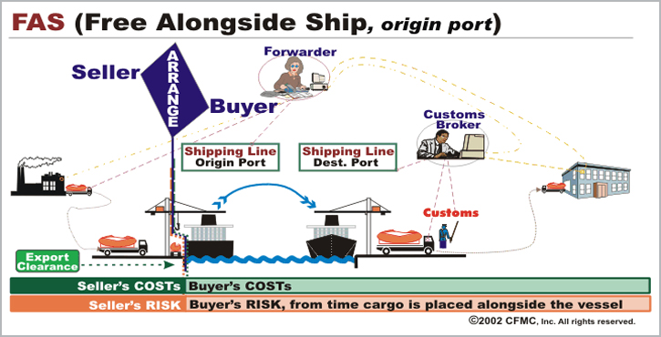

Slide 13
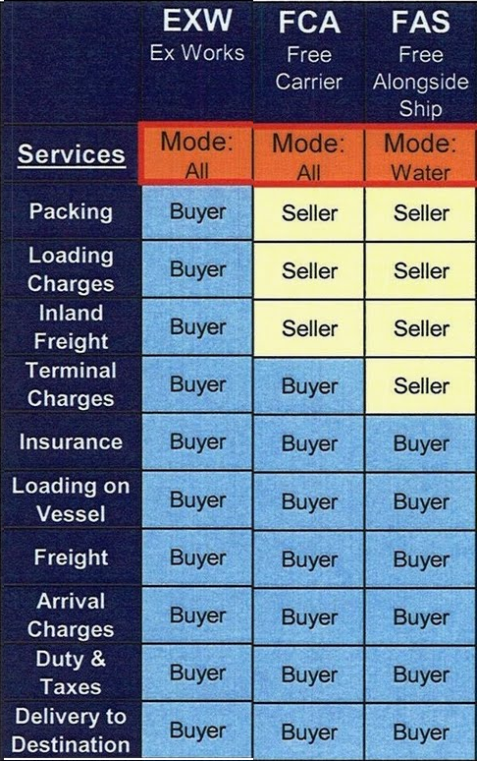

Slide 14
FOB – free on board , karachi port by sea only
Seller is responsible for arranging transportation of goods to a vessel named by the buyer at a named port.
Seller is responsible for inland freight and all costs for placing the goods on board the vessel.
Seller is responsible for custom clearance.
Seller is not responsible for the cost of ocean carriage, marine cargo insurance, nor for arranging the contract of carriage unless the buyer requests his assistance with this.
Buyer is responsible for insurance of goods.
Important Under Incoterms 1990 and 2000, “FOB” may be used only for shipments via vessel (prior to these editions, “fob” could is used with other transportation modes).

Slide 15
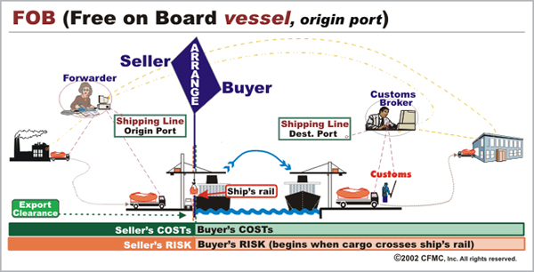

Slide 16
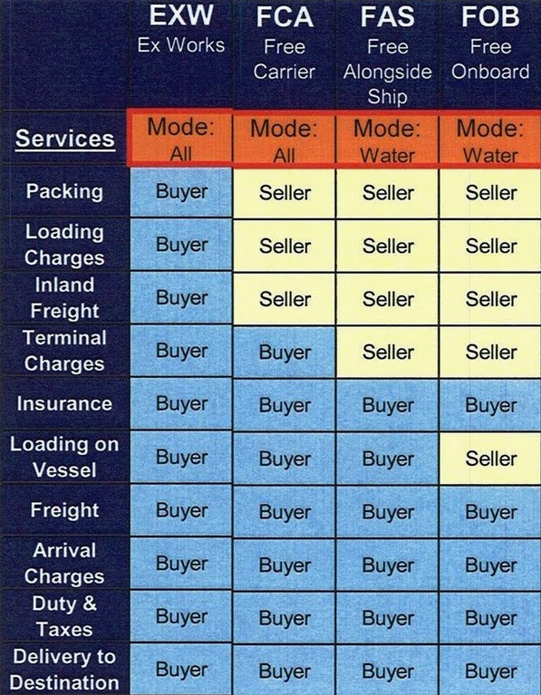

Slide 17
C&F / CFR - (Cost & Freight Named Desgination Port) By Sea
Seller is responsible for arranging and paying for transportation of the goods to a named ocean/inland waterway in importing country destination port.
Buyer is responsible for insurance of goods.
Seller has fulfilled his obligation when he has tendered the goods to the transportation carrier who, under the contract of carriage, will accomplish this transportation to the named point at destination.
When the cargo is “on-board” the vessel, typically in the origin country, the risk of loss of the goods and/or unforeseeable costs transfers to the buyer.
This Incoterm may be used only with ocean or inland waterway transportation.
Buyer is responsible for insurance

Slide 19
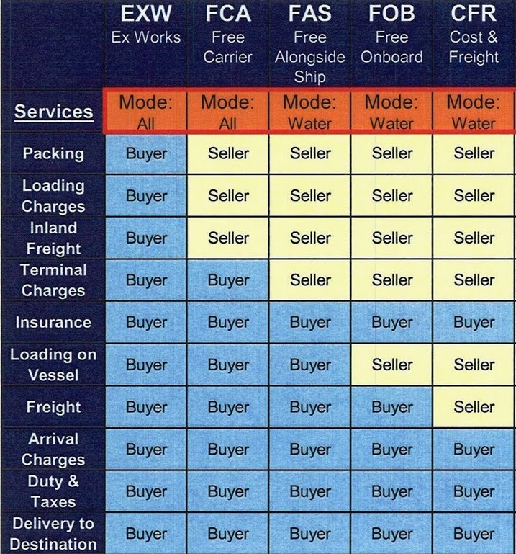

Slide 20
CIF – Cost, Insurance & Freight – By Sea
Seller is responsible for arranging and paying freight for transportation of the goods through to a named ocean or inland waterway destination port.
Seller is responsible for insurance of goods.
Note, however, that the seller has fulfilled his obligation when he has tendered the goods to the transportation carrier who, under the contract of carriage, will accomplish this transportation to the named point. Once the cargo is “on-board” the vessel, typically in the origin country, the risk of loss of the goods and/or unforeseeable costs transfers to the buyer.
Note that under this Incoterms, CIF is used only for ocean or inland waterway shipment.

Slide 21
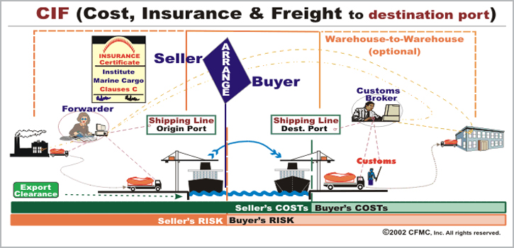

Slide 22
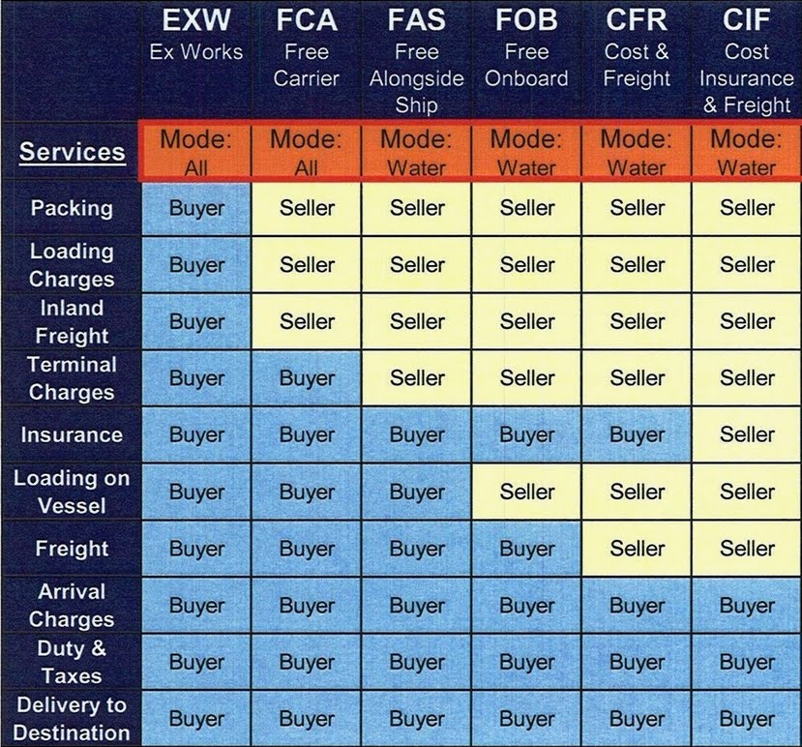

Slide 23
CPT – Carriage Paid to (Desgination Port) Transportation : All Modes
Seller is responsible for arranging transportation and paying the freight for goods to a named point, typically in the destination country.
Buyer is responsible for insurance
Note, however, that the seller has fulfilled his obligation when he has tendered the goods to the transportation carrier who, under the contract of carriage, will accomplish this transportation to the named point.
At this point, typically in the origin country, the buyer assumes the risk of loss of the goods and/or unforeseeable costs.
This Incoterm may be used with any transportation mode, including through multimodal movements.

Slide 24
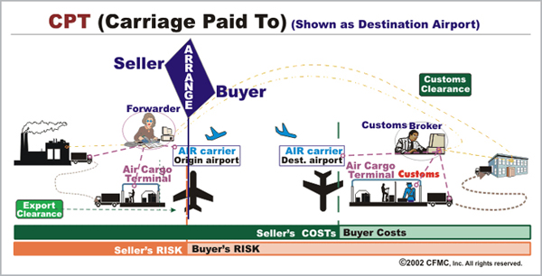

Slide 25
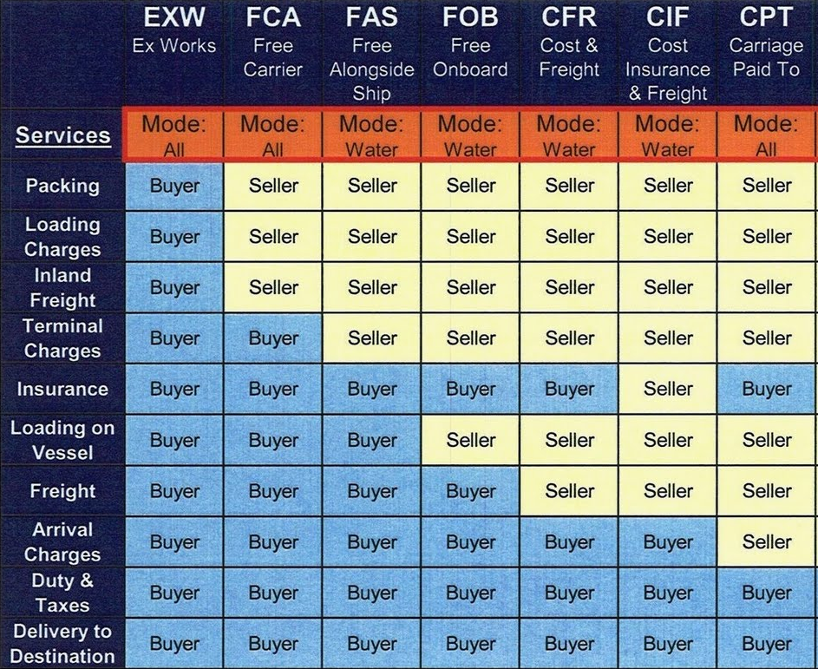

Slide 26
CIP – Carriage & Insurance Paid To (Destination Port)
Seller is responsible for arranging and paying for freight transportation of the goods to a named destination point, typically in the destination country.
Seller is responsible for insurance of goods.
Seller is responsible for custom clearance
Note, however, that the seller has fulfilled his obligation when he has properly insured the goods and tendered them to the transportation carrier who, under the contract of carriage, will accomplish this transportation to the named point. At this point, typically in the origin country, the risk of loss of the goods and/or unforeseeable costs transfers to the buyer.
This Incoterm may be used with any transportation mode.

Slide 27
Responsibility for government security requirements:
Incoterms 2010 changed rules A2 & B2, now captioned “Licenses, authorizations, security clearances and other formalities,” to include government imposed security requirements, whatever they may be, as part of export formalities and import formalities. Under CIP terms, the seller is responsible for export formalities and thus also security requirements in the export country whereas the buyer is responsible for import formalities and thus for security responsibilities in the import country. For security requirements in a transit country, if any, since the seller has already accomplished delivery, the buyer is responsible for this.

Slide 28
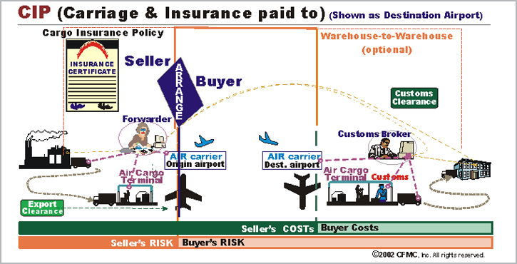

Slide 29
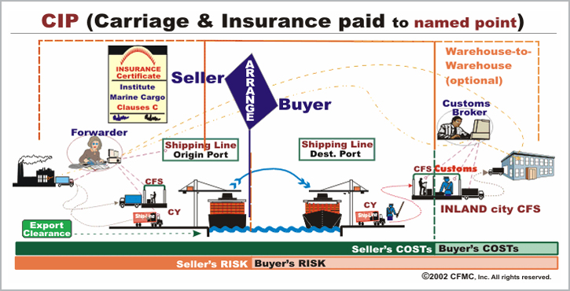

Slide 30
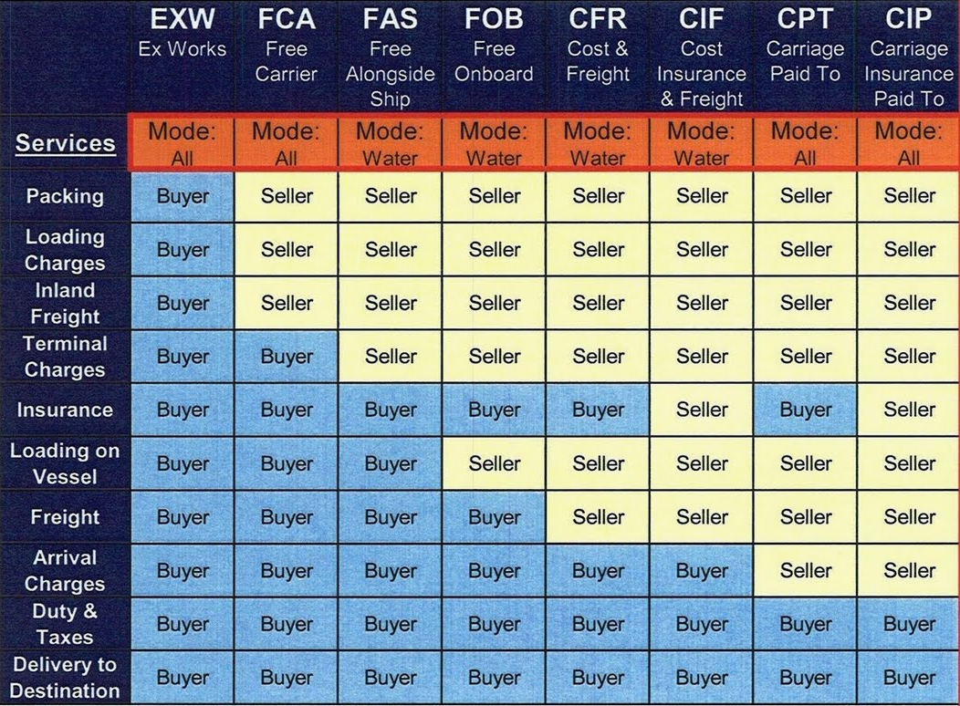

Slide 31
DAT – Delivered at Terminal (Named Point) Transportation – All Modes
Seller is responsible for delivering the goods, export cleared, to the carrier’s terminal at the named destination location
Seller is responsible for unloading cost of goods at destination point and available for customer.
Buyer is responsible for customs clearance and/or pick-up by the buyer.
This term may be used with any transportation mode.
DAT is new under Incoterms 2010, replacing Incoterm DEQ, but may be used with any mode of transportation, including through intermodal transportation.
Under DAT terms, the seller has no obligation to insure the shipment. In contrast to “C” terms in which the seller’s risk terminates once he has tendered the goods over to the export carrier in the origin country, under this and other “D” terms, the seller remains at risk for cargo loss or damage until delivery occurs at the named destination point.

Slide 32
Responsibility for government security requirements:
Incoterms 2010 changed rules A2 & B2, now captioned “Licenses, authorizations, security clearances and other formalities,” to include government imposed security requirements, whatever they may be, as part of export formalities and import formalities. Under DAT terms, the seller is responsible for export formalities and thus also security requirements in the export country whereas the buyer is responsible for import formalities and thus for security responsibilities in the import country. For security requirements in a transit country, if any, since the seller has already accomplished delivery, the buyer is responsible for this.

Slide 36
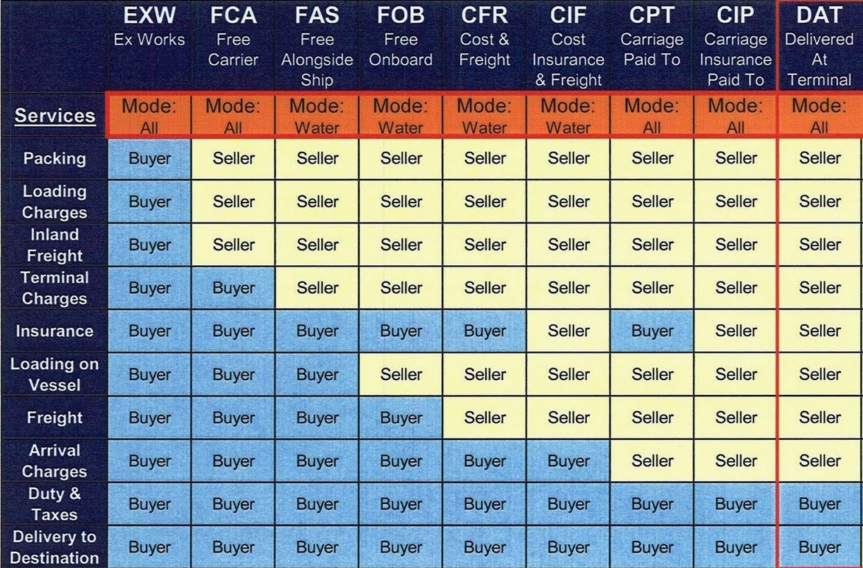

Slide 37
DAP – (Delivered At Place) Transportation All Modes
Seller is responsible for delivering the goods, to a named destination place, on-board the transportation conveyance, available (“at the disposal of the buyer”) for unloading by the buyer.
Seller is responsible for export clearance.
Buyer assumes the cost and risk of unloading at the named destination place and customs clearance.
Buyer is responsible for insurance.
Note: DAP is new under Incoterms 2010, replacing Incoterms DAF, DES, and DDU.
In contrast to “C” terms in which the seller’s risk terminates once he has tendered the goods over to the export carrier in the origin country, under this and other “D” terms, the seller remains at risk for cargo loss or damage until delivery occurs at the named destination point.

Slide 38
Responsibility for government security requirements:
Incoterms 2010 changed rules A2 & B2, now captioned “Licenses, authorizations, security clearances and other formalities,” to include government imposed security requirements, whatever they may be, as part of export formalities and import formalities. Under DAP terms, the seller is responsible for export formalities and thus also security requirements in the export country whereas the buyer is responsible for import formalities and thus for security responsibilities in the import country. For security requirements in a transit country, if any, since the seller has not yet accomplished delivery, the seller is responsible for this.

Slide 40
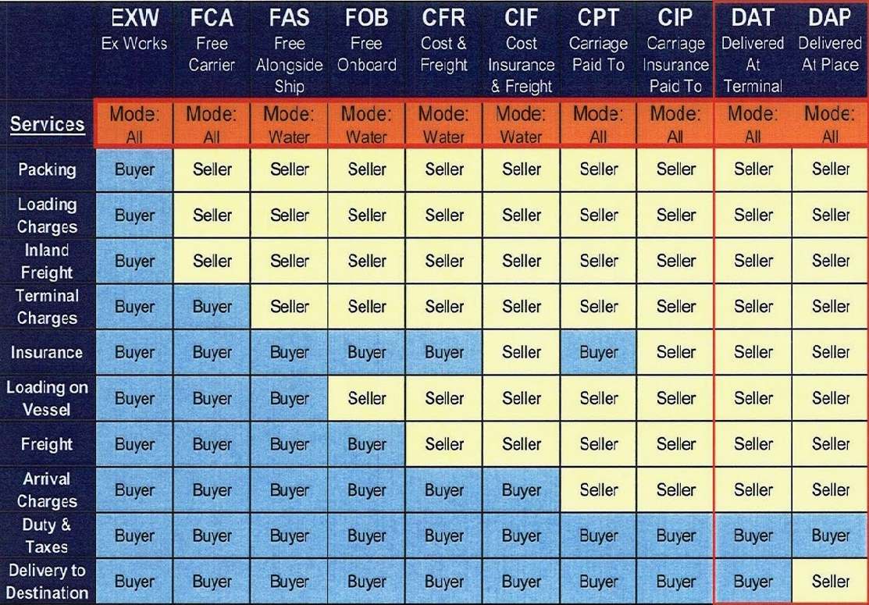

Slide 41
DDP – Delivered Duty Paid (Destination named point) Transportation : All Modes
Seller is responsible for arranging transportation of the goods through to the buyer’s door,
Seller pays all costs required to accomplish this, including customs clearance, customs duty, and taxes due in importing country.
Under pre-1990 versions of Incoterms, and under American Foreign Trade Definitions, this is also known as free domicile or free house.
Under DDP terms, the seller has no obligation to insure the shipment.

Slide 42
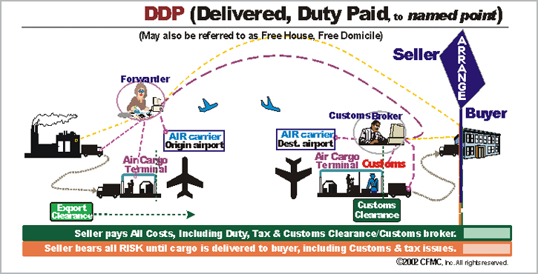

Slide 43
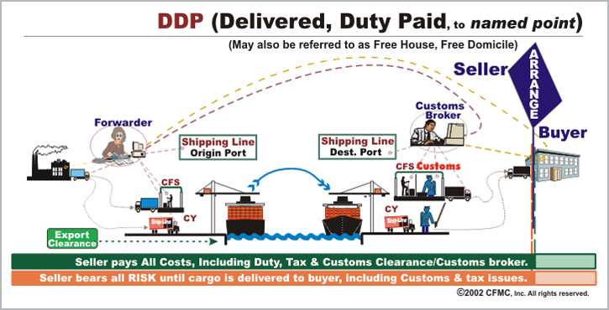

Slide 44
