Slide 1


Tti Testing Laboratories (ISO 17025 Accredited Testing Facility)
Since 1995

Slide 2


Slide 3

Overview of Technical Scope
Largest ISO/IEC 17025 Accredited Testing scope in Pakistan
127 Accredited Tests and 188 accredited test methods

Slide 4

Large Manufacturers
SME’s
Global Buyers
Textiles & Apparel
Oil & Gas
Personal Protective Equipment
Hospitals
Leather , Gloves & Footwear
Government & NGOs
Power Plants
Buying Houses & Agents
Cement Industries
Food Industry
Chemicals
FMCGs
Hypermarkets & Stores
Leather
Paints & Coatings
International Institutional Sector
Automotive
Pharmaceutical
Pulp & Paper
Cosmetics

Slide 5



Global Test Reports Acceptability
ISO/IEC 17025 Accreditation Is The Highest Level Of External Verification A Testing Lab Can Achieve.
Test Reports of an ISO/IEC 17025 Accredited Lab are technically acceptable around the world.
International Laboratory Accreditation Cooperation
Asia Pacific Accreditation Cooperation (APAC)
Mutual Recognition Arrangement

Slide 6
Our Global Recognition and Certifications
ISO/IEC 17025 Accredited Testing Facility
ISO/IEC 17020 Accredited Inspection Body
US CPSC Accredited Conformity Assessment Body
EPA Certified Laboratory
PSQCA Approved Inspection Agency
OGRA Approved Testing Lab
Pakistan Scientific Laboratory Association Approved
Successful Participant (Global PTP Programs ASTM/IIS )

Slide 7
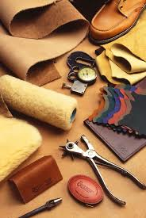
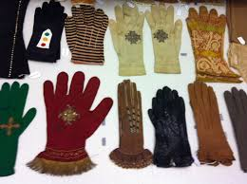
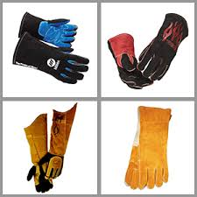

CE Marking of Personal Protective Equipment Tti Testing Laboratories
Our Company Tti testing laboratory doing testing and inspections of products which are being shipped to European Countries and Gulf Countries .
Being the largest ISO/IEC 17025 Accredited testing lab and ISO/IEC 17020 Inspection body in Pakistan we are contributing to help our clients in Testing and Inspection of Products and helping them in issuance of CE Mark Certification through European Notifying bodies and Saber Certification through our partner Gulf Tic Testing and Inspection Services .

Slide 8
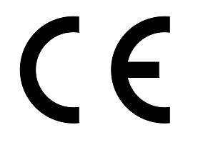


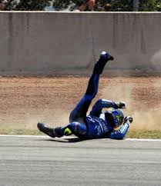
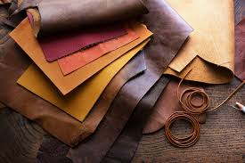
CE Marking
The Conformitè Europëenne (CE) Mark is defined as the European Union’s (EU) mandatory conformity marking for regulating the goods sold within the European Economic Area (EEA) since 1985. The CE marking represents a manufacturer’s declaration that products comply with the EU’s New Approach Directives. These directives not only apply to products within the EU but also for products that are manufactured in or designed to be sold in the EEA. This makes the CE marking recognizable worldwide even to those unfamiliar with the EEA.
A CE Mark is a symbol that must be affixed to many products before they can be sold on the European market. The mark indicates that a product:
Fulfills the requirements of relevant European product directives
Meets all the requirements of the relevant recognized European harmonized performance and safety standards
Is fit for its purpose and will not endanger lives or property

Slide 9
CE Marking
CE MARK CERTIFICATION VS. SELF-DECLARATION
CE marking does not provide any specific information to the consumer. It is not a quality assurance declaration, it does not show evidence of third-party testing, and it should not be confused with any independent certification mark of the type issued by international or European notified test bodies.
Certain directives include an option for the responsible organization to provide a declaration of conformity stating that a product fulfills the requirements of the applicable directives. However, if challenged, the appropriate evidence must be supplied to support the self-declaration claim..
MEETING EU CE MARK REQUIREMENTS AND CONFORMING TO DIRECTIVES
Affixing a CE Mark to a product is considered a means to certify for authorities within the EU member states that the product meets all appropriate EU requirements.
There is an EU requirement that products not in conformity with the provisions of the directives are not allowed to circulate in the territories of the member states; appropriate action should be taken to remove these products from sale and use within the specific state. One example is the recent import of toys from China to the UK which, when examined, were found to contain a high level of poisonous toxins that endanger life.
The importer and/or manufacturer must take steps to comply with safety provisions, produce the appropriate records, and decide on the necessary procedures to maintain production in conformity with directives. The CE Mark must be affixed to demonstrate conformity with the provisions of the directives.
Specific directives have comprehensive safety objectives, but they leave the manufacturer to make decisions on how these may be achieved.
THE BOTTOM LINE IN DEMONSTRATING CE MARK CONFORMITY
Any organization manufacturing or selling products in the EU should be aware of its obligations when it comes to demonstrating conformity to requirements and directives:
In the event of a challenge, a report from a notified body may be submitted showing conformity of the equipment.

Slide 10

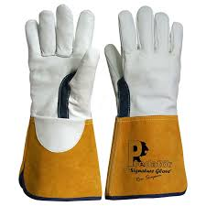
Gloves
STANDARD | TEST DESCRIPTION
EN 388:2016+A1:2018 | Protective Gloves – Mechanical risk
EN 420:2003+A1:2009 | Protective Gloves – General requirements
EN 407:2004 | Protective Gloves - Thermal risks (Heat & Fire)
EN 12477:2001+A1:2005 | Protective Gloves – Welders
EN 374-3:2003 | Protective Gloves – Protection from Chemicals
EN 659:2003+A1:2008 | Protective Gloves - Fire fighters
EN 13594:2015 | Protective Gloves - Motorcycle riders
EN 16027:2011 | Protective Gloves – Football goal keepers
ANSI/ISEA 105 | Protective Gloves – Hand protection classifications

Slide 11
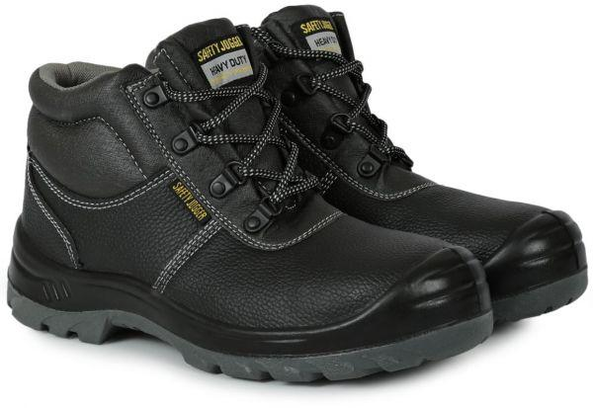
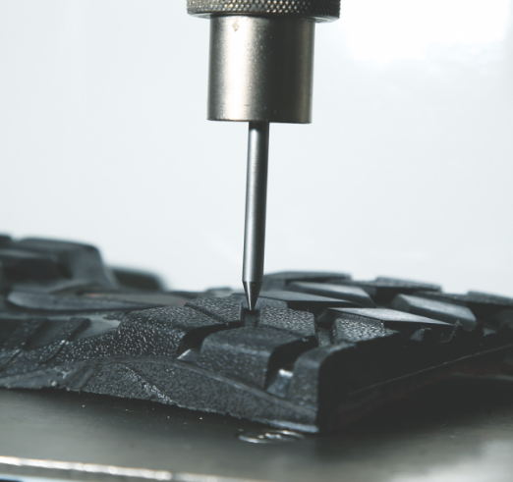
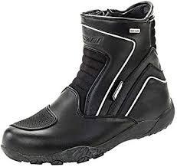
Footwear
STANDARD | TEST DESCRIPTION
EN 20344:2011 | PPE - Safety shoes methods
EN 20345:2011 | PPE - Safety footwear
EN 20346:2014 | PPE– Safety footwear
EN 20347:2012 | PPE– Occupational footwear
EN 344-1:1993 | PPE – Safety, Protective & Occupational footwear
EN 13634:2017 | PPE – Motorcycle riders

Slide 12

Protective clothing
STANDARD | TEST DESCRIPTION
EN 17092 | Protective garments for motorcycle riders
BS EN ISO 13688:2013 | Protective clothing – General requirements
EN 13034:2005+A1:2009 | Protective Clothing against Liquid Chemicals
BS EN ISO 11611:2015 | Protective Clothing - Welding and allied processes
BS EN ISO 11612:2015 | Protective Clothing – Heat & flame
EN 14325:2018 | Protective Clothing against Chemicals
EN 1150:1999 | Protective Clothing – High visibility
EN ISO 20471:2013 | High visibility clothing
ANSI/ISEA 107:2010 | Protective Clothing – High visibility

Slide 13
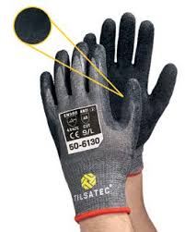
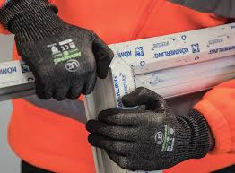
Protective Gloves General Requirement EN 21420
Sr. No. | Test Parameters | Methods
1 | PH value | BS EN ISO 21420 § 4.2 (ISO 3071 / 4045)
2 | Chromium VI | BS EN ISO 21420 § 4.2 (ISO 17075)
3 | Size | BS EN ISO 21420 § 5.1
4 | Dexterity | BS EN ISO 21420 § 5.2
5 | Water vapour transmission | BS EN ISO 21420 § 5.3.1
6 | Water vapor absorption | BS EN ISO 21420 § 5.3.2
7 | Analysis Of Dimethyl Formamide (DMFa) | BS EN ISO 21420 § 4.2
8 | Detection of AZO colorants in dyed Leather | BS EN ISO 21420 § 4.2 (ISO 17234)
9 | Determination of Pentachlorophenol (PCP) | BS EN ISO 21420 § 4.2 (ISO 17070)
10 | Presence of Polycyclic Aromatic Hydrocarbons (PAH) | § 4.2 (ISO/TS16190)

Slide 14

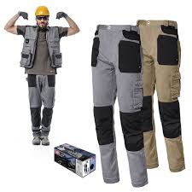

Protective clothing – BS EN ISO 13688:2013
Sr. | Test Parameters | Methods
1 | Innocuousness; Chromium (VI) content | ISO 17075
2 | Innocuousness; Nickel release | EN 1811
3 | Innocuousness; pH of leather | ISO 4045
4 | Innocuousness; pH of textiles | ISO 3071
5 | Innocuousness; Azo colorants (Textiles) | EN 14362
6 | Innocuousness; Azo colorants (Blended) | EN 14362
7 | Innocuousness; Azo colorants (Leather) | EN 17234
8 | Design | EN 13688
9 | Tensile strength - Stripe method | ISO 13934-1
10 | Tensile strength – Leather | ISO 3376
11 | Tear strength – Textiles | ISO 4674-1
12 | Tear strength – Leather | ISO 3377-1
13 | Comfort - Ergonomic requirements | EN 13594, Annex B
14 | Washing and dry cleaning (5 cycles) | ISO 3175-1
15 | Washing (5 cycles) | ISO 6330/5077/3175-1
16 | Dimensional Stability to cleaning | ISO 6330/5077
17 | Size Designation | ISO 3635 EN 13688 Annex

Slide 15
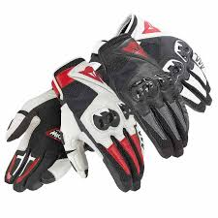
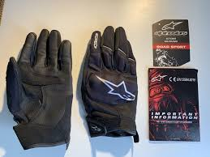
Protective Gloves for Motorcycle Riders EN 13594
Sr. No | Test Parameters | Methods
1 | Innocuousness; Chromium (VI) content | BS EN ISO 21420 § 4.2 (ISO 17075)
2 | Innocuousness; pH of leather | BS EN ISO 21420 § 4.2 (ISO 4045)
3 | Innocuousness; Azo colorants (Leather) | BS EN ISO 21420 § 4.2 (ISO 17234)
4 | Analysis Of Dimethyl Formamide (DMFa) | BS EN ISO 21420 § 4.2
5 | Determination of Pentachlorophenol (PCP) | BS EN ISO 21420 § 4.2 (ISO 17070)
6 | Presence of Polycyclic Aromatic Hydrocarbons (PAH) | BS EN ISO 21420 § 4.2 (ISO/TS 16190)
7 | Hard inclusions | EN 13594 § 6.3
8 | Ergonomic requirements | EN 13594, Annex B
9 | Sizing and length | BS EN ISO 21420 § 5.1
10 | Restraint | EN 13594 § 4.5
11 | Tear strength | EN 388 § 4.6
12 | Strength of seams | EN 13594, Annex B § 4.7
13 | Cut resistance | EN 388 § 4.8

Slide 16
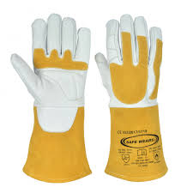
PROTECTIVE GLOVES FOR WELDERS EN 12477
Sr. No. | Test Parameters | Methods
1 | Abrasion resistance | BS EN 388:2016 § 6.1
2 | Blade cut resistance | BS EN 388:2016 § 6.2
3 | Tear resistance | BS EN 388:2016 § 6.4
4 | Puncture resistance | BS EN 388:2016 § 6.5
5 | Burning Behavior | BS EN 12477 § 5.5
6 | Contact Heat | BS EN 12477 § 5.6
7 | Convective Heat | BS EN 12477 § 5.7
8 | Size | BS EN ISO 21420 § 5.1
9 | Dexterity | BS EN ISO 21420 § 5.2
10 | Small splashes of Molten Metal | BS EN 12477 § 5.8

Slide 17
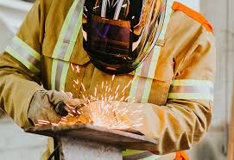

Protective clothing for use in welding EN 11611 Class 2A1
Sr. No. | Test Parameters | Methods
1 | Chromium VI Contents (For Leather) | ISO 17075
2 | nickel Release (Only Applicable on Metal Parts) | EN 1811
3 | pH Value | ISO 4045 (Leather) ISO 3071 (Textile)
4 | Banned Azo Amines | EN 14362-1 (Textile) ISO 17234-1 (Leather)
5 | Protective Clothing | EN 11611 § 4.2
6 | Size designation & fit | EN 11611 § 4.3
7 | Additional protective Clothing | EN 11611 § 4.4
8 | Pockets and flap closures | EN 11611 § 4.5
9 | Closures & Seams | EN 11611 § 4.6
10 | Hardware | EN 11611 § 4.7
11 | Pre-treatment of material - Washing 5 Cycle (Only Washable material) | EN 11611 § 5.2
12 | Tensile Strength (Per Material) | EN 11611 § 6.2 (ISO 13934-1 (Textile) EN 11611 § 6.2 (ISO 3376 (Leather)
13 | Tear Strength (Per Material) | EN 11611 § 6.3 (ISO 13937-2 (Textile) EN 11611 § 6.3 (ISO 3377-1 (Leather)
14 | Burst Strength - Only Knitted Fabric | EN 11611 § 6.4 (ISO 13983-1)
15 | Seam Strength (Per Seam) | EN 11611 § 6.5 (ISO 13935-2)
16 | Dimensional change of textile material (Woven & Knit Fabric) (After 1 Wash) | EN 11611 § 6.6 (ISO 5077)
17 | Limited Flame spread | EN 11611 § 6.7 (ISO 15025)
18 | Impact of Spatter | EN 11611 § 6.8
19 | Radiant heat resistance | EN 11611 § 6.9 (ISO 6942)
20 | Fat Content of Leather | EN 11611 § 6.11 (ISO 4048)

Slide 18
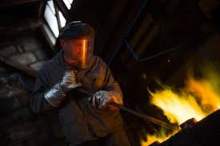
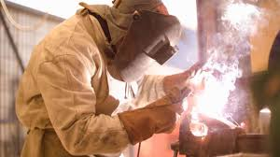
Protective clothing for use in welding and Allied process ISO 11612
Sr. No. | Test Parameters | Methods
1 | Chromium VI Contents (For Leather) | ISO 17075
2 | nickel Release (Only Applicable on Metal Parts) | EN 1811
3 | pH Value | ISO 4045 (Leather) ISO 3071 (Textile)
4 | Banned Azo Amines | EN 14362-1 (Textile) ISO 17234-1 (Leather)
5 | Protective Clothing | EN 11612
6 | Additional protective garment | EN 11612
7 | Pockets and closures | EN 11612
8 | Hardware | EN 11612
9 | Additional design requirements for molten splash protective garments | EN 11612
10 | Pre-treatment by cleaning 5 cycle ( Only for textile material) | ISO 6330,ISO 15797,ISO 3175-2
11 | Heat resistance | ISO 17943
12 | Limited flame spread | ISO 15025
13 | Dimensional change of textile materials | ISO 5077
14 | Tensile | ISO 13934-1(Textile) ISO 3376 (Leather)
15 | Tear | 13937-2(Textile) , ISO 3377-1
16 | Burst strength of knitted materials & seam (Only knitted fabric) | ISO 13983-1 ISO 13983-1
17 | Seam strength | ISO 13935-2
18 | Fat content of leather | ISO 4048
19 | Convective heat | ISO 9151
20 | Radiant heat | ISO 6942

Slide 19
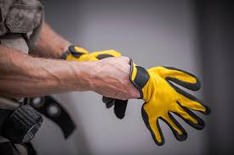
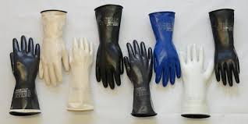
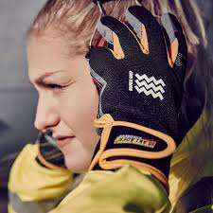
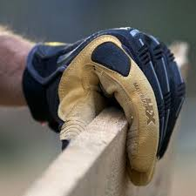
Protective Gloves Against Mechanical Risks EN 388
Sr# | Test Parameters | Methods
1 | Abrasion resistance | EN 388
2 | Blade cut resistance | EN 388
3 | Tear resistance | EN 388
4 | Puncture resistance | EN 388
5 | TDM Blade Cut | EN ISO 13997

Slide 20

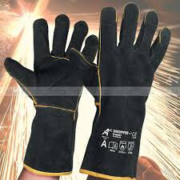
Protective Gloves Against Thermal Risks EN 407
Sr. | Test Parameters | Methods
1 | Burning Behavior | EN 407
2 | Contact Heat | EN 407
3 | Convective Heat | EN 407
4 | Radiant Heat | EN 407
5 | Small splashes of Molten Metal | EN 407
6 | Large splashes of Molten Metal | EN 407

Slide 21
Protective Glove for Firefighter EN 659
Sr. | Test Parameters | Methods
1 | Gloves Design & Constructions | EN 659 § 4.1
2 | Chromium VI | EN 659 § 3.1 (ISO 17075-2)
3 | pH Value | EN 659 § 3.1 (ISO 4045)
4 | Banned Azo amines | EN 659 § 3.1 (ISO 17234-1)
5 | Analysis Of Dimethyl Formamide (DMFa) | EN 659 § 3.1 (EN ISO 21420)
6 | Determination of Polycyclic Aromatic Hydrocarbons (PAH) | EN 659 § 3.1 (EN ISO 21420)
7 | Sizing (per size) | EN 659 § 3.2 (EN ISO 21420)
8 | Abrasion resistance | EN 659 § 3.3 (EN 388)
9 | Blade cut resistance | EN 659 § 3.4 (EN 388)
10 | Tear resistance | EN 659 § 3.5 (EN 388)
11 | Puncture resistance | EN 659 § 3.6 (EN 388)
12 | Burning Behavior | EN 659 § 3.7 (EN 407)
13 | Convective Heat | EN 659 § 3.8 (EN ISO 9151)
14 | Radiant Heat Resistance | EN 659 § 3.9 (EN ISO 6942)
15 | Heat Resistance of Lining Material | EN 659 § 3.11 (ISO 17493)
16 | Heat Shrinkage | EN 659 § 3.12 (ISO 17493)
17 | Dexterity | EN 659 § 3.13 (ISO 21420)
18 | Seam Breaking Strength | EN 659 § 3.14 (EN ISO 13935-2)
19 | Time for Removal of Gloves | EN 659 § 3.15
20 | Resistance of gloves material to water penetration (Optional) | EN 659 § 3.16 (EN ISO 20811)
21 | Resistant to Liquid chemical penetration | EN 659 § 3.18 (EN ISO 6530)

Slide 22
ISO 20345:2007: personal protective equipment – safety footwear
Sr. No | Test description | Method
1 | Heat resistance of footwear | SATRA TM 49, SATRA TM 455, EN ISO 20344: 2004 (E), EN ISO 20345:2004 (E)EN ISO 20346: 2004 (E), EN ISO 20347: 2004 (E)
2 | Footwear seam strength | SATRA 180, BS 5131: 5.13
3 | Abrasion resistance of outsole(for rubbers) | ISO 4649,SATRA TM 174,EN 12770
4 | Sole abrasion test | DIN 53516,ISO/DIS 4649,BS903 PART 9
5 | Whole sole flexing Test | ISO 17707.EN SO 20344,SATRA TM 161,DIN 53543
6 | Finish shoe Flexing test | SATRA 92
7 | Toe Impact test for safety shoe | EN ISO 20344:2011
8 | Creasing/Flexing test for shoe upper | ISO 22288 EN ISO 7854 ISO 2023,ISO 4643,SATRA TM 25
9 | Finish shoe flexing/bending angle test
10 | Peeling test/sole adhesion | ISO 17708,SATRA 404,BS 5131
11 | Electrostatic properties | EN 420, EN 1149-1, 2 -3
12 | Trim and bow attachment test | SATRA TM 149

Slide 23

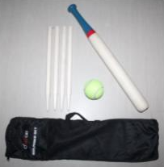
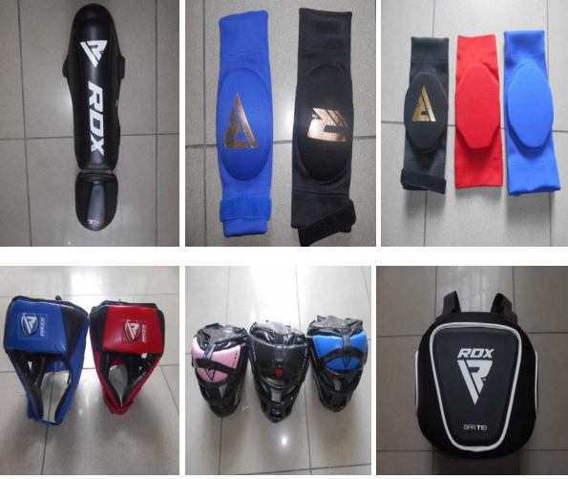
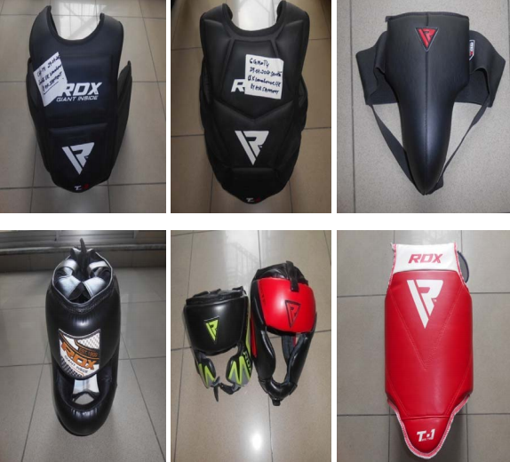
Testing on Sports Goods: Rounder Base Ball Set, Rugby Ball, Martial Arts
Sr. No. | Test Parameters | Methods
1 | Mechanical and physical properties | EN 71-1: 2014+A1:2018
2 | Flammability | EN 71-2: 2011+A1:2014
3 | Migration of certain elements | EN 71-3:2019
4 | Determination of Chromium (VI) in Leather | ISO / DIS 17075-3
5 | pH Value (Leather) | ISO 4045
6 | Colorfastness to Perspiration (Leather) | EN ISO 11641
7 | Colorfastness to Perspiration (Fabric) | ISO 105 E04
8 | Pentachlorophenol (PCP) Content | EN ISO 17070:2015
9 | Polycyclic Aromatic Hydrocarbons (PAH) | AfPS GS 2014:01/ZEK 01.4-08
10 | Azo Colorants in dyed Leather | ISO 17234-1
11 | Phthalates content | ISO 14389
12 | Banned Azo Colorants (Textile) | BS EN ISO 14362-1

Slide 24
Restricted Substances Limited- Analytical Testing
Sr. No | Test Method | Test standard
01 | pH | AATCC 81, BS EN 1413, ISO 3071 EN ISO 4045
02 | Formaldehyde, Qualitative Analysis, Released by sealed jar method (Leather & Textile) | Spot test AATCC 112, BS EN 14184-2, M & S C18B
03 | Free & hydrolyzed method Formaldehyde (Textile & Leather) | BS EN 14184-1, Japanese law 112 JIS 1041-1, ISO TS 17226-1,2 ,DIN 53315
04 | Leathers Azo dyestuff test , Extraction method (Polyester) Reductive cleavage (Non polyester), Combined method (blend), Dyed leather | BS EN 14362-1:2012 ISO 17234, DIN 53316
05 | Phthalates | CPSC-CH-C-1001-09.3 EN 15777
06 | Carcinogenic Dyes Stuff | DIN 54231
07 | Allergenic Dyes Stuff | DIN 54231
08 | Biocides | §64 LFGB 82.02.8
09 | Pentachlorophenol (PCP), Tetrachlorophenol (TeCP) o-Phenylphenol (OPP) , Trichlorophenols (TriCP) | ISO 17070
10 | Lead in paint & other similar surface coatings | CPSC-CH-E1003-09.1
11 | Total Lead (Pb) in metal products | CPSC-CH-E1001-08.3 ISO 17072-2
12 | Total Lead (Pb) in non-metal products | CPSC-CH-E1002-08.3 ISO 6101-2
13 | Determination of cadmium | EN 1122
14 | Nickel release | EN 1811
15 | Chromium VI | ISO 17075, , EN ISO 420, DIN 53314,CEN/TS 14495, IUC 15

Slide 25
Restricted Substances Limited- Analytical Testing
Sr. No | Test description | Method
16 | Extractable heavy metals Antimony – Sb, Arsenic – AS, Lead – Pb, Cadmium – Cd, Chromium – Cr, Cobalt – Co, Copper – Cu, Nickel – Ni, Mercury – Hg, Zinc –Zn | ISO 105 E04, ISO 17072-1Total heavy metals (Soluble) ISO 17072-2
18 | Determination of Chromic Oxide Contents | ISO 5398-3
19 | Determination of matter soluble in Dichloromethane & free fatty acid | ISO 4048
20 | Polycyclic Aromatic Hydrocarbons (PAH) | AFPS GS 2014
21 | APs & APEOs (NP & OP) (NPEO & OPEO) | ISO 18254-1
22 | Dimethyl Fumarate DMFu | ISO/TS 16186
23 | Dimethyl Formamide DMFa | ISO/TS 16186
24 | Perfluorooctane sulfonate (PFOS) Perfluorooctanoic acid (PFOA), | 122/EC/2006
25 | Total Chromium Contents | DIN EN ISO 17294
26 | Organotins Compounds | ISO/TS 16179
27 | Polyurethane (PU Identification) | By FTIR
28 | Short Chain Chlorinated Paraffins (SCCP) | Solvent extraction / Analysis by GC-ECD/MS
29 | Medium Chain Chlorinated Paraffins (MCCP) | Solvent extraction / Analysis by GC-ECD/MS
30 | Chlorinated Organic Carriers (COCs) | DIN 54232

Slide 26
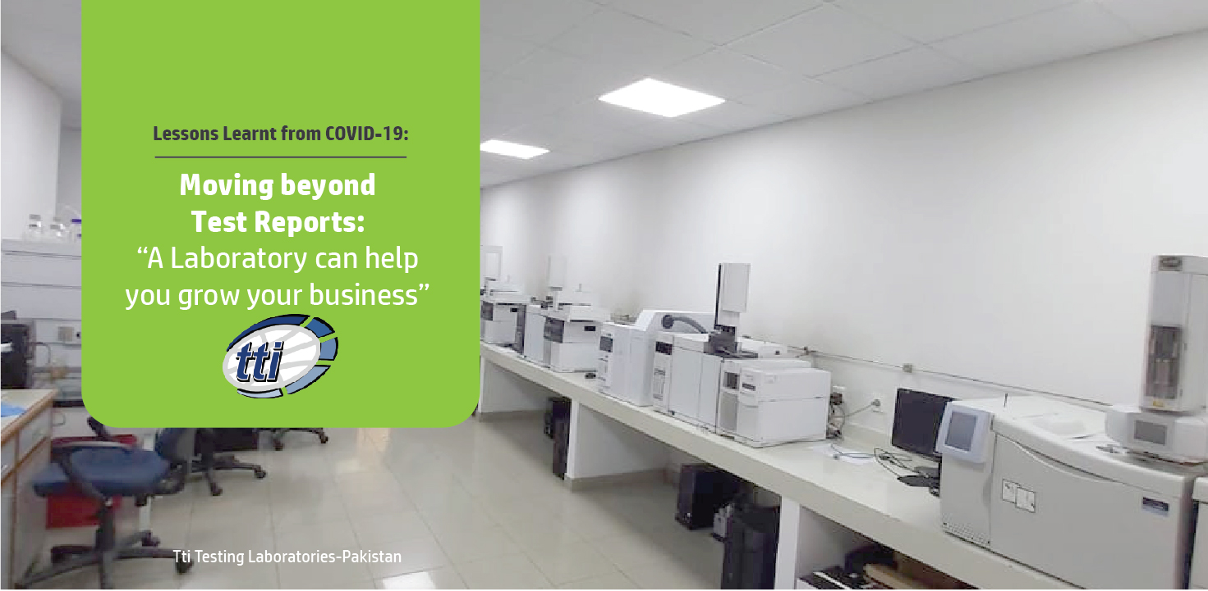

Thank you !
Email:
adnan.malik@ttilabs.net
Ph: 042 111 786 001
www.ttilabs.net

