Slide 1
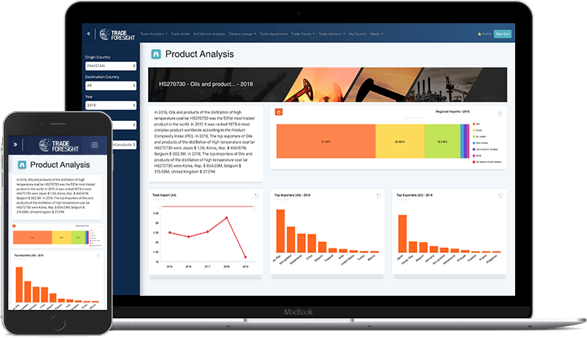
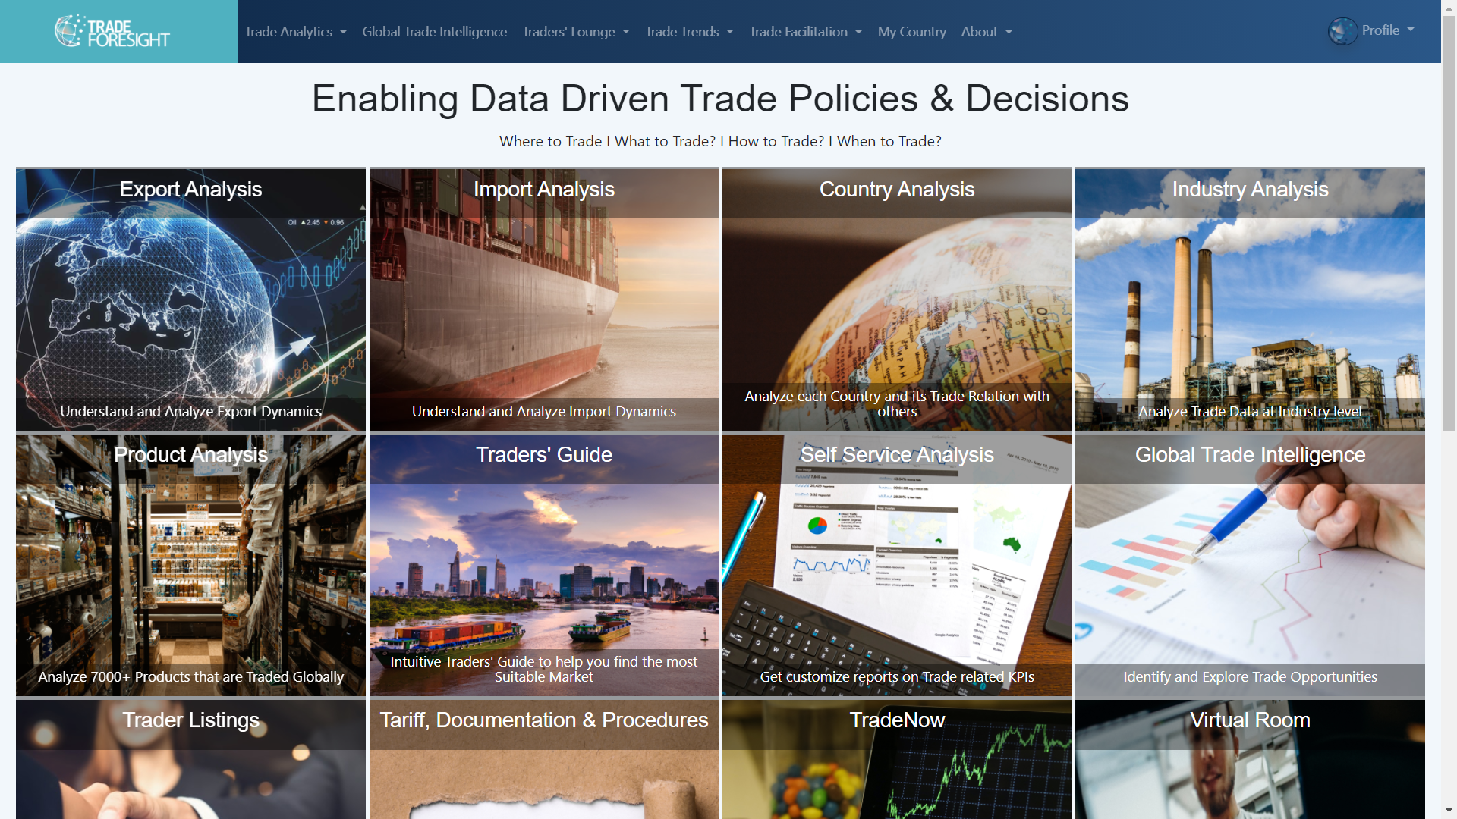
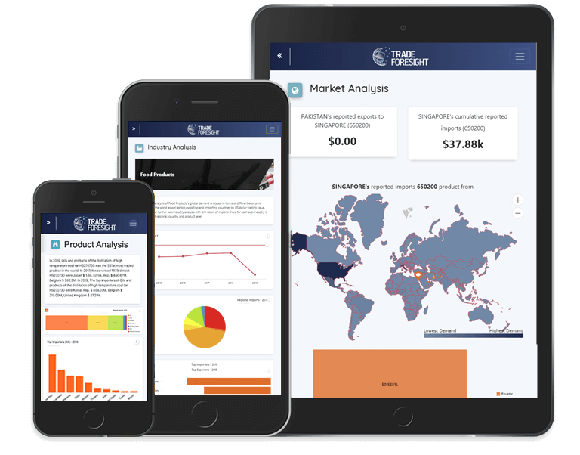
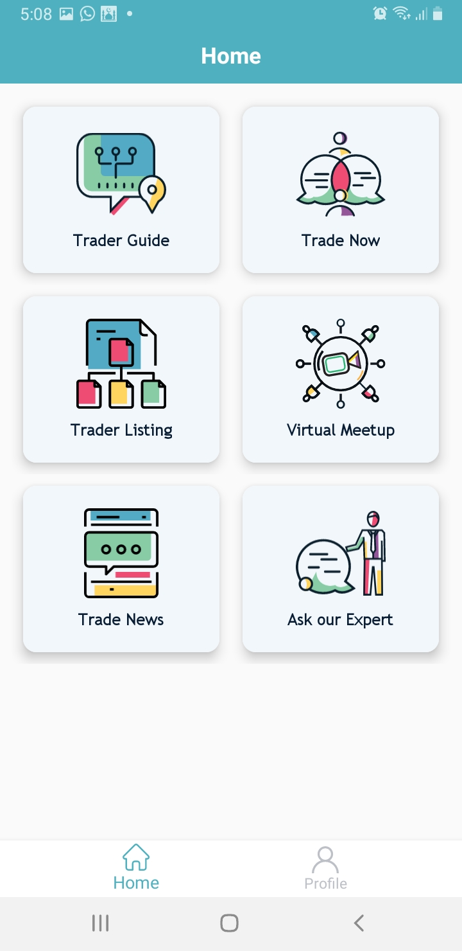
Trade Foresight
Utilize Trade Data, Identify Opportunities & Enable Trade

Slide 3
WHAT IS TRADE FORESIGHT
World’s First Data and Analytics Driven Global Trade Platform.
Whether you are a SME, a big cooperation or a government organization, if you are in trade, Trade Foresight is for you!
With a robust team of Economist, Trade Consultants and Trade Advisors we have a one-stop solution that can serve 125M SMEs and Trade Entities in 196 countries by not only helping them to making smart and effective Trade Strategies and Decisions but also Facilitate in Trading.

Slide 4
Our Vision
__________________________________________________________
Building Data Driven Sustainable & Profitable Trade Value Chains

Slide 5
In order to build such Trade Strategies and Relations – What you need is?
Consolidated Data and Information
27.5 USD/KG
3 Million+ Traders of Carpet: HS Code 570242
FTA
8 Core Steps to Export
370 Million USD Imports

Slide 6
Trade Foresight – One Stop Solution
ONE CLICK TRADE
Data Driven
One Click to Find Markets
One Click to Connect with Partners
One Click to Connect Trade Associations
One Click Logistics
One Click to connect with Financing Institutions
One Click TRADE EXECUTION

Slide 8
Trade Analytics
Traders’ Lounge
Trade Facilitation
Country Analysis
Match Making
Trade Financial Institutions
Industry Analysis
B2B Market Place
Trade Advisory
Product Analysis
Virtual Meeting
Trade Logistics
Trade Authorities
& Agreements
Self Service Analysis
Market Finder

Slide 9
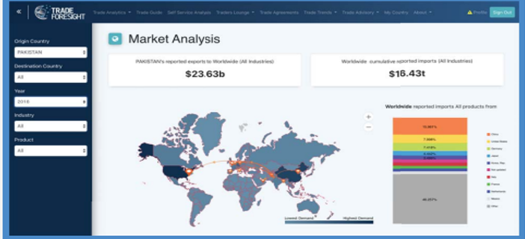
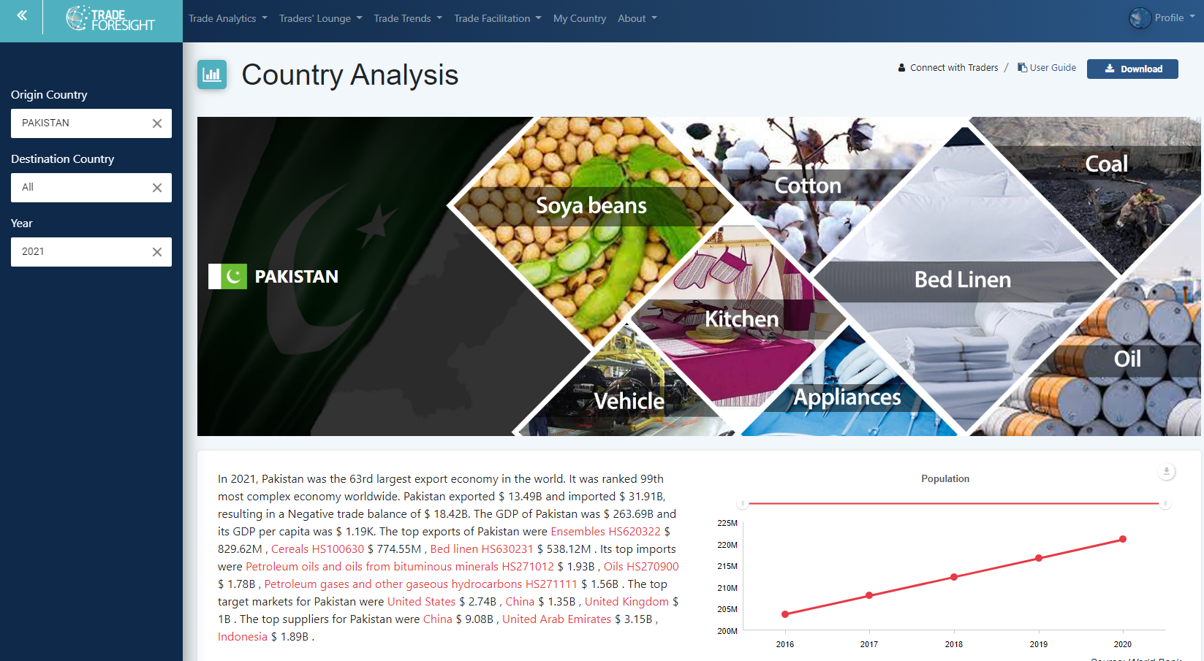
PLATFORM FEATURES
1. Trade Analytics Gain insights to make informed decisions, spot problems ,highlight potential risks, and identify cost-saving opportunities that can support your business favorably.
2. Country Analysis
Plan ahead trade and business activities efficiently for local and international trade with access to insights about economic policies along with international trade agreements.

Slide 10
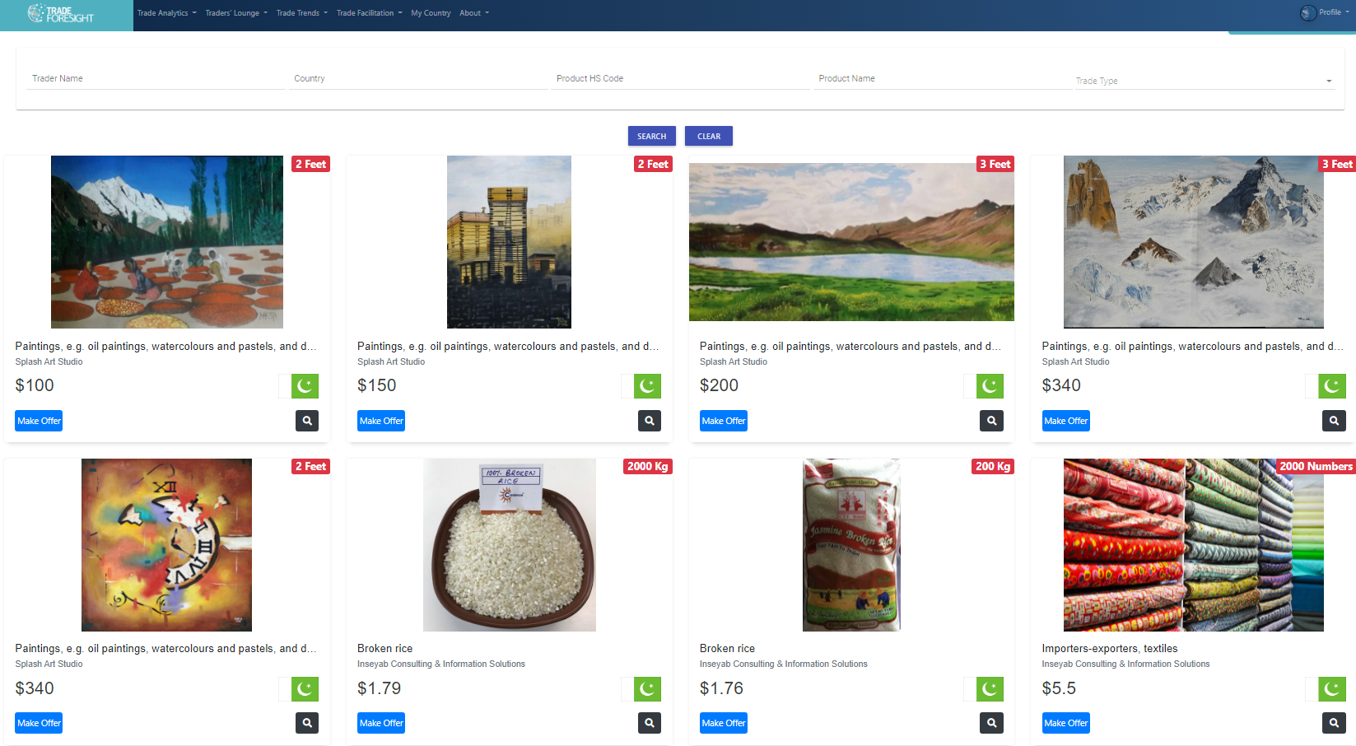
3. On-Spot Trading (B2B Marketplace)
- (B2B) marketplace that connects small and medium businesses across the globe for international trade. - Traders can now directly navigate to On Spot Trading to seek prospect buyers, sellers, exporters, importers, or services providers for any product or service -Traders can also list their products or services in the marketplace for all the registered users to view the product/service listings.

Slide 11
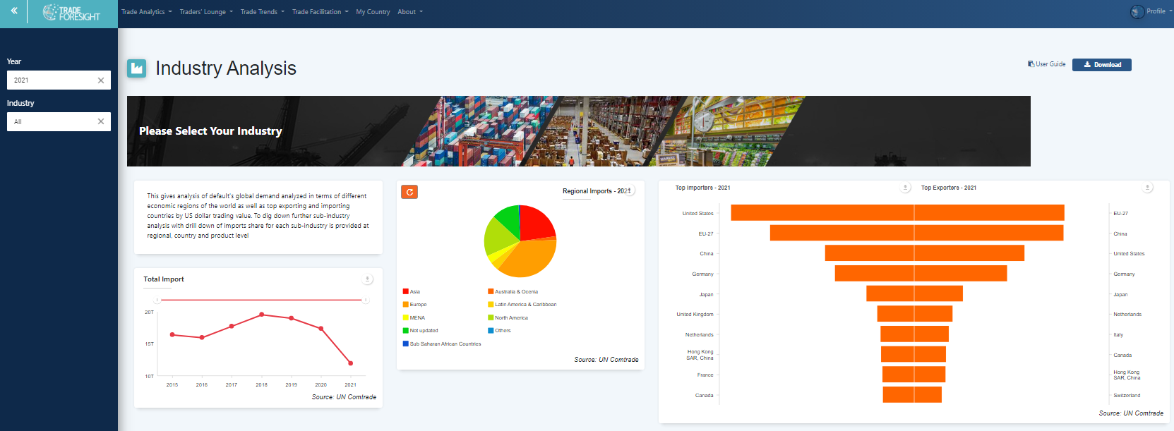
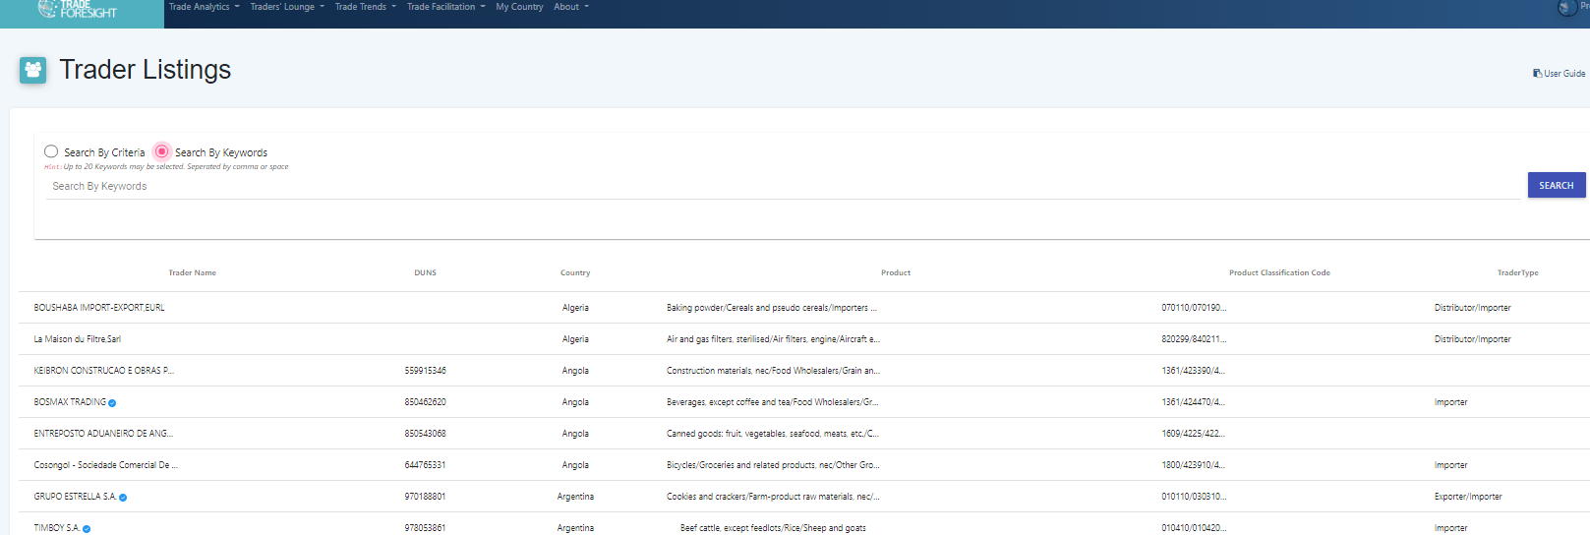
4. Industry Analysis
- As a member you can access insightful information about industry-specific market share, global demand, top exporting and importing destinations, and sub-industry analysis for products and services.
5. Traders List
Trade Foresight™ has congregated a database of manufacturers , buyers, and traders from across the world with a vision to establish a direct point of contact to promote business activities with ease, without any delays.

Slide 12
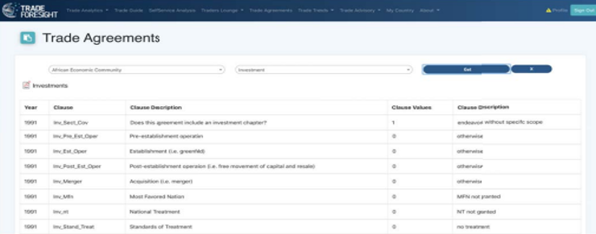
6. Trade Agreements TradeForesight provides access to database of more than 600 multilateral trade related conventions currently effective around the world.
7. Trade Advisory We have embedded a Trade Advisory feature, that helps businesses make logically calculated business decisions. The feature connects business users with our experienced trade experts which will provide well-rounded expert advice to help you take trade related decisions that can optimize your business.

Slide 13
8. Trade News
We have has access to real-time data related to trade policies and news for a diverse range of trade avenues. The feature notifies users with real-time insights of the trading industry, exchange rates, policy updates, and other region-specific trade related updates allowing users to gain detailed insights and make efficient business decisions way ahead of time.
9. Trade Authority
You will have an access to provide details for direct point of contact to trade regulating authorities and trade supporting associations globally. The feature provides information about trade assisting and trade regulating bodies operating in a country, to support the international trade.

Slide 14
10. Authentic Data Sources
Global Trade Data from multiple authentic sources like UN Comtrade, IMF, World Bank, OECD, GTAP, WITS etc. provides a comprehensive analysis on numerous aspects of global trade..
11. Product Level Search
Our Platform enables users to undertake Self Service Analysis, using authentic and verified formulas, the platform showcases indices using data from different sources already accumulated on a Single Trade Data Platform which will conclude all relevant KPIs for the users to devise trade strategies or utilize it for research purposes, formulating creative reports, and customizing them based on their requirements.

Slide 15
11. Virtual meeting between traders
- The virtual meeting features enables traders, buyers, and sellers to interact with and hold secured meetings at virtual meeting rooms. - Members can schedule and hold meetings with Traders, Buyers and Sellers, share screens and presentations. - Meetings can be recorded, and users can choose to record sessions, collaborate on projects, and share or annotate on one another's screens, all with one easy-to-use platform.

Slide 16
Portal Subscription
Web Portal and Mobile Application –
Yearly Subscription Plan
Premium
Premium+
$400
$600
$1000
Standard

Slide 18
Trade Analytics – Quantitative Data
Trades Lounge – Quantitative/Qualitative Data
Trade Facilitation – Qualitative Data
Trade Data Connectors

Slide 19
60+ Quantitative KPIs that provides visibility of Import, Export, Market Access and other Key Measures 196 countries, 19 Industries and 7000+ Products
Trade Analytics

Slide 20
Our KPIs are subdivided into 5 categories that offers diverse information to our clients.
Key Product Indicators (KPIs)
Measures of Diversification
Macroeconomic Indicators
Market Analysis
Product Analysis
Trade Related Indicators

Slide 21
Diversity
Economic Complexity Index
Herfindahl-Hirschman Market
Concentration Index
Herfindahl-Hirschman Product
Concentration Index
A measure of how many different types of products a country can make.
This indicator ranks how diversified and complex a country’s export basket is. ECI is a scale that uses the theory of and calculations for economic complexity to rank countries according to their level of complexity
Measures the concentration of exports at the product level. The index ranges from 0 to 1 with a larger value indicating a higher concentration in the export market. A value equal to 0 indicates that all countries in the world export an equal share of product i, while a value of 1 means that a single country is responsible for all exports of product i.
Measures the degree of concentration of exports at the country level i.e. If the export of country A are concentrated on some products. The index ranges from 0 to 1. A value equal to 1 indicates that all exports of a country come from a single country, while a value of 0 means that the country's exports are homogeneously distributed among all products.
It is the share of the actual number of export relationships (at the country product level) forged by Country A in the maximum possible number of export relationships it can form given the number of its exports. The denominator is calculated by summing the number of countries that import each product that Country A exports.
This indicator is used to measure the geographical diversity of a country by counting the number of distinct markets involved in the trade. Higher the number of distinct partners, higher is the geographical diversity.
This indicator is used to measure the diversity of a country by counting the number of distinct HS2/4/6 products involved in the trade.
It shows comparative advantage a country has over a product with compared to the rest of the world. A value of less than unity implies that the country has a revealed comparative disadvantage in the product. Similarly, if the index exceeds unity, the country is said to have a revealed comparative advantage in the product.
A measure of how many different countries are able to make a product. A higher value of ubiquity for a product indicates a comparatively lower level of know-how required to manufacture it.
Market Penetration Index
Number Of Distinct Partners
Number Of Distinct Products Revealed Comparative Advantage
Ubiquity

Slide 22
Gold
Platinum
$10,000 for 10 KPIs
$18,000 for 30KPIs
$25,000 for 61 KPIS
Silver
Data Connectors – Yearly Plan

Slide 23
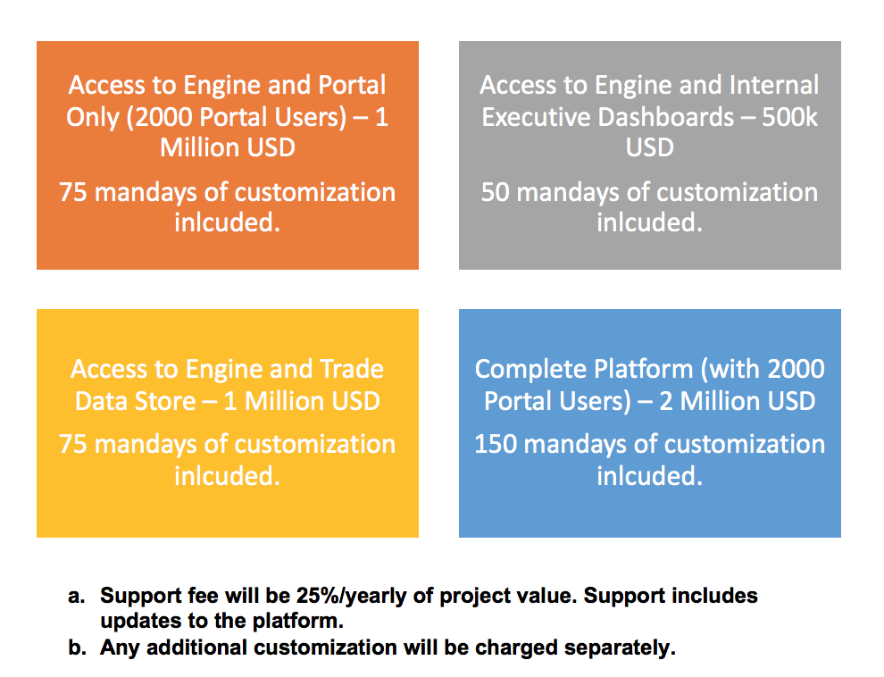
White Label

Slide 24
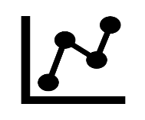
Our Offering - Trade Data for All
Trade Platform – Web Portal & Mobile Application
Data Connectors – Trade KPIs
Personalized - White Label Deployment
Trade Analytics
Traders’ Lounge
API & Bulk Download
Executive Dashboards
Self-Service Analysis
Calculated KPIs
Trade Facilitation
Data Integration
Customized Trade Portal

Slide 25
Offering to Market Mapping
Traders and SMEs
Portal and Mobile Application
Banks and Corporates
Data Connector
Trade Associations
Data Connector
Government and Policy Makers
White Label Deployment
White Label Deployment
Data Connector
Portal and Mobile Application

Slide 26
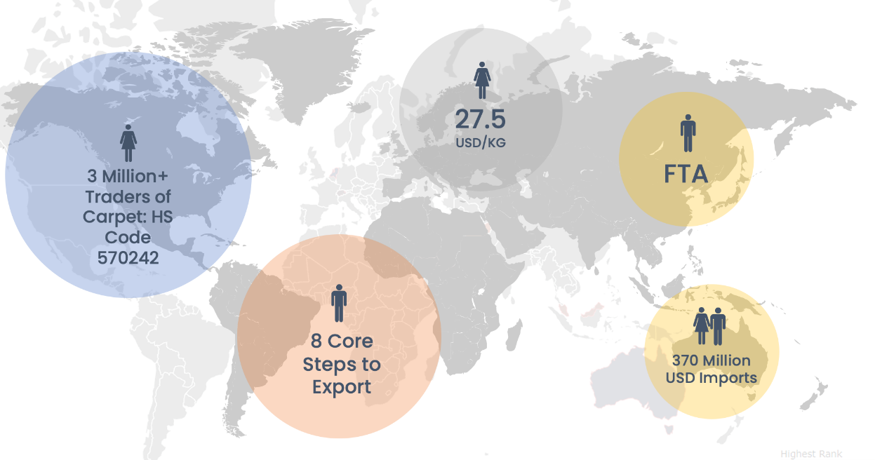
Add-Ons
Go-To-Market Add-Ons
Branding and Design - 2500 USD
Prepare the SME for global market
Creating Brochures, Company Profile, Photography of your facility and products
5 page Website building
Company Presentation
Social Media Marketing
B2B Connections - 1000 USD
Trade Coaching - 2000 USD
24 Genuine B2B meetings a year
Personalized Service with B2B Connections
Support in Facilitation and Trade Financing
Customized Training and Coaching
Consulting On contracts and documentation
Export Strategy related Training
Guidance on Product Packaging

Slide 27
White Label Success Story: Saudi Export
Inseyab deployed Trade Foresight to enable Saudi SMEs and Traders to understand the global trading environment and take data driven decisions such as what to export where and when!
The platform is assisting them identify new markets, explore more revenue generation pockets.
The platform is also supporting Saudi Export Development Authority, to meet their Government's vision to move from an Oil-based to a more balanced economy. Vision 2030 of Saudi Arabia, requires Non-Oil revenue to improve from current 13% to 50% over the next decade.
Phase 2 being discussed for 2022

Slide 28
Data Connector Success Story: Saudi Export
Karandaaz Pakistan bought our Data Connector and enhanced their Portal with Trade related Data!

Slide 29
Current Context
White Label Deployment at Saudi Government – 1.13 Million USD. 5000 plus traders using the portal
Currently in discussion with Saudi Government for Phase 2 of Trade Platform & UAE Ministry of Foreign Trade
Data Connectors – 100K Deal Finalized with Karandaaz
SaaS Platform have over 11,000+ Users
Deal Finalized with SMEDA

Slide 30
Question? Contact Us
www.tradeforesight.com

