Slide 1
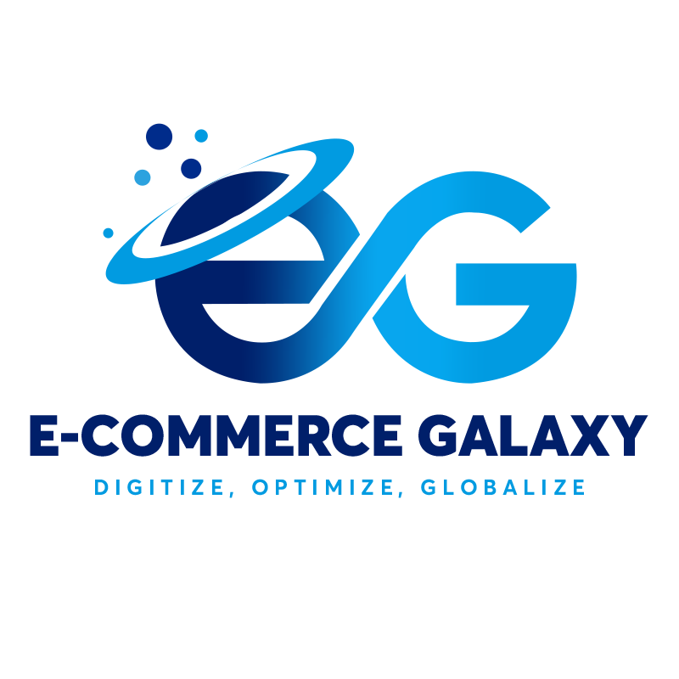
Selling on Amazon

Slide 2
Private Label (PL)

Slide 3
What is a Private Label?
Private Label means that your product is manufactured from a third party (which may be in any country), but you will sell it under your brand name.
You will sell your products under your brand name and, this brand is your asset
This is the most famous business model on Amazon, and many small brands take their start from here.

Slide 4
Fulfillment Models

Slide 5
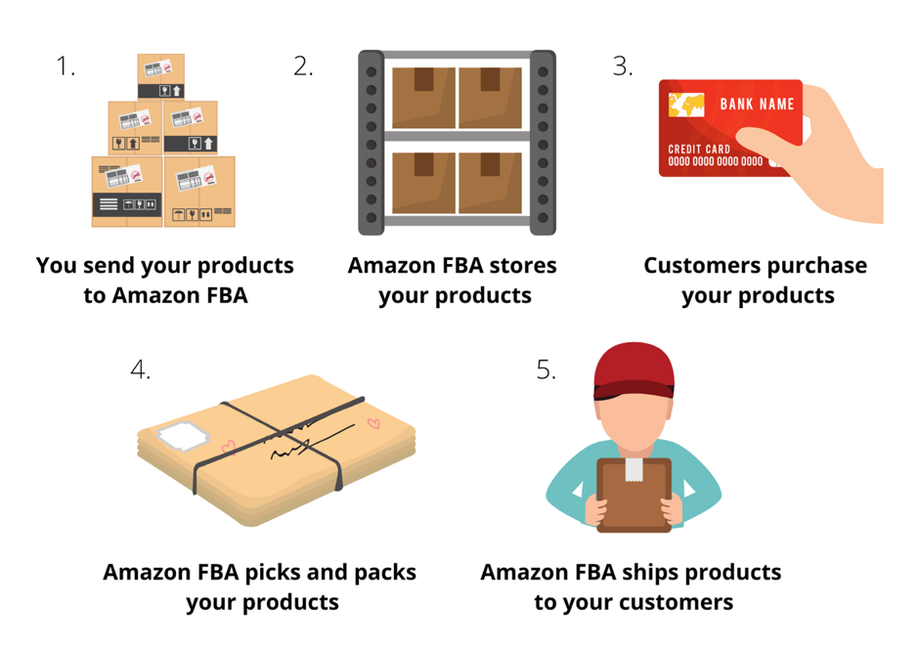
What is FBA Model?
FBA means Fulfilled by Amazon.
You simply send your inventory to Amazon, and when customers purchase your product, Amazon ships it directly to them.
From storage to
customer support,
Amazon handles
everything.

Slide 6
What is FBM Model?
FBM means Fulfilled by Merchant.
Whenever a customer purchases from you, you have to pack your product and send it to the customer directly.
Amazon customers are addicted to the quick service; that’s why the FBM model is not preferred.

Slide 7
Simplify Your Amazon Journey

Slide 8
Steps for starting your Amazon Business
Your Amazon journey consists of these steps:
Account Creation
Product Research
Sourcing
Listing creation
Launch & Rank
Scale your Business

Slide 9
Account Creation

Slide 10
Documents Required for Account Creation
You can create Amazon Account from any of the approved countries with these documents:
ID Verification Document (Driving License or Passport)
Physical Address
Mobile Number
Utility Bill
Physical Bank Account with Credit Card

Slide 11
Product Research

Slide 12
What to Sell?
You know that Amazon business has potential, but what can you sell for making money.
Selling any product on Amazon may not result in a successful experience; product research and analysis are critical for this business model.
Now you will learn:
What type of product is right for you?
What products to avoid?
How to identify a winning product opportunity?

Slide 13
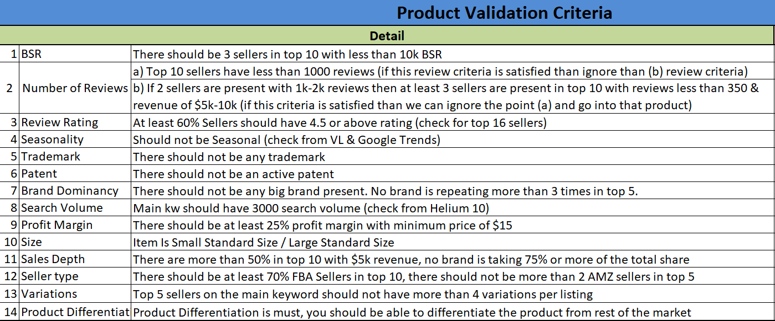
EG Product Criteria
Selling Price: $15- $ 50
Reviews: Average of 500 reviews in top 10
BSR: At least 3 sellers in the top 16 with BSR less than 10K
Seasonality: Not seasonal
Brand: Must not be Brand Dominant

Slide 14
How to find your winning product?

Slide 15
EG Product Criteria
How to overwhelm your competition with Product Differentiation?
Ask yourself why the customer should purchase from you instead of your competitors.
Product Differentiation means to give a reason to the customer for purchasing your product instead of the competitors.

Slide 16
Tools
Helium 10
Jungle Scout
Viral Launch

Slide 17
Sourcing

Slide 18
Who will manufacture your product?
If you can manufacture your product, this is a big advantage.
If you can’t manufacture it, don’t worry you can take advantage of the local manufacturers.
Sialkot is full such amazing opportunities.

Slide 19
Samples
Finalize at least three suppliers for your product.
Always take samples from your supplier and analyze the quality of the sample.
Check the quality of the samples, abuse the samples.

Slide 20
Placing your order
Finalize your supplier
Check the samples you received and decide which supplier gave you the best samples.
You have to finalize one supplier on the base of:
Sample quality
Ease of communication
Price
Place your order
After finalizing your supplier now, you can place the order.
Place the order for at least two months inventory.

Slide 21
Placing Your Order
Inspection
Once your suppliers say that your product's manufacturing is completed, visit the supplier and check if the product's quality is up to the mark.
If you can't visit yourself, you can hire someone to do this for you.

Slide 22
Shipping
Find a Freight Forwarder
After duly assessing the manufacturing quality of your product, you can ship it to Amazon.
Shipping types
There are two types of Shipping:
1) By Air: It is fast but expensive
2) By Sea: It is slow but cheaper

Slide 23
Listing Creation & Optimization

Slide 24
Listing Components
Your Amazon Listing consists of these components:
Images
Title
Bullets
Description
EBC (Enhanced Brand Content)
Video

Slide 25
Listing Components
Images
Images are the first thing that the customer sees in your listing.
If your images are not good, then it will be tough to make sales.
On the other hand, if your images are perfect, then they will boost your sales.

Slide 26
Importance of EBC & Video
Video and EBC are very important and have a high impact on customer conversion.
Adding a video and EBC will increase your sales by 3%-7%.

Slide 27
Keywords
Keywords are the names used by customers to search for your product on Amazon.
Knowing all the keywords of your product is very important, to index them and obtain sales from all the keywords.
Find the keywords which are being used by your competitors.
Use those keywords in your listing and rank on them to get sales from where your competitors are also getting.

Slide 28
How to find keywords?
For finding keywords, you need these tools:
Helium10
Viral Launch

Slide 29
Where to use the keywords?
Keywords in some parts of your listing play a more important role than other parts.
This is the keyword weight-age to follow on Amazon:
Title
Search terms
Other Attributes
Bullet Points
Description
Don't stuff your keywords.
The use of the keywords should be such that they make perfect sense in the sentences.
Do not neglect grammar and common sense just to stuff the keywords.

Slide 30
Listing Content
Use killer content to attract customers.
Describe the benefits of your product.
Use emotional sentences. Tell the customers how your product will solve their problems.
Your content should have a strong impact on the customer so that he makes a purchase from you.

Slide 31
Maximize your sales with Launch & Rank

Slide 32
Why Launch & Rank Your Product?
Just listing your product on Amazon does not mean that you will start getting sales.
When a buyer searches for a product on Amazon, it does not go beyond the first or second page. This means that customers will not purchase from you when you list a new product until you can rank to the top positions

Slide 33
Ranking Strategies
For ranking your product to the top positions, we use these two strategies:
The Product Testers Method
PPC

Slide 34
The Product Testers Method
In this ranking method, we will generate sales by doing Giveaways.
We offer our product for free and advertise it on Social Media.
Customers purchase our product at full price, and we refund them through PayPal.
Although we have done the refund but in Amazon’s eyes, this is counted as a full order and helps increase sales velocity.
More sales (by this method + organic orders) means high sales velocity, which in turn improves our ranking.

Slide 35
PPC
PPC stands for Pay Per Click
We use PPC for advertising our product on Sponsored positions on Amazon.
PPC is also used to rank your products by running PPC Campaigns on your relevant keywords.
There are two types of PPC Campaigns:
Auto: Amazon algorithm runs and decides which keywords will bring you sales.
Manual: You decide on which keywords you should advertise and rank with the help of PPC.

Slide 36
Expanding Your Amazon Business

Slide 37
How to scale your Amazon Business
You have launched your product, so what should be done now?
Add more products to your Brand or add more variations into the products that you have already launched.
Start selling on other marketplaces too.
Start selling on your website too.
Hire VA’s to manage your business

Slide 38
No money for PL.
No Problem

Slide 39
Strategies to make MONEY
You have the passion for learning and starting your Amazon journey but don’t have the investment for this. Don’t worry, we have a solution for you too.
You can also gain experience and knowledge without investing huge money by providing Amazon Services.
Start providing Amazon Services on Freelancing websites.
By providing services, you will not only get money but experience too.
Famous Freelancing websites are:
Upwork
Fiverr

Slide 40
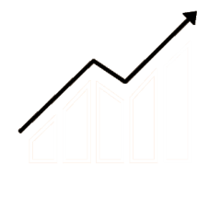
Amazon Wholesale
Amazon Wholesale Business Model
Muhammad Usman Yousaf

Slide 41
Welcome
“Success usually comes to those who are too busy to be looking for it.” – Henry David Thoreau

Slide 42
Amazon Wholesale Model
There are consumers around the globe buying hundreds of millions products on Amazon, Amazon’s sales platform is supported by more than 2 million third-party sellers worldwide; of those sellers, 26% sell products using a sales model called wholesale.

Slide 43
Amazon Wholesale Model
There are consumers around the globe buying hundreds of millions products on Amazon, Amazon’s sales platform is supported by more than 2 million third-party sellers worldwide; of those sellers, 26% sell products using a sales model called wholesale.

Slide 44
Amazon Wholesale Model
In this model, wholesalers actually buy already established products from brands with good sales and revenue then resell them on Amazon. It most of the time base on the buying products in bulk on discounted price from manufacturers or distributors and resell on Amazon.

Slide 45
Amazon Wholesale Model
Wholesale is the practice of purchasing bulk branded products from another manufacturer, supplier, or distributor to resell to consumers. Examples include popular consumer Electronics, Health & Household, Home & Kitchen and even popular toys.

Slide 46
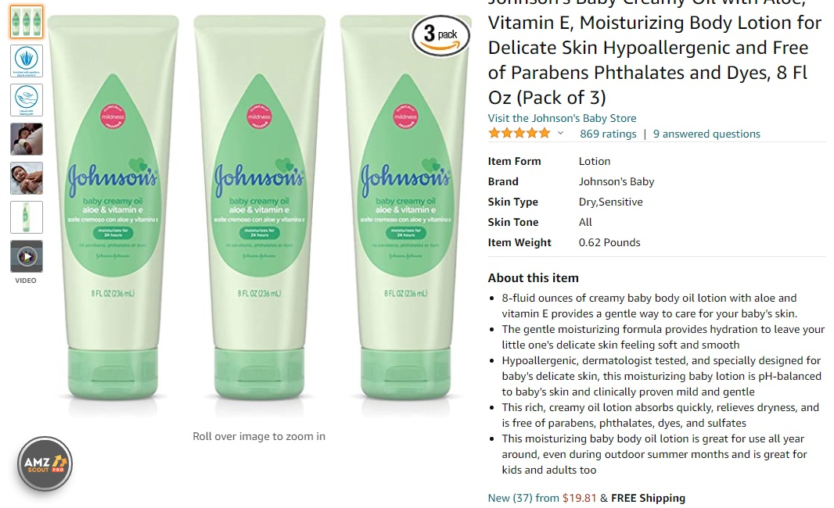

Slide 47
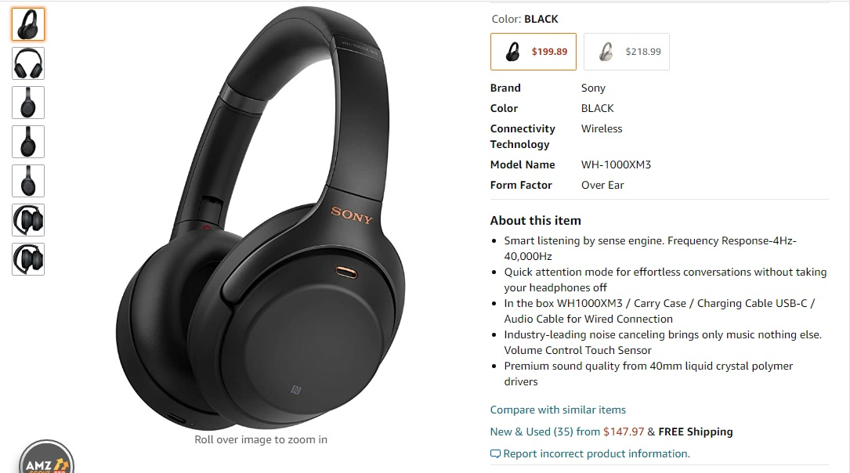

Slide 48
Amazon Wholesale Process
Sourcing the products (in this case, from suppliers)
Creating listings on products already listed on Amazon
STEP 03
STEP 04
Finding high-demand profitable products to sell
Promoting the products (in some cases)
STEP 02
STEP 05
Setting up a seller account
Managing and growing your business (including inventory, sales, etc.)
STEP 01
STEP 06

Slide 49
Amazon Wholesale Model
No Launching
No Sourcing from China
No Marketing/Give-Aways/PPC
No Running ADs

Slide 50
Business Requirements
Legal Entity
EIN
Reseller Permit
Amazon Account
Bank Account
Website
Email
Commercial Address
Prep Center
Phone Number

Slide 51
Amazon
Wholesale Sourcing
Notes:
To use this title animation slide with a new image simply 1) move the top semi-transparent shape to the side, 2) delete placeholder image, 3) click on the picture icon to add a new picture, 4) Move semi-transparent shape back to original position, 5) Update text on slide.

Slide 52
INTRODUCTION
Relationship Building
Building relationship with suppliers will help you build long lasting and sustainable business.
Sourcing is most Important Factor in Amazon Wholesale business.
Business Dependency
Amazon Wholesale business model absolutely depend on your hunting and sourcing, You need to find new leads all the time to get your business running.
Let’s learn more the process in detail.

Slide 53
Product Hunting
In this module, we will go through from different Product Hunting and Sourcing techniques.
Product Hunting
Learn product hunting of Amazon Wholesale like Reverse Sourcing, Leaf Sourcing. Product History, Price History, Best Seller Rank (BSR), BuyBox %age, Sellers History
Hunting Tools
Learn to use different tools for hunting in this process like Keepa, H10, and JS
Preserve Data
Maintain the Brand and Distribution information on XL sheets, HubSpot

Slide 54
EG WS Product Hunting Criteria
Amazon shouldn’t be selling
Brand shouldn’t be the only seller
BSR Check For 90days
More than 3 FBA/FBM seller
Minimum Selling price $15
Maximum weight 10lbs
Match the product

Slide 55
Obtaining Profitable Suppliers
Finding profitable suppliers are the key element of the WS successful business. You work with Manufacturer and Distributors both, below is the brief difference between them.
1
2
3
4
5
1: Manufacturer is the company make brands
2: Buying directly from brands is most beneficial
3: Brand can produce Invoice
4: Building Brands relationship is highly reamended
5: Most difficult part in this business
6: It is exceptionally rewarding though
1: Distributor is authorized by the brand to sell its products.
2: Due to work with multiple brands, distributor can be more saucerful
3: Auth. Distributor’s invoice is acceptable by Amazon
4: Opening account much easier with Distributors

Slide 56
Amazon Wholesale Tools
Keepa
Helium 10
BuyBotPro
Amzanlyzer
FBAToolkit
Tactical Arbitrage
AmzScout
JungleScout

Slide 57
Inventory Management
Creating Shipments
Manage Shipments
Manage Inventory Level
Reordering
Labeling
Build a System

Slide 58
Important Factors
Buy Box
Profit Calculation
Weight Calculation
Cash Flow
Variation

Slide 59
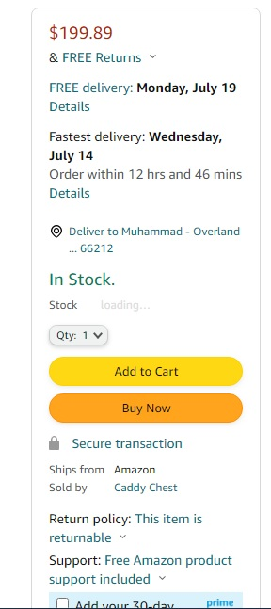
BUYBOX

Slide 60
Amazon Wholesale Business
We can create our own business from Pakistan
We can build Wholesale business in USA and a handsome profit almost 20% ROI
We can sell other established brands from Pakistan like Utopia, RDX and many others

Slide 61
Amazon Wholesale Business
01
02
03
04
05
SCALABLE BUSINESS MODEL
INVESTMENT FLEXIBILITY
LOW RISK
SUSTAINABLE BUSINESS
INSTANT PROFIT

Slide 62
For Freelancers and VAs
Importance
Invest on Yourself
You are the Brand
Endless Opportunity
Develop Income Stream
Offer your services (UpWork, Fiverr, Freelancer)

Slide 63
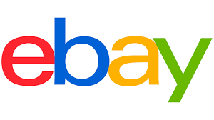
Coming Trainings in Ecommerce Galaxy

Slide 64
Thanks for Listening
Muhammad Usman Yousaf

