Slide 1
Formation of a Company
(Companies Act, 2017)

Slide 2
WHAT IS A COMPANY?
A Company is a legal entity formed by a person or association of persons for lawful purpose & registered under the Companies Act, 2017
It has following distinct characteristics:
  Separate legal entity.
  Limited liability (means liability of its members are limited to the extent of their share in the company).
  Perpetual succession (has an indefinite life).
The word “Company” can only be used for a body or a business
organization which is registered under the Companies Act. 2017
Mere use of the word “Company or Corporation” as a part of it
name like ABC & CO. or XYZ Corporation does not make it a company.

Slide 3
Why Corporatize ?
Benefits of Corporatization
Distinct legal entity.
Enjoy limited liabilities and protect your personal assets.
Elevated entity status (It is considered superior as compared to other forms of doing business like sole proprietorship or partnership)
Have long life enterprise with perpetual succession.
Work under defined legal frame work.
Have easy transferable ownership / shares.
Become a part of documented and regulated economy.
Enhance credibility with responsibility and accountability.
Enjoy better access to capital markets
Raise funds easily.

Slide 4
Market Trends:
SECP has experienced a significant increase in number of companies incorporated over the last 2 years especially in Ecommerce and IT sector.
More than 600 companies registered in Ecommerce sector .
Above 2500 companies working in information technology sector

Slide 5

Company Incorporation Process

Slide 6
Step-1
RESERVATION OF COMPANY NAME
Step-2
SUBMISSION OF DOCUMENTS FOR INCORPORATION

Slide 7
Reservation of Company Name
Conditions
The name should not be :
    Identical with or closely resemble to the name of a company;
    Inappropriate
    Undesirable;
    Deceptive;
    Designed to exploit or offend religious susceptibilities of the people
  Companies (Incorporation) Regulations, 2017 to get detailed information about the prohibited names or names allowed with certain conditions
The proposed name can be checked from the website/ e-Services portal using the search facility
Name reservation for 60 days

Slide 8

For Availability of Name & Incorporation

Slide 9

Offline
Online
Documents filed physically
eServices Module

Slide 10
Online Filing
Single Step Process
Combined Name Reservation and Company Incorporation
Multiple step Process
Step 1: Name Reservation
Step 2: Company Incorporation

Slide 11
Combined Name Reservation and Company Incorporation

Slide 12
Benefits of Combined Incorporation Process
Two in One: Two processes merged into one thereby saving time of one additional process
Speedy Processing: Application Processing in only 4 working hours after challan verification
Easy Application with no attachments except CNICs
System Generated MOA and AOA: No need to prepare Memorandum and Articles
No rejection of name
No need to add Primary users in the primary user e-services account

Slide 13
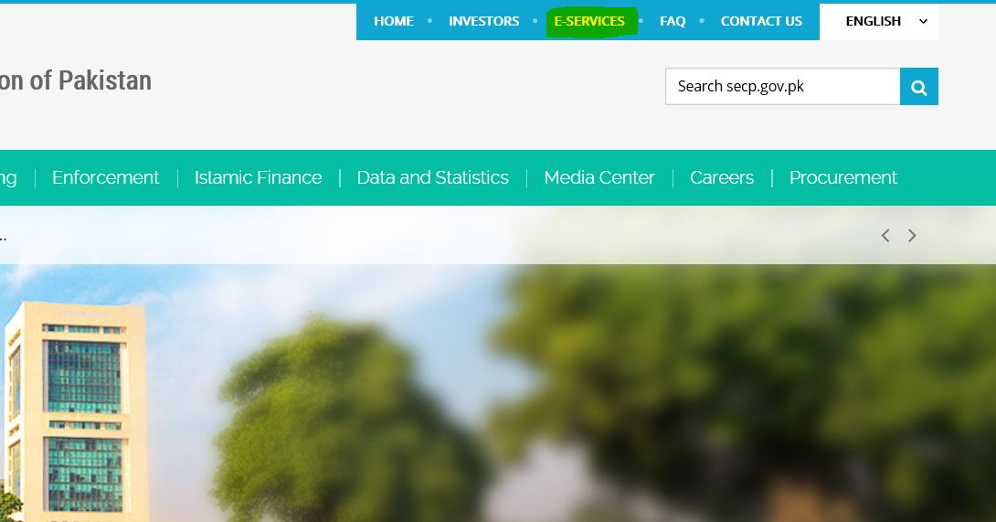
Online Filing
Step-1: Please visit our website i.e. www.secp.gov.pk & click on E-services option on top of it.

Slide 14
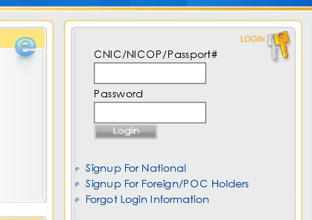
Online-Name Reservation
Step-2: On the e-services portal, create signup as a National or a Foreigner, depending upon on your requirement. After successful signup, a PIN will be generated which needs to be saved carefully.

Slide 15
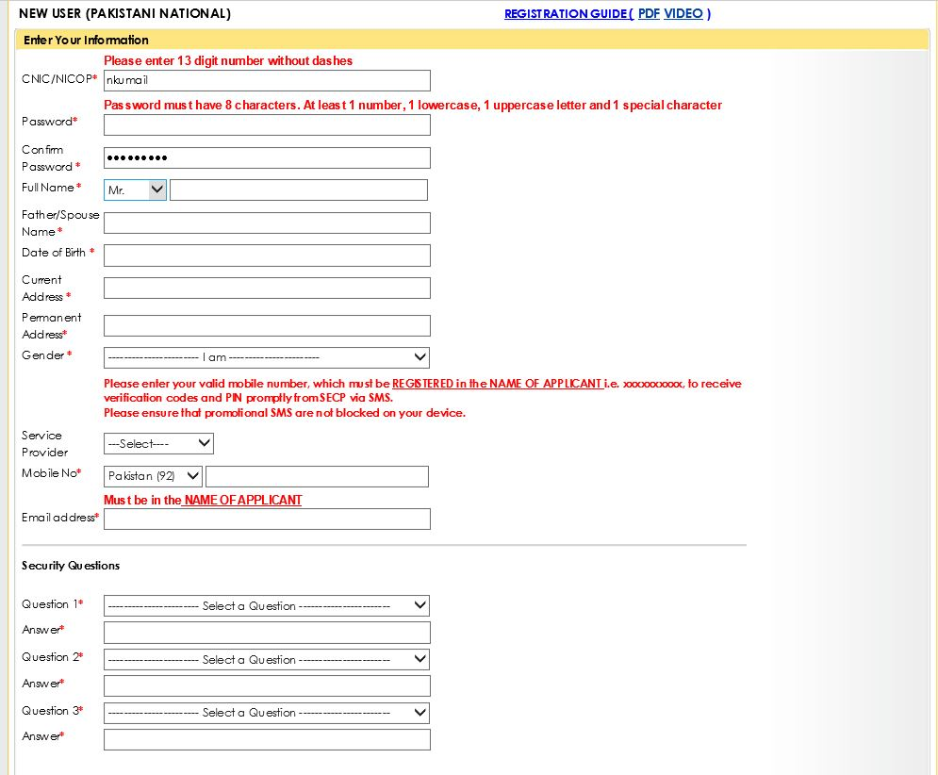
Signup Application Screenshot

Slide 16
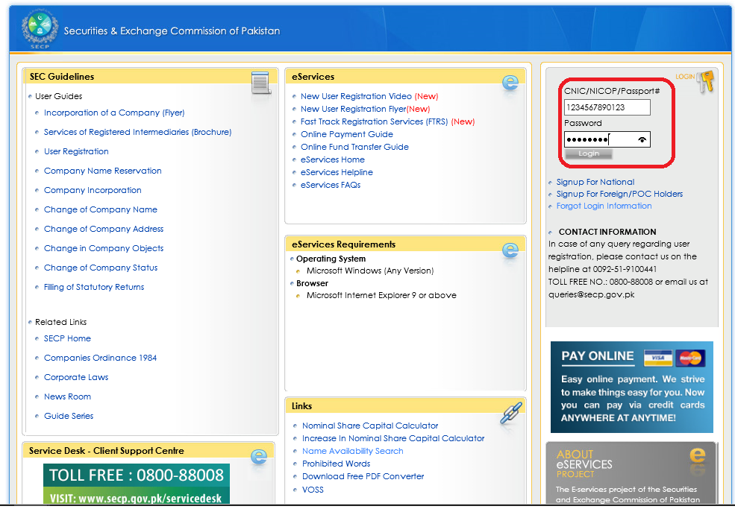
Login to User Account
Enter User ID and Password of the User and Login to his/her personal User Account.

Slide 17
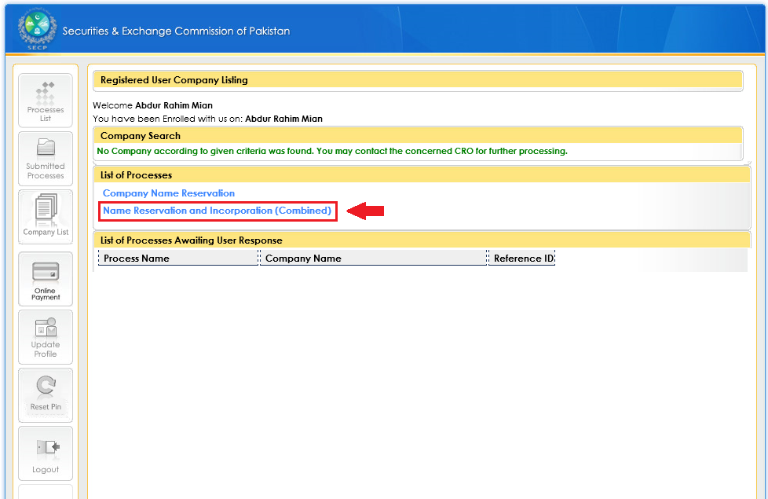
Opt for Combined Process
(Name Reservation and Incorporation)
Click “Name Reservation and Incorporation (Combined)” to start combined application.

Slide 18
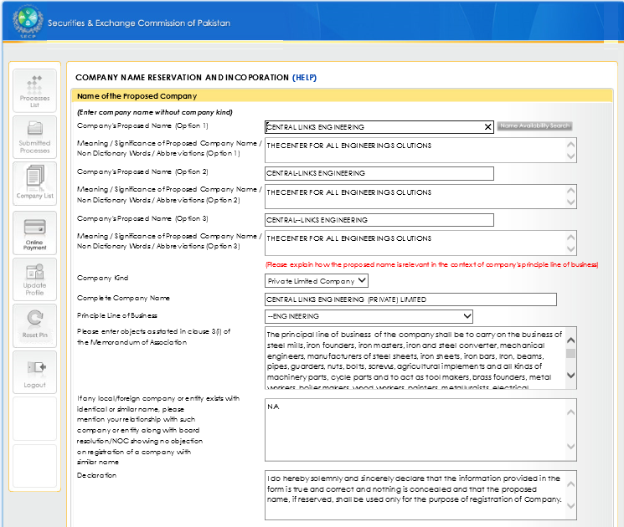
Application: Company Name Reservation Details
Enter data required for Company Name Reservation.

Slide 19
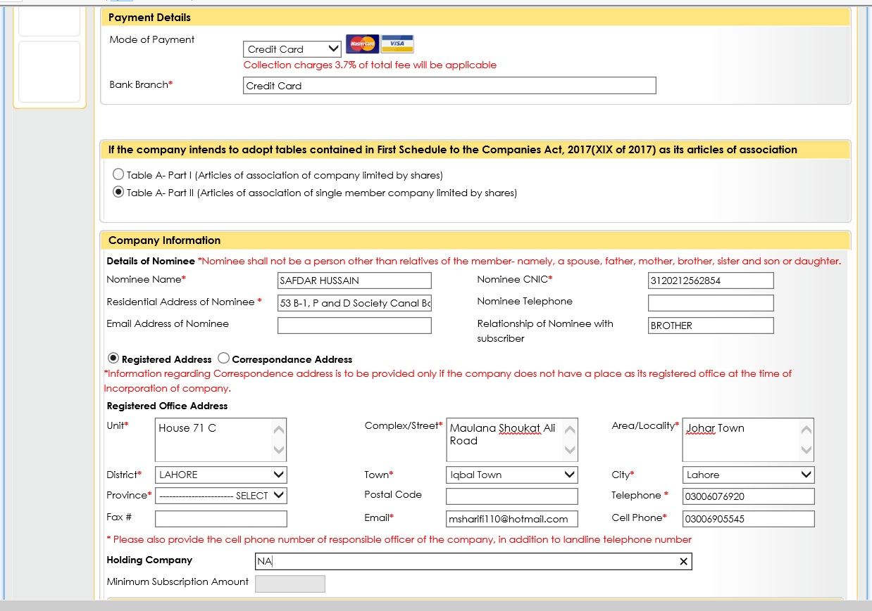
Application: Payment, Applicant, and Declarant Details
(Continued)
Enter the required data.

Slide 20
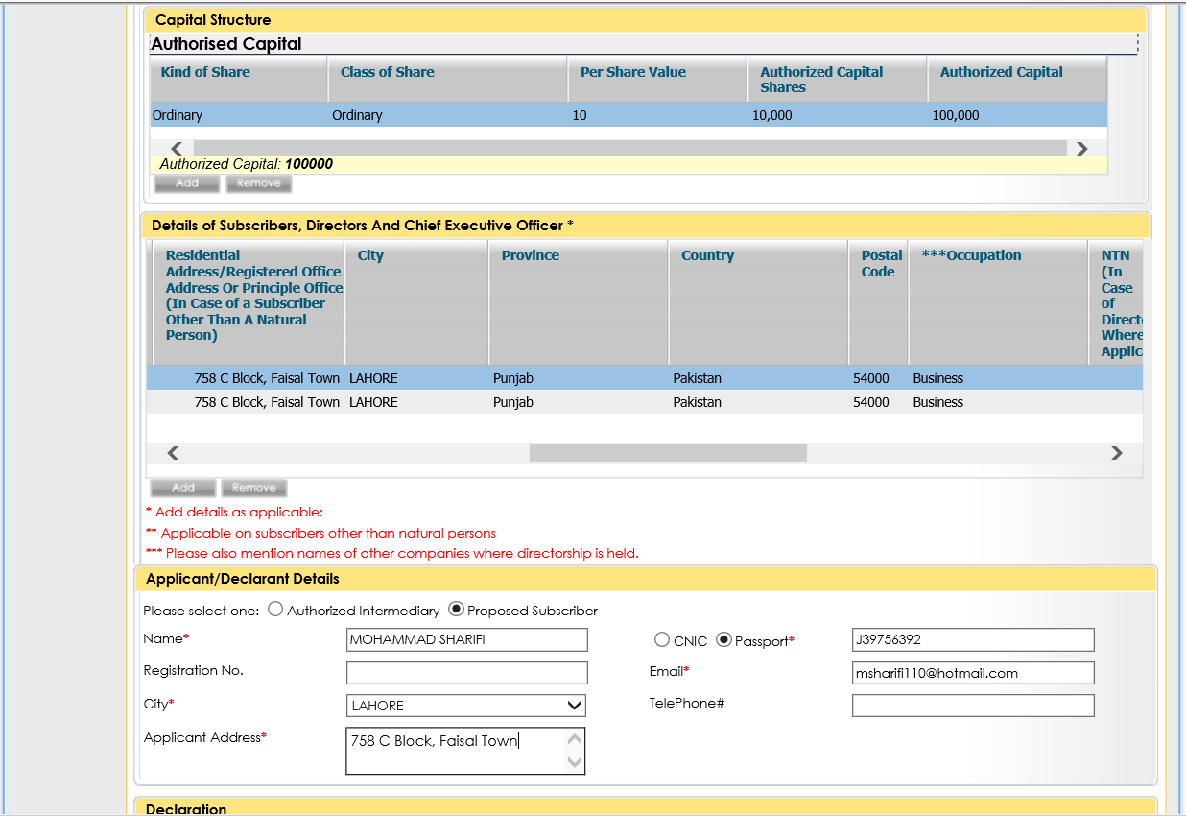
Application: Company Information
(Continued)
Enter the required Company Information.

Slide 21
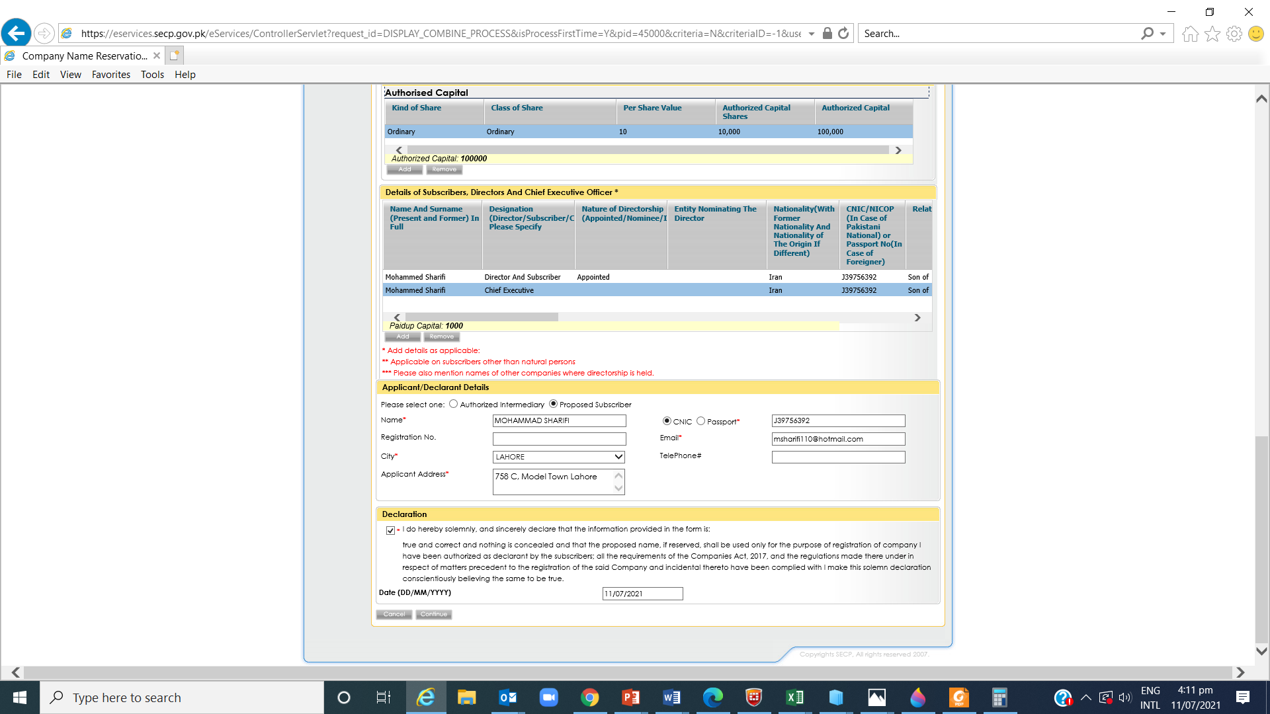
Application: Date & Signatory Details
(Continued)
Click “Continue” after completing the application form.

Slide 22
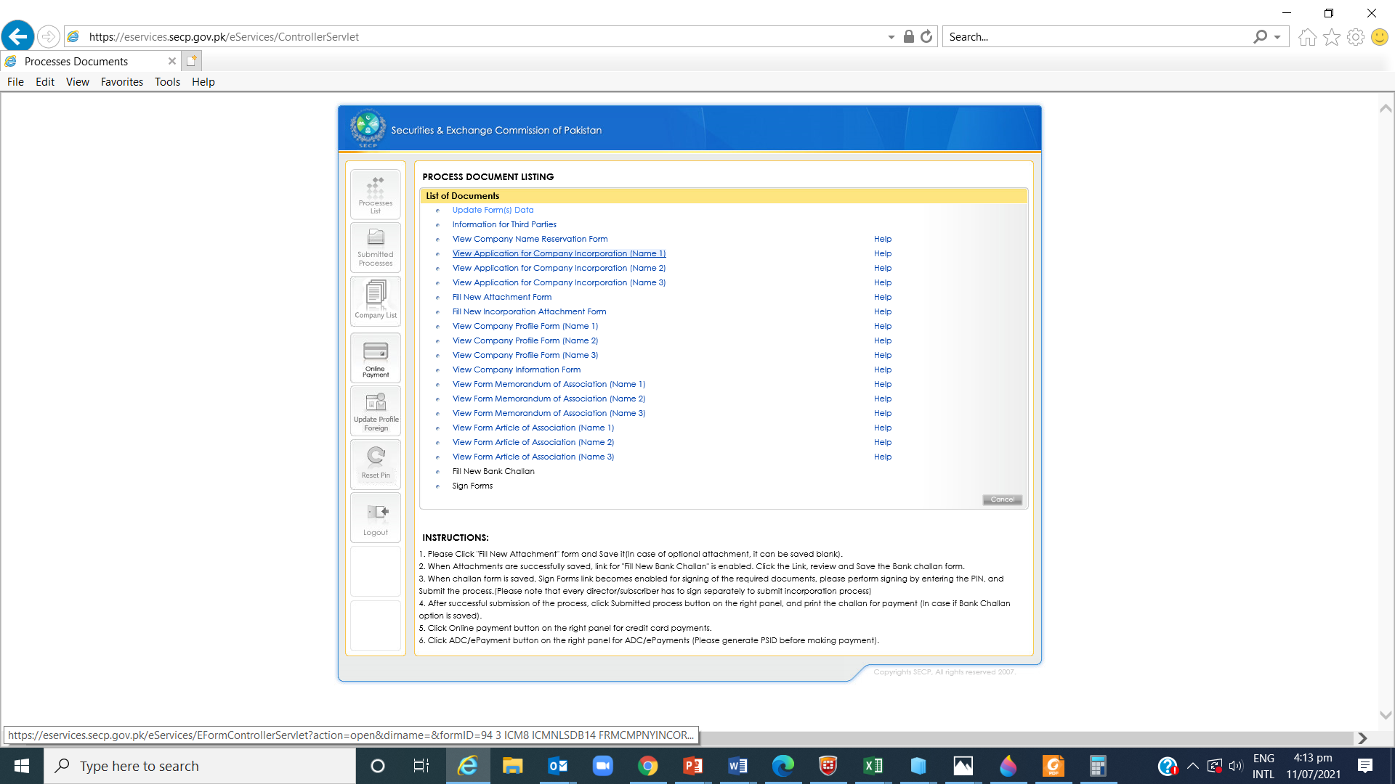
Update the application form if needed
Click “Update the Form(s) Data” to update the form if needed.

Slide 23

NTN and provincial related information
Click this and add information for all subscribers/directors for NTN purposes. Click Back to main screen after saving the data

Slide 24
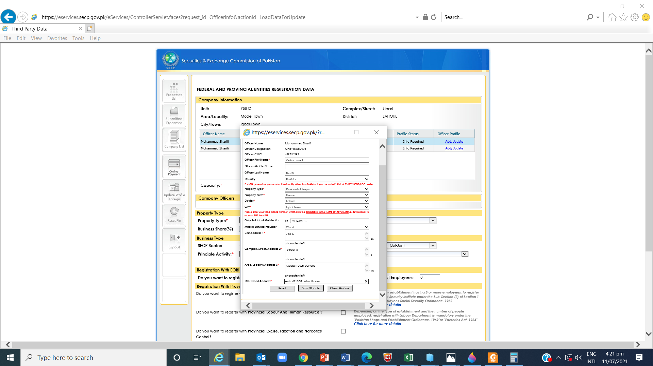
Continued

Slide 25
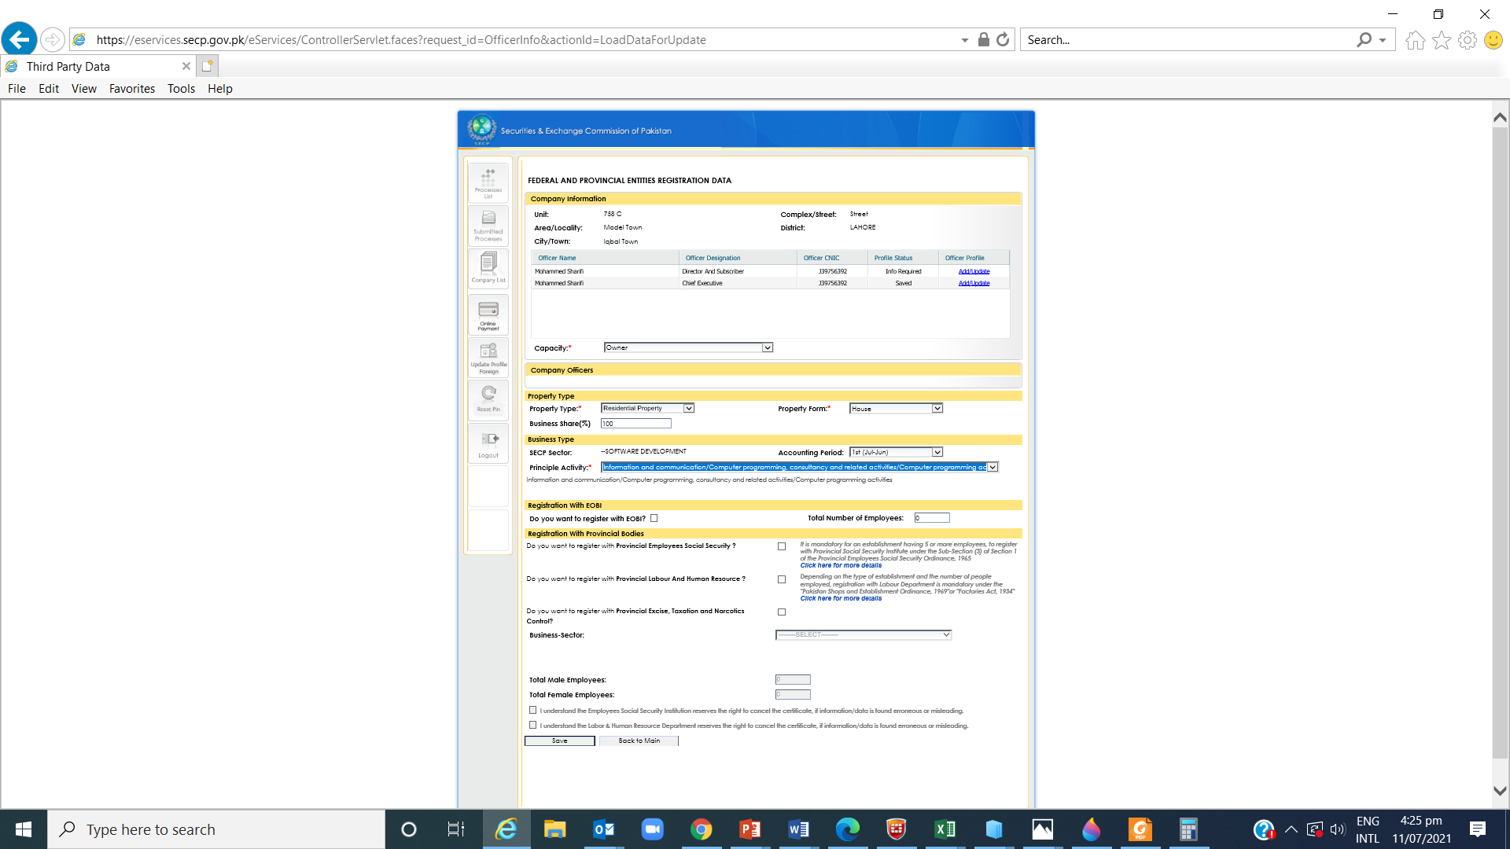
Continued

Slide 26
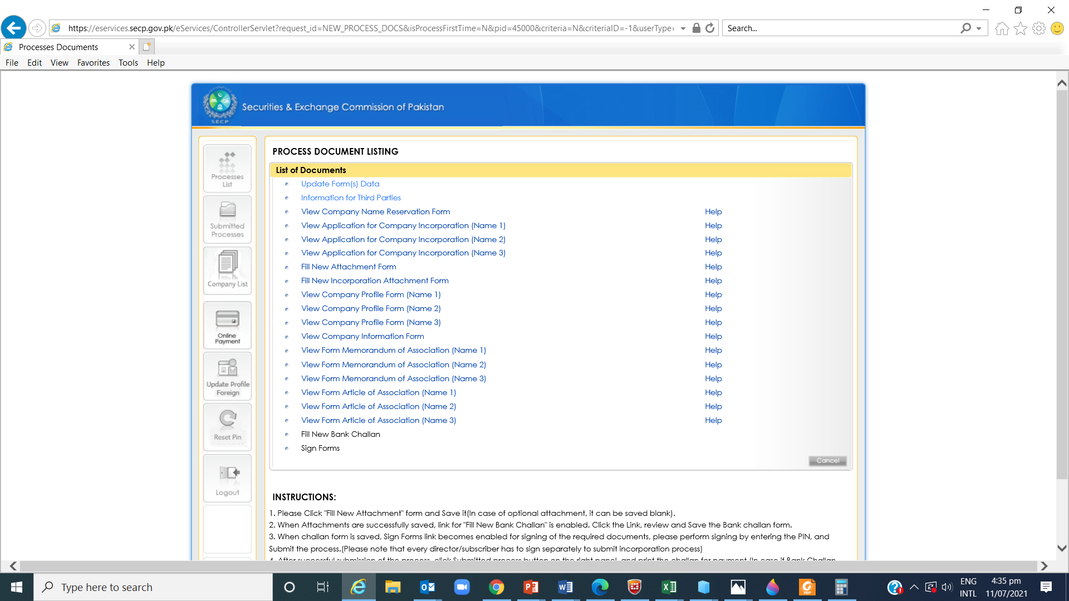
Attach CNICs/NICOPs/Passports of all subscribers and CEO

Slide 27
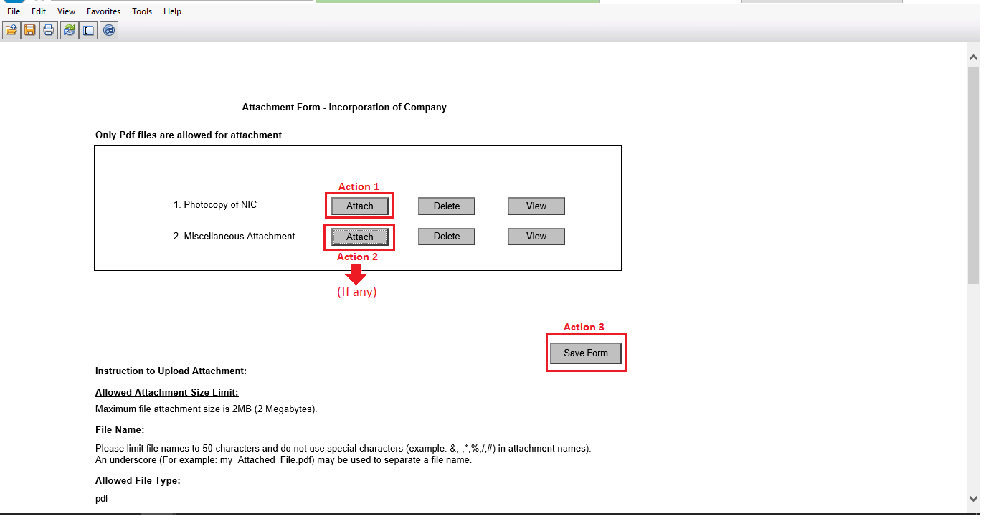
Attachment for Company Incorporation
(Continued)
Click “Attach” (Action 1) to attach CNICs of all the Directors/Subscribers, Representatives, CEO, Nominee etc.
Click “Attach” (Action 2) to attach other supporting documents if required.
Click “Save Form” to save the attachments.

Slide 28
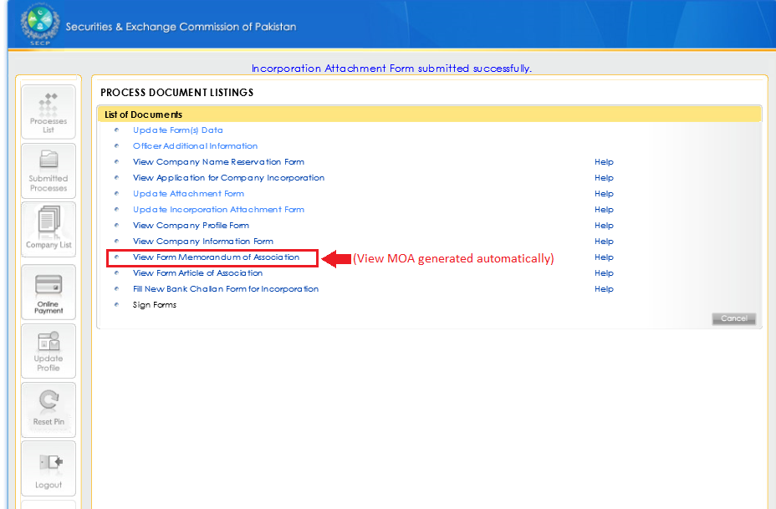
View MOA generated automatically
Click “View Form Memorandum of Association” to view MOA generated automatically.

Slide 29
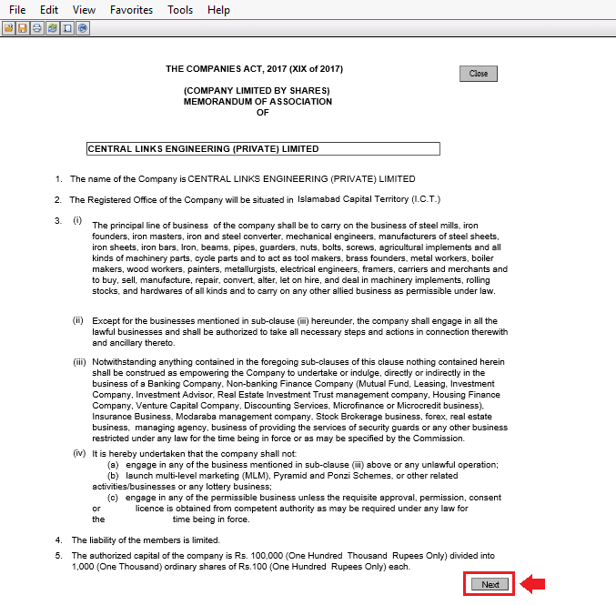
View MOA generated automatically
(Continued)
Click “Next” to view Subscribers Page of MOA.

Slide 30
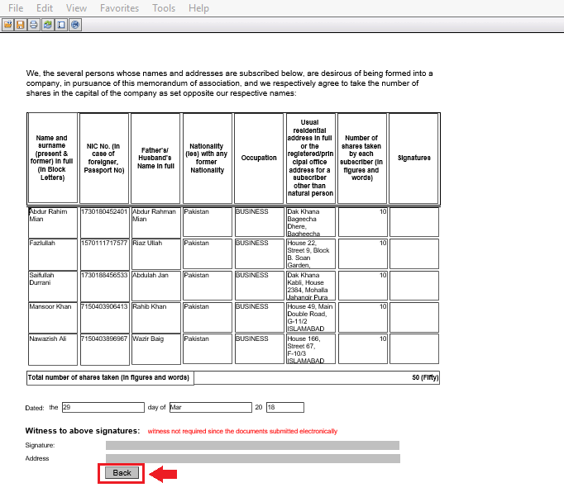
View MOA generated automatically
(Continued)
Click “Back” to go back to the main page of MOA.

Slide 31
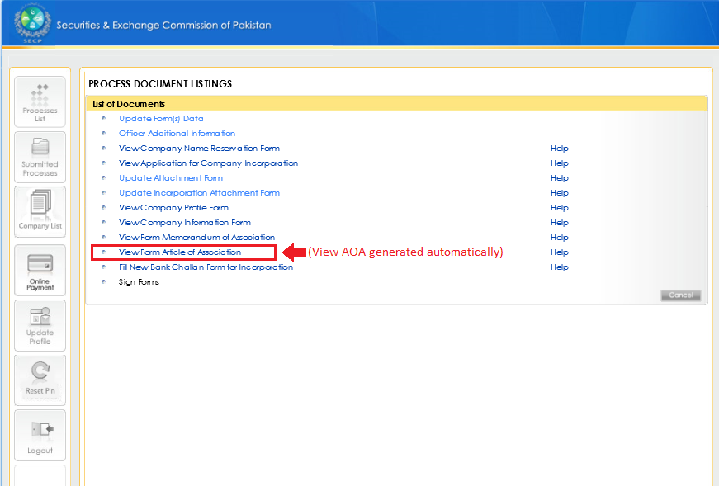
View AOA generated automatically
Click “View Form Article of Association” to view AOA generated automatically.

Slide 32
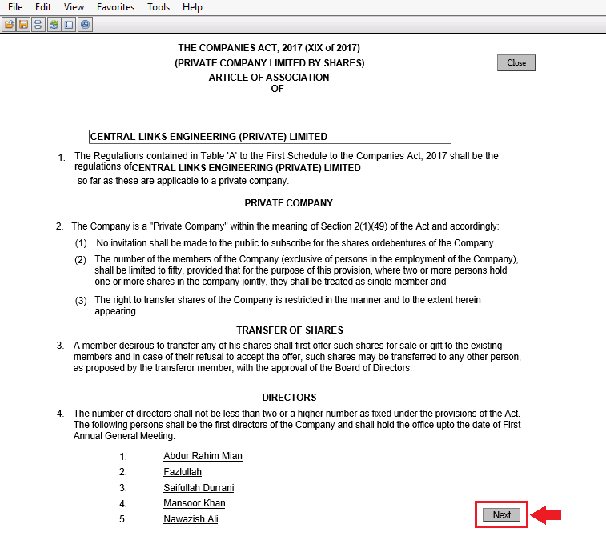
View AOA generated automatically
(Continued)
Click “Next” to view Subscribers Page of AOA.

Slide 33
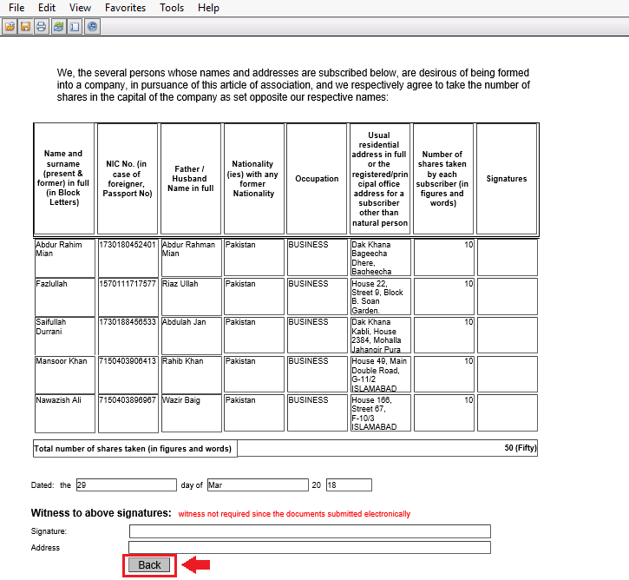
View AOA generated automatically
(Continued)
Click “Back” to go back to the main page of AOA.

Slide 34
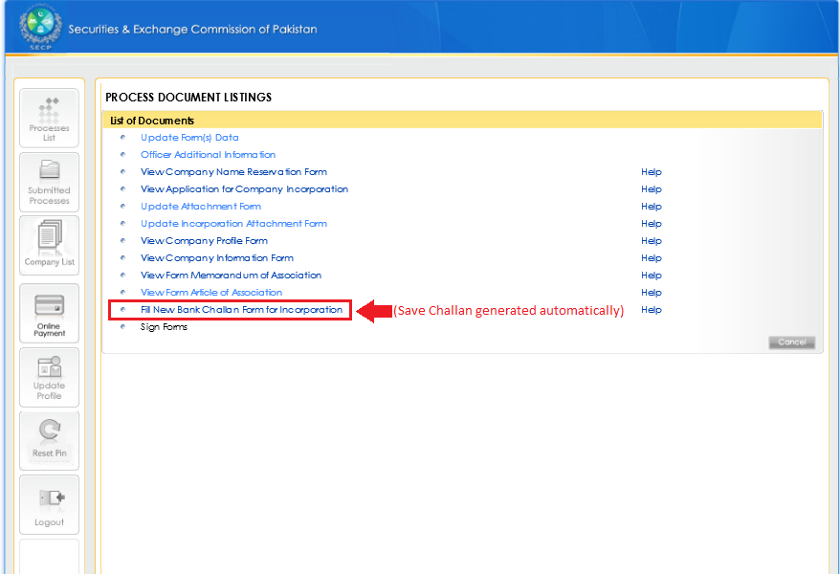
Open Bank Challan generated automatically
Click “Fill New Bank Challan Form for Incorporation” to open the Bank Challan generated automatically.

Slide 35
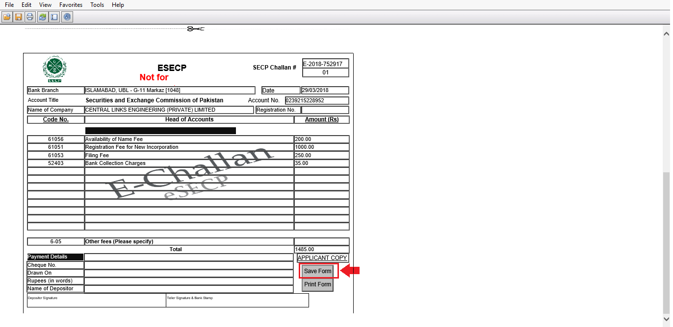
Save Bank Challan generated Automatically
Scroll down the page and click “Save Form” to save the Bank Challan generated automatically.

Slide 36
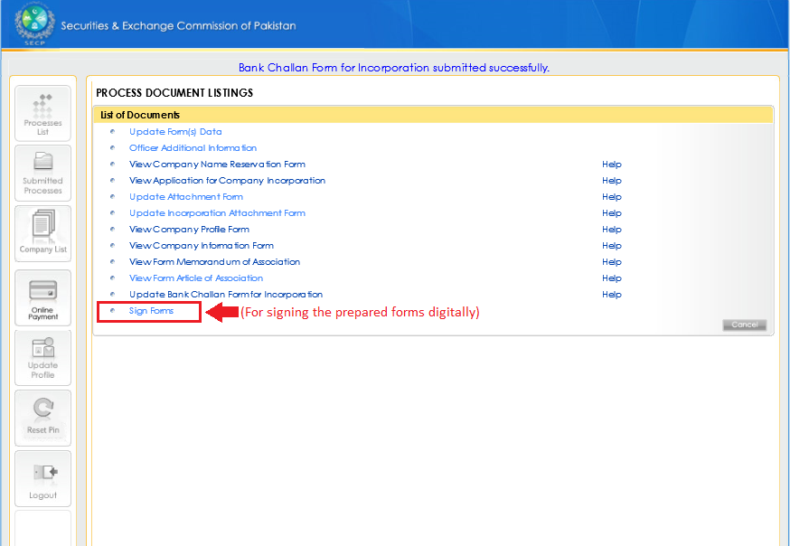
Sign Prepared Forms digitally
Click “Sign Forms” to sign the prepared forms digitally by entering PIN Codes.

Slide 37
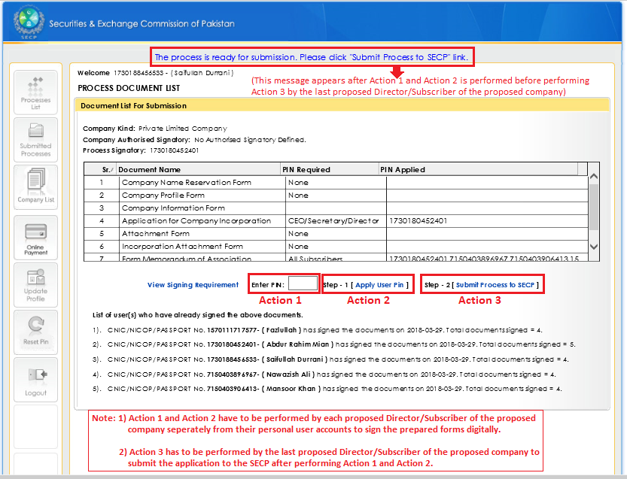
Enter User PINs, Apply User PINs, and Submit Process to SECP
Enter User PINs (Action 1), apply User PINs (Action 2) of Directors/Subscribers separately from their personal User Accounts and submit process to SECP (Action 3) from the last Director/Subscriber’s User Account.

Slide 38
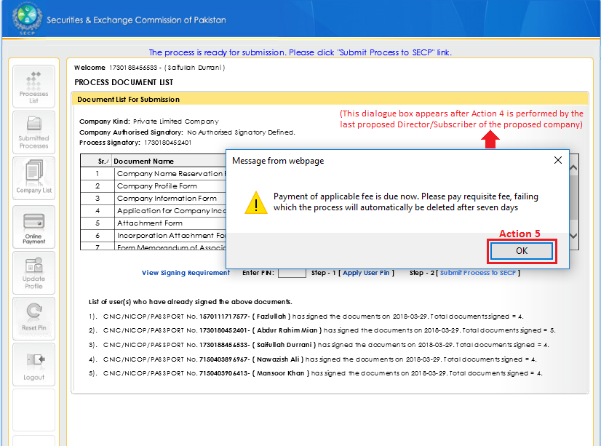
Due applicable fee payment intimation
Click “OK” (Action 5) after Action 4 has been performed from the last Director/Subscriber’s User Account.

Slide 39
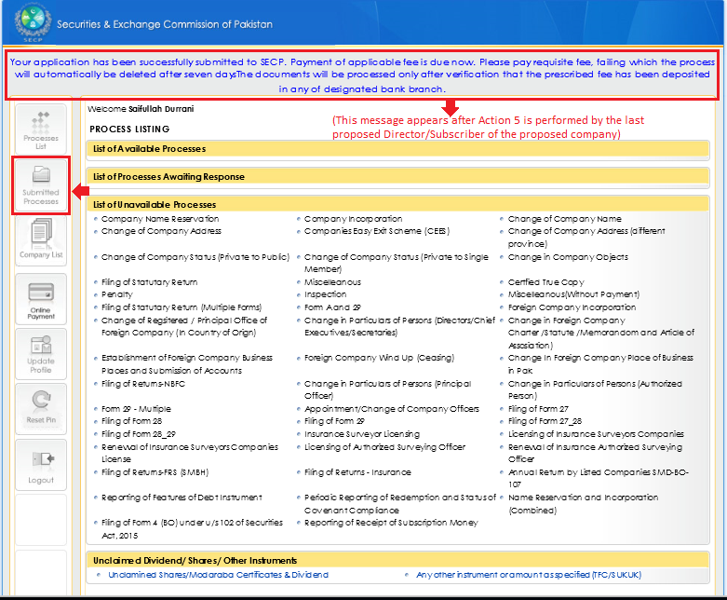
Taking printout of the Bank Challan saved
Click “Submitted Processes” to go to the Submitted Processes Menu.

Slide 40
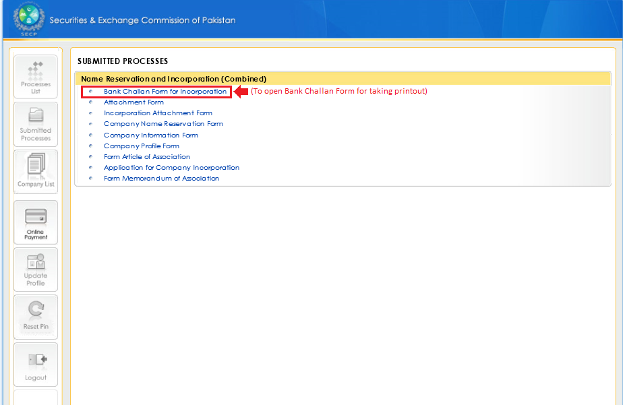
Taking printout of the Bank Challan saved
(Continued)
Click “Bank Challan Form for Incorporation” to open the Bank Challan saved.

Slide 41
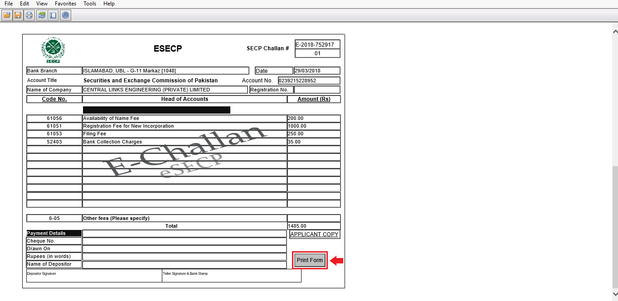
Taking printout of the Bank Challan saved
(Continued)
Click “Print Form” to open print preview window.

Slide 42
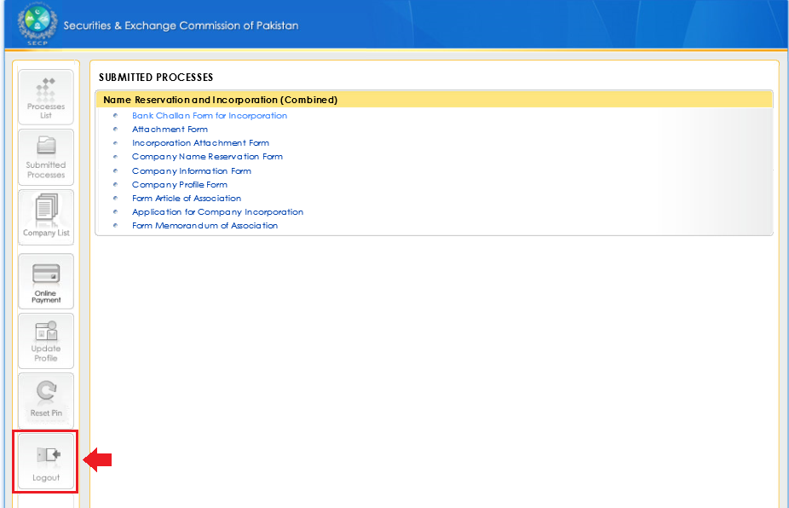
Logout of User Account
Click “Logout” to logout of the User Account.

Slide 43
After challan verification, documents are examined by SECP which may result is any of the following actions;
  Company is incorporated
  Company Registration is refused;
  Issue Resolution(further clarification is sought or advised to rectify any deficiency in documents)

Slide 44
ADDITIONAL REQUIREMENTS FOR FOREIGNERS
Security clearance is required for all the foreigners, who intend to register company/start business in Pakistan.
To cater this, SECP has devised a system in coordination with Ministry of Interior, for security clearance of foreigners at a faster pace.
Under this arrangement, every foreigner has to submit an undertaking on prescribed format, duly attested by notary public along with the application for incorporation.
In case of foreigner subscriber individual, Undertaking is also accompanied with the following set of documents;-
  9 copies of Bio data
  9 copies of Passport
  8 photographs
  9 copies of MOA/AOA,
  9 Copies of Inc. Form-II
  Proof of Ultimate Beneficial ownership in case of more than 25% of shareholding interest in proposed company in compliance with S.R.O Dated 927(I)/2020-Amendments in Companies Incorporation Regulations 2017

Slide 45
ADDITIONAL REQUIREMENTS FOR FOREIGNERS
In case of foreigner subscriber company, Undertaking is also accompanied with the following set of documents;-
  Proof of registration of foreign company duly attested notarized and attested by Pakistan Embassy in the country of origin. (• Original Proof of registration of foreign company as well as charter/statute/Memorandum & Articles of Association and other documents/instruments as per regulation 15 of Incorporation regulation2017 duly attested notarized as well as authenticated by Pakistan diplomatic consular or consulate office in the country of origin)
  BOD Resolution by the foreign company, through which it has been authorized to become subscriber of the local company and to appoint authorized representative to sign MOA/AOA and undertaking.
  9 copies of profile of the foreign company containing details about its business, registered office address and other contact details.
  9 copies of List of directors in the foreign company along with their nationalities and country of origin.
  9 Copies of Memorandum and Articles of Association & Form-II (Application for company incorporation)
  9 copies of Bio Data of nominee/authorized person (must contain the contact details)
  Proof of Ultimate Beneficial ownership in case of more than 25% of shareholding interest in proposed company in compliance with S.R.O Dated 927(I)/2020-Amendments in Companies Incorporation Regulations 2017

Slide 46
Completion of Incorporation and NTN Registration Process
On successful completion of the Process;
You will receive an e-mail form SECP that your company has been incorporated with digital incorporation certificate.
An e-mail form FBR at company and director’s e-mail containing Login ID, Password and PIN.
Open FBR website e-Services Online verification Portal Online NTN/STRN Inquiry Enter Company Registration No. Or CNIC and NTN details will appear on screen
Open FBR website Open Iris (https://iris.fbr.gov.pk/infosys/public/txplogin.xhtml)
Login using User ID and Password received through e-mail submit Form appearing in Drafts Tab order u/s 181 of ITO will appear in Completed Tasks tab

Slide 47
Post Incorporation Requirements
Payment of subscription money
Payment of subscription amount within 30 days to the company –and reported to the registrar concerned within 45 days on Annexure VII of Incorporation Regulations, 2017 alongwith Certification of receipt of money by a practicing CA or ICMA within 45 days [section 17(3)]
Declaration of ultimate beneficial ownership on Form 45 to be filed within 45 days of Company Incorporation.

Slide 48
Initiatives taken by SECP for the promotion of Corporate Sector and Facilitation of Foreign Investors
1. Revolutionary changes
- Friendly environment.
- Efficient, smooth and swift services.
- Incorporation of companies has been made much easier.
- On-line as well as off-line system for easy company formation.
- Guidance to the public on personal visit & even on telephone.
- Designated facilitation officers for guidance
- Introduced its WhatsApp Channel for Business Care through help line number 03069365625
-

Slide 49
Revolutionary Changes- Continued-
- Launched combined digital registration with provincial agencies including Punjab Employees Social Security Institution (PESSI), Sindh Employee Social Security Institution (SESSI), Labour and Human Resource Departments and Excise & Taxation Department of Punjab and Sindh.
- Nominal Fee
- NTN registration

Slide 50
Initiatives taken by SECP for the promotion of Corporate Sector and Facilitation of Foreign Investors
2. Interaction with the professional bodies such as chambers of commerce and the corporate sector through seminars, workshops & meetings etc.
3. Company Formation Desk at Exhibitions. Periodic Facilitation Desks in different cities & at different forums.
4. WEBSITE (www.secp.gov.pk): company name search facility;
All the laws, rules, circulars, regulations, guidelines & guide books are placed on the website for public facilitation.
5. Frequently Asked Questions:-
To provide further facilitation to the end users of eServices
Frequently Asked Questions (FAQs) were developed and placed
on the SECP website. https://eservices.secp.gov.pk/eServices.

Slide 51


