Slide 1


Slide 2

Cantonment Board Sialkot

Slide 3
Maternity Center/CGH

Slide 4
Aim
To brief Sialkot Chamber of Commerce regarding Maternity Center/CGH at Masjid Road and SWM

Slide 5
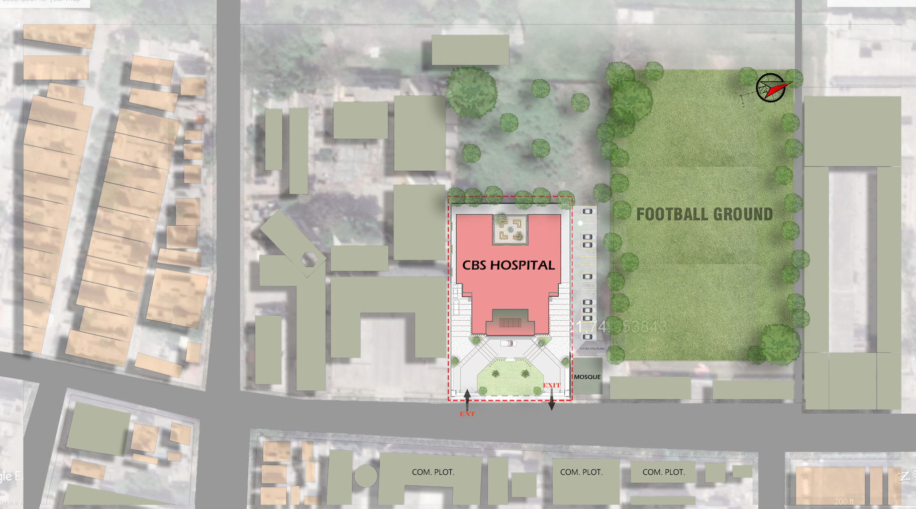
Maternity Center/CGH
5

Slide 6
Maternity Center/CGH
6

Slide 7
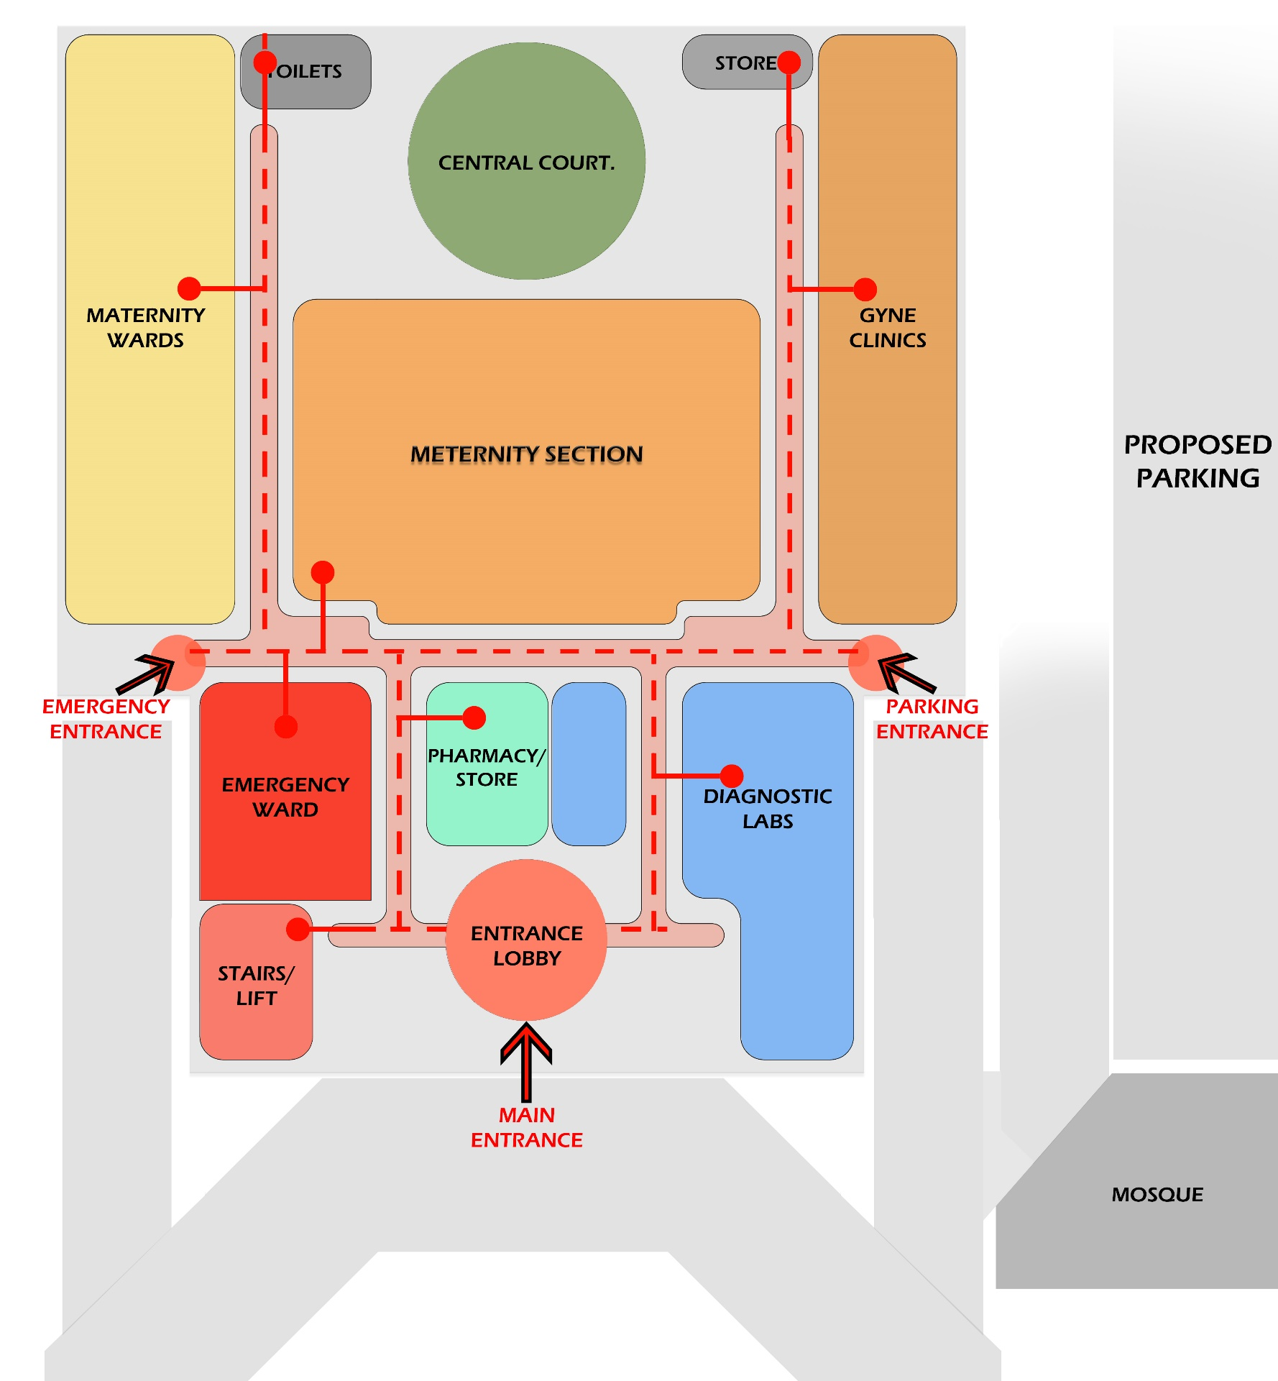
Maternity Center/CGH
7

Slide 8
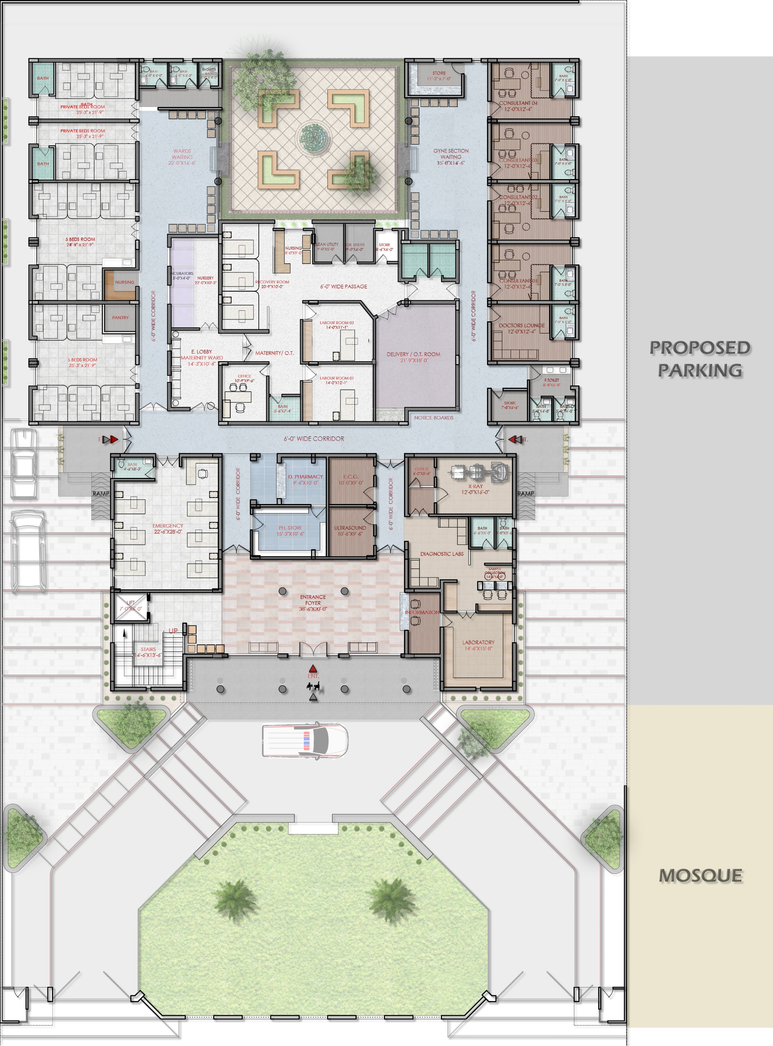
Maternity Center/CGH
8

Slide 9
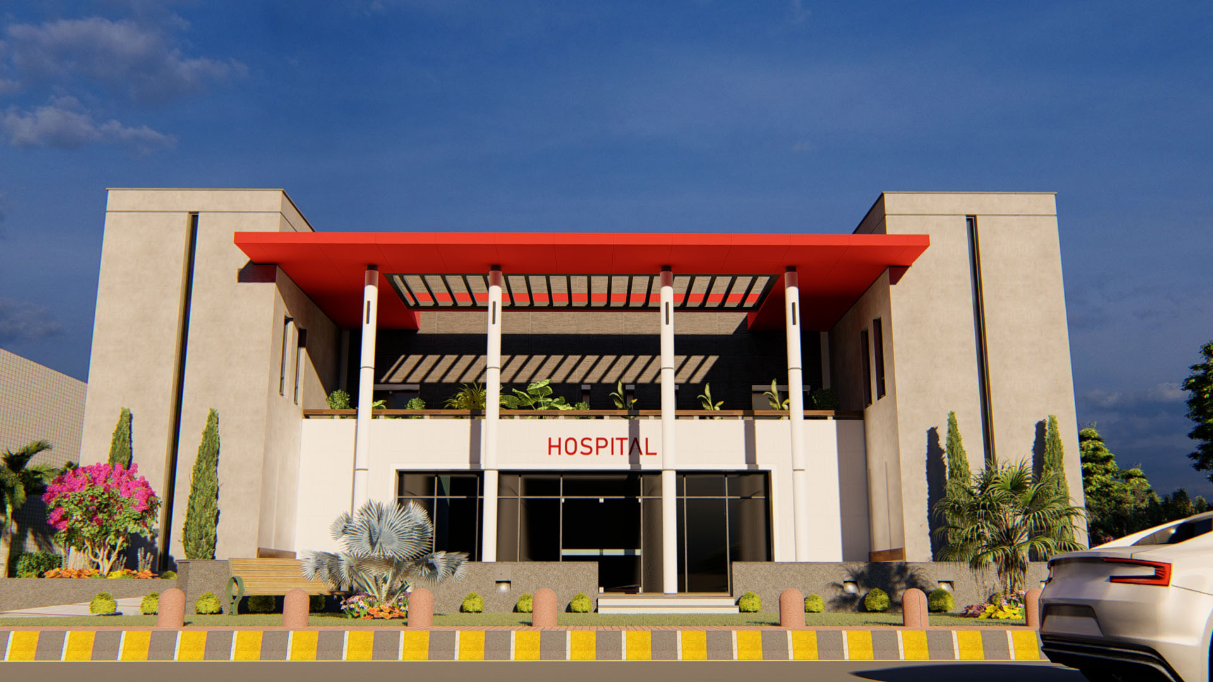
Maternity Center/CGH
9

Slide 10
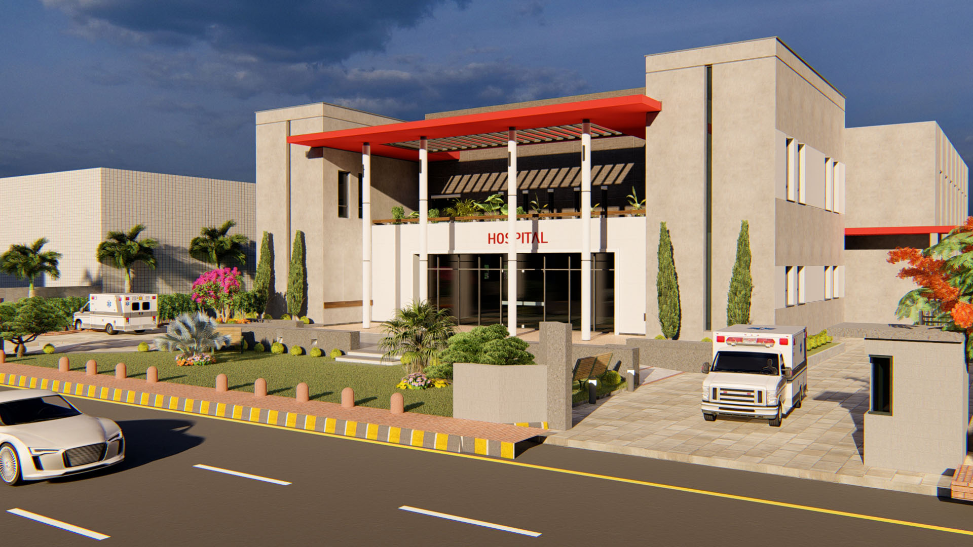
Maternity Center/CGH
10

Slide 11
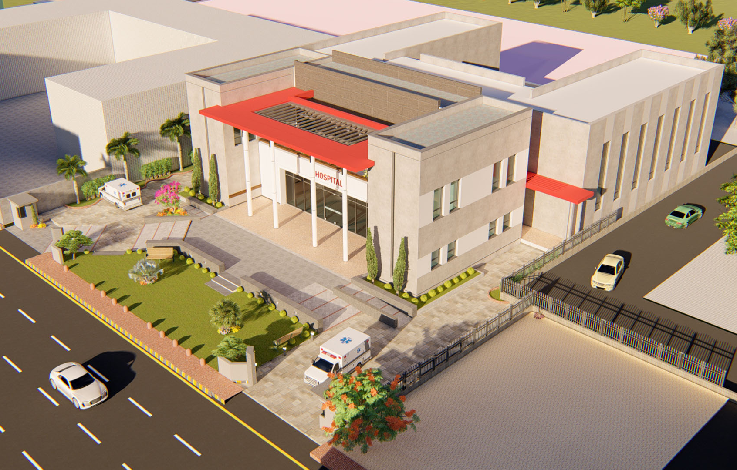
Maternity Center/CGH
11

Slide 12
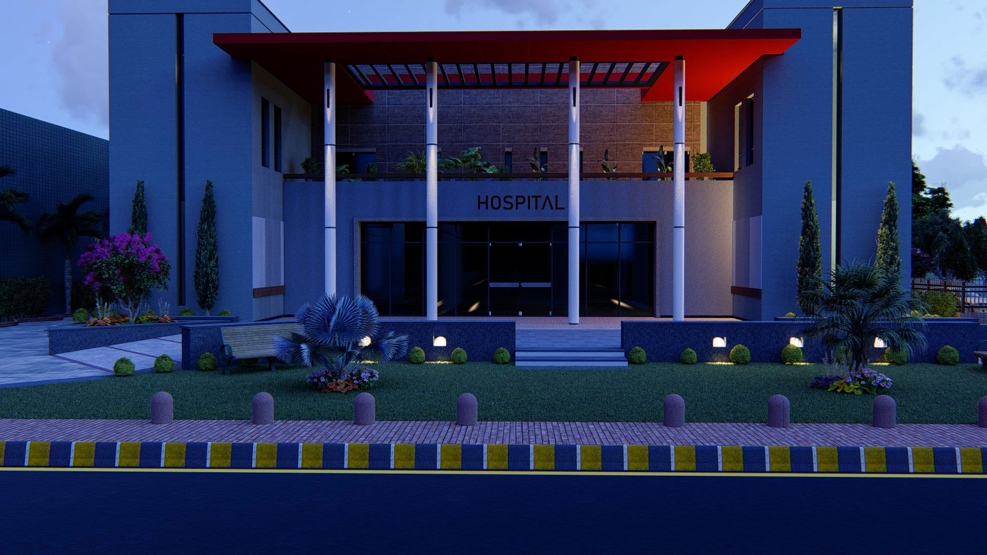
Maternity Center/CGH
12

Slide 13
Maternity Center/CGH
Facilities:-
First stage/ observation room in labor & Delivery unit
Blood Bank, Blood Transfusion
Assessment room with consultant room
Delivery & Sterilization Room
Minor OT in emergency
Modular OT
Administration Block
Diagnostic Center

Slide 14
Maternity Center/CGH
Special Biochemistry Lab
Micro Biology Lab
Physiotherapy Department
General OPD
Immunization Center
Nursery

Slide 15
Maternity Center/CGH
Gynae OPD
No. | Description | Quantity | Est Amount (M)
1 | Furniture (Waiting Area, Reception Consultant Office, Nursing Stations) |  | 1
2 | Electric Exam Couch | 1 | 0.25
3 | Examination Couch | 4 | 0.12
4 | Patients Stool | 10 | 0.5
5 | Examination Light | 2 | 0.13
6 | X Ray Viewer | 5 | 0.062
7 | C T G Machine | 1 | 0.24
8 | U S G Machine With Probes |  | 1.5
9 | Fetal Doppler | 1 | 0.025
10 | Hospital Management System |  | 3
Total |  |  | 6.8

Slide 16
Maternity Center/CGH
Labour and Delivery
No. | Description | Quantity | Est Amount (M)
1 | Electric Labour Bed | 1 | 0.3
2 | Labour Instruments Set |  | 0.5
3 | Cardiac Monitors With 9 Parameters | 15 | 2.6
4 | OT Table | 1 | 0.5
5 | OT Light | 1 | 0.4
6 | OT Equipment's |  | 8.0
7 | OT Structure |  | 2.0
8 | Anesthesia Machine | 1 | 1 .0
9 | Air Washer |  | 0.2
10 | Sterilizer | 1 | 1.0
Total |  |  | 16.5

Slide 17
Maternity Center/CGH
Diagnostics
No. | Description | Quantity | Est Amount (M)
1 | C R System | 1 | 3.0
2 | X Ray 500 Mah | 1 | 8.0
3 | Portable X Ray | 1 | 2.8
4 | Furniture |  | 0.8
5 | Immuno Assay Fouroscent Machine | 1 | 0.6
6 | Biored PCR | 1 | 3.0
7 | Lab Minor Equipment's |  | 1.0
8 | Generator 50 KVA | 1 | 8.0
9 | Ambulance | 1 | 5.0
Total |  |  | 32.2

Slide 18
Maternity Center/CGH
Gynae Ward
No. | Description | Quantity | Est Amount (M)
1 | Furniture |  | 1.4
2 | Patients Bed Electric With Side Table | 20 | 3.3
3 | I V Stand | 34 | 0.17
4 | Over Head Table | 20 | 0.5
5 | Bed Screen | 22 | 0.33
6 | Foot Step | 20 | 0.1
7 | Emergency Trolly | 2 | 0.13
8 | Anesthesia Trolley | 2 | 0.17
9 | Medicine Trolley | 3 | 0.27

Slide 19
Maternity Center/CGH
Gynae Ward
No. | Description | Quantity | Est Amount (M)
10 | Instruments Trolley | 3 | 0.3
11 | INFANT WARMER/Incubators | 18 | 1.8
12 | Hospital Baby Bed | 8 | 0.12
13 | Nursery Equipment's |  | 1.0
14 | Misc. Items( Central Oxygen) |  | 1.5
Total |  |  | 11.09

Slide 20
Solid Waste Management

Slide 21

Solid Waste Management

Slide 22
Solid Waste Management
Military Areas:
‘Pilot Project’ initiated/ launched in following selected area
  Quaid-e-Azam Road
  Ghazi Road
  Clover Model Colony
  Sarwar Road
  Ramzan Lines

Slide 23
Solid Waste Management
Civilians:
Pilot Project as Phase II will be initiated/ launched in following selected area
  Ghazi Road
  Quaid-e-Azam Road
  After successful implementation of Pilot Project. SWM Program will extend to the rest of the Sialkot Cantonment

Slide 24
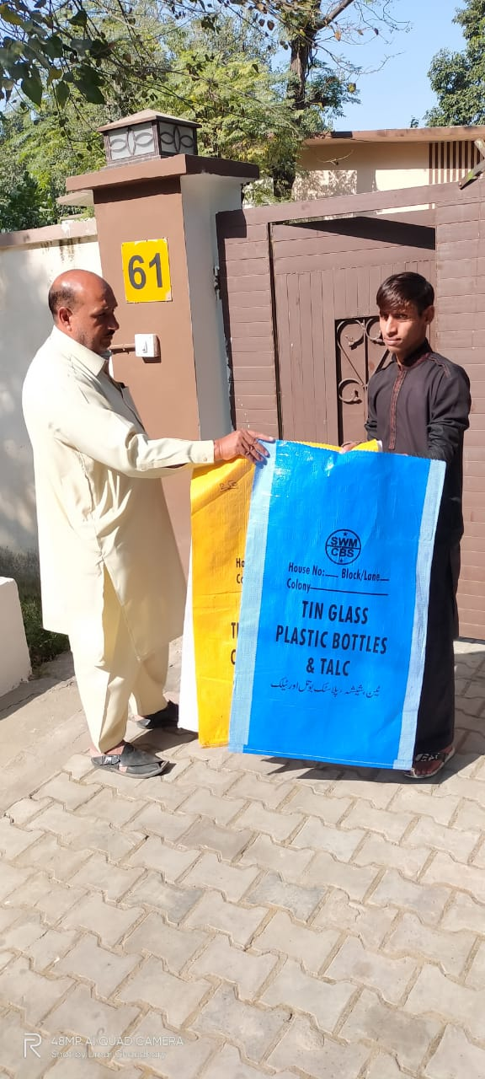
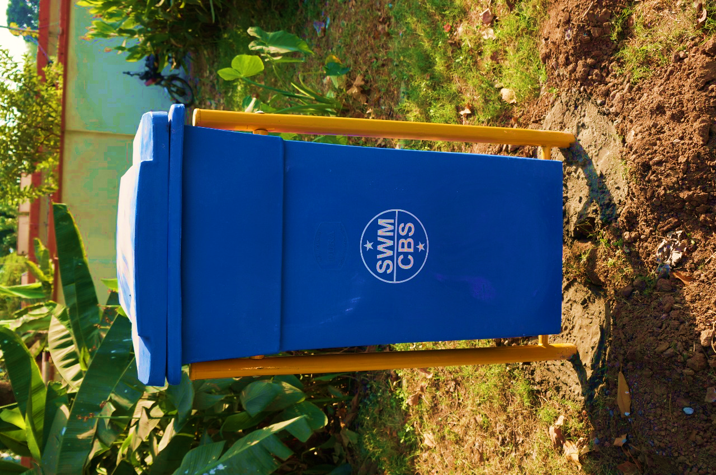
Solid Waste Management

Slide 25
Thanks

Slide 26
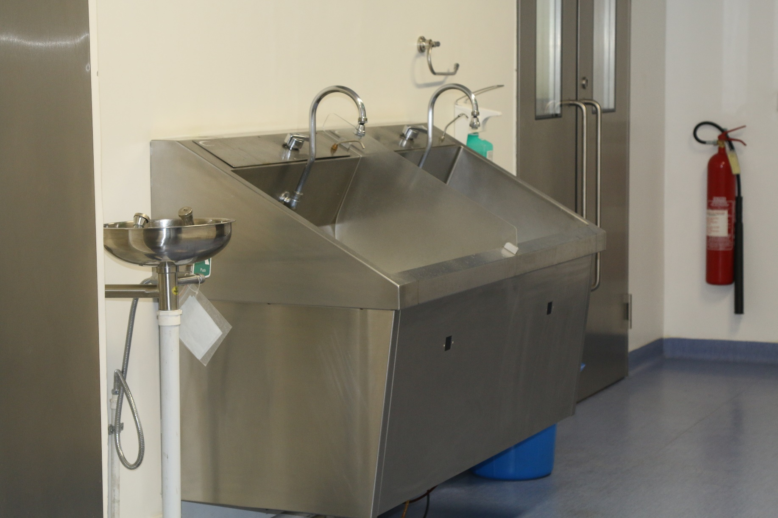
Maternity Center/CGH
Scrub Unit
26

Slide 27
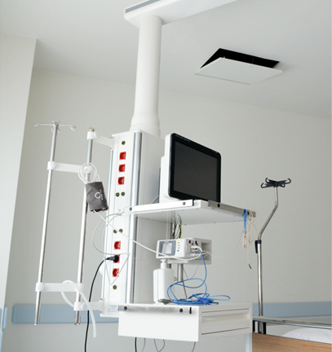
Maternity Center/CGH
Pendant
27

Slide 28
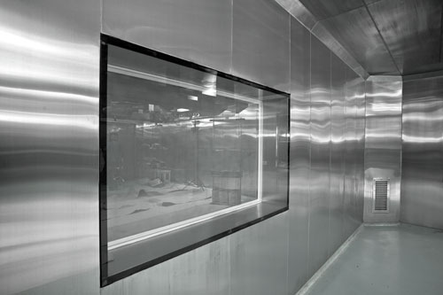
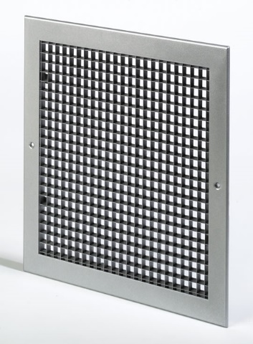
Maternity Center/CGH
Wall Clading
28

Slide 29
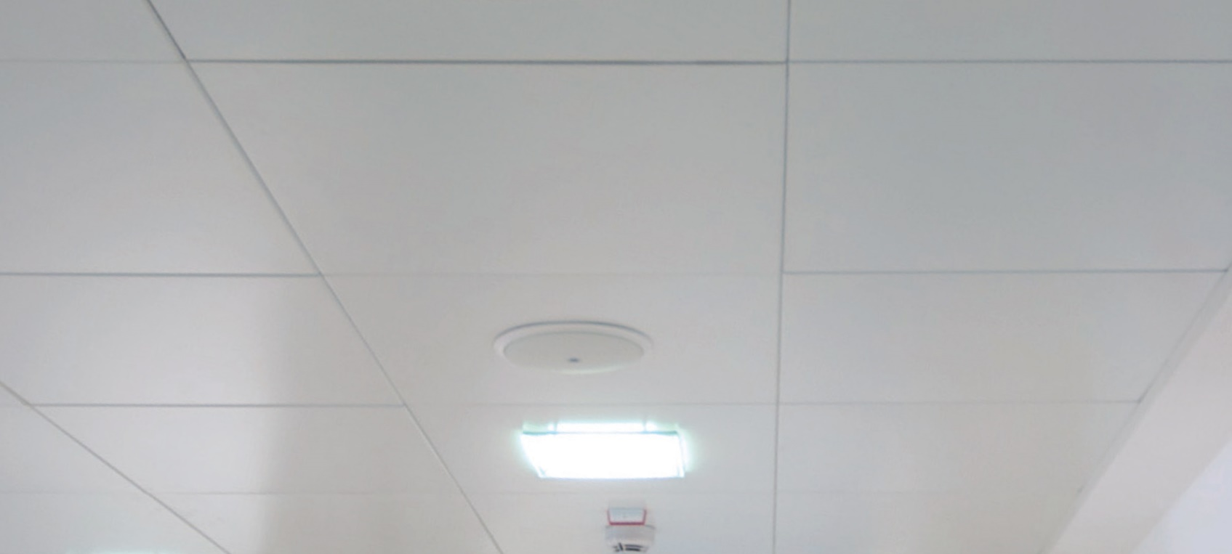
Maternity Center/CGH
Dampa Ceiling
29

Slide 30
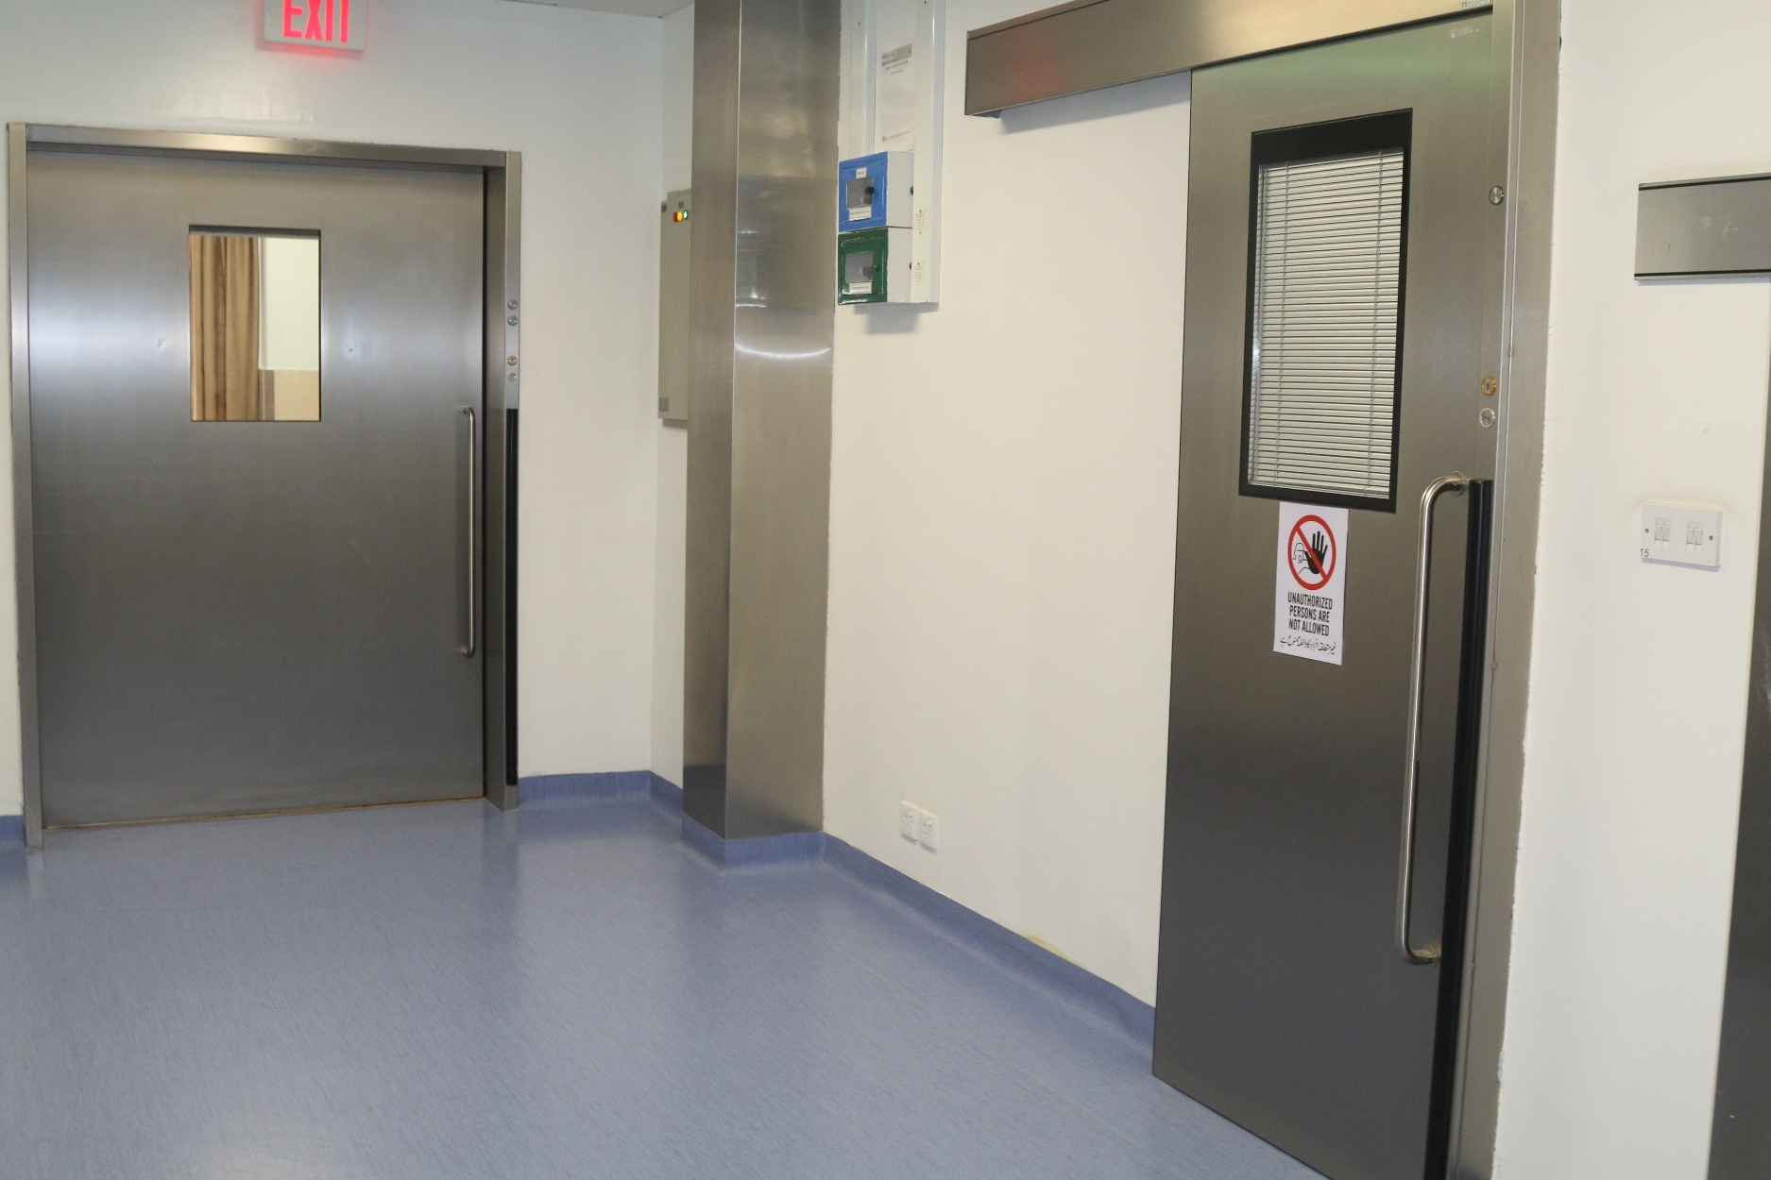
Maternity Center/CGH
Automatic Sliding Door
30

Slide 31
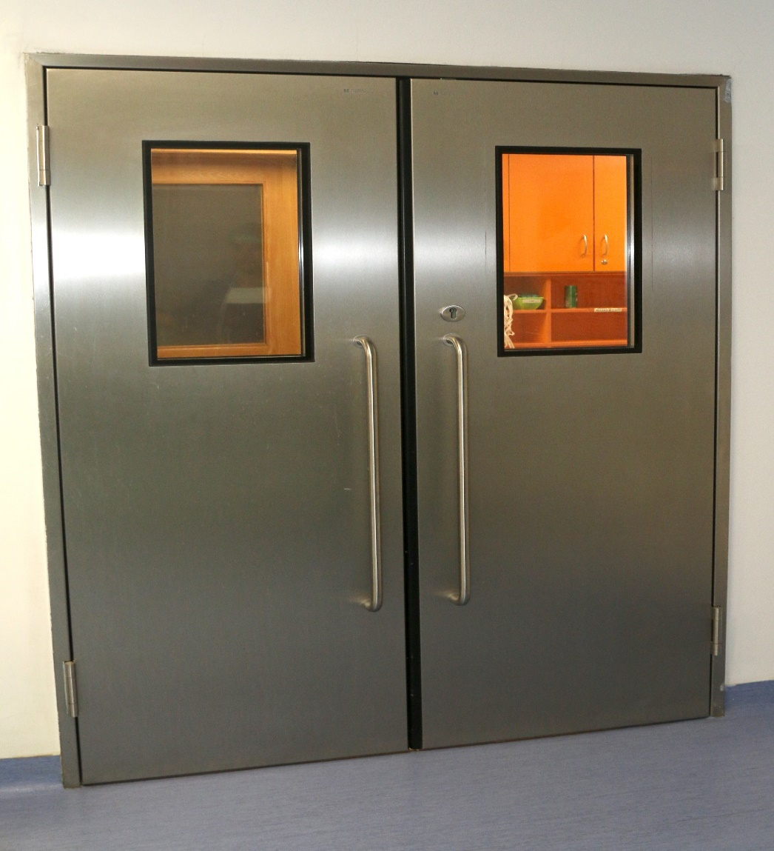
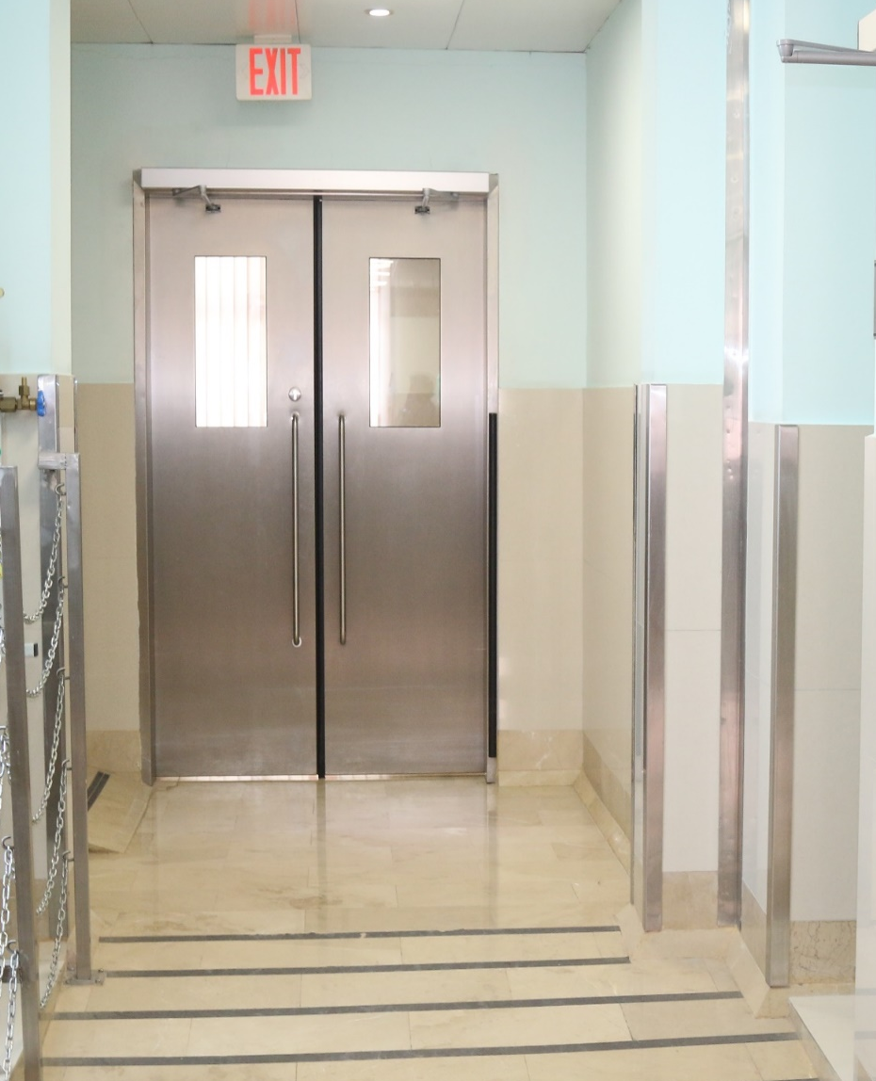
Maternity Center/CGH
Automatic Hinged Door
31

Slide 32
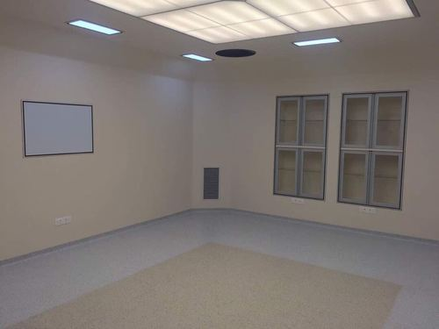
Maternity Center/CGH
Cabinets and X-Ray viewer
32

Slide 33
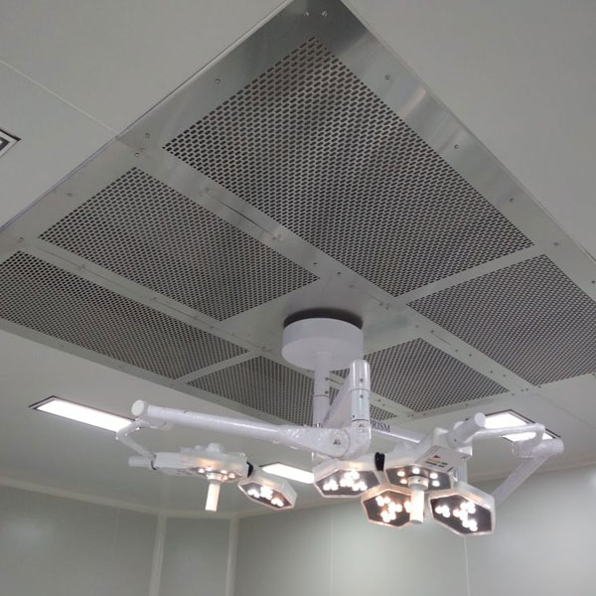
Maternity Center/CGH
Laminar Air Flow
33

Slide 34
Maternity Center/CGH
Laminar Air Flow
HEFA Filters
Positive pressure – 25pa
Temperature 20 – 22 Deg Celsius
Relative humidity 55 – 65
Air change 30 min – no turbulence
34

Slide 35
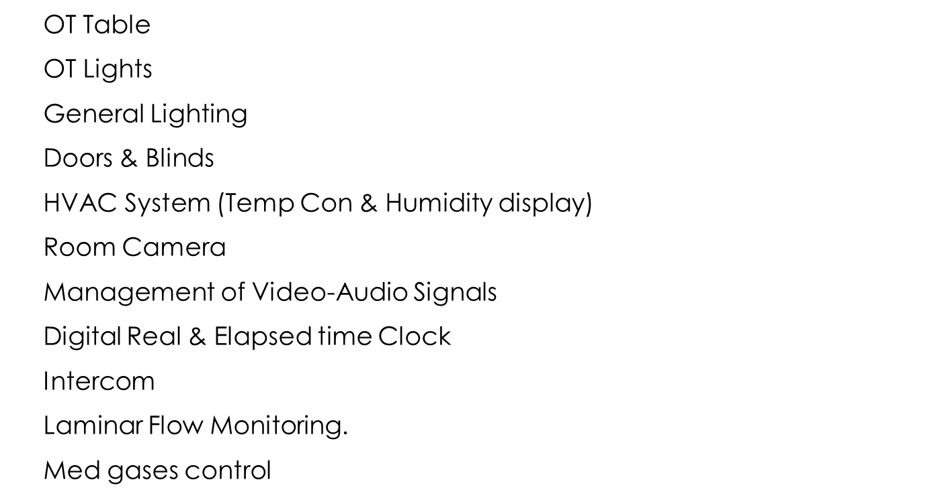
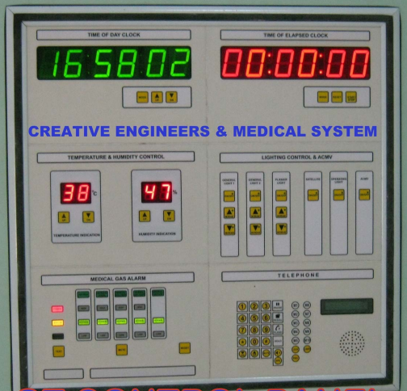
Maternity Center/CGH
Control Panel
35

Slide 36
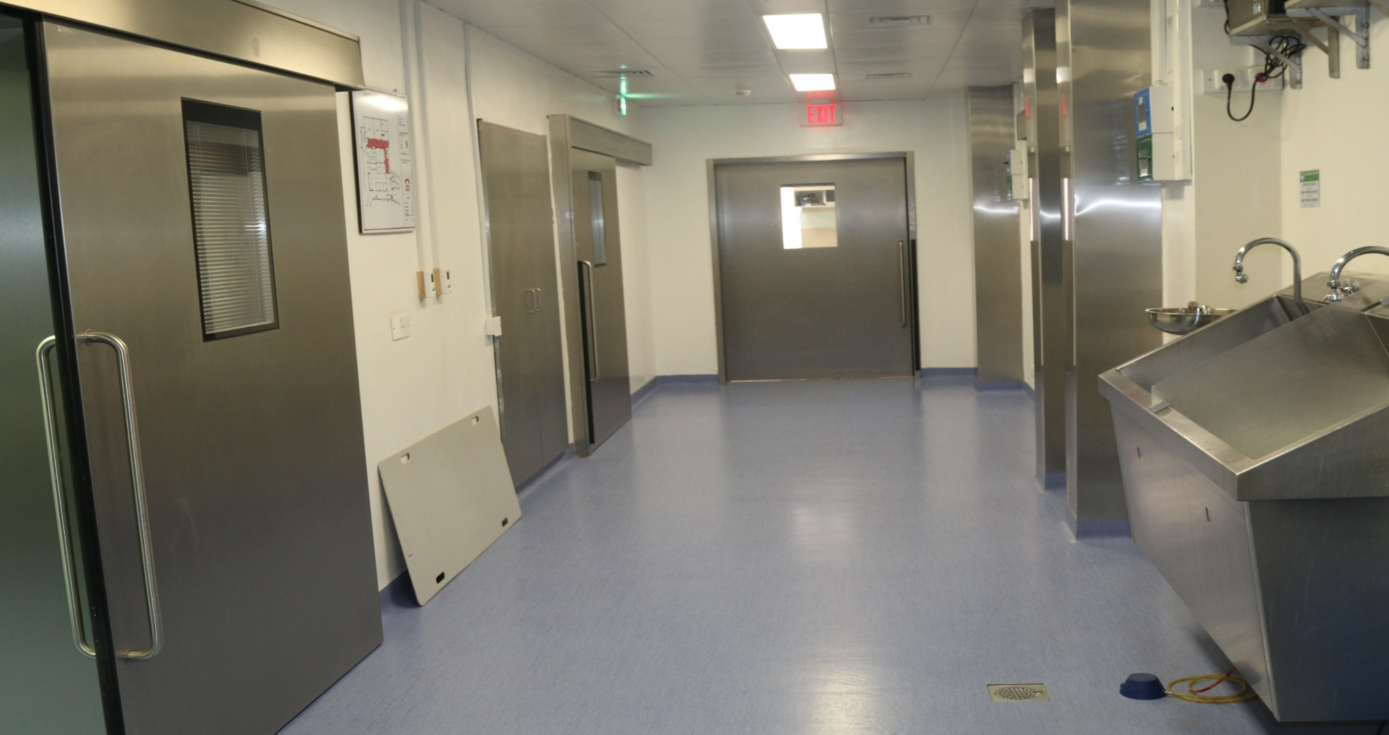
Maternity Center/CGH
Corridor
36

Slide 37
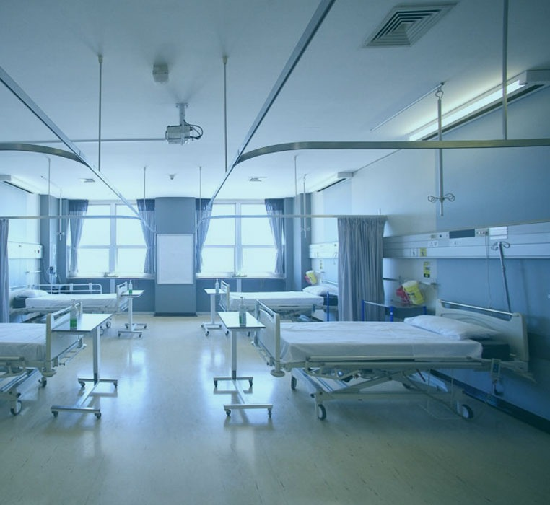
Maternity Center/CGH
Gynae Ward
37

Slide 38

Maternity Center/CGH
Waiting Area
38

Slide 39
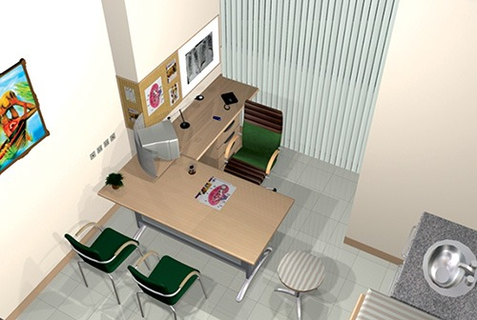
Maternity Center/CGH
OPD
39

Slide 40
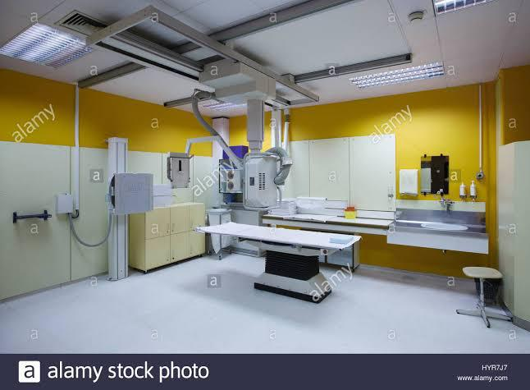
Maternity Center/CGH
Modern X-Ray Room
40

Slide 41
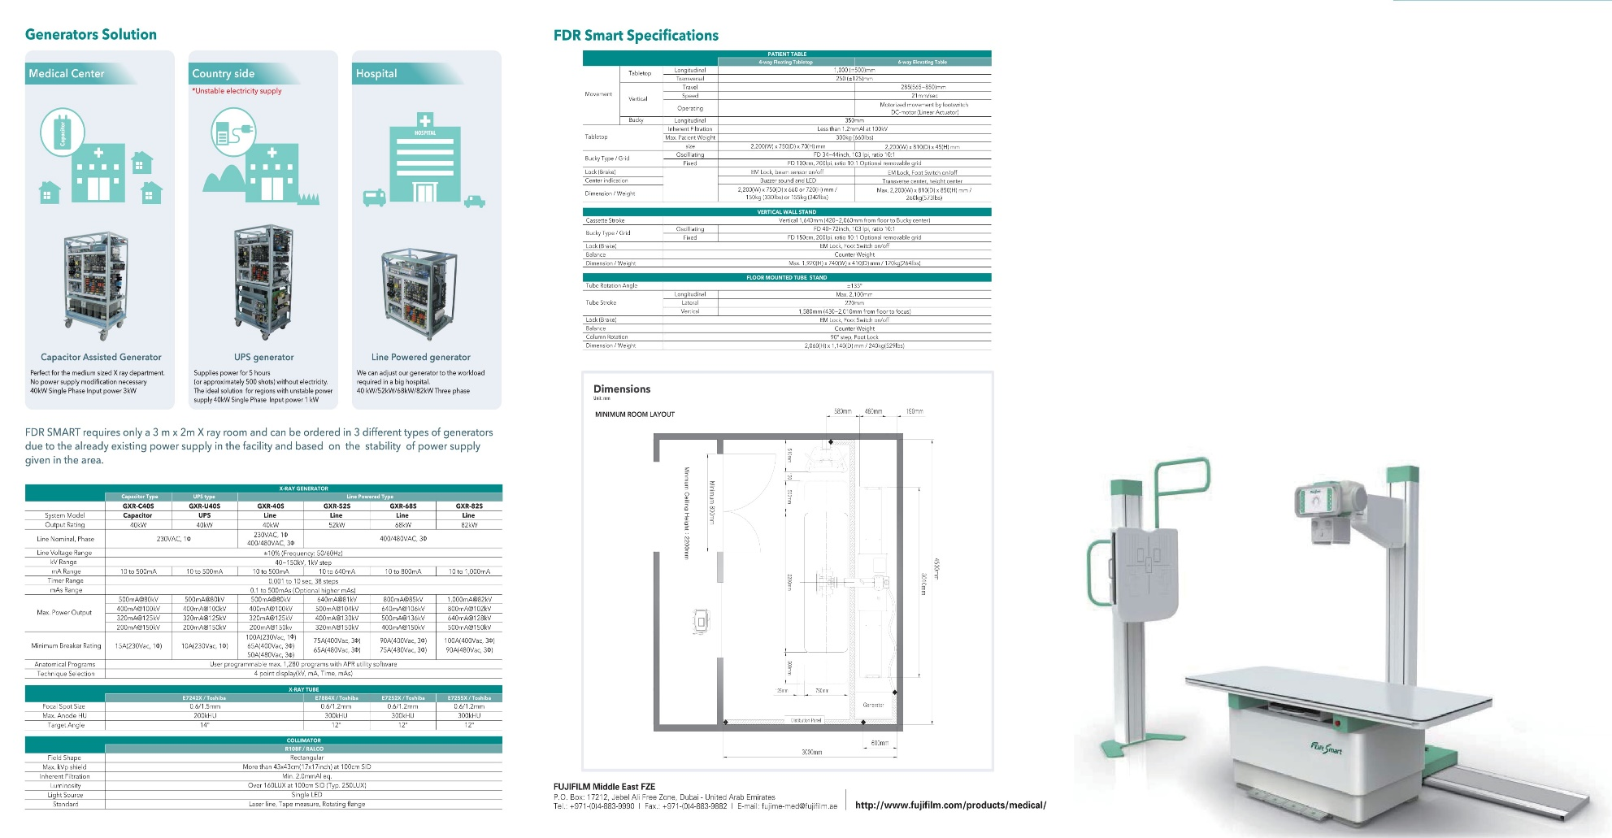
Maternity Center/CGH
Modern X-Ray Room
41

Slide 42
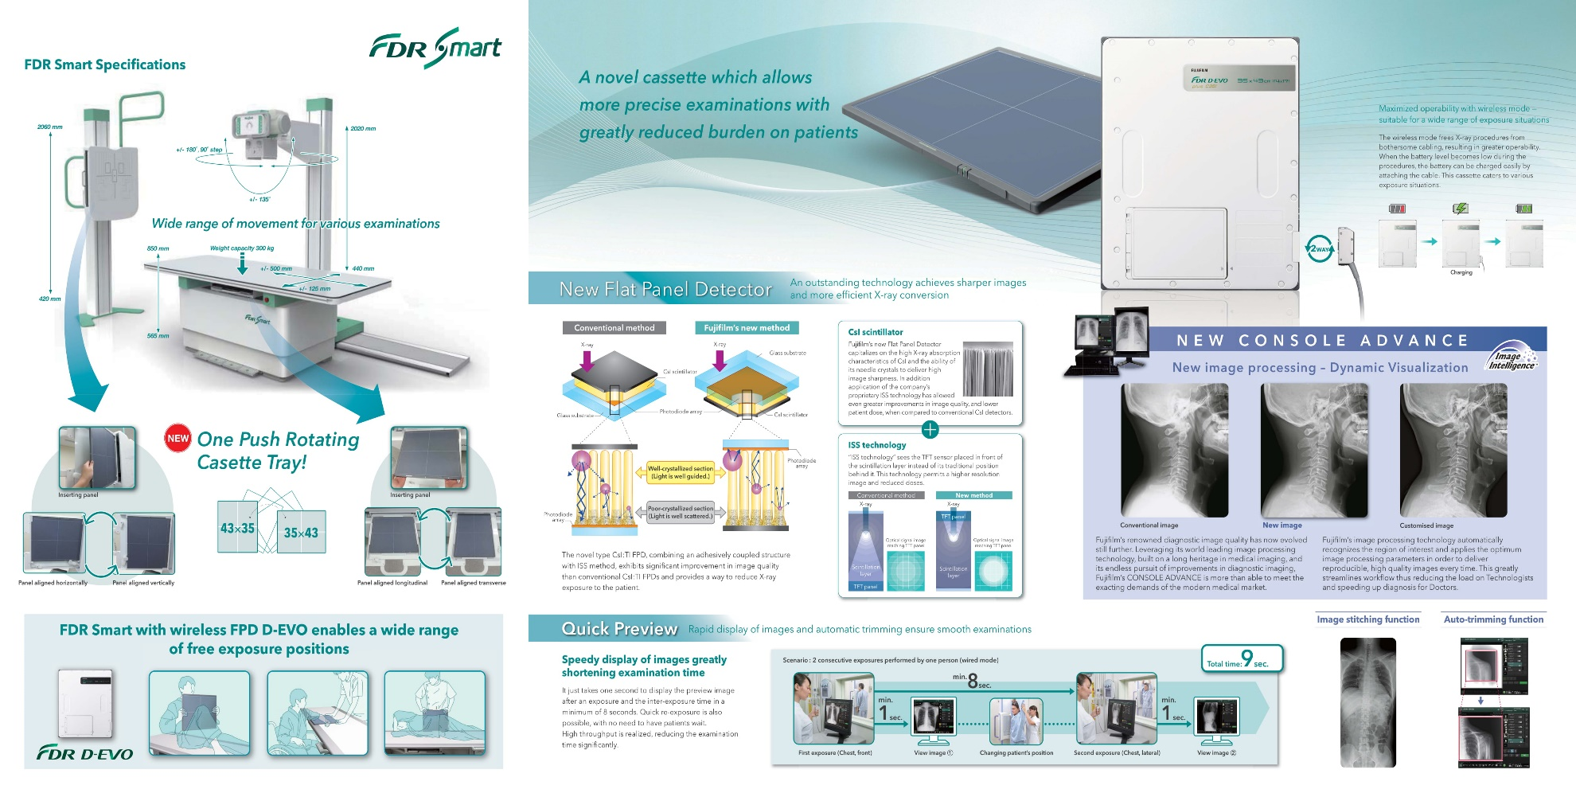
Maternity Center/CGH
Modern X-Ray Room
42

Slide 43
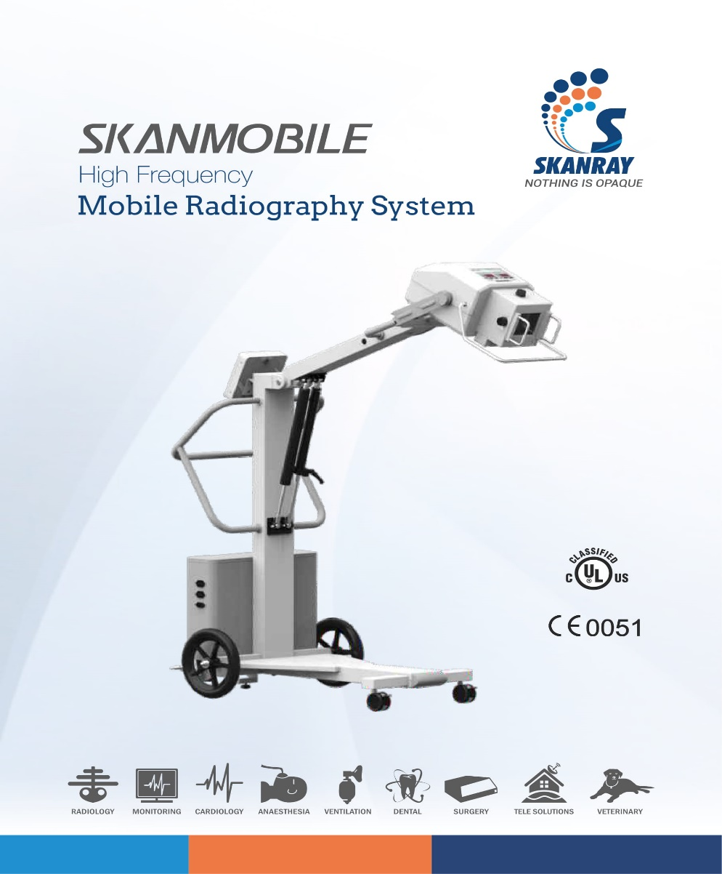
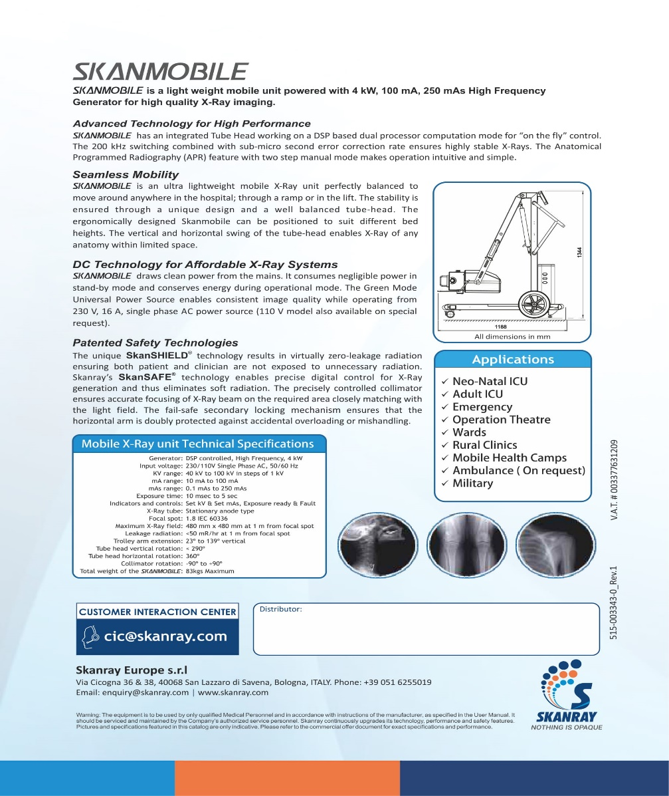
Maternity Center/CGH
Portable X-Ray
43

Slide 44
Solid Waste and Types
Solid Waste
Compostable
Green Waste
Remnants of Fruits/ Veg
Kitchen Waste
Brown Waste Leaves
Landfill
Which cannot be recycled
Req to be dumped
Recyclables
Plastic Bottles
Paper
Glass
Tetra Pack
Metals

Slide 45

Means of waste Management
Sorting of Recyclable
  In order to minimize the waste, useful discarded items can be segregated
Avoidance/Waste Minimization
Composting
  Conversion of organic waste for
  nutrient rich fruits for plants
Landfill
    Non-recyclable
    Non-compostable

Slide 46

Guidelines for SWM
Blue Bag
Yellow Bags
White Bags
Tins, Glass, aluminum foils, Plastic bottles etc.
Polythene bags, shoppers, plastic and talc etc.
Papers/cartons, card boards/charts, tetra packs, tissue boxes etc.
Poly Cart (For Non-recyclables)
Compost pits (Green and Brown waste)

Slide 47
Sorting of Recyclable waste
Blue Bag
Yellow Bags
White Bags
Tins, Glass, aluminum foils, Plastic bottles etc.
Polythene bags, shoppers, plastic and talc etc.
Papers/cartons, card boards/charts, tetra packs, tissue boxes etc.
Distribution of 3x colored bags
Replace after 03 Months or whenever required
Collection on Monthly basis. However, bags can be collected earlier on complaint basis
Must be ensured that tetra packs and bottles are rinsed and dried

Slide 48
Compost Pits
  Browns:
  Papers/card board, tissue paper, egg shells, leftover tea including bags, wool, vacuum bag contents, cotton threads , straws, hay and dry leaves etc.
  Greens :
  Vegetable peeling, food waste, green leaves, plant trimming, fresh grass, garden pruning and old flowers etc.

Slide 49
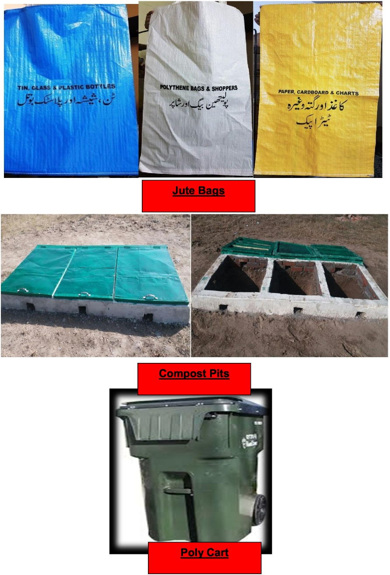
Construction of Compost Pits
  Compost Pit Dimension:
  6’x3’ , 1.5’ deep
  Officers:
  1x compost pit for each house or 3 earthen pots at a place with adequate sunlight and air
  1 x Dustbin for each house

Slide 50
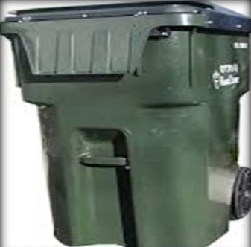
Land Fill waste
  Items which cannot be recycled i.e. wrappers of biscuits/chips, diapers and food wastes
  Officers:
  1x Poly Cart for two adjacent houses
  1 x Poly Cart for each block of
  MOQs/flats

