Slide 2
Fundamentals | Products | Services
Introduction to
Introduction to Islamic Banking
اسلامی بینکاری کاایک تعارف، پراڈکٹس اور خدمات
Member Sharia Advisory Board – Global Halal Assurance
Founder & Director Sharia – Center for Halal Assurance
Head of Sharia Advisory – Cannar Ventures (USA, Canada, Pakistan, UAE)
Sharia Scholar Translator for Sharia Standard – AAOIFI (Bahrain)
Mufti Muhammad Muaz Ashraf
Research Sharia Scholar (PDSC) Meezan Bank
Deputy Regional Head – Centre for Islamic Economics

Slide 3
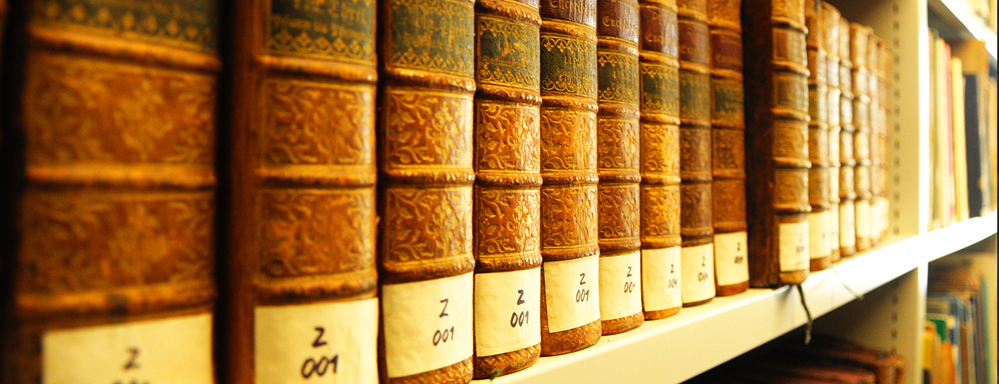
The Concept of Islamic Banking
اسلامی بینکاری کا بنیادی تصور
Meezan Bank

Slide 4
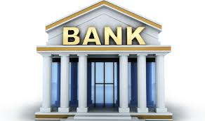
What Is Islamic Banking?
Islamic Banking refers to a system of banking or banking activity that is mainly involved in trade and consistent with the principles of the Sharia (Islamic rulings).
Islamic
Key Features:
Trade
Islamic Rulings

Slide 5
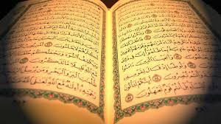
The permissibility of Trade
القرآن الكريم
﴿أَحَلَّ اللَّهُ الْبَيْعَ وَحَرَّمَ الرِّبا﴾
“Allah has permitted trade and prohibited Riba”
”اللّہ نے تجارت کو حلال کیا اور ربا (سود) کو حرام قرار دیا“
[Al-Baqarah, 275]

Slide 6
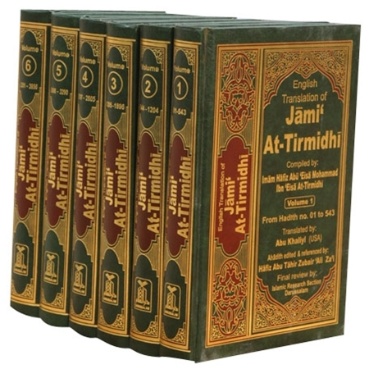
The Reward of Trade
الاحاديث المباركة
An honest, trustworthy trader on the day of judgment will be among the Prophets, Siddiqeen and martyrs. [Al-Tirmidhi]
Indeed, the honest and truthful trader shall be under the shade of the throne of Allah on the day of Qiyamah.
[Al-Targheeb]
Prophet (SAW) once said that Allah Ta’ala has stated:
“He will become a partner in a business between two partners until they indulge in cheating or breach of trust (Khayanat).” [Abu Dawood]

Slide 7
Effect of Haram Food & Earning
"A slave (of Allah) who acquires Haram wealth and gives charity from it, it is not accepted from him. If he spends from it, he does not have any blessing in it. If he leaves it behind him (i.e. he dies) it will be a means of taking him to the fire (of Hell).
(Sharh As-sunnah; Mishkaatul Masaabih)
“A man who, having journeyed far, is disheveled and dusty and who spreads out his hands to the sky saying, 0 Lord! 0 Lord! While his food is Haram, his drink Haram, his clothing Haram, and he is nourished unlawfully, how can he be answered?” (Muslim)
"No meat (i.e. person) that was nourished with Haram will enter paradise. Every meat (i.e. person) that was nourished with Haram is more deserving of the Fire." (Musnad Ahmad, Daarami, Baihaqi; Mishkaatul Masaabih)
“When the pilgrim, who journeys to Hajj, by Haram money, says. “Here I am! At your service.” Our Lord, here I am! At your service. Allah will say to him, “your calling is rejected and your Hajj is valueless.” (lbn Hajar)

Slide 8
Principles of Sharia
Key Prohibited Elements
Riba/Interest
Maysir/Gambling
Uncertainty
ربا اور سود
قمار اور میسر
غرر

Slide 9
Interest |Gambling |Uncertainty
The invalidity of these three renders also many contracts and arrangements as un-Islamic or unlawful, for instance:
Any excess on principle in Loan
Sale of Debt
Future Sale
Forward Sale
Sale Without Possession or Risk
Sale without Ownership
Sale of Unspecified Goods or Assets.
Bonds etc.
T-Bills etc.
Conventional Mortgage
Conventional REIT’s
Insurance

Slide 10
The Prohibition of Riba in Qur’an and Sunnah
Classification
Arguments

Slide 11
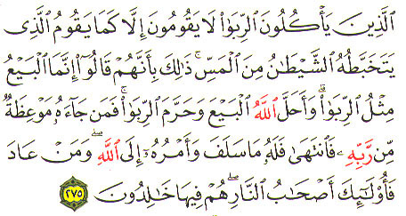
القرآن الكريم
“Those who devour Riba shall rise up before Allah like men whom Shaitan has demented by his touch; for they claim that trading is like Riba. But Allah has permitted trading and forbidden Riba. He that receives an admonition from his Rabb and mends his ways may keep what he has already earned; his faith is in the hand of Allah. But he that pays no heed shall be among the people of fire and shall remain in it forever.”

Slide 12
القرآن الكريم
“O you who believe, Fear Allah and give up what remains of your demand for Interest, if you are indeed a believer. If you do not, then you are warned of the declaration of war from Allah and His Messenger; But if you turn back you shall have your principal: Deal not unjustly and you shall not be dealt with unjustly.”

Slide 13
الاحاديث المباركة
The receiver and the payer of interest, the one who records it and the witnesses to the transaction And said:
"They are all alike [in guilt]."
The Prophet
(صلى الله عليه وسلم)
Cursed:
(Muslim, Tirmidhi and Musnad Ahmad)
The Prophet
(صلى الله عليه وسلم)
Said:
“Riba has seventy segments, the least serious being equivalent to a man committing adultery with his own mother”
(Ibn Majah)

Slide 14
Classification of Riba

Slide 15
Classification of Riba
Riba Al-Nasi’ah
Riba means any excess compensation over and above the
principal which is without due consideration in a contract
of loan.
کل قرض جر منفعة فھو ربا
قرض كے ذريعے حاصل ہونے والی کسی بھی قسم کی منفعت ربا ہے

Slide 16
Classification of Riba
Riba Al-Fadl
it is defined as excess which is taken in exchange of specific homogenous commodities and encountered in their hand-to-hand sale and purchase as explained in the hadith, in which the Prophet صلي الله عليه وسلم said:
“Gold for gold, silver for silver, wheat for wheat, barley for barley, dates for dates, and salt for salt, should be exchange like for like, equal for equal and hand-to-hand. If the types of exchanged commodities are different, then sell them as you wish, if they are exchanged on the basis of hand-to-hand transaction.”

Slide 17
Riba - Present Day Arguments
“Riba as practiced during the days of the Prophet (SAW) was only Usury”.
Islam when prohibiting something does not only prohibit the prevalent form, but all forms that might erupt in future. The changed state does not change the ruling. E.g. Liquor, Pork, Corruption/Immorality: Today’s modern and sophisticated forms does not change their rulings.
The same applies to interest and gambling.
1

Slide 18
Riba - Present Day Arguments
“Commercial interest did not exist in the days of Prophet (SAW).”
This claim is wrong as both forms of interest existed in Islamic and pre Islamic history. Some examples:
The tribe of Umr bin Aamir used to take interest from the tribe of Mughairah.
The tribe of Thaqeef advanced cash as well as commodities on interest to the natives of Taif, the tribe of Mughairah and the business community of Makkah.
Hazrat Abbas and Hazrat Khalid bin Waleed (RA) formed a company with joint capital whose prime business was cash advancement on interest.
Hazrat Usman (RA) (pre-Islamic times) lent money on interest.
2

Slide 19
Riba - Present Day Arguments
There is a Quranic verse “O believers do not devour one another’s possession wrongfully; rather than that, let there be trading by mutual consent”
(Al Nisa verse 29).
“Wrongful devouring” only arise if the consent of one of the parties is absent but in commercial interest the mutual consent is present of both parties, so its not Riba.
Mutual consent is not the criteria to render anything halal which is haram.
3

Slide 20
The Key Difference Between
Islamic and Conventional Banking

Slide 21
The basic Difference Between Conventional and Islamic Mode of Finance
Conventional
Money
Client
Loan
Interest
Money
+
Money

Slide 22
The basic Difference Between Conventional and Islamic Mode of Finance
Islamic
Client
Goods | Services
Profit | Fee
Money

Slide 23
Saving AC
Current AC
Deposit
Musharkah
Mudarabah
Loan
Loan
Islamic
Conventional
Asset Side
(Trade)
Asset Side
(Lending)

Slide 24
Distinguishing Features
Conceptual & Socio-religious level
Business model & Governing framework
IBs actively participate in trade and production process
Product Level Implementation
Not money lenders
Cannot deal with interest & non permissible industries
Governing framework in terms of Sharia Advisor &/or SSB
usually asset backed & involve trading/renting of asset & participation on profit & loss basis
Implementation is not just a mere change of paper work and terms but it involves: having the right intention and the correct sequence of steps and timing of execution

Slide 25
What distinguishes Islamic Banking
Muaz Ashraf
Transactions are asset-based or backed
Transactions are money lending & Riba based
It is socially-responsible banking because it operates under Sharia restrictions
Involve in many impermissible transactions like Short selling, Sale of Debt, Speculation etc.
Permit financing of prohibited goods & Industries like alcohol, casinos etc.
Islamic
Does not permit financing of prohibited goods / Industries
Conventional
Ethics and moral values play a major role in investment decisions. Not a choice but a must
A matter of choice

Slide 26
Islamic Modes of Finance
&
Products

Slide 27
Islamic Banking Products
Islamic banking now offers a complete range of Islamic banking solutions to cater their Financing & banking needs
Financing Side modes
Murabaha (working capital/consumer goods)
Salam (overheads, utilities & receivable)
Istisna (overheads, utilities & receivable)
Tijarah (Finished Goods)
Diminishing Musharakah
Ijarah (Rental Financing)
Mudarabah
Musharakah

Slide 28
Islamic Banking Products
Murabaha
A sale contract where the seller discloses the cost price and the profit to the buyer.
Musawamah
A sale contract where the seller discloses only the sale price to the buyer.
Mudarabah
A partner ship contract where one partner invests (Rab ul Maal) and the other (Mudarib) manages the funds

Slide 29
Islamic Banking Products
Ijarah
A rental contract where the owner of the asset gives the asset on rent to the lessee.
Istisna’a
Essentially an “Order to manufacture”, Istisna is a sale contract that enables manufacturer to take advance payment for a manufactured good to be delivered later.
Bai’ Salam
A forward financing transaction, where the financial institution pays in advance for buying specified assets, which the seller will supply on a pre-agreed date.

Slide 30
Application of Mode
Based on the criteria for selection of modes, the appropriate mode(s) is/(are) applied to fulfill the customer’s need.
Need of the Customer
Business Cycle / Purchase Process of the customer
Tenure of Financing required (Long or Short term)
Rate of Financing (Fixed or Variable)
Payment Flexibility
Need
Mode Selection
Mode Application
Murabaha
Example

Slide 31
MURABAHA
Step by Step

Slide 32
Murabaha - Step by Step
Muaz Ashraf
Step 1
Client and bank sign an agreement to enter into Murabaha (MMFA).
Client
Doc
1
Agreement to Murabaha
Doc
2
Agency Agreement
Step 2
Client appointed as agent to purchase goods on bank’s behalf
Notes:
STEP BY STEP MURABAHA FINANCING
1.The client and the institution sign an overall agreement whereby the institution promises to sell and the client promises to buy the commodity from time to time on an agreed ratio of profit added to the cost. This agreement may specify the limit up-to which the facility may be availed.
2.An agency agreement is signed by both parties in which the institution appoints the client as his agent for purchasing the commodity on its behalf.
3.The client purchases the commodity on behalf of the institution and takes possession as the agent of the institution.
4.The client informs the institution that it has purchased the commodity and simultaneously makes an offer to purchase it from the institution.
5.The institution accepts the offer and the sale is concluded whereby ownership as well as risk is transferred to the client.
All the above are necessary to effect a valid murabaha. If the institution purchases the commodity directly from the supplier it does not need any agency agreement.
Note: The most essential element of the transaction is that the commodity must remain in the risk of the institution during the period between the third and the fifth stage.
The above is the only way by which this transaction is distinguished from an ordinary interest-based transaction

Slide 33
Murabaha - Step by Step
Muaz Ashraf
Step 3
The Bank gives money to supplier or agent for purchase of goods.
Doc
1
Agreement to Murabaha
Doc
2
Agency Agreement
3
Disbursement to the agent or supplier
Supplier

Slide 34
Murabaha - Step by Step
Muaz Ashraf
Step 4
The client as an agent takes possession of goods on bank’s behalf. After which the Risk of the goods transferred to the Bank.
Transfer of Risk
Delivery of Goods
Supplier
Vendor

Slide 35
Murabaha - Step by Step
Muaz Ashraf
Step 5 (a)
Client declares the receipt of goods through a declaration form and offer to purchase the same goods through a Murabaha Contract.
Doc
Declaration & Offer to Purchase
A
B
Doc
Murabaha Contract & Transfer of Title
Step 5 (B)
Bank accepts the offer and signs the Murabaha Contract through which sale is concluded.

Slide 36
Murabaha - Step by Step
Muaz Ashraf
Step 6
Client pays agreed price to bank according to an agreed schedule. Usually on a deferred payment basis (Ba’i Muajjal – بیع مؤجل)
Payment of The Price
Step 5 (B)

Slide 37
Key Misconceptions
About
Islamic Banking

Slide 38
Islamic Banking FAQ’s
What is Islamic Banking?
1
Islamic banking is system of conducting trade and banking activities in line with the principles of Islamic Shariah while avoiding all the prohibited activities such as interest or Riba, Gharar, financing of haram trades & businesses etc.
It is not banking which is based on pricing money and earning interest as conventional interest based banks do but it is a system of trade where goods and services are sold and capital is invested by taking risk to earn halal profits.
Hence it is not just a change of name as misunderstood by many but it is based on the Quranic injunction of
‘ Allah has permitted trade and forbidden Riba.’
(Surah al-Baqarah, Verses 275)

Slide 39
Islamic Banking FAQ’s
Since the end result of Islamic and Conventional Banking is the same; it is merely a change of name?
2
The validity of a transaction does not only depend on the end result but rather the steps followed in reaching the end.
If a transaction is done according to the rules of Islamic Shariah then it is completely permissible no matter the end result may look similar to a result achieved through a non Shariah compliant transaction.
For example the beef burger in USA cannot be judged as Haram or Halal until we know that the animal has been slaughtered according to the Islamic Law. The end result (Burger) is same.

Slide 40
Islamic Banking FAQ’s
Since the end result of Islamic and Conventional Banking is the same; it is merely a change of name?
2
Similarly if a person is feeling hungry, he may steal a piece of bread and eat or alternatively he could buy a piece of bread to eat. The apparent end result would be same but one is permissible in Shariah and the other is not allowed.
The same is also true for Islamic and conventional banking. Apparently the end result of both may look or feel the same but due to adherence to a Shariah compliant process Islamic banking is permissible and interest based banking is not allowed and is like a declaration of war against Allah & His Messenger.

Slide 41
Islamic Banking FAQ’s
Can Interest rate be used as a Bench Mark?
3
Using Interest Rate benchmark for determining the profit of any permissible transaction like sale or Murabaha does not render the transaction as invalid or haram. The nature of the transaction determines the validity of the transaction.
For example A and B are two brothers. A sells liquor that is totally prohibited in Shariah. B, being a practicing Muslim dislikes the business of A and starts the business of soft drinks, but he wants his business to earn as much profit as A earns through trading in liquor, therefore he resolves that he will charge the same rate of profit from his customers as A charges over the sale of liquor. Thus he has tied up his rate of profit with the rate used by A in his prohibited business

Slide 42
Islamic Banking FAQ’s
Can Interest rate be used as a Bench Mark?
3
One may say that B uses an awkward benchmark in determining the rate of profit, but obviously no one can say that the profit charged by him in his halal business is haram, because he has used the rate of profit of the business of liquor as a benchmark.
The same is true for Islamic banks, it is most desirable & preferable that Islamic banks develop their own benchmark for profits however; in the absence of any such alternative interest rate related benchmark can be used.

Slide 43
Islamic Banking FAQ’s
Some people claim that there is no concept of banking in Islam
4
The use of the word banking does not make any institution halal or haram, rather it is the underlying scope & nature of activities that are being conducted which makes it halal or haram.
Concept of banking based on pooling of excess funds of depositors and channeling them towards those who require it for investing activities is not only approved but encouraged by Islam.
But the concept to lending and borrowing on the basis of interest in not allowed in Islam.

Slide 44
Islamic Banking FAQ’s
Is charging penalty on late payment allowed?
5
Taking interest in the form of late payment penalty or in any other form is strictly prohibited in Islamic Shariah. However, in order to safe guard Islamic banks from being exploited and to instigate a financial discipline some check & balances are allowed to be in place by the Shariah scholars.
It is allowed by the SSB of Meezan Bank that in order to discourage late payments and defaults, the customer can be asked to give a unilateral undertaking to pay a certain amount for charity to be utilized for charitable purpose as approved by the Shariah Supervisory Board or Shariah Advisor of the bank.
However it is very clear that any amount in this charity pool cannot be considered as bank income.

Slide 45
Islamic Banking FAQ’s
The price of cash sale and deferred sale can be different? Will it not cause interest?
6
If a commodity is sold in exchange of money, the seller, when fixing the price, may take into consideration different factors, including the time of payment. A seller, being the owner of a commodity, which has intrinsic utility, may charge a higher price and the purchaser may agree to pay it due to various reasons. Thus at the time of the execution of the sale transaction the seller can charge a higher price if the buyer is paying on deferred basis.
However once the price is fixed and the sale is executed the price cannot be increased if the buyer does not make the payment on its due date.

Slide 46
Islamic Banking FAQ’s
A fix rate of return is not permitted in sharia
7
Fixed return does not make a transaction halal or haram
For example:
Profit on trading
Rent on property

Slide 47
Islamic Banking – Global Perspective

Slide 48
Islamic Banking – Global Perspective
500 + Islamic financial institutions
Total size to exceed 3.4 Trillion*
250+ Sharia compliant mutual funds with $ 300bn funds
Around 700 International Islamic Sukuks issued till date
200+ Takaful companies; Expected to exceed 11 billion contribution by 2017
Over 60+ Sharia & Accounting Standards for Islamic financial institutions (by AAOIFI)
Establishment of Islamic indices (Dow Jones, FTSE, KMI-30 etc.)
Global IF Hubs (London, Bahrain, Malaysia, UAE)

Slide 49
Islamic Banking - a Success Story
More than 75 countries have ISLAMIC BANKING Institutions
Approx. 45 Muslim countries including Kuwait, Dubai, Saudi Arabia, Iran, Malaysia, Brunei and Pakistan
Approx. 30 non-Muslim countries including USA, UK, Canada, Switzerland, Srilanka, South Africa and Australia

Slide 50
Country wise Global Islamic Banking Share
Muaz Ashraf
Source: IFSB Stability Report 2017

Slide 51
Islamic Banking In Pakistan
Market Share | 12.9%
Total Deposits | 1461 Billion
Total Assets | 1745 Billion
Annual Deposit Growth Rate | 62.5%
Full Fledged Islamic Banks | 5
Islamic Banking Windows | 17

Slide 52
اسلامی بینکاری کے مقاصد
معاشرہ میں دولت کی منصفانہ تقسیم
تمام غیر شرعی معاملات سے اجتناب کرنا
ربا النسیئہ اور ربا الفضل
قمار/جوا
غرر( جہالت فی البیع، بیع قبل القبض)
عقود فاسدہ
شراکت داری اور اثاثہ کی بنیاد پر کی جانے والی سرمایہ کاری کی ترویج
حلال کاروبار کرنے والوں کی ضروریات کی تکمیل
تمام امور میں شرعی اصولوں سے مطابقت

Slide 53
جزاکم اللہ خیرا

