Slide 1
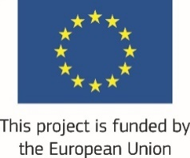
International Labour and Environmental Standards Application in Pakistan’s SMEs (ILES)
Presenter:
Adeel Younas
Senior Officer Site
WWF Pakistan

Slide 2
Project Introduction
Duration: 6 years
Target Sectors: Textile and Leather
Target Locations: 4 Major cities (Lahore, Karachi, Faisalabad, Sialkot)
Funded by: European Union
Compliance of International Labour and Environmental Standards
Project lead: International Labor Organization & WWF-Pakistan

Slide 3
Overall Objective
To support the economic integration of Pakistan into global and regional economy by increasing exports through improved compliance and competitiveness
Specific Objective
To support the enforcement, implementation and compliance with the international labour and environmental standards (ILES) by public and private sectors in Pakistan

Slide 4
Capacity of Federal and Provincial Environmental Administration strengthened to enforce environmental laws and standards in Pakistan
Expected Result -1.2
Outputs :
1.2.1 Enabling environment for implementation of Multilateral Environmental Agreements
1.2.2. Capacity development of relevant departments on Environmental standards and building capacity of relevant stakeholders on Environment, EU standards and linkages with Research & Academia
1.2.3. Building capacity of Financial Institutions (FIs) and promoting green financing
1.2.4. Establishment of city-wide partnerships in other cities (Faisalabad, Sialkot and Karachi)

Slide 5
Textile & Leather sector SMEs implementing low carbon production practices through reduced water and energy foot print
Expected Result -2.2
Outputs
2.2.1 Engagement with enterprises, building capacity of industry people and developing an Integrated framework for MEAs
2.2.2. Implementation of Smart Environmental Management Practices (SEMPs) in 75 SMEs and dissemination among 500 SMEs
2.2.3. Supply chain mapping of 5 international brands
2.2.4. Implementation of Alliance for water stewardship (AWS) in SMEs

Slide 6
Dissemination and Communication http://www.wwfpak.org/wwf-projects/ILES.php

Slide 7
Provincial stakeholders
Mobilized Stakeholders
Environmental Protection Agency (EPA)
Karachi
Korangi Industrial Estate
Sindh Industrial Trade Estate (SITE)
Faisalabad
Pakistan Textile Exporters Association (PTEA)
All Pakistan Textile Processing & Manufacturers Association (APTPMA)
WASA Faisalabad
National Textile University (NTU)
University of Agriculture (UAF)
Sialkot
Sialkot Tannery Association G Limited (STAGL)
Pakistan Leather Garments Manufacturers & Exporters Association (PLGMEA)
Lahore
Karachi Chamber of Commerce and Industries (KCCI)
Lahore Chamber of Commerce and industry (LCCI)
All Pakistan Textile Manufacturers Association (APTMA)
Pakistan Readymade Garments Manufacturers and Exporters Association (PRGMEA)
University of Engineering & Technology (UET)
Sialkot Chamber of Commerce & Industry (SCCI)
Pakistan Tanners Association (PTA)
Faisalabad Chamber of Commerce & Industry (FCCI)
SEPA
Pakistan Gloves manufacturing exporters Associations (PGMEA)
Mehran University of Engineering and Technology (MUET)

Slide 8
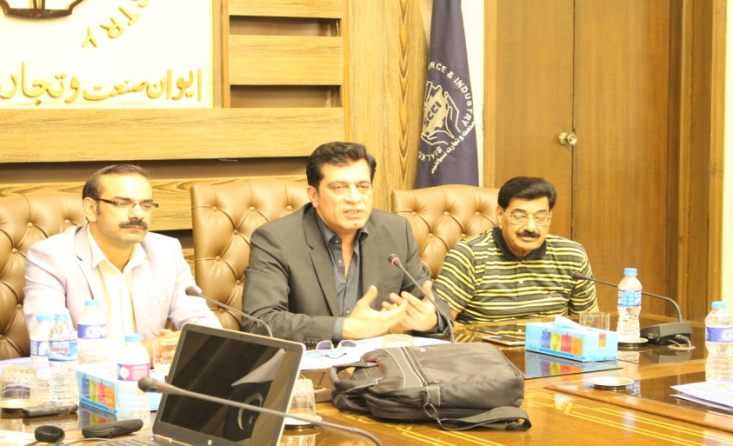
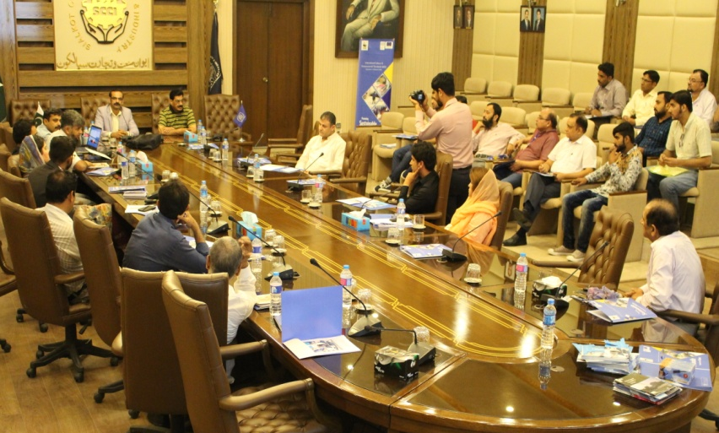
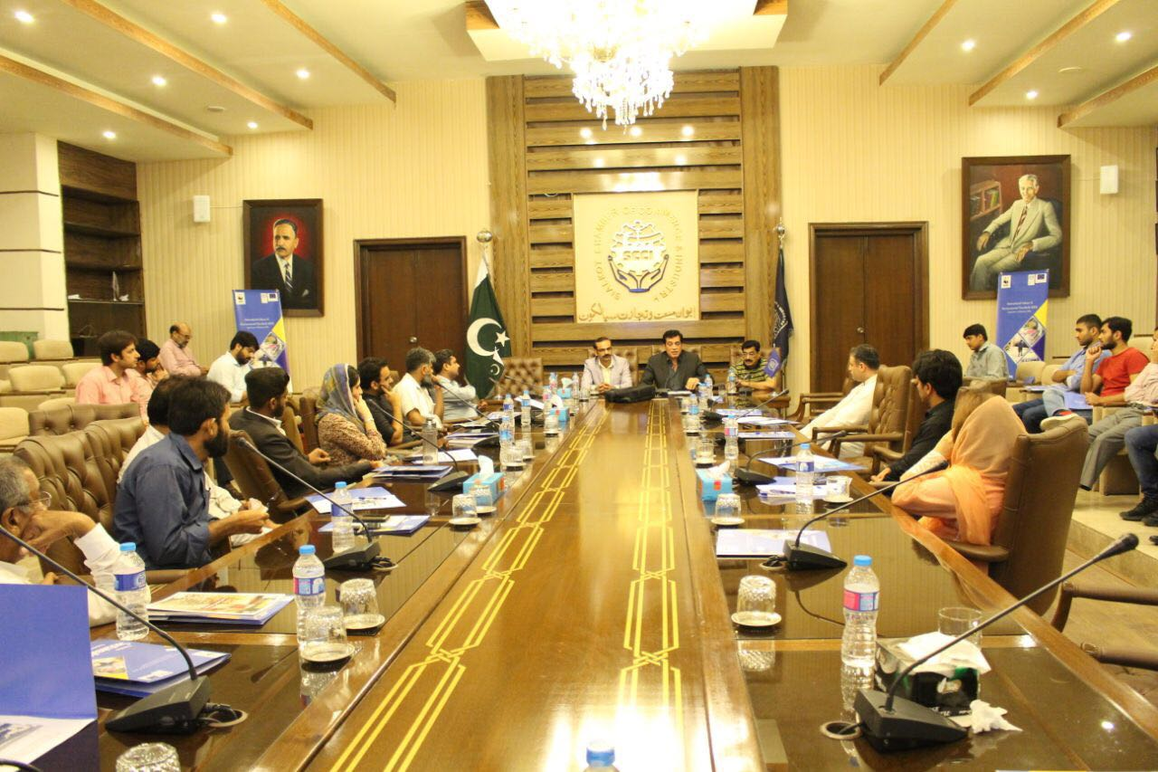
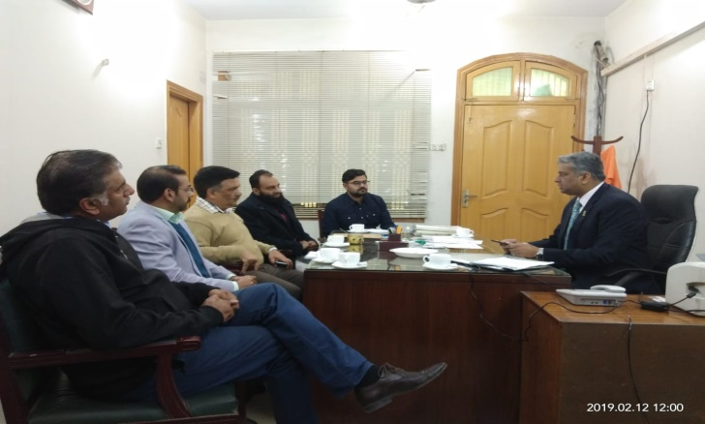
Engagement with stakeholders
WWF Pakistan conducted ILES Project introductory workshop at Sialkot Chamber of Commerce and Industry (SCCI) on 18 July 2017 for official launch of ILES project in Sialkot City.

Slide 9
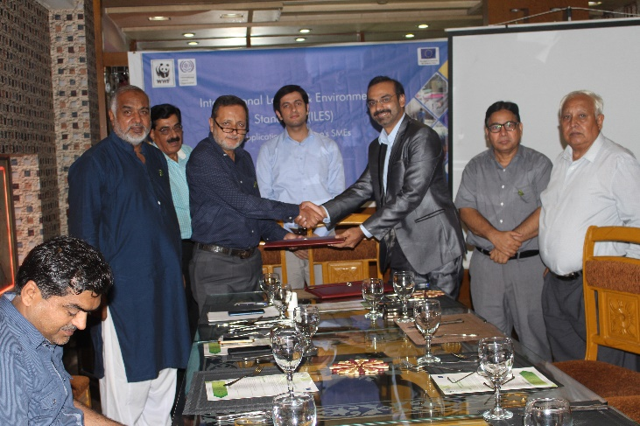
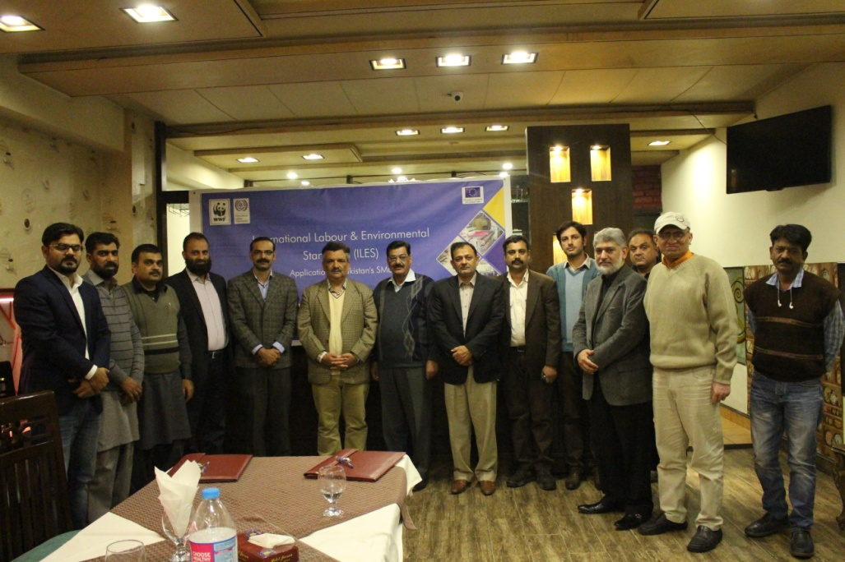
MOU/LOI Signings with Stakeholders
Signed LOI with Pakistan Leather Garments Manufacturers & Exporter Association (PLGMEA) on 7 August 2017
Signed LOI with Sialkot Tannery Association (Guarantee) Limited (STAGL) on 29 November 2017
Signed LOI with Pakistan Glove Manufacturers & Exporters Association (PGMEA) on 31 July 2018

Slide 10
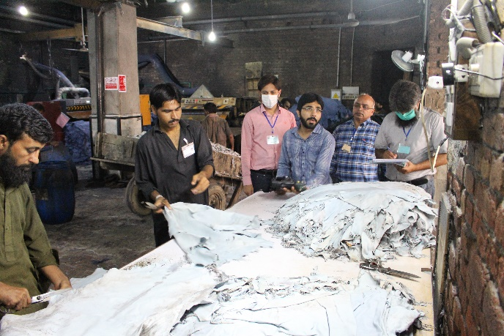
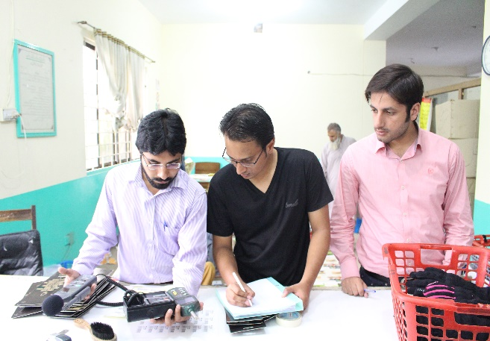
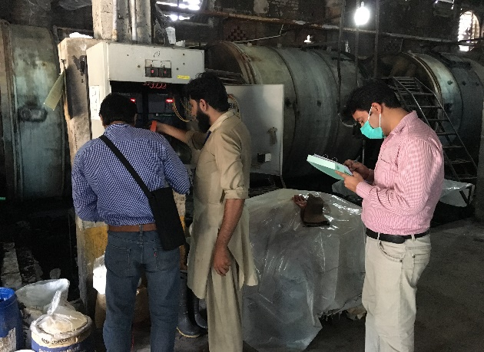
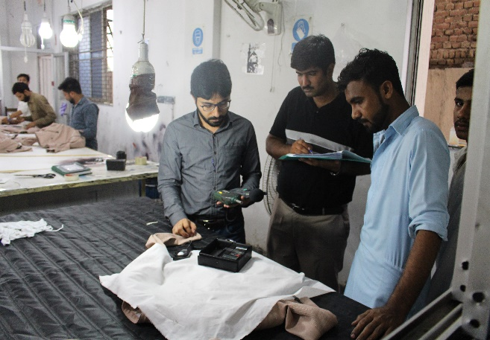
Mobilization of SMEs in Sialkot
SMEs in Sialkot were mobilized for ILES Project and later on ILES audit were conducted in respective SMEs

Slide 12
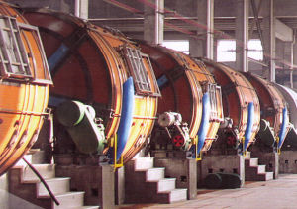
Success Stories in Sialkot
REDUCTION IN WATER CONSUMPTION
An industry installed water flow meters at ground water turbines discharge lines.
Calculated fresh ground consumption in tannery [wet to finished] process
Focused on Neutralization step as follows:
Measured the amount of water consumption at washing step
Reduced the amount of water consumption
Tested the completion of process in their in house laboratory
Reduction in Water Consumption = 22% in about 3 months
Reduction in Water Consumption = 28 lit/kg

Slide 13
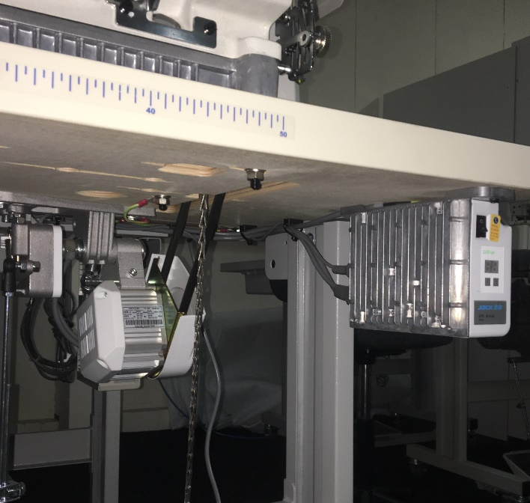
Success Stories in Sialkot
REDUCTION IN ENERGY CONSUMPTION
One of industry installed 103 energy efficiency (Servo) motors by investing 0.67 Million PKR
In term of energy they saved 22,589kWh/y with a financial saving of 0.43 Million PKR
Investment pay back in 1.56 Year

Slide 14
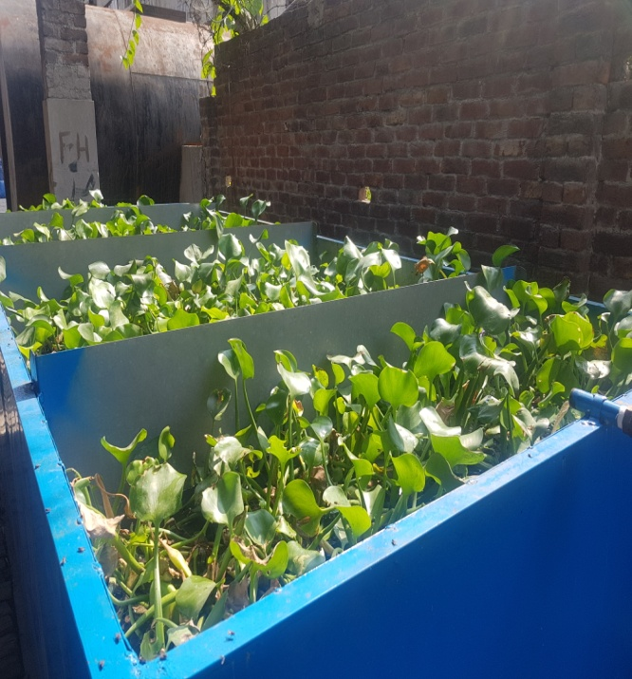
Success Stories in Sialkot
Bio-remediation for the wastewater treatment system
Waste Water Treatment
Parameter | Before (mg/l) | After (mg/l) | Percentage Removal
TDS | 2353 | 1738 | 26 %
pH | 7.92 | 8.4
COD | 1326 | 35 | 97%
BOD | 659.6 | 23.5 | 96%
TSS | 138.5 | 20.5 | 85%
Cr | 9.435 | 0.68 | 93%
EC | 4790 | 3163.5 | 34%

Slide 15
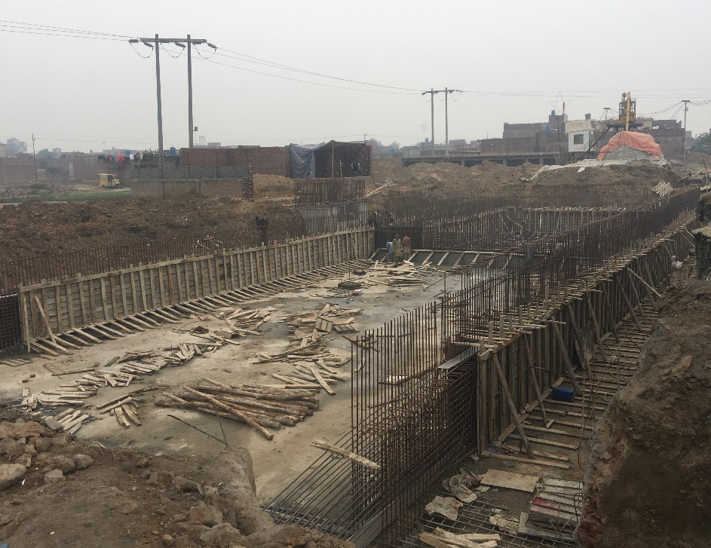
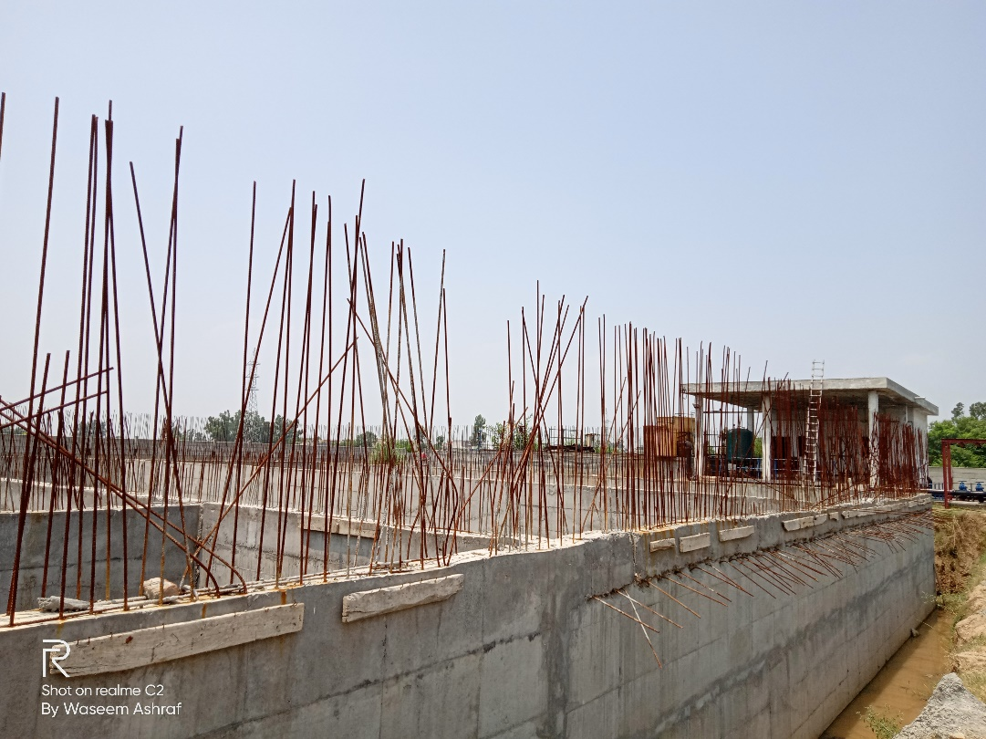
Success Stories in Sialkot
WASTEWATER TREATMENT PLANTS (under-construction)

Slide 16
Workshops for SMEs in Sialkot
Workshops of SEMPs was conducted in collaboration with PGMEA on 16th April 2018
WWF Pakistan in collaboration with STAGL and UNIDO organized Workshop on Leather Working Group (LWG) Environment Stewardship Protocol on 7th May 2019
WWF Pakistan in collaboration with STAGL and UNIDO organized Workshop On Resource Efficiency (Best Available Techniques / Smart Environmental Management Practices) Leading to Compliance of LWG on 18th September 2019
Session on Alliance for Water Stewardship (AWS) Standard was conducted 15th October 2019 for SMEs
Workshops of Smart Environmental Management Practices was conducted in collaboration with GCCI on 17th December 2019
Session on Green Office Initiative was conducted on 27 February 2020 for SMEs

Slide 17
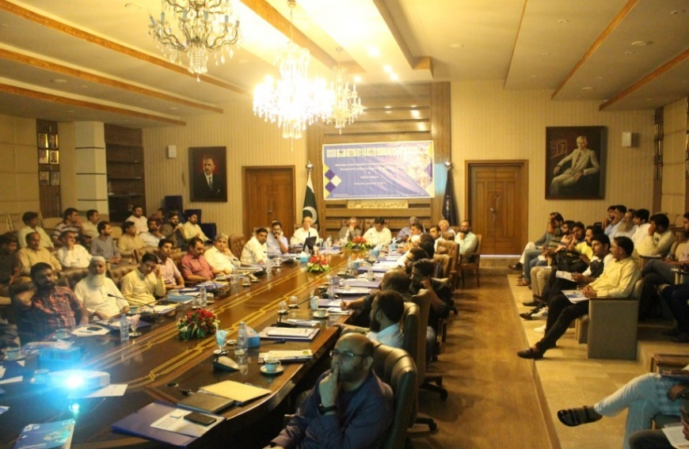
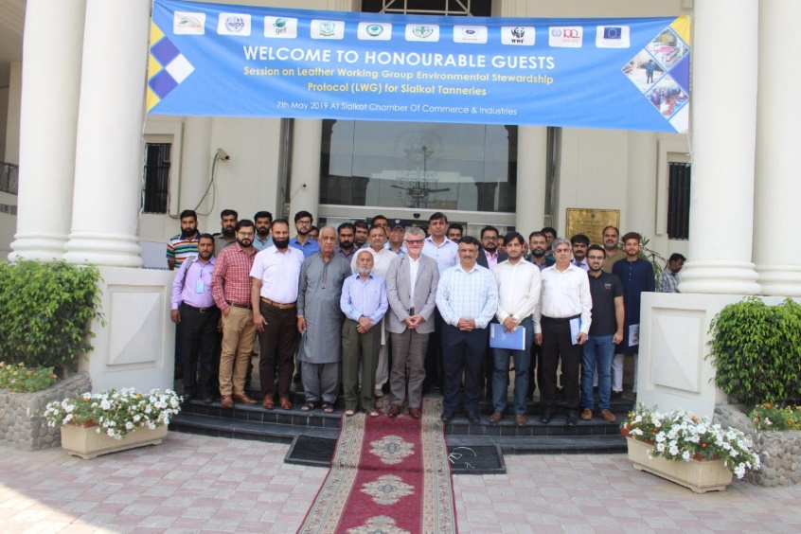
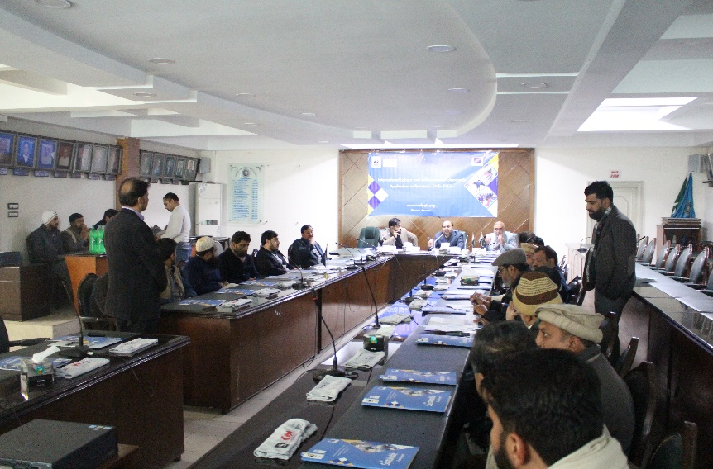
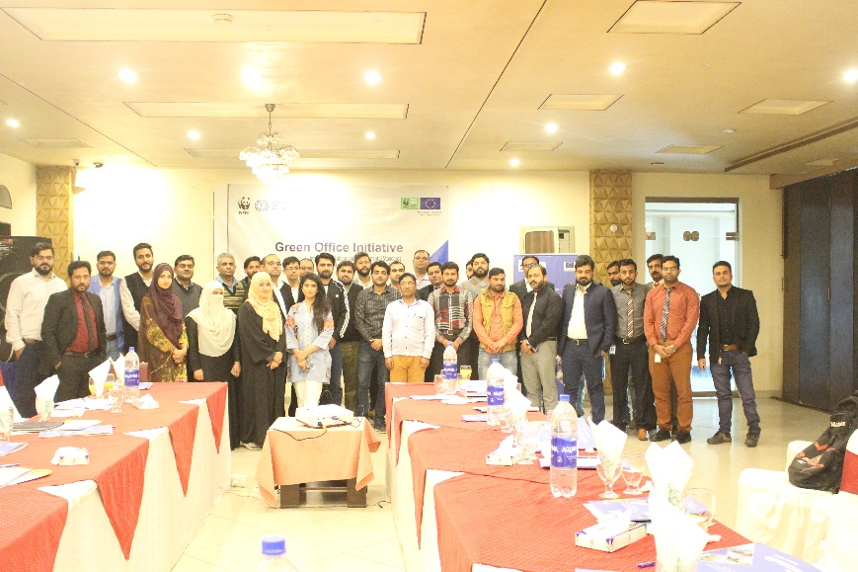
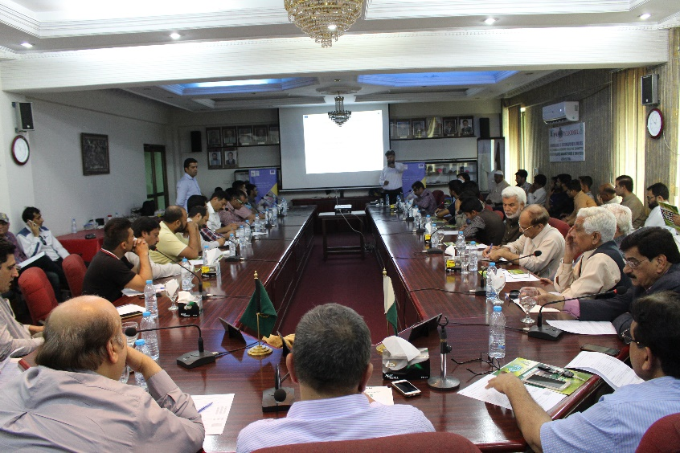

Slide 18
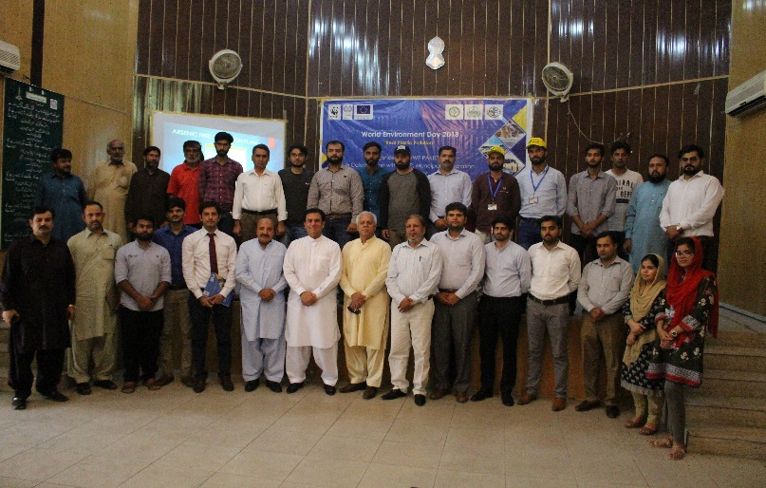
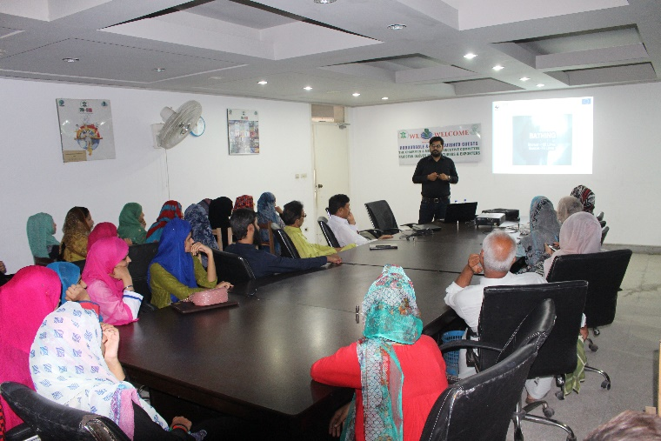
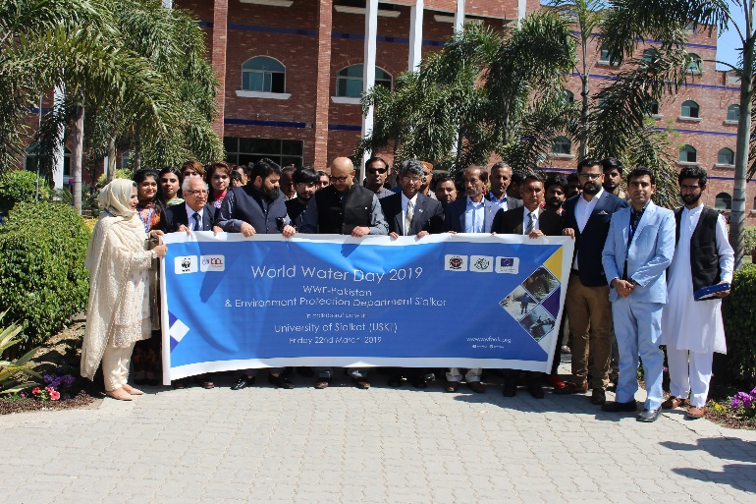
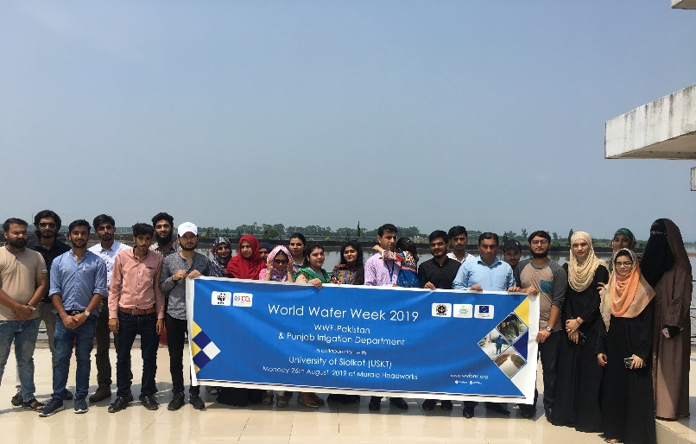
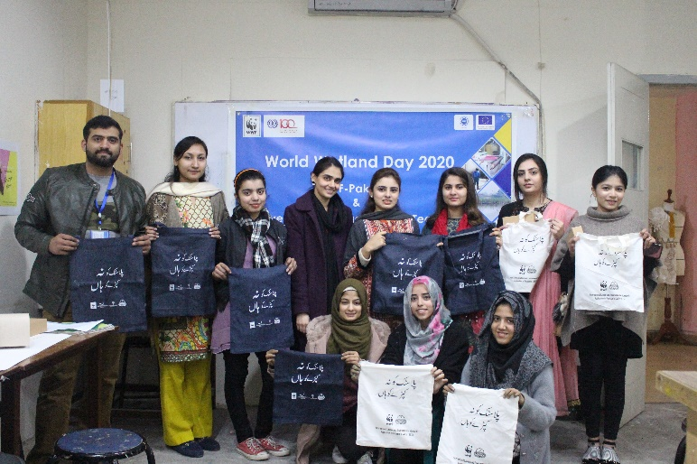
Environmental Awareness
Earth Day 2018 at GC Women University
Environment Day 2018 with TMA
World Water Week 2018 at LPDI
World Water Day 2019 with USKT
Water Week 2019 with USKT
World Wetlands Day 2010 at UMT

Slide 19
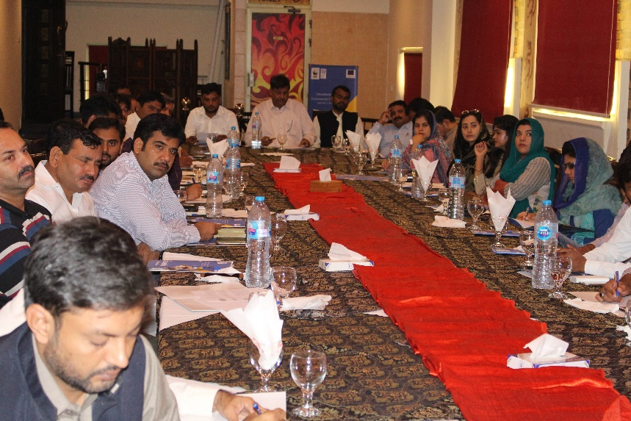
Capacity Building of Government Sector
Workshop for Public Sector on Challenges pertaining to Water, Energy Stewardship, Management of Hazardous Chemicals and Pollution mitigation to support implementation of Environmental Standards was organized on 18th October 2018

Slide 20
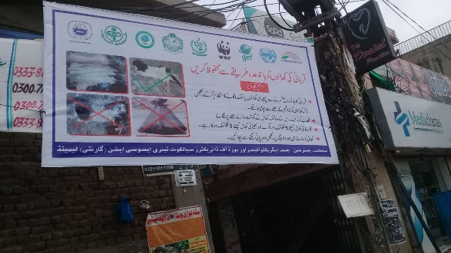
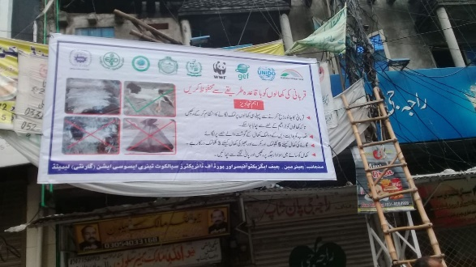
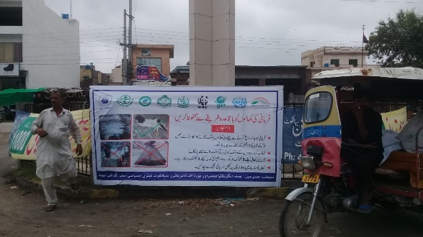
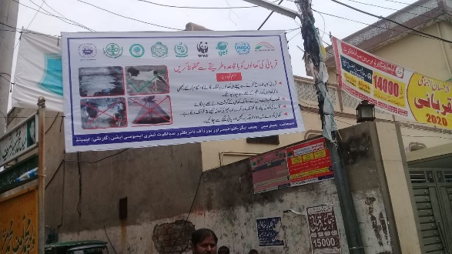
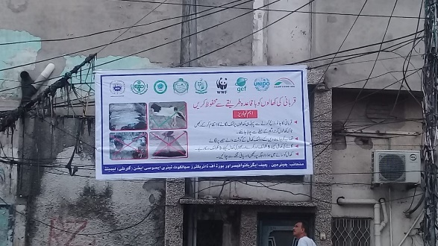
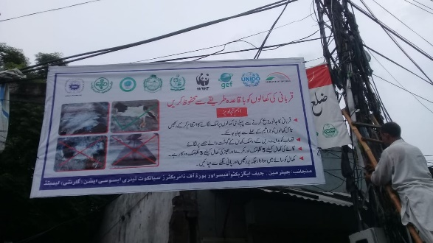
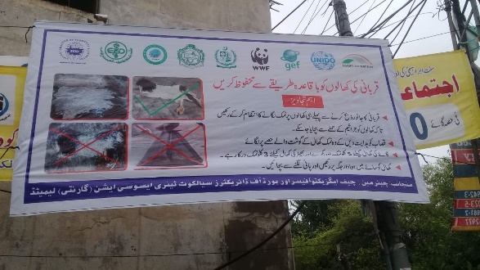
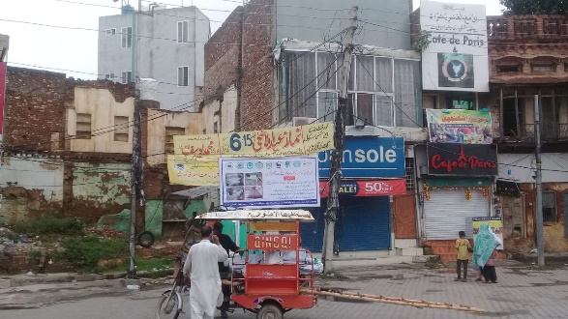
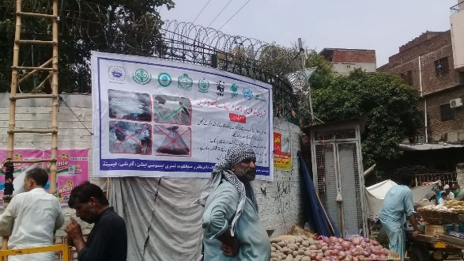
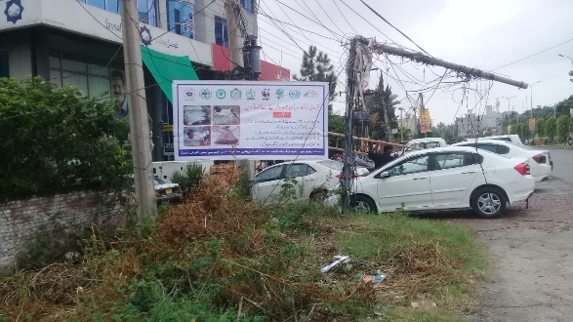
Awareness Raising on Eid-ul-Azha with STAGL

Slide 21
Activities in Process
Green Tannery Design Guidelines
Technical Support in implementation of Leather Working Group (LWG) Environmental Stewardship Protocol
Certification Programme for resource persons from leather and textile SMEs on ISO 14001:2015 Environmental Management System
Study on Green Financing
Life Cycle Assessment (LCA) of Leather Process
Implementation of Alliance for Water Stewardship Standard
Implementation of Green Office

Slide 22
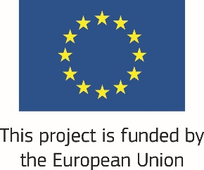
Thank You
Panda.org

