Slide 1
ESTABLISHMENT of
Sialkot tannery zone
Sialkot Tannery Association Guarantee Limited
November , 2020

Slide 2
Leather sector of pakistan
Amongst the manufacturing sector, after textile, leather industry is the 2nd largest foreign exchange contributor.
Contribution of leather sector exports has been hovering around 01 billion US Dollars per annum.
The exports of leather sector which were US$ 1.275 Billion during 2013-14 declined to US$ 948 Million during 2017-18. One of the major issue is the compliance of international environment standards.
Pakistan is an agro based Country and rich in livestock having Buffalo 35.6 Mn Nos, Cattle41.2 Mn Nos, Goat 68.4 Mn Nos & Sheep 29.4 Mn Nos.
The present government has introduced various livestock and dairy development programs which would ultimately result in availability of raw hides and skins in sufficient quantities to keep the tanneries running at optimum capacity as well as expansion of the tanning capacity.

Slide 3
Global Leather Sector Outlook
Pakistan Leather Sector Outlook
US$ 123 Billion Global Leather Market
Total Value: Around US$-1.00 Billion
Source: International Trade Center

Slide 4
Constraints viz a viz Opportunities
The growth of leather sector has however been restrained by an inability of the leather industry to meet rigorous customer requirements and compliance regulations of the importing countries.
Meeting environmental compliance standards has always been challenging for tanners as they produce waste in three forms solid, liquid and gas.
The major environmental concern for leather goods manufacture is the chemical and residues retained in the leather and managing solid waste materials.
The compliance of environmental & social compliance standards are mandatory for the EU markets as Pakistan has granted GSP+ status. Now a New requirement from the Brands of EU has also been introduced that is compliance of Leather Working Group (LWG).

Slide 5
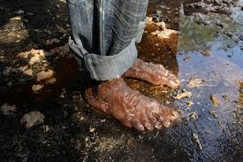
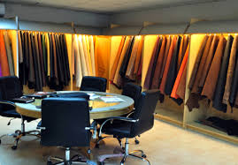
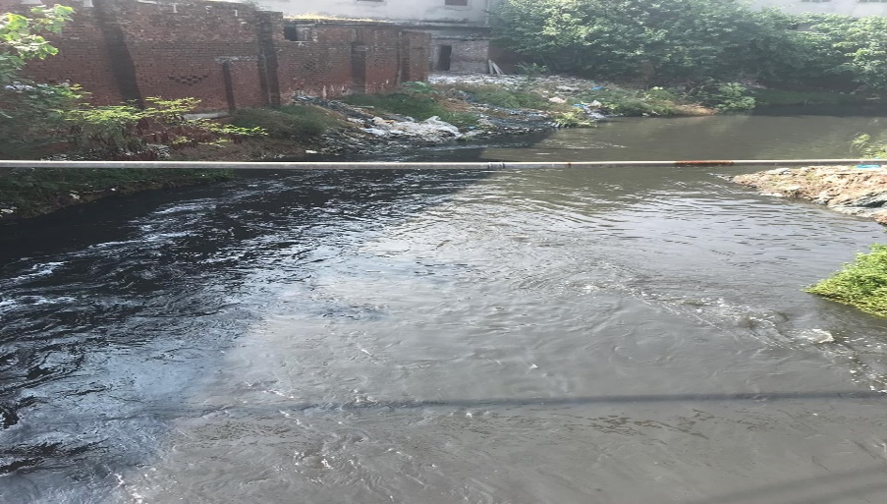
TANNING INDUSTRY & ENVIRONMENT
The tanning industry is considered one of the most polluting industries and it severe environmental degradation. During the tanning process more than 85% of the chemicals and the entire quantity of water are not taken up by the leather and this quantity is discharged to wastewater streams and most of the chemicals included in the wastewater are toxic and harmful in nature and pose hazards to the environment and human health.
HEALTH
ENVIRONMENT

Slide 6
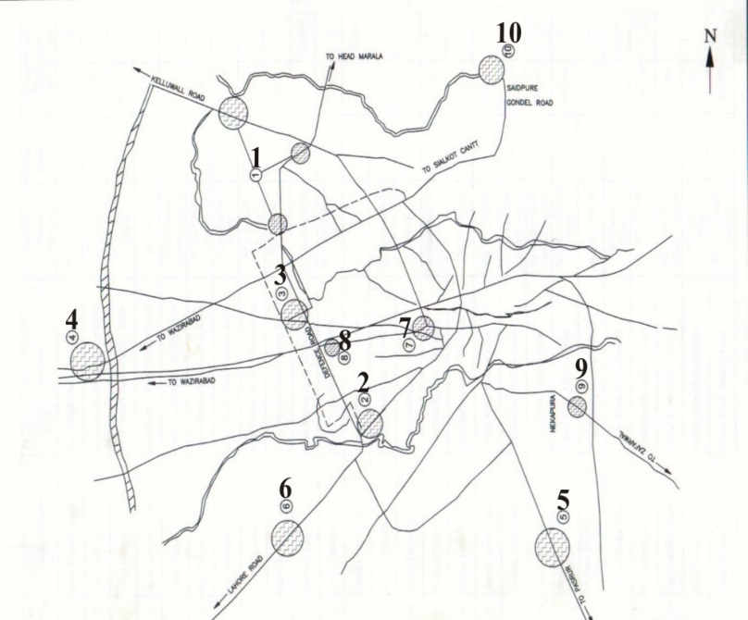
TANNING UNITS IN PAKISTAN
There are 250 tanneries scattered in 10 clusters in and around Sialkot.
Map of Sialkot City

Slide 7
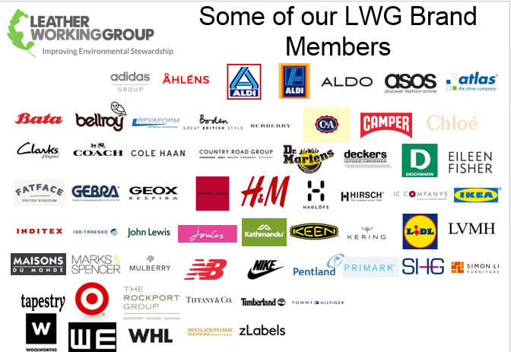

Slide 8
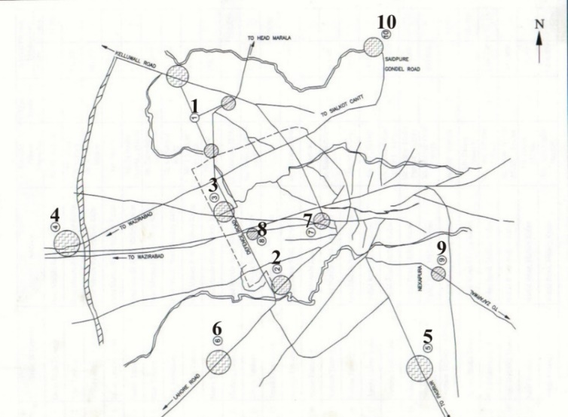
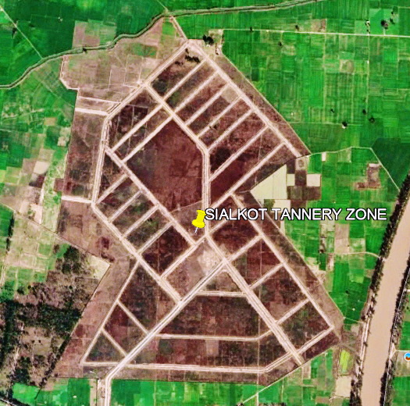
SOLUTION
Relocation of the tanneries to a more spacious location with appropriate infrastructure for efficient and cost-effective treatment of solid and liquid wastes has thus become a prerequisite for survival and growth of this vital export-oriented sector of the country’s economy and for protecting the region’s agriculture and health.

Slide 9
PROJECT IDEA
The establishment of Sialkot Tannery Zone was conceived by Sialkot Chamber of Commerce & Industries (SCCI) in 2004.
The project idea was submitted to Govt. of Punjab, Planning & Development Department through Environment Protection Department.
The project idea was appreciated by Govt. of Punjab and after various meetings with Planning and Development, Government of the Punjab and Environment Protection Department, Government of the Punjab it was decided to execute this project by Private Sector with the support of Government(EPD).
It was also decided the private sector (Sialkot Chamber of Commerce and Industry) will play the leading role in execution of this project. And for this purpose
Sialkot Tannery Association Guarantee Limited is formed.

Slide 10
Project Objectives
To enhance the exportability and International acceptability of the leather sector products of Pakistan through green productivity.
To enhance resilience of the communities in around Sialkot Tannery Zone through adaptation measures.
To centralize tanning activities to reduce environmental degradation.
To provide common facilities (CEPT, CRP, CFTC, etc.) to ensure adherence to the National & International Environment Quality Standards.
To reduce use of water, chemicals & waste in tanning process through introduction of cleaner production techniques, (e.g BAT, BEP, REACH) to comply with international requirements of LWG & GSP+.
To provide fresh employment to a number of people.
To improve health facilities of tannery workers
To stop ingress of toxicity to ground water.
To improve overall environmental situation in Sialkot
To allow improvement of infrastructure facilities in the city after re-location of existing tanneries

Slide 11
Financial arrangements
Source | Funds
Private Sector (STZ members) | Rs. 1645 million
Govt of Pakistan (Ministry of Commerce through EDF) | Rs. 1170 million
Govt of Punjab through EPD ( for land) | Rs. 292 million
International Donors (Global Environment Facility through Ministry of Climate Change & UNIDO) | Rs. 460 million (USD: 3.3 million)

Slide 12
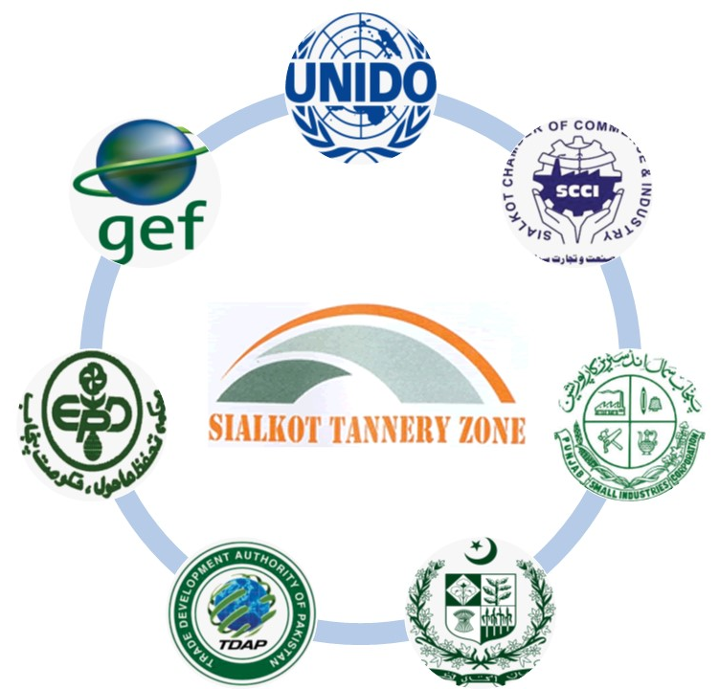
Project Partners
PROJECT PARTNERS
Sialkot Tannery Association Guarantee Limited (STAGL) through Sialkot Chamber of Commerce & Industry (SCCI) Lead Executing Partner
Ministry of Commerce, Govt of Pakistan – Export Development Fund
Ministry of Climate Change (MOCC), Govt of Pakistan
UNIDO (GEF Implementation Agency)
Industries, Commerce, Investment & Skill Development Dept. through PSIC, Govt of Punjab.
Environment Protection Department, Government of Punjab
District Government, Sialkot

Slide 13
Project Governance
A Project Steering Committee has also been formulated to overall monitor and execute the project. The composition of members of this PSC is as follow,
Secretary, Ministry of Climate Change, Govt. of Pakistan – Chairman
United Nations Industrial Development Organization – Convener
Representative of Ministry of Industry & production, Govt of Pakistan
Representative of Ministry of Commerce, Govt of Pakistan
Representative of Environment Protection Department, Govt. of Punjab
Representative of Sialkot Chamber of Commerce and Industry
GEF Focal Point – Climate Change Division
Representative of TADAP, Govt. of Pakistan
Representative of STAGL
Funding Partner
Project Steering Committee
Cahir: Secretary, MoCC
Member: Rep of MoIP, STAGL, UNIDO, MoC, TDAP, SCCI, EPD
Implementation Agency
Execution Agency –
STAGL
Project Management Unit
Headed by: Project Director
Supported by: UNIDO PMU, STAGL Staff; Resident Engineer; Driver; National & International Experts.
The members of PSC meets annually to review the updated progress of project, to give suggestions / inputs and to approve the yearly work plan of the project. The day to day affairs are looked after by STAGL Board.

Slide 14
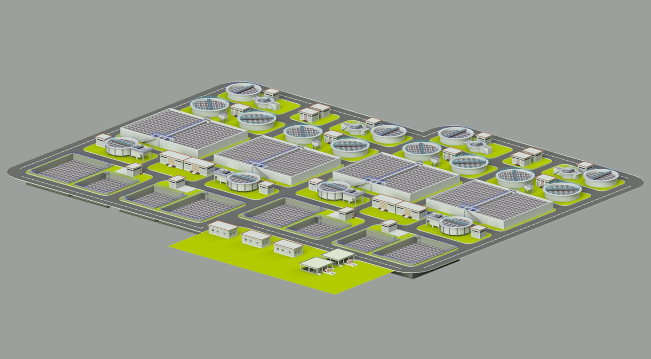
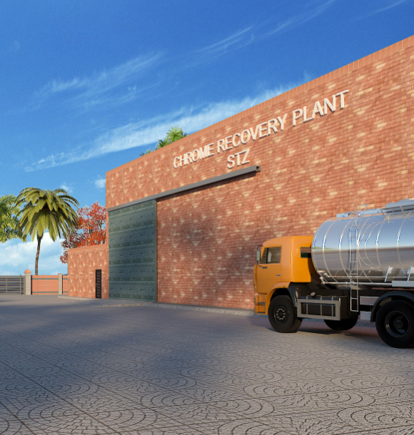
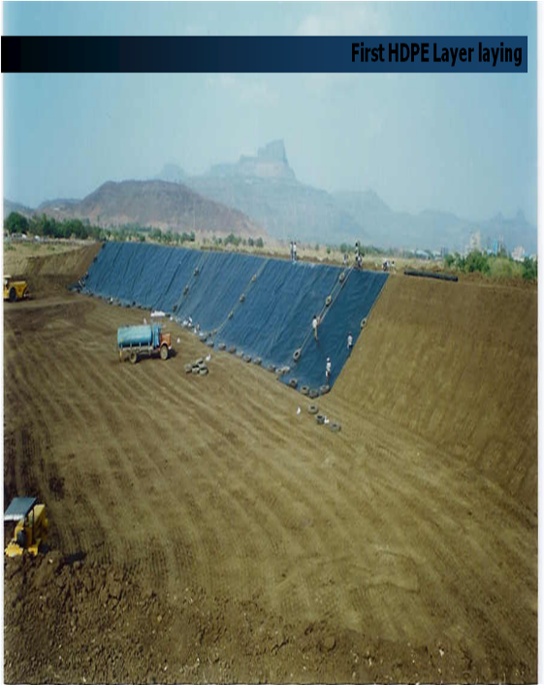
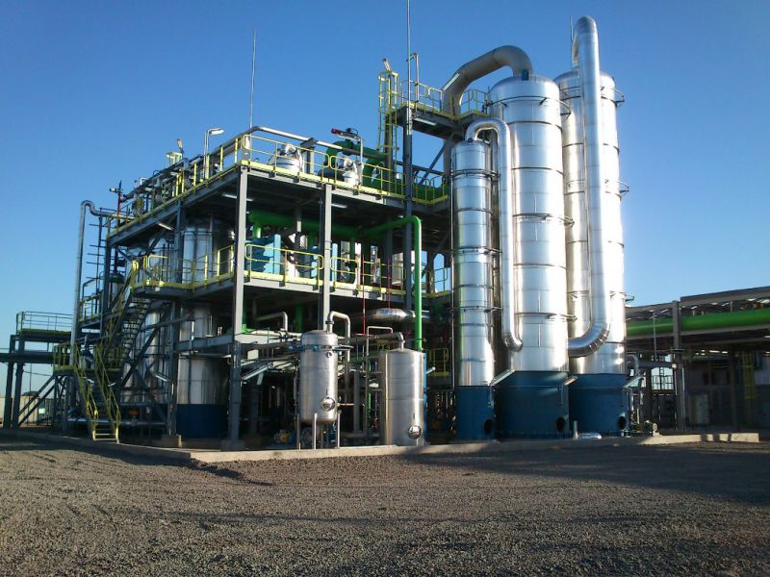
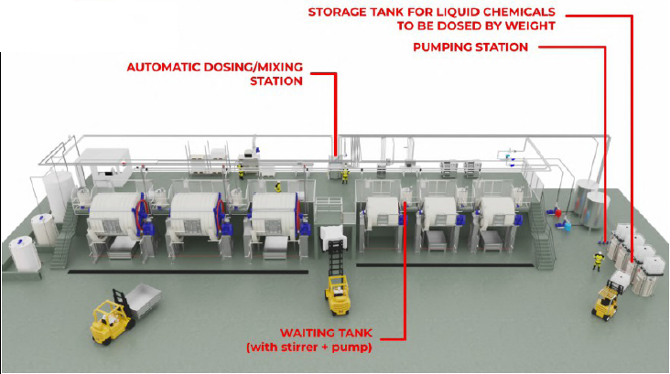
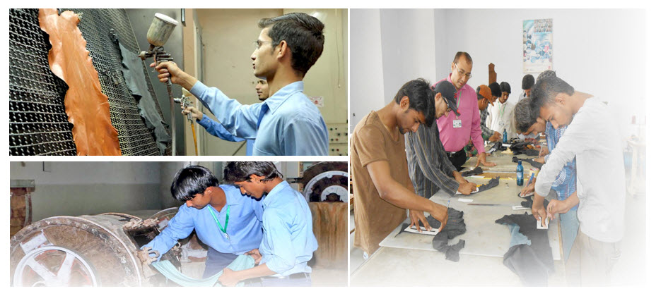
Major Common Facilities Planned for STZ
Common Effluent Treatment Plant
Common Chrome Recovery Plant
Integrated Solid Waste Management with Pakistan’s 1st W to E Plant
Typical Tannery Design based on new innovations, modern tech. Best Available Techniques & Best Environment Practices
Common Training & Facility Center

Slide 15
Progress of the Project

Slide 16
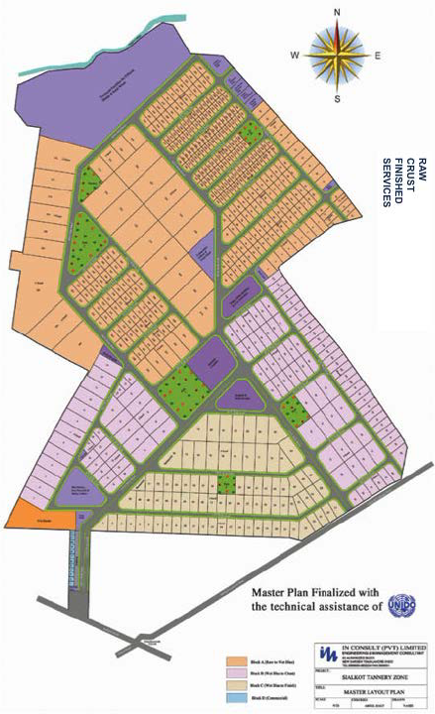
STAGL has acquired 396 Acers of land for establishment of STZ .
Plot Size | No. of plots as per approved layout plan
 | Block-A | Block-B | Block-C | Block-D | Total
10 Marlas | 0 | 0 | 0 | 24 | 24
1-Kanal | 137 | 0 | 1 | 0 | 138
2-Kanal | 199 | 6 | 0 | 0 | 205
3-4 Kanal | 26 | 72 | 64 | 0 | 162
5-9 Kanal | 11 | 36 | 18 | 0 | 65
10-14 Kanal | 4 | 3 | 2 | 0 | 9
16-19 Kanal | 7 | 0 | 0 | 0 | 7
23-Kanal | 1 | 0 | 0 | 0 | 1
24-Kanal | 7 | 0 | 0 | 0 | 7
32-46-Kanal | 2 | 0 | 0 | 0 | 2
Total | 394 | 117 | 85 | 24 | 620

Slide 17
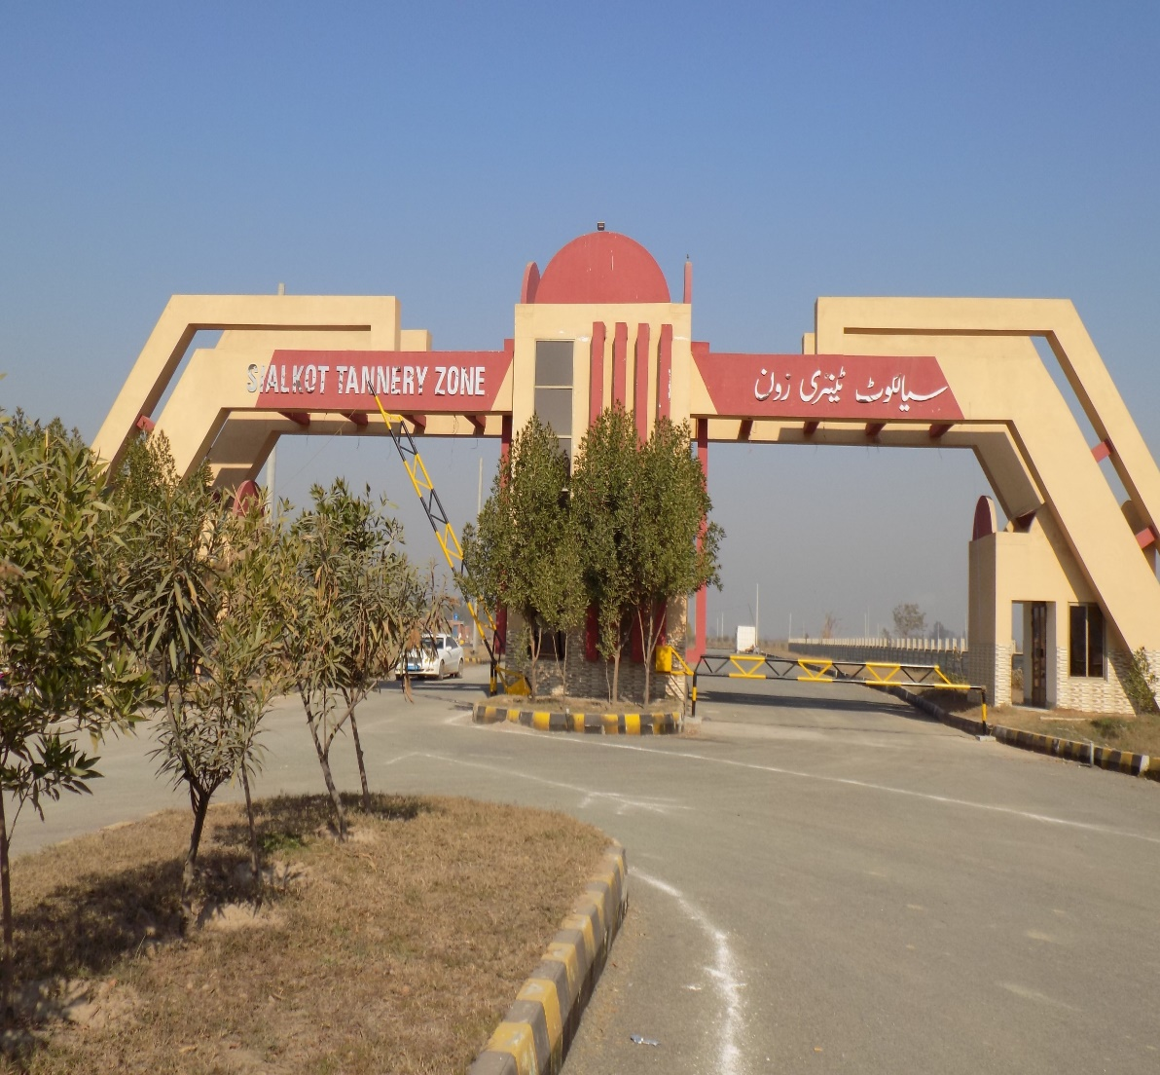
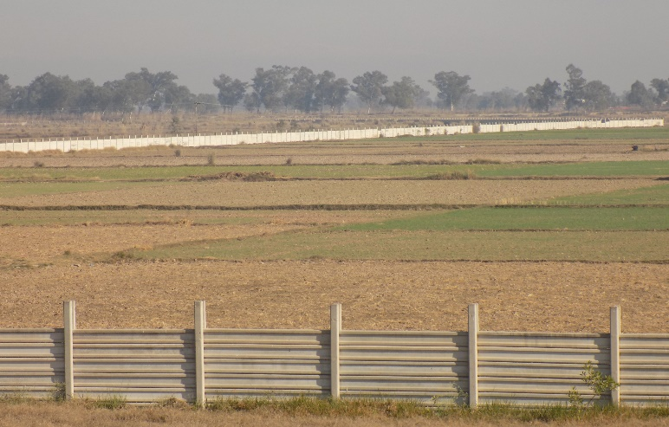
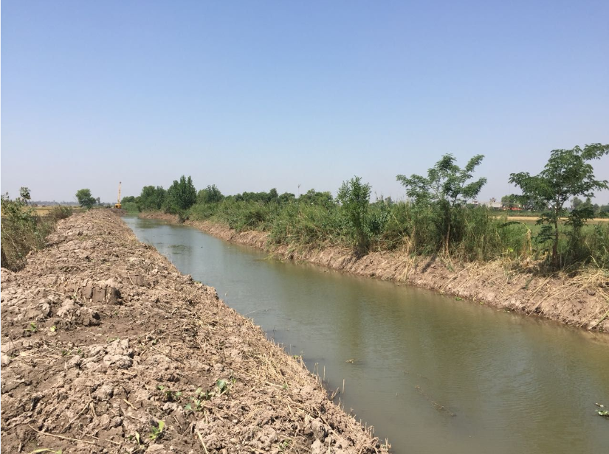
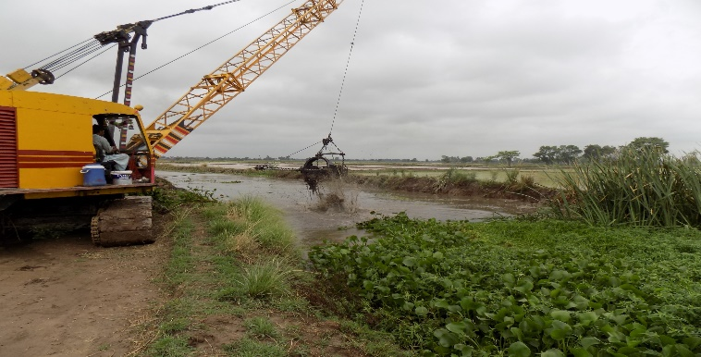
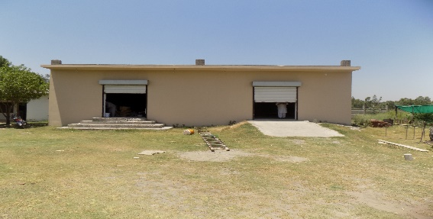
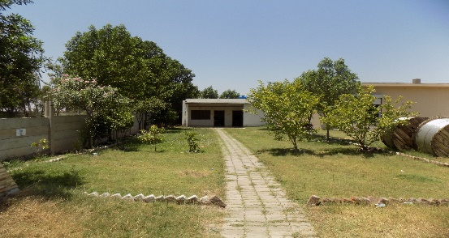
100 % Completion of
Boundary Wall
Main Gate
Site offices / Stores
Flood Protection Bund
One time Cleaning and Capacity raising of Dugri Drain- II
Plotting of Zone

Slide 18
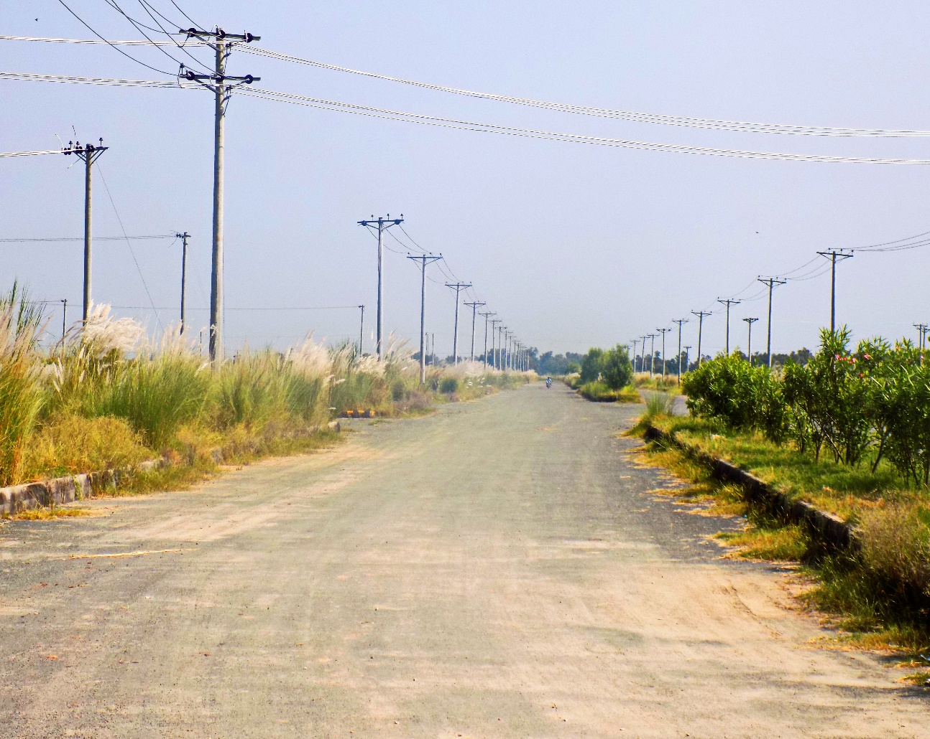
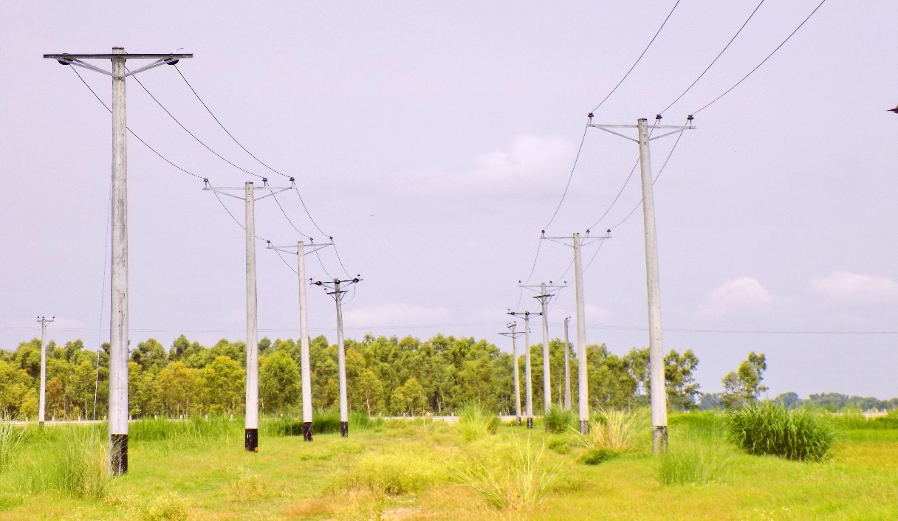
Internal Electrification & Temporary Supply
Internal Electrification & Temporary Supply of 5 MW | 100% Completed
Electric Cable & Connectors installation Investment of Rs 66 Million By tanners (Private Sector) | Temporary Supply of 5 MW by GEPCO has been energized. For Construction of 21 MW Grid Station. GEPCO has issues Demand Notice. EDF has approved Rs. 330 million & 1st instalment of Rs. 131 million has been released to GEPCO.

Slide 19
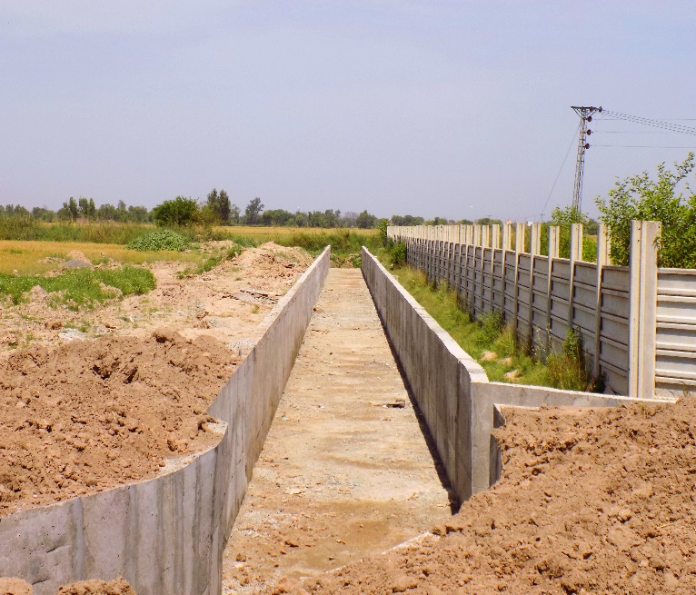
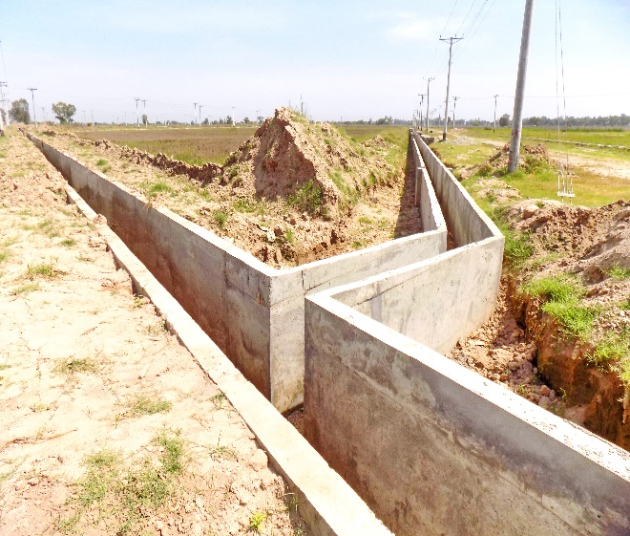
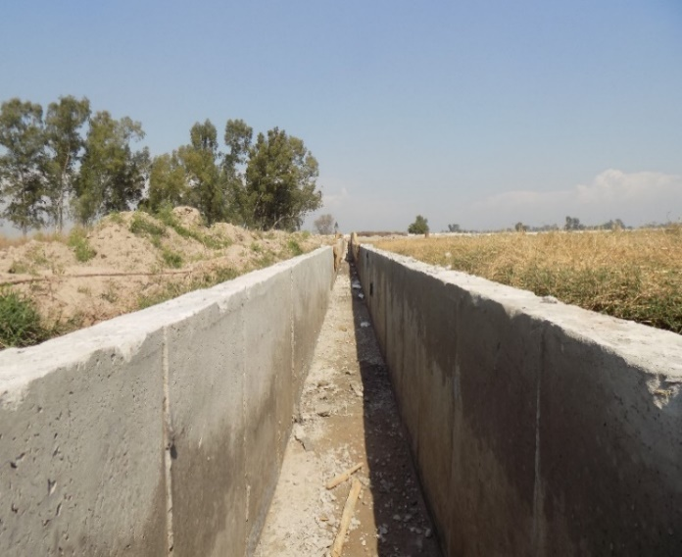
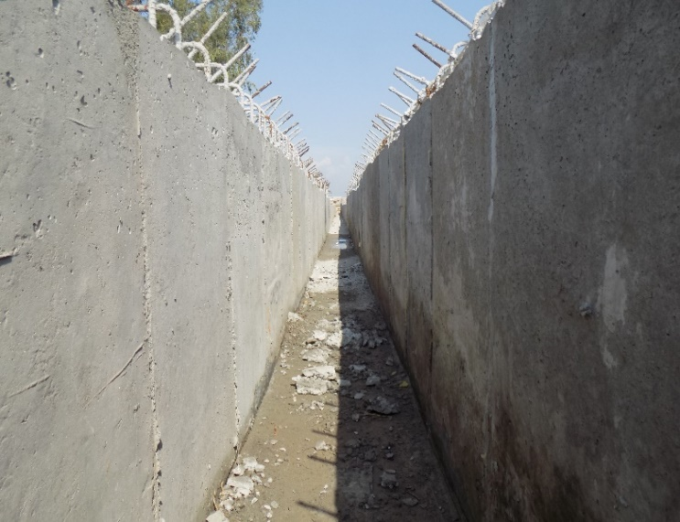
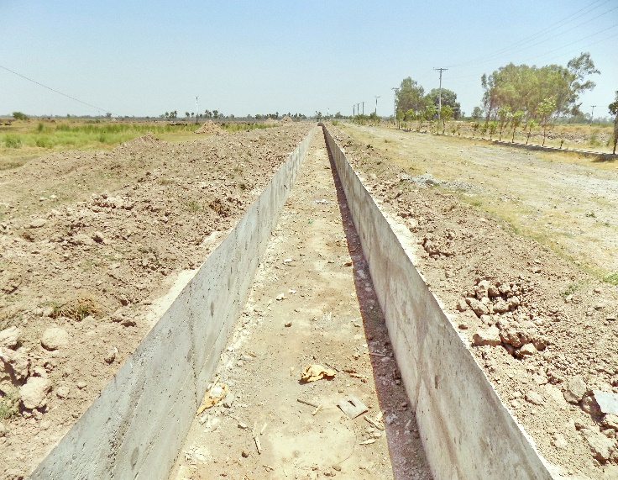
Conveyance Channels | Planned (km) | Completed (km) (Bed/Walls) | Progress (%)
Storm water | 11.82 Km | 11.82 Km | 100%
Effluent streams | 18.95 Km | 18.95 Km | 100%
Investment of Rs 700 Million (Private Sector: 620 million + EDF : 80 million) |  | Progress | 100%

Slide 20
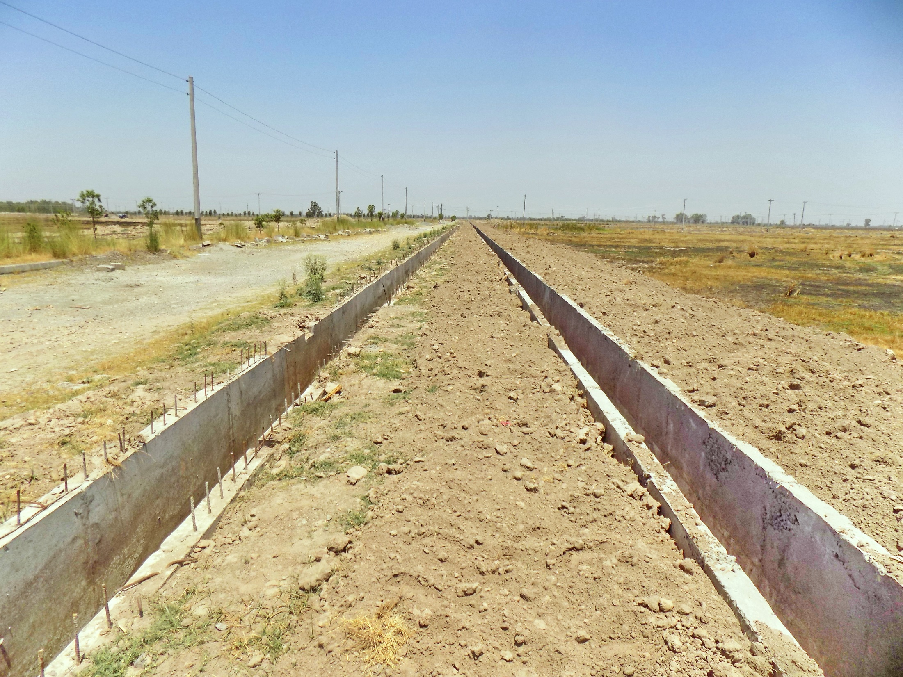

Slide 21
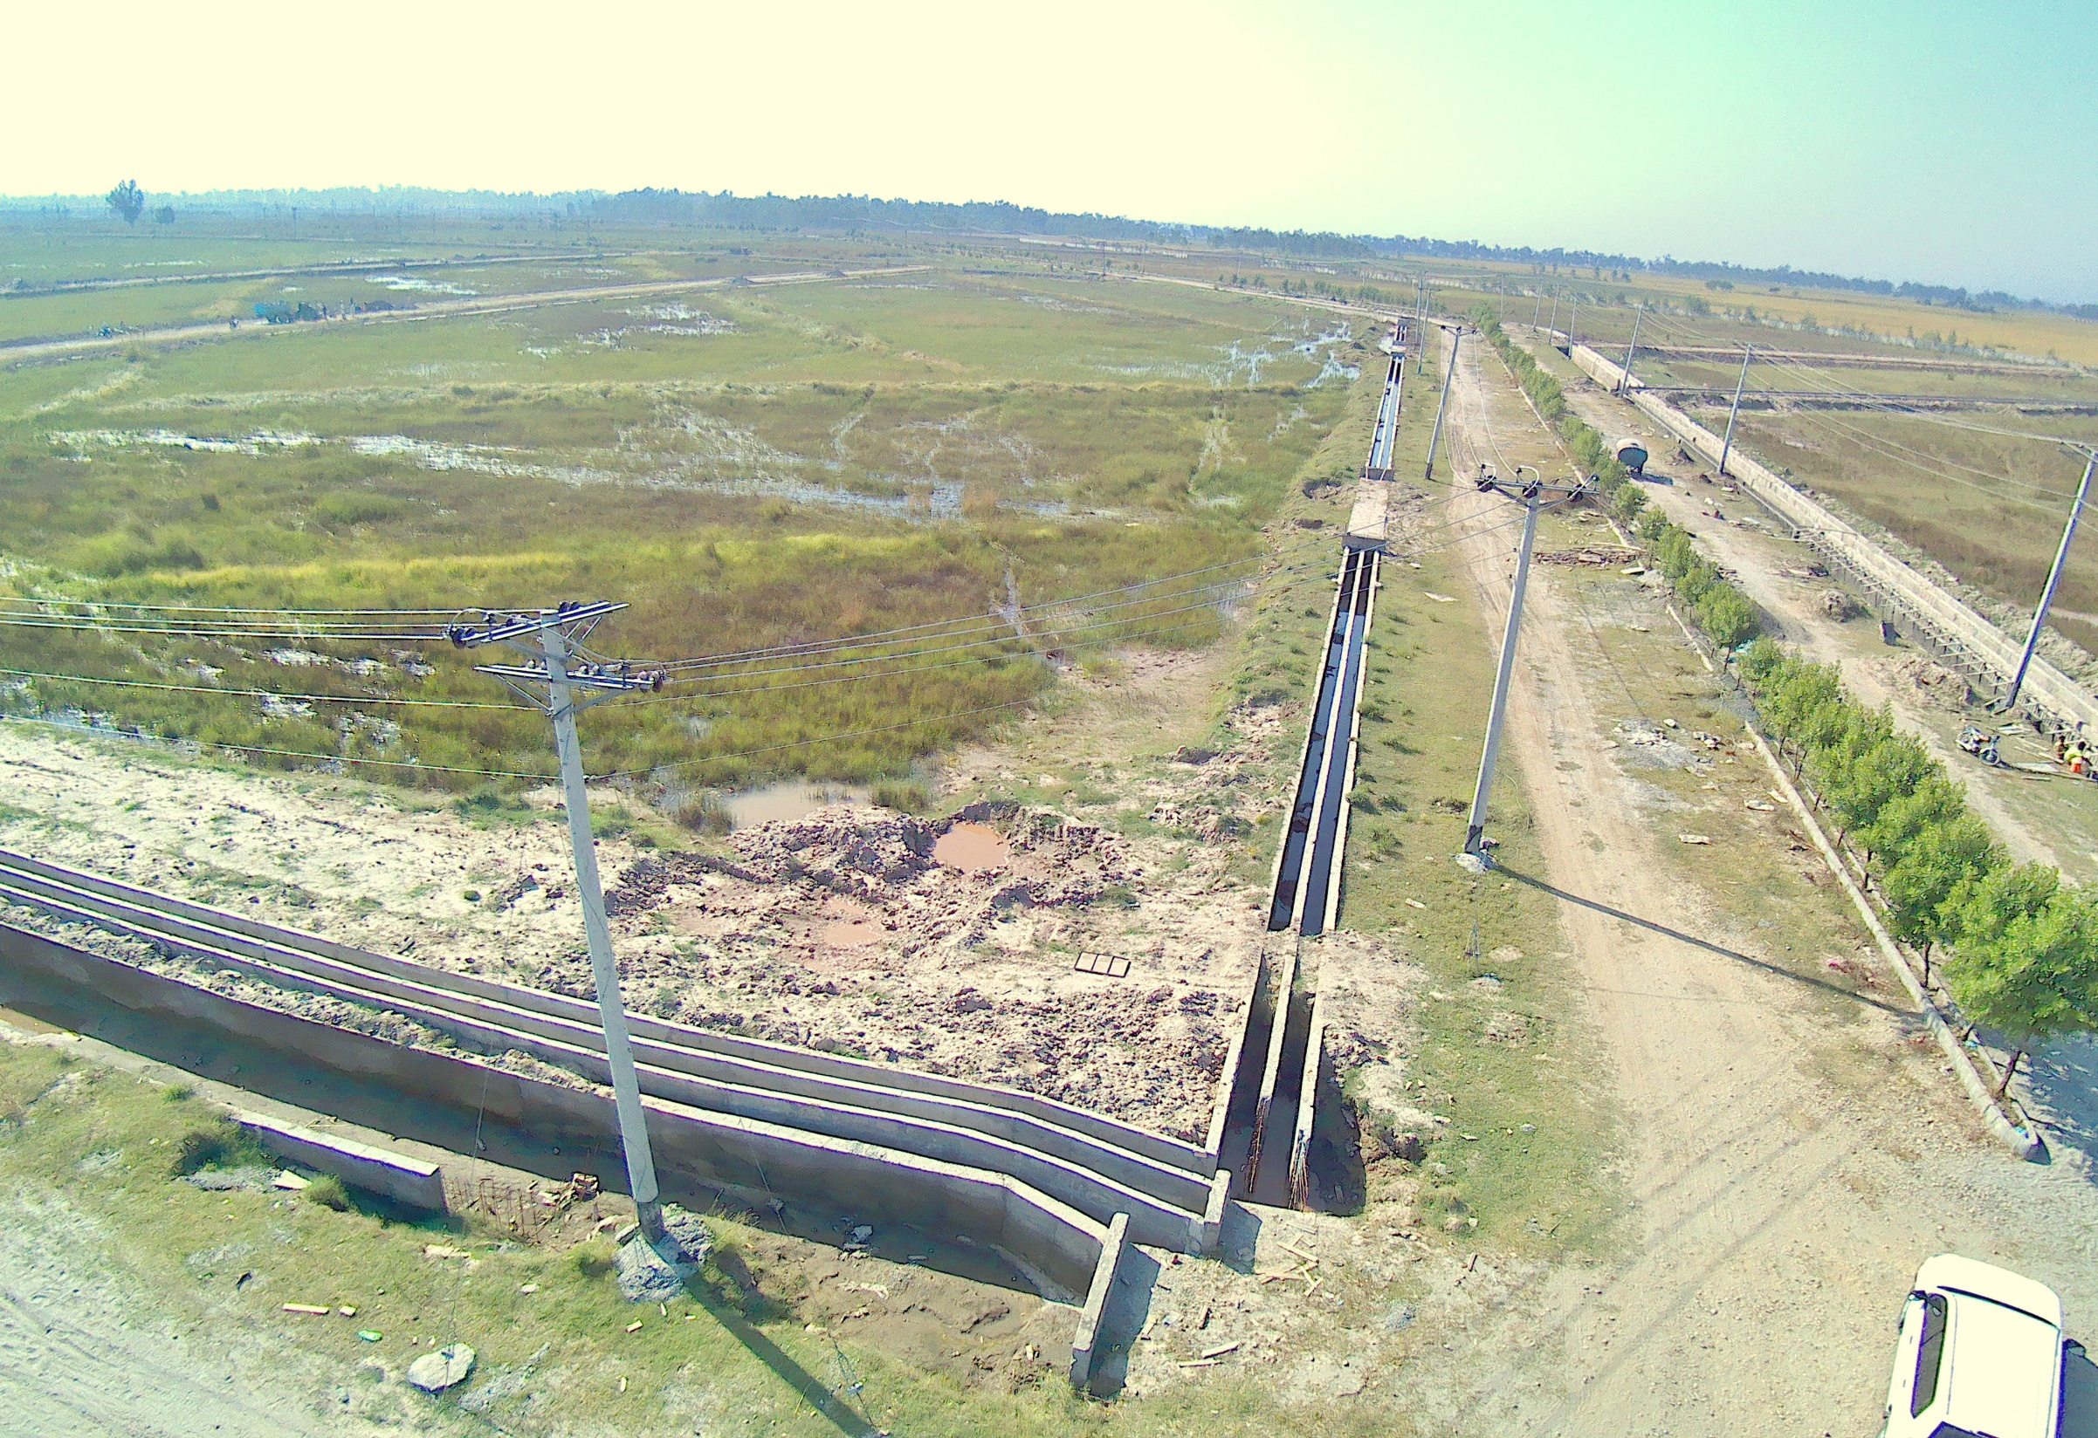

Slide 22
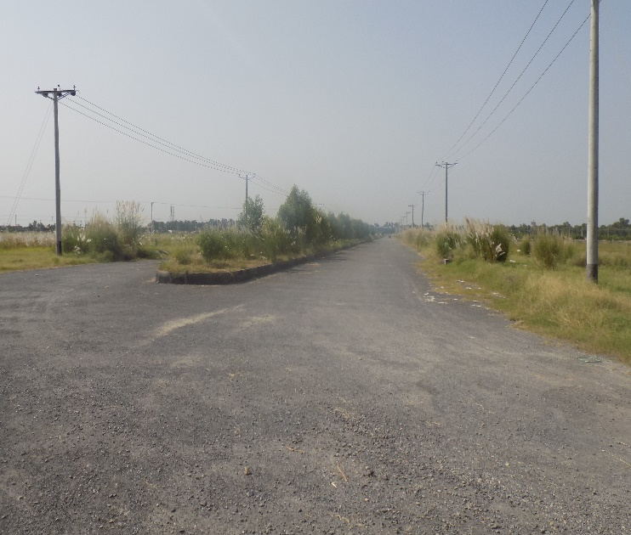
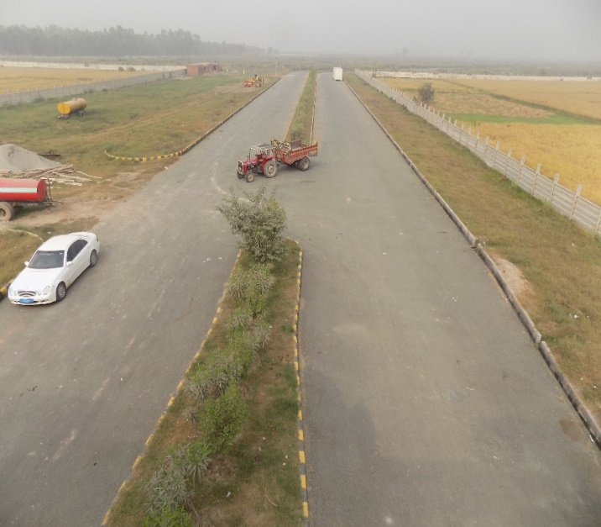
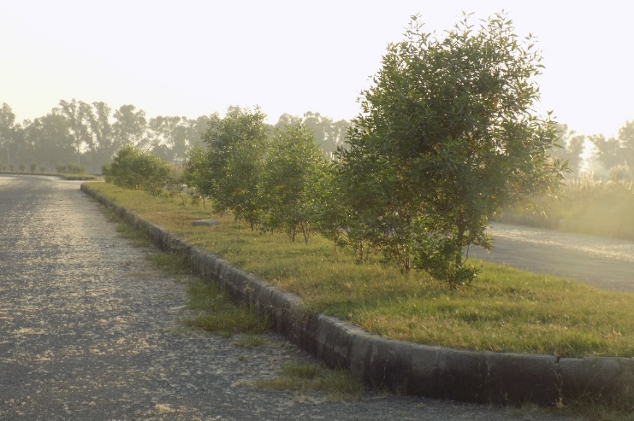
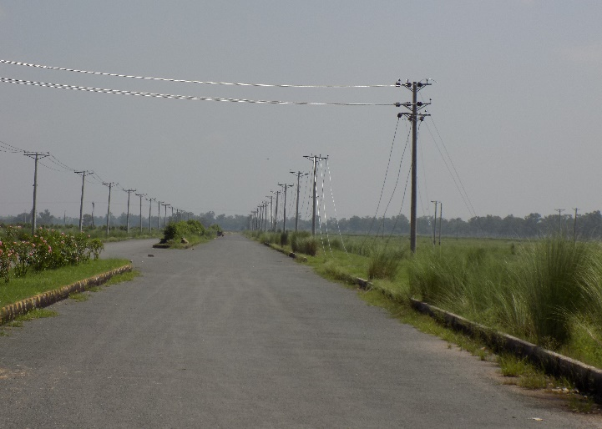
Internal Road Network
Investment Rs. 320 Million By tanners (Private Sector) | Progress | 80%
 | Only top layer left, which will be completed after heavy construction works at site.

Slide 23
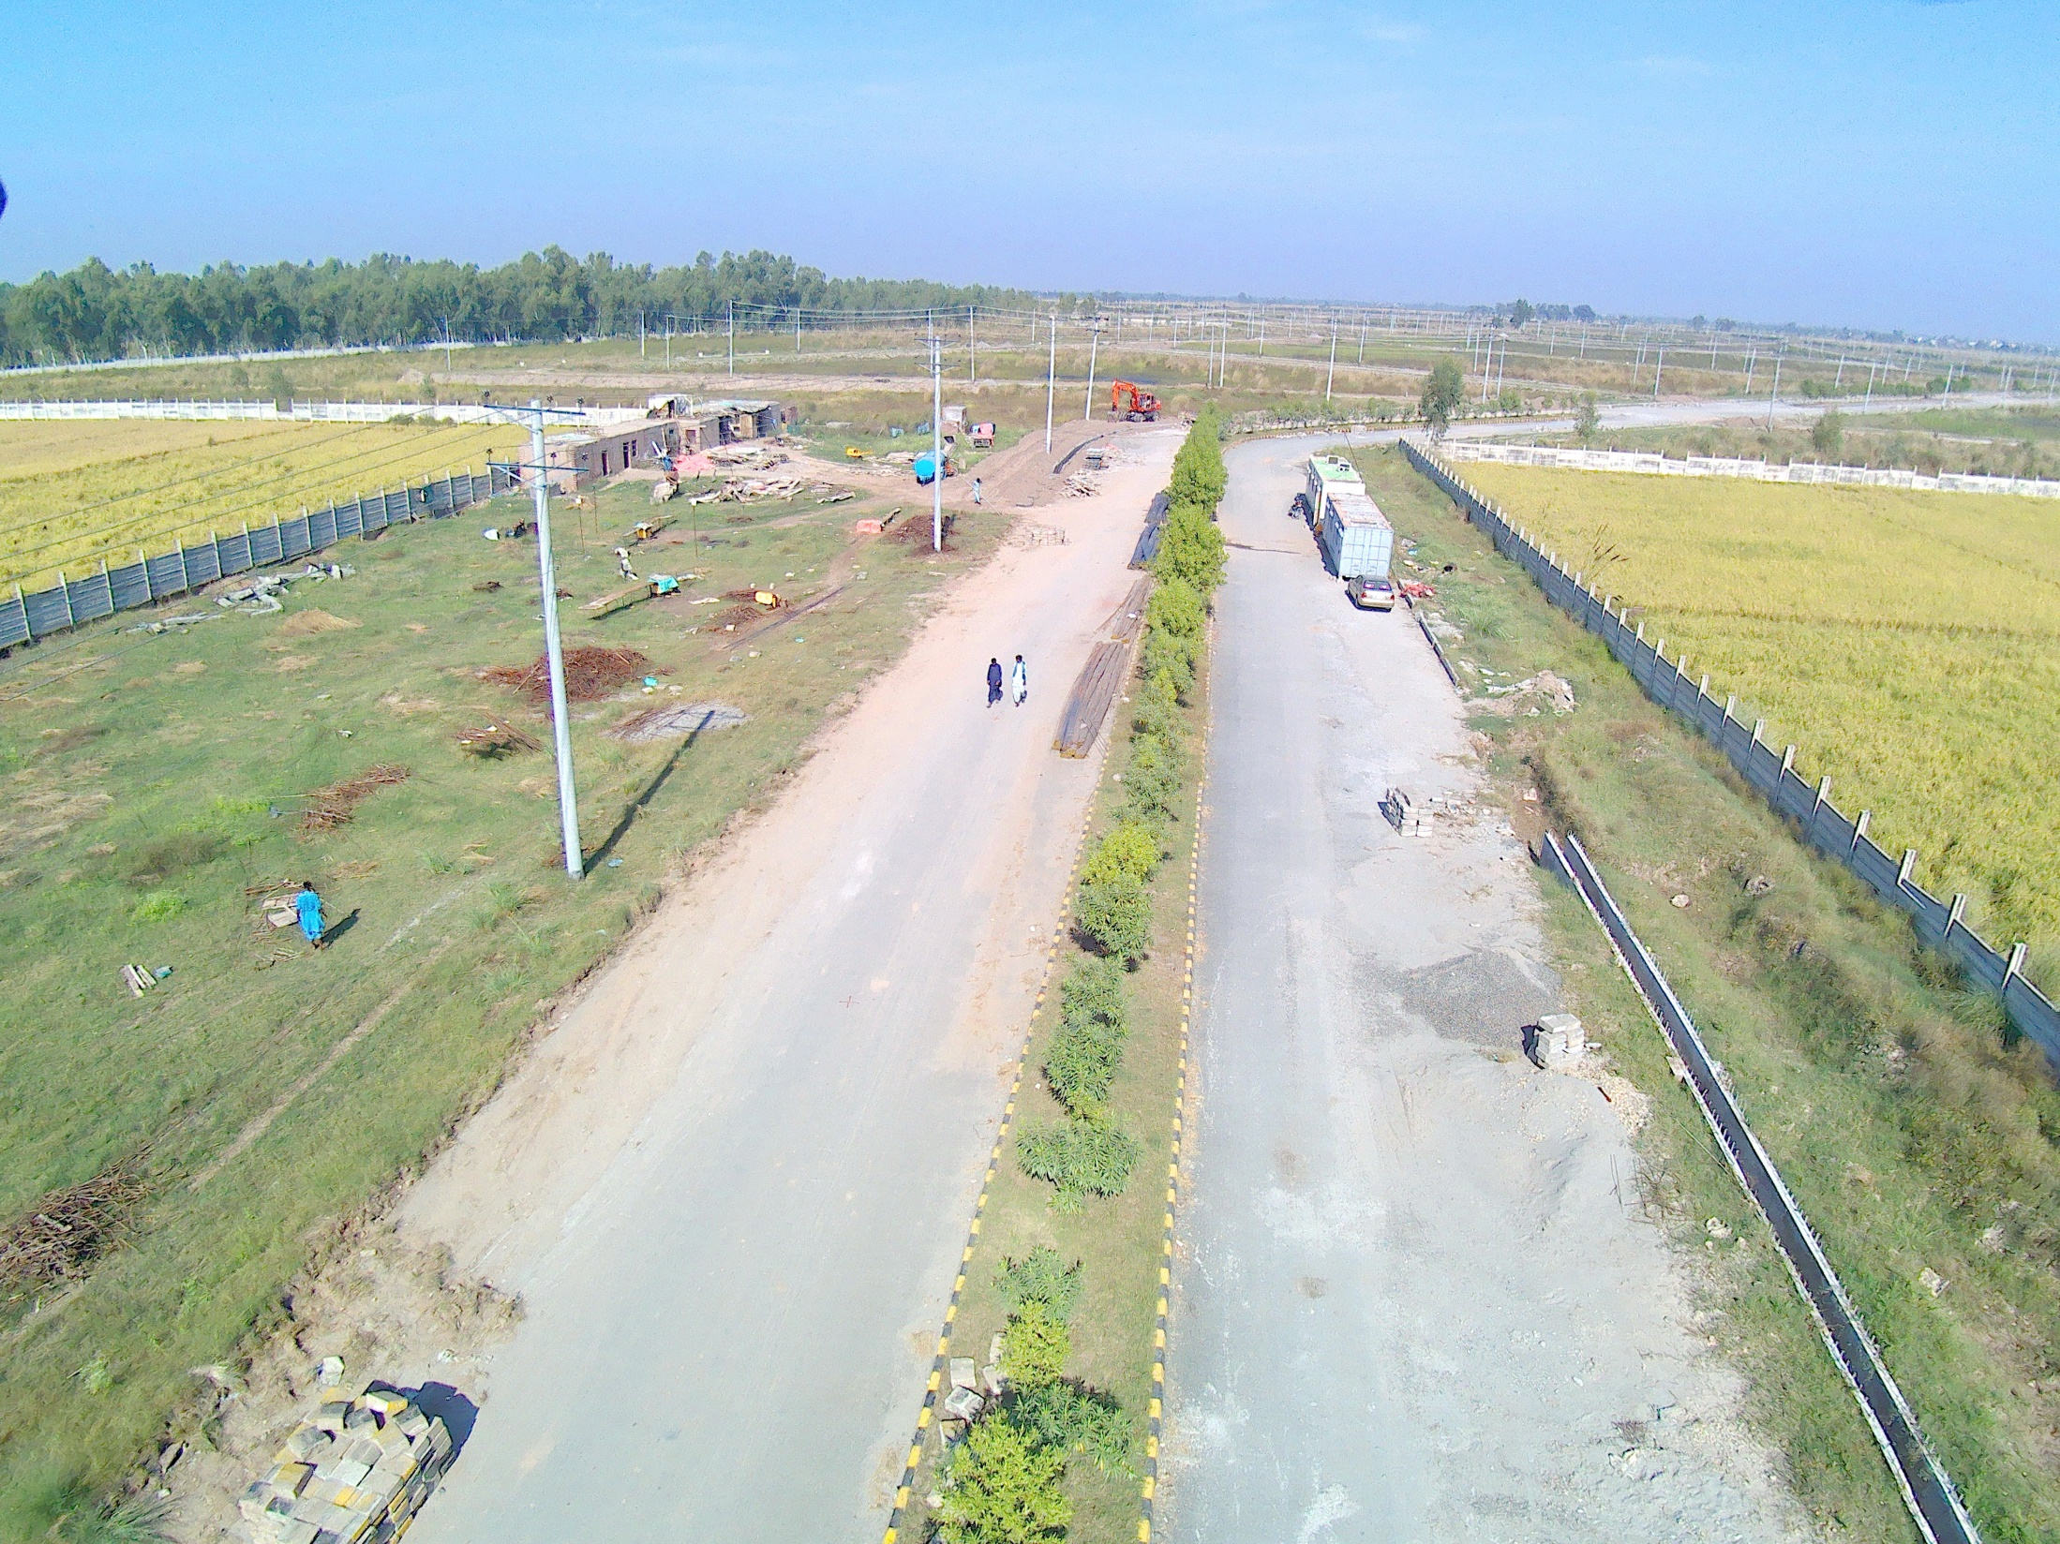

Slide 24
ESTABLISHMENT OF COMMON EFFLUENT TREATMENT PLANT
Detail Designing Completed.
EIA for construction of CETP has also been completed along with public hearing.
The Civil works of CETP to be undertaken with EDF approved funds. Through open competitive bidding process the contract of Rs. 387,717,589 has been awarded to lowest bidder. The contractor is in mobilization phase.
Tendering Process for Purchase of Mechanical & Electrical Machinery / Equipment, with the approved funding of GEF-UNIDO is under process. The technical & financial bids have been submitted by five companies and are under technical evaluation.

Slide 25
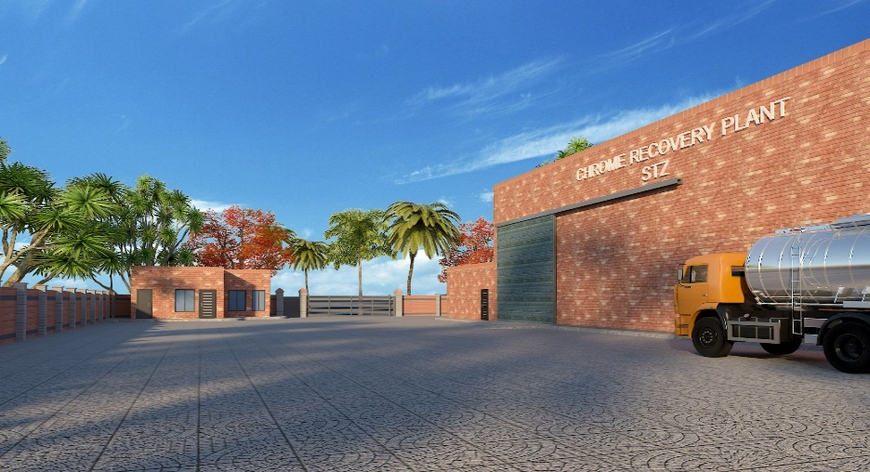
Chrome Recovery Plan (CRP)
CRP is necessary to recover and reuse the chrome so that the environment could be saved and the product could be competitive. It is planned to establish CRP having capacity of 60m3/day with estimated cost of Rs. 80 million
ToRs for Consultant : Completed
Hiring of Consultant : Completed
Techno-Economic Study : Completed
Detail Design : Completed
Tender Documents : Completed
Tendering Process : under TDAP approval process

Slide 26
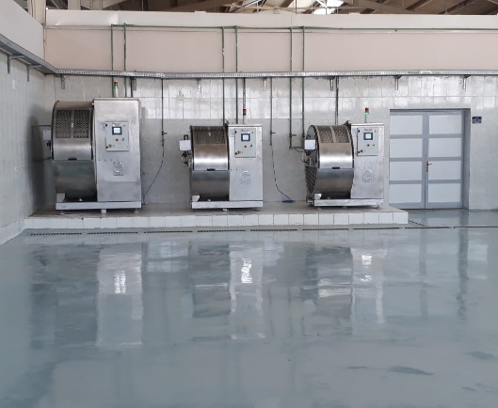
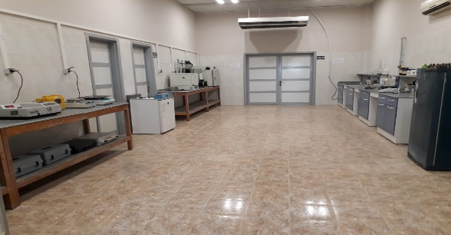
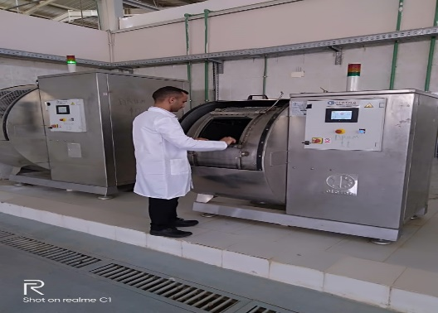
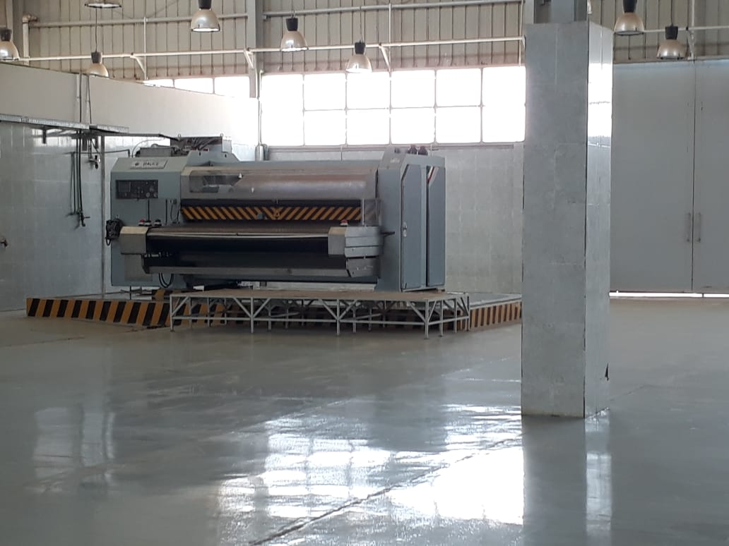
Common Facility Center
The tanning industry of Sialkot is considered as SMES. They are looking at STAGL for provision of technical assistance on modern techniques of finishing. Hence it has been planned to establish a common facility cum training center where training to the workers on modern Eco-friendly technique of leather finishing could be implemented according to latest trends & fashion.
Pre-Qualification : Completed
Hiring of Consultant : Completed
Detail Design : Underway

Slide 27
Landfill Site/Waste To Energy _{(Pakistan’s 1st W to E)}
The Waste generated by leather sector is rich in organic contents. In addition sufficient quantity of fleshings / trimmings from hides and skins is also generated by tanneries. To take cater this issue STAGL plans to establish scientific land fill site & solid waste to energy plant, leading towards production of electricity, fuel oils and syn gas.
Such facility based on advance thermal technology has been developed and utilized by British Leather Confederation (BLC) UK.
Initial Selection of Technology : Completed
ToR for Consultant (Waste Generation) : Under Review by BoD
Approval for EOI From EDF

Slide 28
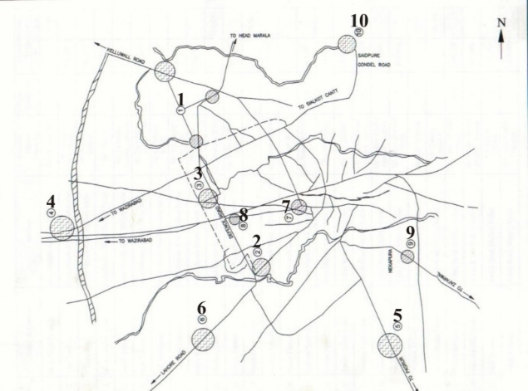
Shifting of Tanneries
The STZ Construction By-Laws have been completed and now under Translation & Printing Stage.
The Typical Tannery Design Guidelines has been prepared.
The Civil Designs of tanneries is under way.
It is planned to permit the tanners to shift their units at STZ soon after start of the construction of CETP & completion of civil designs of tanneries .

Slide 29
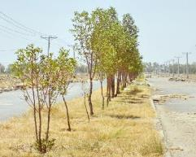
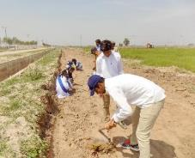
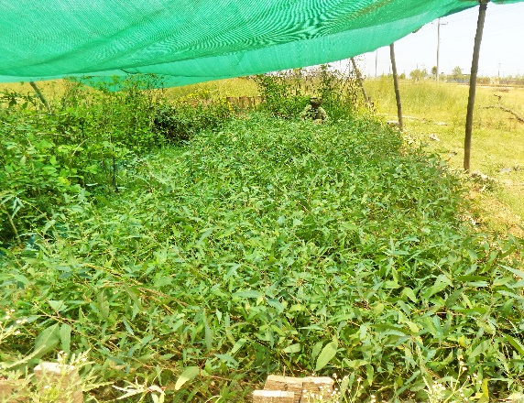
Other Initiatives on Climate Change Adaptation
Plantation
In order to reduce effects of climate changes and revitalize Sialkot Tannery Zone to a site with a greener, healthier, and more beautiful environment, STAGL along UNIDO-GEF launched various Tree Plantation Drive at Sialkot Tannery Zone (STZ). So far under this project 10,000 trees were planted.
Wetland
STAGL has planed to develop a wetland further polishing of treated effluent from CETP and to re-use it for horticulture purpose.

Slide 30
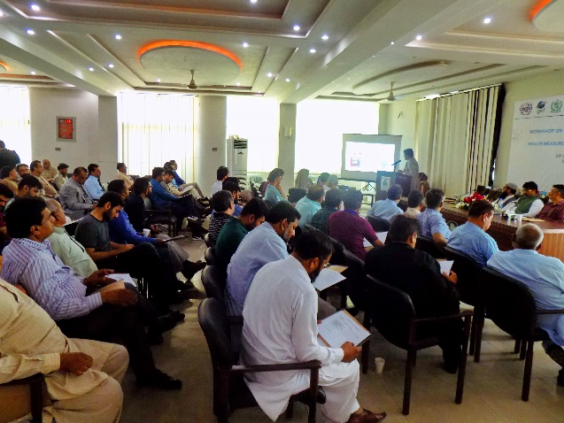
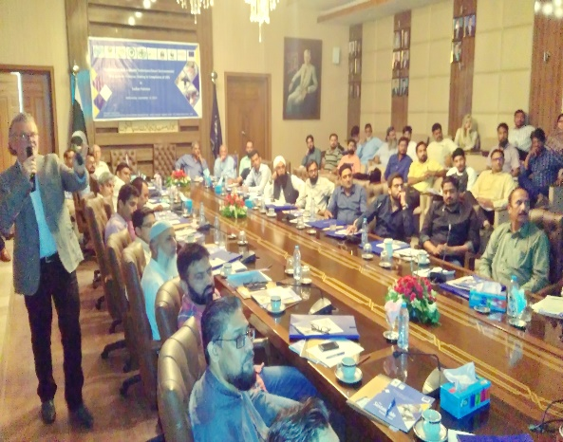
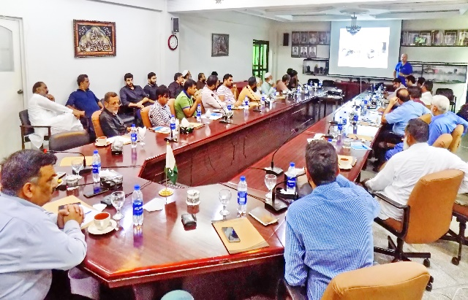
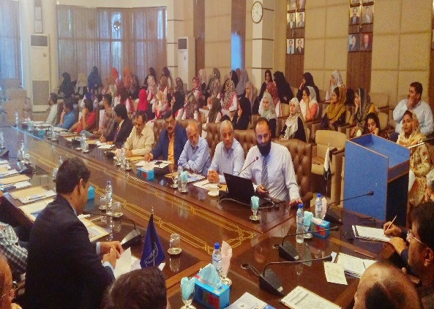
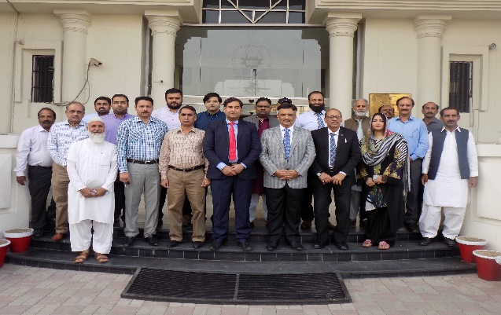
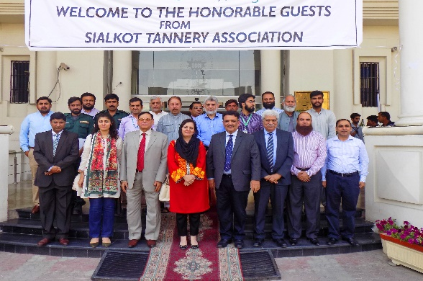
Other than Construction Activities
Human Resource – Capacity Raising Activities
Consultative Session on Common Chrome Recovery Plant
Occupational Health & Safety Measures in Sialkot Tanneries
Consultative Session on EIA Report for construction of CETP at STZ
Consultative Session on Typical Tannery Design
Workshop on Best Available Techniques / Smart Environmental Management Practices Leading towards Compliance of LWG Standards in Sialkot
Workshop of Climate Change: Emerging Issues, Adaptation Challenges and Recommendations for Leather Sector in Sialkot

Slide 31
Other than Construction Activities
Human Resource – Training
Topics
H2S Gas Safety
OSH Aspects in Leather manufacturing
Internship Program
Fire Protection
To Communities
Workforce of Tanneries
Rescue 1122
Leather Tech Institute
Female Students of GCWU- Sialkot
More than 150 persons get trained under this program.

Slide 32
Project Beneficiaries
Tanning Community
Youth in particular females by providing fresh job opportunities in the industry
Farmers with improved vegetation.
Livestock Business
Middle Management, Managers, Technicians and Technologists.
Chemical Industry & Chemical Suppliers
Local Engineering Industry
Academia and Research Institutes
Freight Forwarding & Cargo Sector
Govt Agencies in terms of revenue generation i.e, taxes, import duties, etc.

Slide 33
Project MISSION
Our MISSION is to successfully complete this mega project having great National Importance.
The Same did by Govt. of India in Kolkata Leather Complex, Govt. of Egypt in Cairo Leather Complex, Govt. of Turkey in Bursa tannery Zone and Govt. of China in Hinning Leather City.
Robiki Leather City - Egypt
Haining Leather City - China
Bursa Leather Zone - Turkey
Calcutta Leather Complex - India

Slide 34
Thank You

