Slide 1
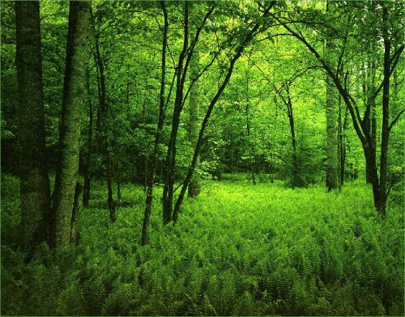

Bio-degradable Plastics
Environmental & Commercial Aspects
Presented By:
Muhammad Amin
National Sales Manager – d2w Pakistan
0334-4072383
amin@businessdynamics.com.pk

Slide 2

  Business Dynamics (Pvt) Limited, is the exclusive distributor of d2w Oxo- biodegradable additive in Pakistan for M/s Symphony Environmental Limited, UK (www.d2w.net) who is the world leader in OBD technology.

Slide 3

About Symphony Environmental
  Symphony is British Public Company quoted on the AIM market of the London Stock Exchange also on Plus Market and Bank of New York and Mellon US ADR program
  Global distribution network. d₂wTM is now in over 98 countries
  The Global Brand
  Global Headquarters – Borehamwood, England -UK
  Investment in R & D
  High Tech test facilities
  Chief Scientist, Professor Gerald Scott DSc, FRSC, C.CHEM, FIMMM
  Symphony is member of the Oxo-biodegradable Plastic Association (www.biodeg.org), The Society for Chemical Industry (UK), the American Society for Testing and Materials (ASTM), the British Plastic Federation (BPF), and the European Organisation for Packaging and the Environment (EUROPEN).
  Certified by ISO represented by British Standard Institute, the ISO and the CEN.

Slide 4
Plastic is fantastic!!!

Slide 5
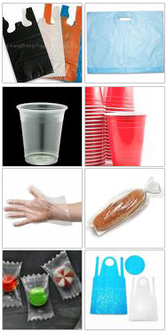
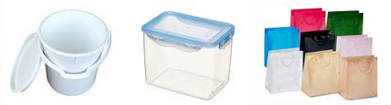
The benefits of Plastic Packaging
  Lightweight
  Flexible
  Strong/Durable
  Heat sealable
  Impervious to moisture
  Printable
  Recyclable
  Reusable
  By-product of oil refining

Slide 6
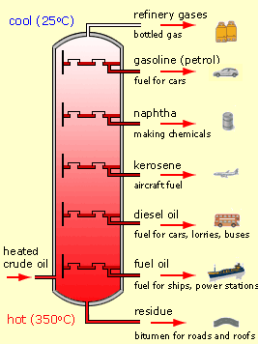
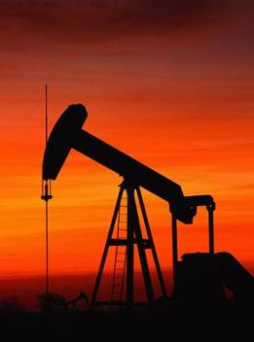
Using available resources
NAPHTHA →RAWMATERIAL→ PLASTIC BAG
LPG 2%
Gasoline 45%
Naphtha 3%
Aviation Fuel 15%
Diesel 15%
Lubricants 5%
Heating Oils 10%
Bitumen 5%
Plastic is made from a by-product of oil refining process.
Plastic is made from less than 4% of oil
It makes good environmental sense to use it for plastic production, otherwise it could be flared off.

Slide 7

Environmental benefits of plastic
Fossil fuel used to produce:
Energy
A million square meters of cellophane 180 tonnes
A million square meters of PP Film 76 tonnes
A million glass bottles 230 tonnes
A million PET bottles 66 tonnes
60 miles of cast iron Pipe 2000 tonnes
60 miles of Plastic Pipe 270 tonnes
Notes:
For every million square meters of cellophane produced 180 tonnes of fossil fuel is utilised.
To manufacture the equivalent million square meters in polypropylene only 76 tonnes are used.
Glass bottles compared to PET bottles gives a similar scenario,
And cast iron pipe compared to PVC piping is really dramatic at nearly a tenth of the amount of fossil fuel required.

Slide 8


“ BUT WHAT
HAPPENS AFTER THE USEFUL LIFE
OF PLASTIC” ”

Slide 9
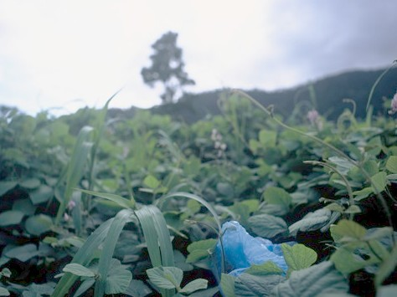


400 years
*FACT
PLASTICS CAN TAKE
UP TO 400 YEARS TO
BREAK DOWN
TRUE
5

Slide 10
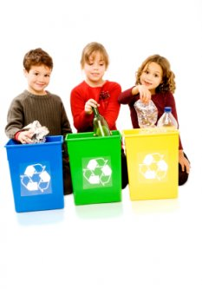
The Plastic Disposal Issue
  Current options on disposal of plastic waste:
  Traditional landfill
  Incineration
  Recycle
  Composting
  ONLY IF IT CAN BE COLLECTED

Slide 11
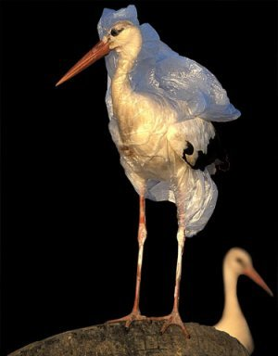
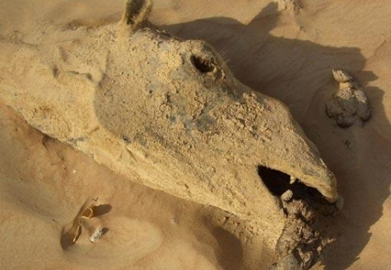
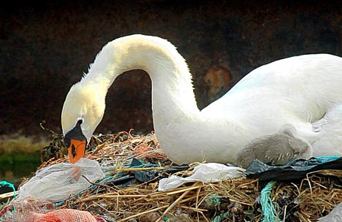
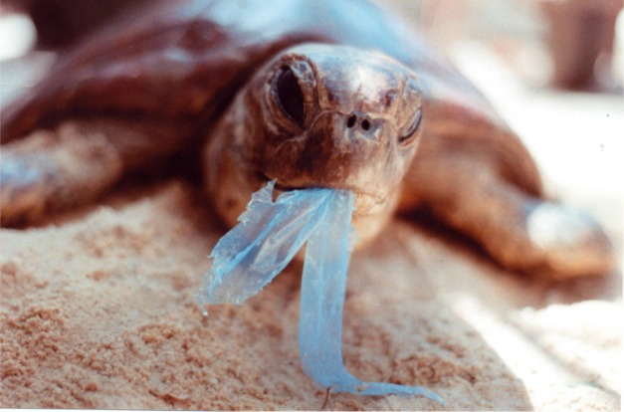
Environmental Disadvantages of Commercial Packaging Plastics
A major source of very visible litter
In many cases, litter cannot be economically collected and may be too contaminated to be recycled
Plastics packaging is bulky in landfill
85 percent of all sea turtles will be injured or killed by plastics in their lifetimes
Plastic particles have been found in the stomachs of 63 species of sea birds around the world
Plastic bags and other plastic garbage thrown into the oceans kill as many as 1 million sea creatures every year

Slide 12
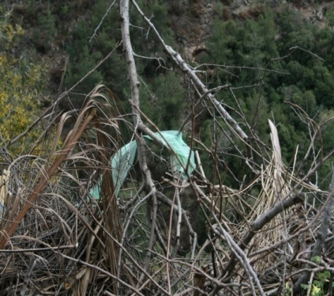
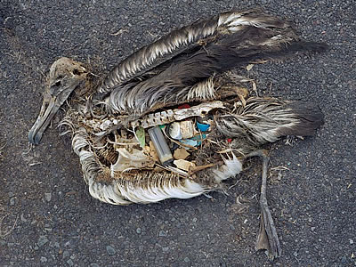
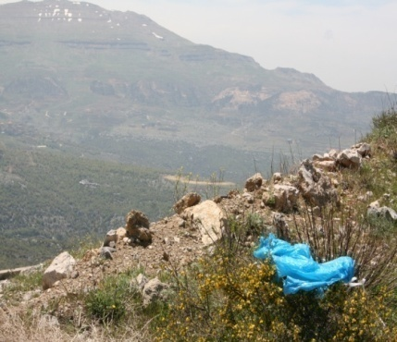
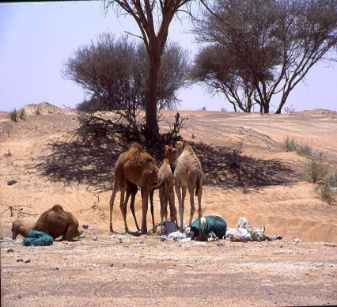
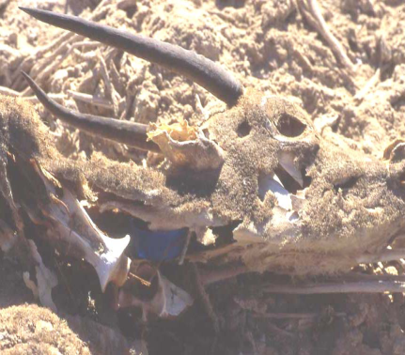

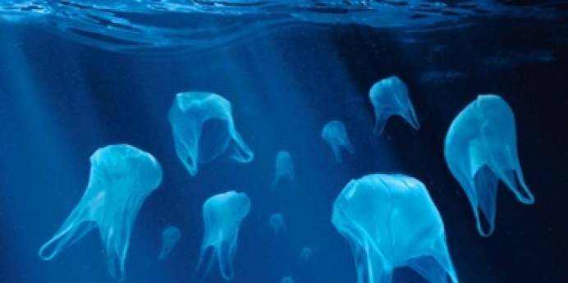
Problems caused by plastic that
escapes collection

Slide 13

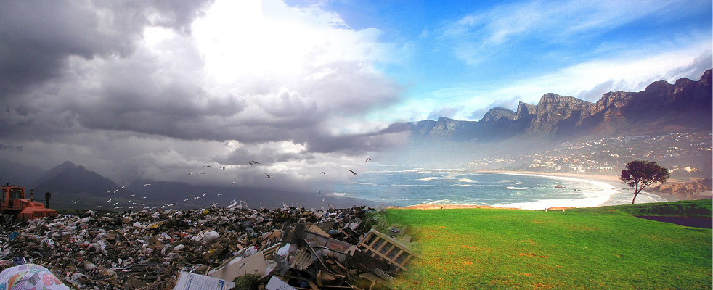
Symphony Environmental has
developed the solution for this plastic
pollution problem by developing
a new technology called “d₂w ”

Slide 14


Added Value Solution
  d₂wTM Oxo-Biodegradable Plastic Technology
Useful life
  1 – 5 years of useful life depending on customer’s requirement.
  Degradation starts after the end of the products’ predetermined useful life span*
  If littered, degradation can start in 3 months when exposed to hot climatic conditions
Littering life
  * Depends on product type and exposure conditions

Slide 15




Responsible use of plastic
The Three R’s
  REDUCE: will reduce the burden of persistent plastic waste in the environment
  REUSE: based products can continue to be reused during its useful life.
  RECYCLE: based products can be recycled and made from recycled plastic polymers
Notes:
For every million square meters of cellophane produced 180 tonnes of fossil fuel is utilised.
To manufacture the equivalent million square meters in polypropylene only 76 tonnes are used.
Glass bottles compared to PET bottles gives a similar scenario,
And cast iron pipe compared to PVC piping is really dramatic at nearly a tenth of the amount of fossil fuel required.

Slide 16
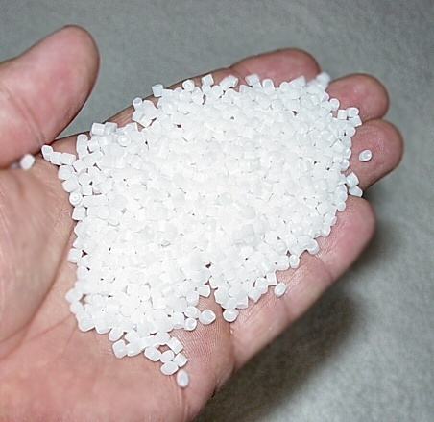
d₂w® Oxo-Biodegradable Additive
system
  Used with virgin & recycled polymers
  Compatible with Polypropylene PP, Polyethylene PE, PS, polyester & most consumable Plastic Packaging (HDPE, LDPE, LLDPE)
  Inclusion rate is 1%
  1 year to 5 years shelf life - The stabilisers used in the d₂w® additives allow for controlled degradation

Slide 17
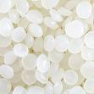
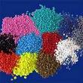


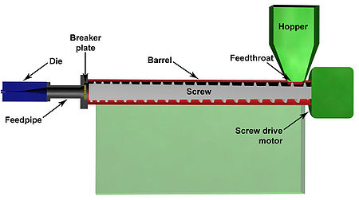
d₂w® Oxo-Biodegradable Additive system
+
+
=
Raw Material ( PE or PP )
Master batch
d2w additive
d2w degradable product

Slide 18

How does d₂w® Oxo-Biodegradable plastic work?
d₂w® is an additive technology that is added to the basic polymer resin during the manufacturing process
Breaks molecular chain
Plastic starts degrading at end of pre-determined useful life
Process of oxidation – accelerated by light, heat and stress
Bio-degradation completed by micro-organisms
Residues
  Water
  CO₂
  Biomass

Slide 19

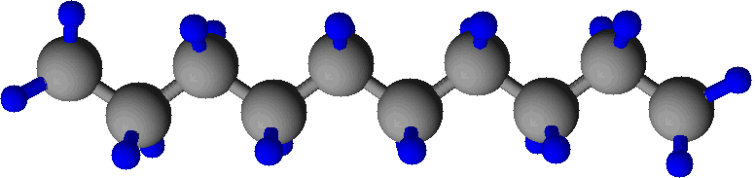

Oxo-biodegradable plastics
The process of Degradation
Long Chains / Flexible material
Short chains /
brittle
CO₂ + H₂O
+ Biomass
OXIDATION
MICROBIAL DEGRADATION
Carbon
Hydrogen

Slide 20
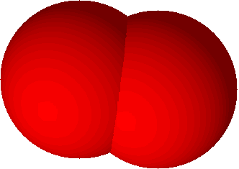



Oxo-biodegradable plastics
The process of Degradation
Long Chains / Flexible material
Short chains /
brittle
CO₂ + H₂O
+ Biomass
OXIDATION
MICROBIAL DEGRADATION
Carbon
Hydrogen
Oxygen
degradation is affected by heat, light, stress and air

Slide 21








Oxo-biodegradable plastics
The process of Degradation
Long Chains / Flexible material
Short chains /
brittle
CO₂ + H₂O
+ Biomass
OXIDATION
MICROBIAL DEGRADATION
Carbon
Hydrogen
Oxygen
Micro-organism
(Stenotrophomonas sp., Pseudomonas sp., Rhodococcus sp., Acinetobacter sp. etc)

Slide 22
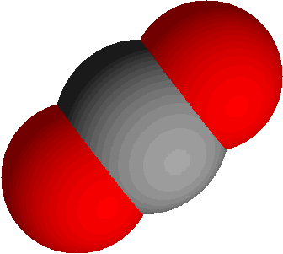


Oxo-biodegradable plastics
The process of Degradation
Long Chains / Flexible material
Short chains /
brittle
CO₂ + H₂O
+ Biomass
OXIDATION
MICROBIAL DEGRADATION
Carbon
Hydrogen
Oxygen
Micro-organism
(Stenotrophomonas sp., Pseudomonas sp., Rhodococcus sp., Acinetobacter sp. etc)
After the degradation process the harmless residues are CO₂, H₂O and Biomass.

Slide 23
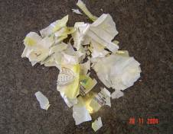
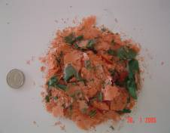
Degradation
in Real Pictures
Embrittlement of plastic bag
Continuing fragmentation

Slide 24
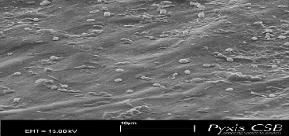
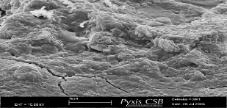
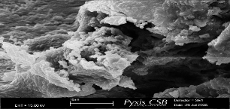
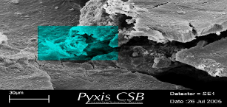
How does it Work?
The process in Microscopic Pictures
Un-oxidised film. Film intact and limited microbial activity on surface due to the surface being hydrophobic
Cracks and fissures on surface of oxidised, hydrophilic film
Microbial colonisation on surface of oxidised, hydrophilic film
Furrows and ridges eroded into the surface of the film by microbial activity
Notes:
MSs
It is well accepted that polyolefins that have undergone oxidative degradation provide hydrophilic surfaces having greatly reduced molecular masses.
Reduction of the molecular weight of the polyolefin to around 40,000 combined with the introduction of oxygen containing functional groups leads to bio-degradation.
These images are taken from a pieces of fragmented oxo-degraded d2w film. They were subjected to immersion in water and a compost mixture.
They were then examined in a Leo variable pressure scanning electron microscope.
In an area of extensive cracking colonies of bacteria have arrived.
A closer look at the area highlighted in blue shows…..

Slide 25
Bio-film forming on degradable plastic. Biofilms are complex carbon based polymers containing bacterial colonies and the system as a whole protects the bacteria. Carbon for the polymeric biofilm is obtained from the oxidation-shortened chains of the polymer making up
the plastic.

Slide 26
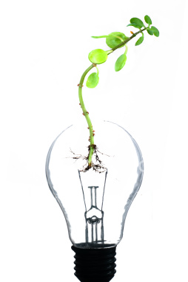
d₂wTM main features
  No special machinery or workforce
  No change of supplier or raw materials
  No compromise in functionality:
  strength, clarity, barrier properties, sealability, printability
  Compatible with all types of plastics for flexible and rigid packaging
    polypropylene (PP)
    polyethylene (PE),
    Polystyrene (PS)
  1 year to 5 years shelf life
  Comprehensively tested and proven

Slide 27

Standards
“d₂wTM Oxo- biodegradable plastic has
been extensively tested by leading
European laboratories in accordance
with ASTM 6954 ”
“These independent laboratories
include Smithers Rapra , Pyxis ,OWS”
“d₂wTM products also comply with the
essential requirements of EU
packaging waste directive ”

Slide 28

ASTM D 6954 – 04
“Standard Guide for Exposing and Testing Plastics that Degrade in the Environment by a Combination of Oxidation and Biodegradation”
This guide prescribes the use of standard tests to prove the following for oxo-biodegradable products:
Degradation
Bio-degradation
Non-Toxicity
28
28

Slide 29





Tested & Proven Technology
  Degradation, Biodegradation & Eco toxicity- Eurofins
  Degradation - Smithers Rapra
  Bio-degradation - Smithers Rapra ,
  Pyxis –UK,
  Applus -Spain
  Eco-Toxicity - OWS, Belgium (Soil Safety)
  FDA Compliance - Keller & Heckman
  Migration test Report - Rapra, Sidwell
  Recycling Report - TCKT
  Biodegradation in Oceans -Bandol Report
  Life Cycle Assessment - Intertek Testing Services
  Ecolabel - ABNT
A brand we can trust!
is not only a trademark- It’s a Trustmark!
Notes:
MNL

Slide 30
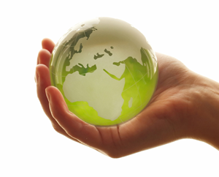
The brand you can trust!
The value added technology
The advantages of d₂w® eco-compatible plastics are many
It will degrade within the timescale specified
It does not degrade prematurely
Until it starts degrading it is just as strong and serviceable as conventional plastic
It can be made using existing machinery and work force, at little or no extra cost
It is safe for food contact- FDA Approved
It can be recycled and can be made from recyclate
It can be composted
It does not just fragment but totally biodegrades to nothing more than CO₂, water and humus, leaving no harmful residues
✓
✓
✓
✓
✓
✓
✓
✓
30
Notes:
30
MNL

Slide 31
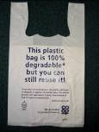

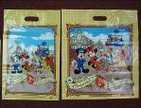

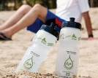
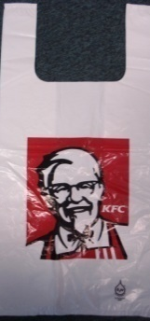

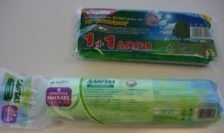
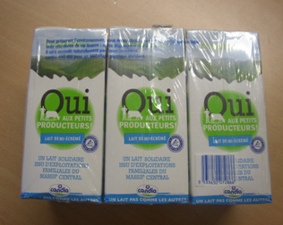
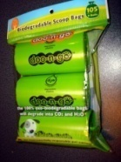
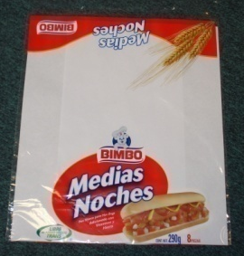
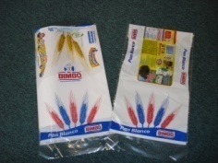
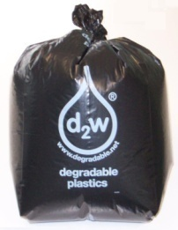
Products Available
Aprons
Bin Liners
Bread bags
Bubble-wrap
Carrier bags or Shopper-bags
Frozen food bags
Gloves
Refuse sacks
Rigid products such as bottles and cups
Shrink-wrap and pallet-wrap
Wrappers for cigarette packets

Slide 32


Environmental Aspects of Using d2w
Oxo-biodegradable Technology
It degrades, biodegrades without any harmful effects on the environment leaving Biomass, Water and CO2.
Reduced litter, as Oxo-biodegradable plastics have significant advantage in terms of biodegradation.
d2w Oxo-biodegradable plastics have no harmful effects.
Oxo-biodegradable plastic recycling can reduce global warming potential by 19%.
Low energy consumption

Slide 33
Commercial Aspects of Using d2w
Oxo-biodegradable Technology
Requirement of many companies as their Corporate Social Responsibility
Cheap and most suitable solution for plastic pollution
Many countries have legislated the use of OBD technology to encourage Eco-friendly environment.
Regarding imports, many countries have made it compulsory for the exporters to export the products in bio-degradable plastic packaging.

Slide 34

Legislation in favor of Oxo-biodegradable
UAE
Saudi Arabia
Bahrain
Pakistan
Albania
Brazil
Ghana
Jordan
Mauritius
Rwanda
Togo
Yemen
34

Slide 35
UAE
Saudi Arabia
Pakistan
UK
Japan
Turkey
Brazil
Malaysia
Italy
Singapore
South Africa
Afghanistan
Albania
Algeria
Argentina
Bahamas
Bahrain
Bangladesh
Barbados
Belarus
Belgium
Bolivia
Bosnia
Bulgaria
Burundi
Canada
Chile
China
Colombia
Congo
Costa Rica
Cote D’Ivoire
Croatia
Cyprus
Czech Republic
East Timor
Ecuador
Egypt
El Salvador
Ethiopia
Fiji
Greece
Guatemala
Hong Kong
India
Indonesia
Iran
Israel
Jordan
Kazakstan
Kenya
Korea
Kosovo
Kuwait
Lebanon
Libya
Maldives
Mali
Malta
Mauritius
Morocco
Nepal
New Zealand
Nigeria
Oman
Pacific Isles(English Speaking)
Panama
Paraguay
Peru
Philippines
Poland
Portugal
Republic of Macedonia
Romania
Russia
Rwanda
Senegal
Serbia
Slovakia
Slovenia
Sri Lanka
Sudan
Syria
Taiwan
Togo
Tunisia
Uganda
Ukraine
Uruguay
Venezuela
Vietnam
Yemen
Zanzibar
Mexico
Montenegro
Italy
Korea
Bosnia
Countries using
Oxo Biodegradable Technology

Slide 36

Legislation in Saudi-Arabia and UAE
SASO (Saudi Standards, Metrology and Quality Organisation)
ESMA (Emirates Authority for Standardization and Metrology)
It is a mandatory requirement in Saudi Arabia and UAE that all plastic products and plastic packaging must be made using approved Oxo-biodegradable masterbatch, whether they are made in the country or exported to that country.
Legislation is enforced in different phases and final phase will be enforced in April 2020, making all products Oxo-biodegradable in Saudi Arabia.
Saudi Arabia and UAE are one of the largest market for Pakistan. Oxo-biodegradable Plastic Regulation will highly effect exports of Pakistan with these countries.
All factories producing specified plastic products must demonstrate compliance to SASO and ESMA.
All the products, not complying to the Oxo-biodegradable Plastic Regulation will be restricted to enter Saudi-Arabia from April, 2020.

Slide 37
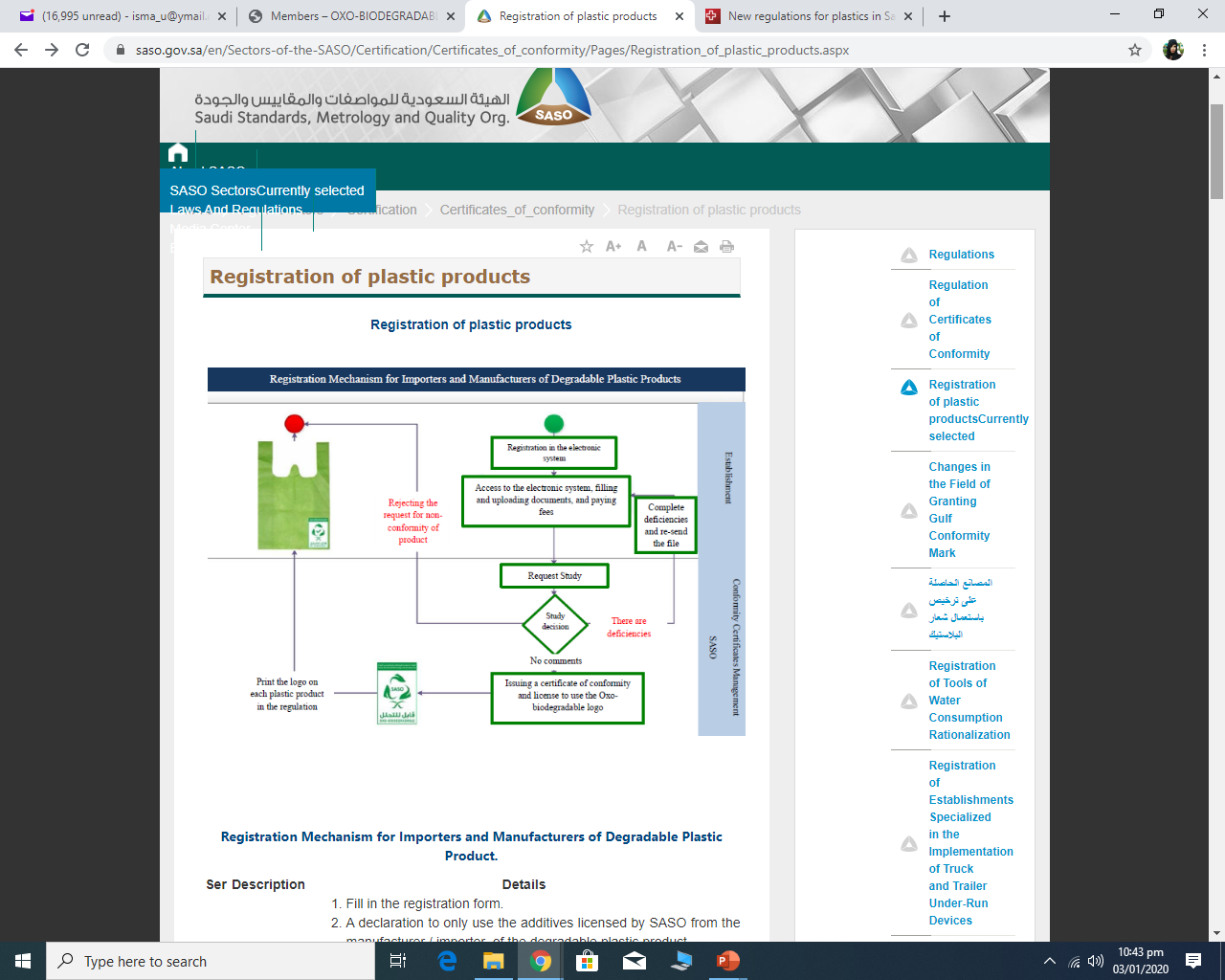
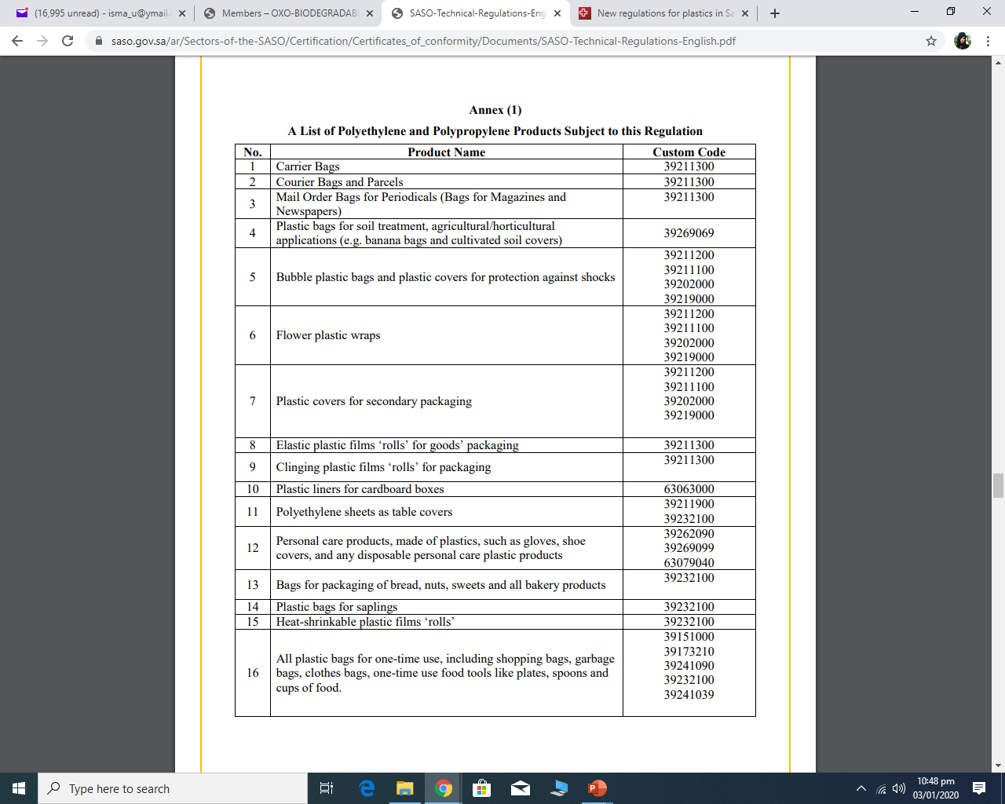

Slide 38

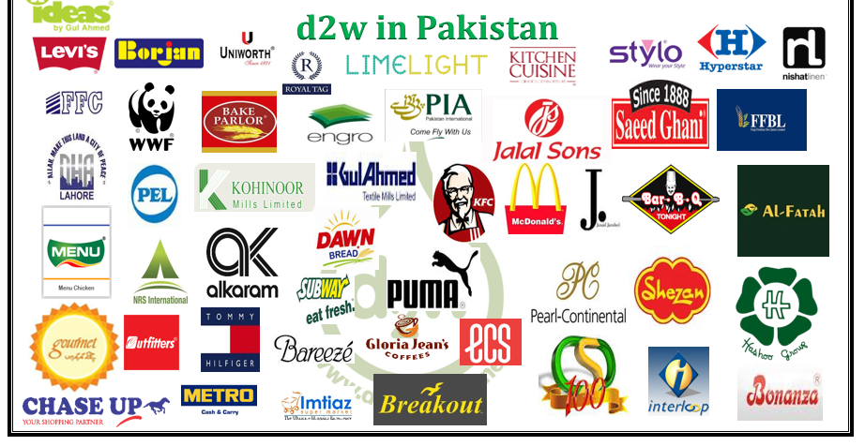


Slide 39


































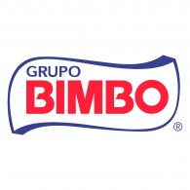























d2w Around The World

Slide 40

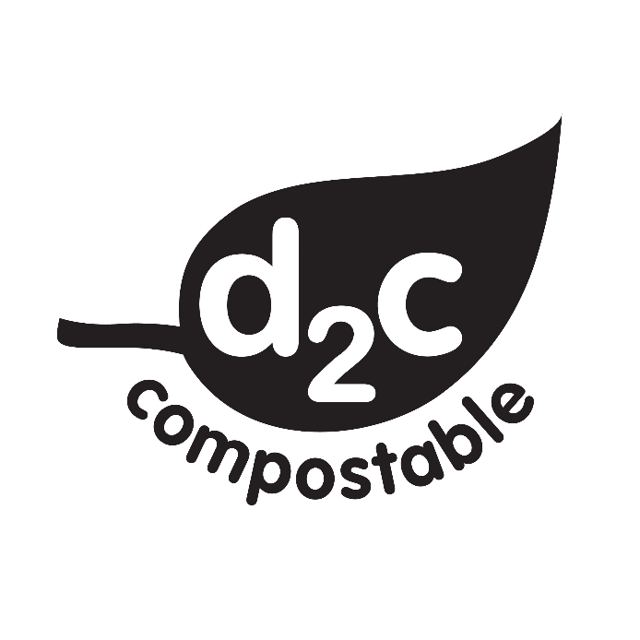
Bioplastics
BD ALSO PROVIDES BIOPLASTICS
TO COMPLY WITH REQUIREMENTS OF CERTAIN COUNTRIES AND CUSTOMERS

Slide 41

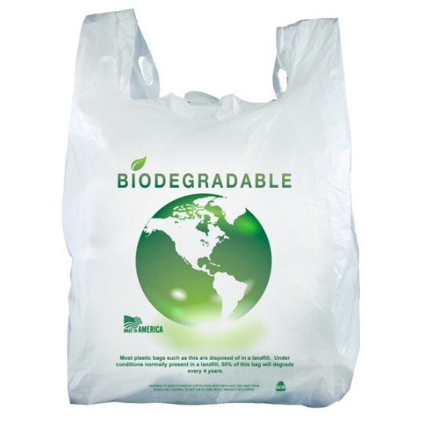
Bioplastics
Bioplastic is biodegradable and compostable resin based on plant starch, biodegradable polyesters and natural plasticizers derived from renewable plant resources esp. Corn Starch.
It is not plastic, but look like plastic with same features like:
High Mechanical Strength
Outstanding Elongation Properties
Toughness

Slide 42
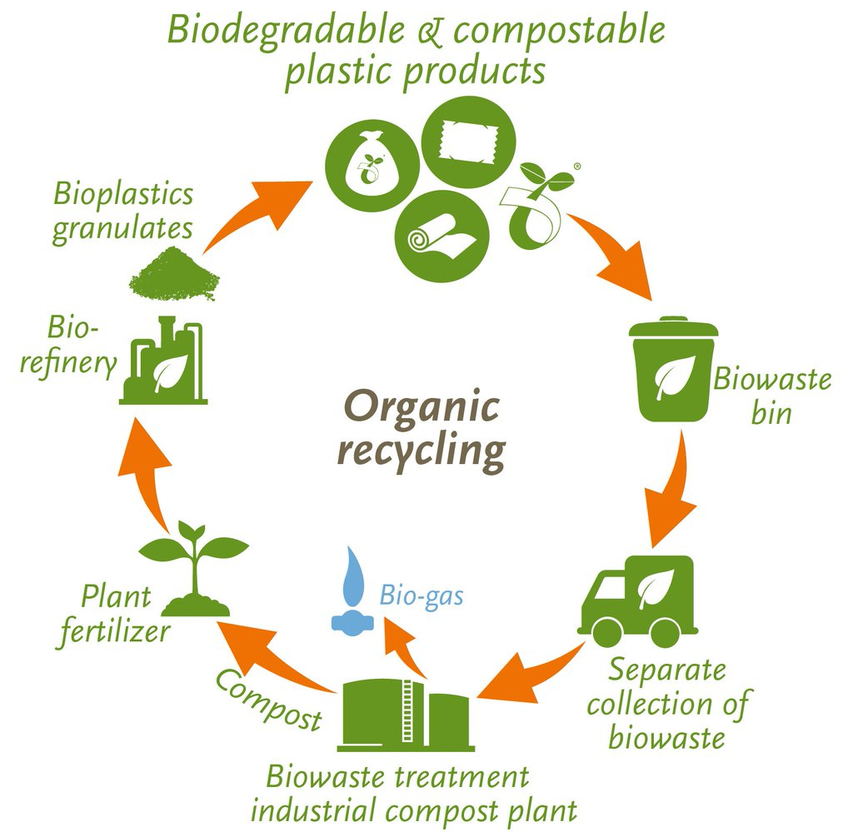
End of Life Options
for Bioplastics

Slide 43



Compostable Plastics
Compostable materials are similar to biodegradable materials, as they are both intended to return to the earth safely.
However, compostable materials go one step further by providing the earth with nutrients once the material has completely broken down.
Compostable materials require special conditions or a Industrial composting facility.

Slide 44



Compostable Plastics
Industrial Compostable
Shelf life 1-1.5 years
Garden Compostable
Shelf life 6 months

Slide 45







Global Standards & Certifications for
Biodegradable & Compostable Plastics
European Standard EN 13432, certified by Din Certco, Germany
USA Standard ASTM D6400, certified by BPI, USA
Australian Standard AS 4736, certified by ABA, Australia
Japanese “GreenPla” Standard, certified by JBPA, Japan
Chinese Environmental Labelling, certified by China Environmental United Certification Center, China
EN13432 (Europe)
AS 4736
(Australia)

Slide 46






Uses
Flexible Packaging
  Shopping Bags
  Garbage bags
  Liners
  Overwrap Packaging
  Breathable films
  Mulch films
Rigid Packaging
  Disposable Cups
  Straws
  Food Containers

Slide 47



Environmental
& Commercial Aspects
It will convert to compost and provide nutrients to soil
Completely Biodegradable polymer with 100% disintegration after 3 months in composting facility
Renewable
Biodegrade faster
Potentially reduced Carbon Footprint
Reduction in litter and improved composability
Reduced greenhouse gas (GHG) emissions
3 times expensive than conventional plastics

Slide 48
Why to Buy Bioplastics from
a Trusted Supplier?
Starch based bioplastic should be purely starch based, mixed or hybrids (Mixed with oil based plastics i.e. PE) are also available in market.
Mixed or hybrid (biobased) bio-plastics are also available in market, BUT these are not 100% bio-degradable and that is why available in low cost.
Results of mixed or hybrid bio-plastics are micro plastics, which are created from non-biodegradable fraction.
FTIR Analysis can be used for testing of bioplastics to differentiate between pure bioplastics & hybrids.
Mixing in bioplastics can lead to rejection of your products

Slide 49
Why Business Dynamics...?
Quality Assurance
Full Technical Assistance
Support in Product Development
Offering specially designed additive that can be used on LDPE machines
WE MEET THE HIGHEST QUALITY STANDARDS

Slide 50

Thank You !!!

Slide 51


  “IN HARMONY WITH THE ENVIRONMENT”
51
51

