Slide 1
Awareness Session on FX Operations & SBP Online Portal
State Bank of Pakistan

Slide 2
Agenda of the Session
SBP Online Portal
Question Answer Session
Introduction to Forex Operations

Slide 3
Key Stakeholders
Foreign Exchange
State Bank of Pakistan
Authorized Dealers
Corporations
Individuals
Exchange Companies
Government

Slide 4
Initiatives
Standardization
Helpdesk
facilitation.fx@sbp.org.pk
021-32455387
Delegation
Engagement with Stakeholders
Segregation of EPD & FEOD
Automation
Continuous Improvement

Slide 5
FX Operations at SBP
Exchange Policy Department
Policy Related Matters
Investments
Foreign Exchange Operations Department
Commercial Remittances
Export & Import Related Matters
Borrowings
Government Subsidy Schemes
Export & Import Related Matters (Exemptions)
Private Remittances
FE Circular No. 10 of 2018 dated October 19, 2018

Slide 6
Previous Process Flow Chart Diagram
Hard Copy of Decision Letter
Hard Copy of Decision Letter
Authorized Dealer
Manual Approval Process
Manual Submission of Cases by Clients
Manual Submission of Cases by ADs
Manual Processing at SBP
Manual Intimation of Decision to AD & Clients
External Clients
State Bank of Pakistan
Documents & Necessary Information
Documents & Necessary Information
Authorized Dealer
Scrutiny of Documents

Slide 7
Major Issues for Businesses in Previous System
Logistics & Storage Issues
No Visibility of Cases
Unable to Track the Progress of Requests
Lack of Knowledge about FX Rules & Regulations

Slide 8
Existing Process (Parallel Run at FEOD) Flow Chart Diagram
Print out of Decision Letter
Electronic Copy of Decision Letter
Authorized Dealer
Electronic Approval Process
Manual Submission by Clients
Electronic Submission by ADs
Electronic Processing at SBP
Electronic Intimation of Decision to ADs
Manual Intimation of Decision to Clients
External Clients
State Bank of Pakistan
Documents & Necessary Information
Online Case Submission
Authorized Dealer
Scrutiny of Documents

Slide 9
Upcoming Functionalities of Portal
Visibility of Cases to External Parties
Ability to Track Progress of the Requests

Slide 10
Upcoming Functionalities of Portal
Quick Solution
Next Step
Lookup on Webpage
Email
Instant Communication of updated Status of Requests to Clients
Option to check the updated status of Requests on the Go.
Ensure correct Email Address is provided by bank to SBP
Must Have Case Number to track the Status

Slide 11
Email to Clients Flow Chart Diagram
Print out of Decision Letter
Electronic Copy of Decision Letter
Authorized Dealer
Electronic Approval Process
Manual Submission by Clients
Electronic Submission by ADs
Electronic Processing at SBP
Electronic Intimation of Decision to ADs
Manual Intimation of Decision to Clients
External Clients
State Bank of Pakistan
Documents & Necessary Information
Online Case Submission
Demo
Authorized Dealer
Scrutiny of Documents

Slide 12
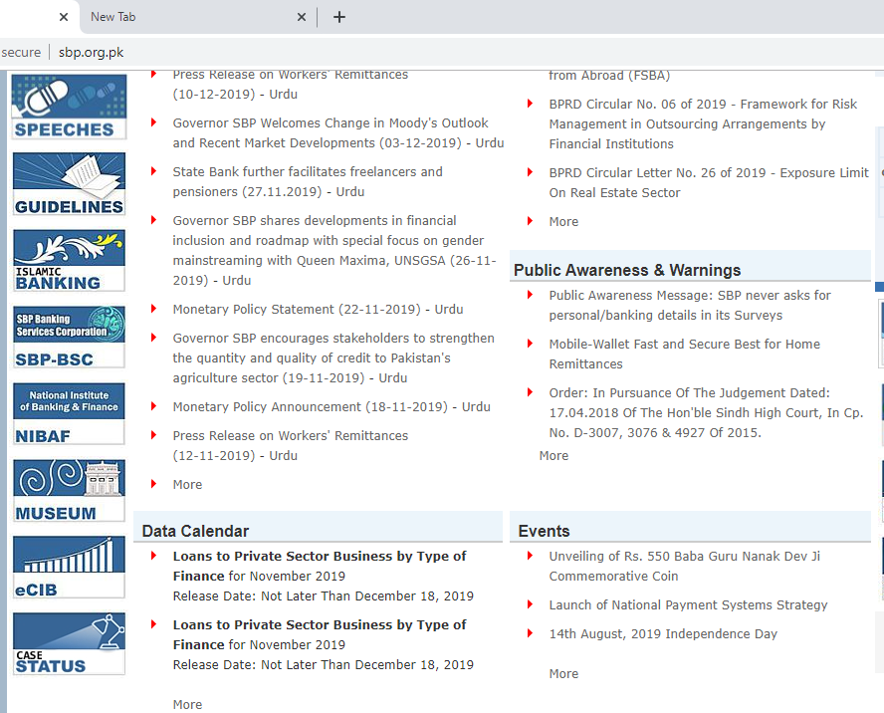
Look-up on Website
Case Search Option

Slide 13
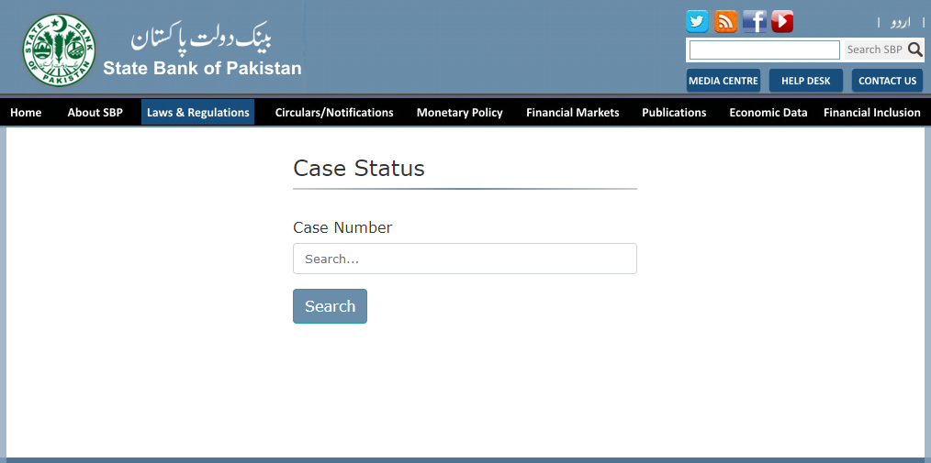
Look-up on Website
Type Case Number

Slide 14
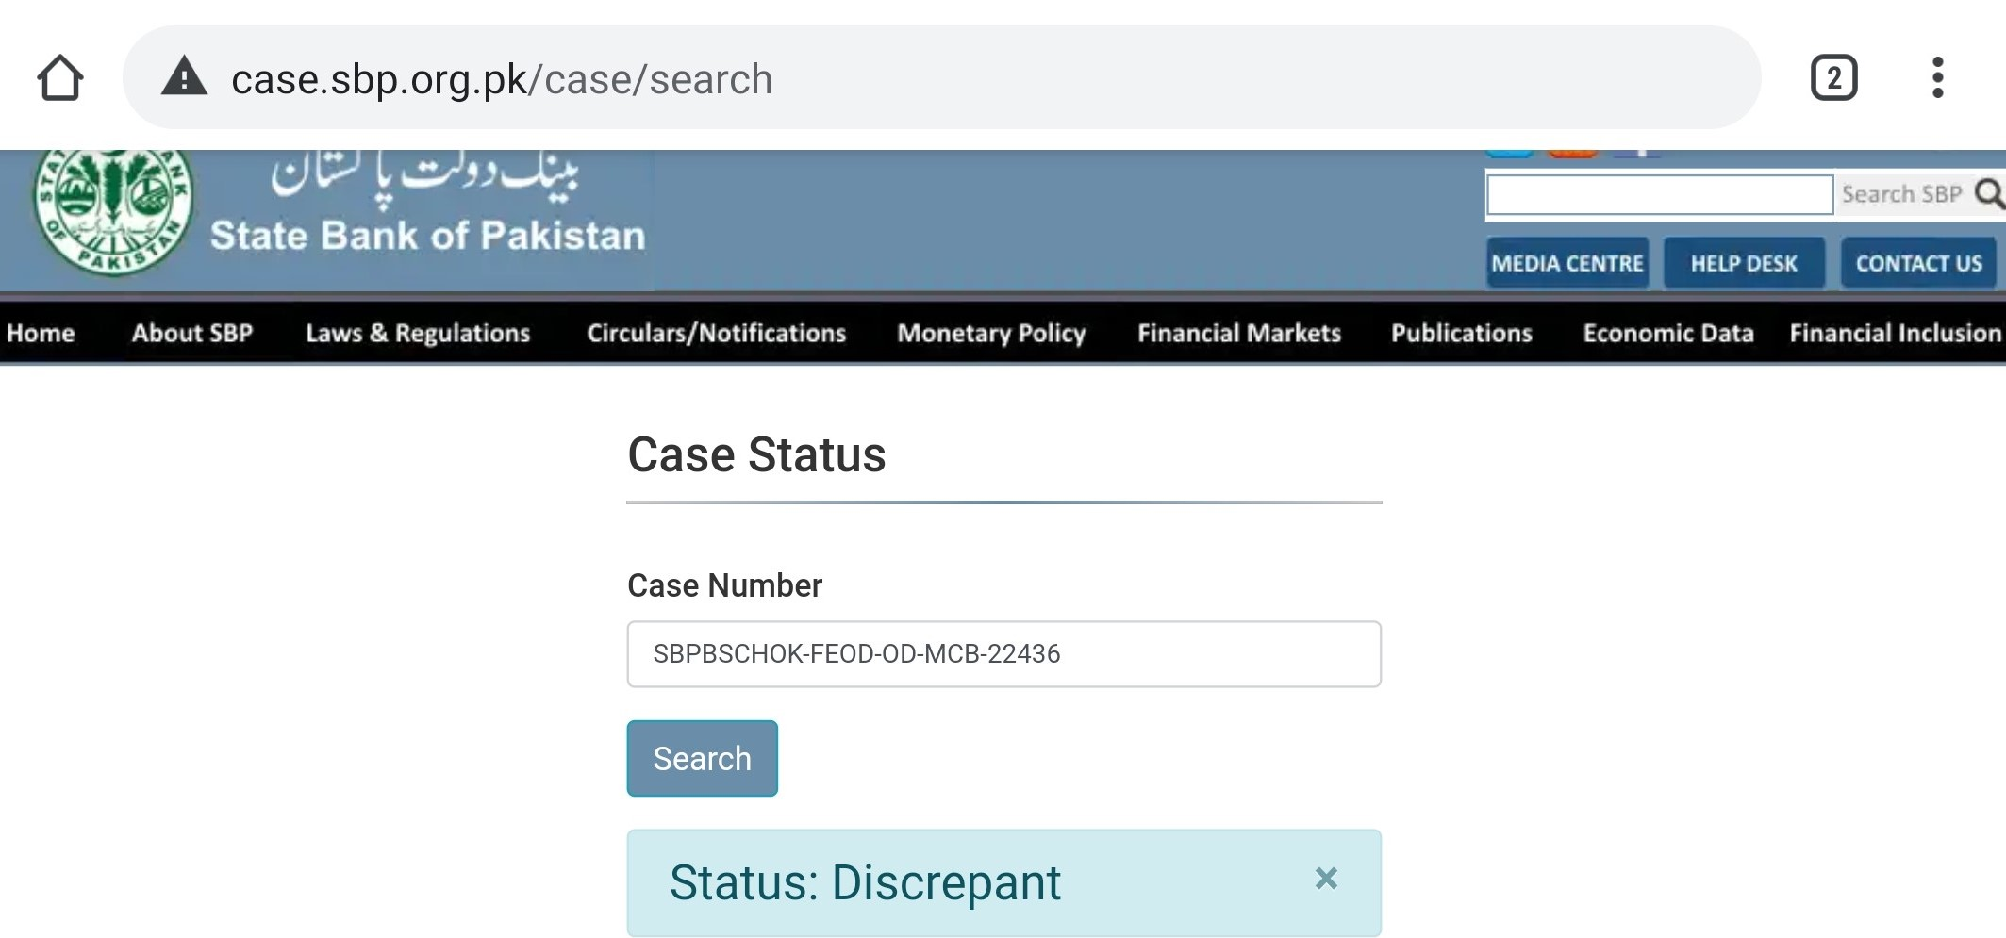
Look-up on Website

Slide 15
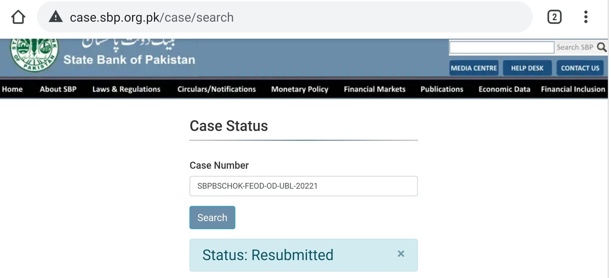
Look-up on Website

Slide 16
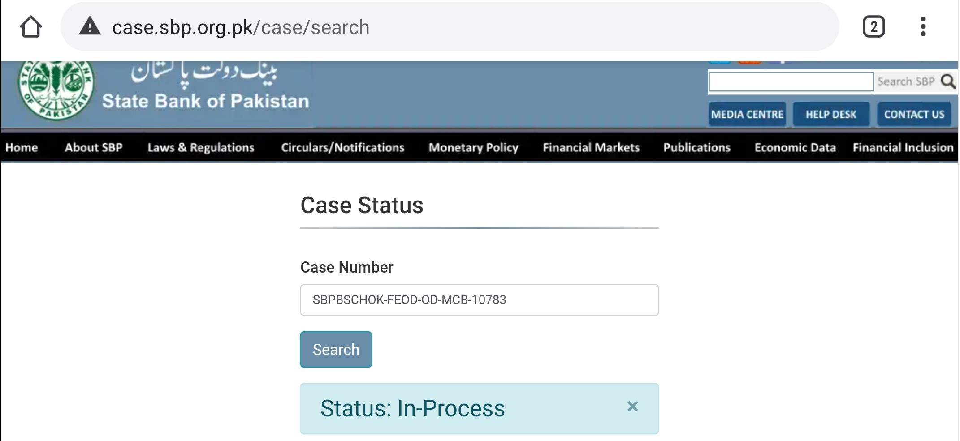
Look-up on Website

Slide 17
Key Expected Benefits
Efficient Case Submission
Compliance of FE Rules & Regulations
Standardized Cases
Less Paperwork & HR required
Ease of Doing Business

Slide 18
Points to Remember
Must Have Awareness with applicable FE Rules & Regulations
Complete Set of Information & Documents should be provided to Banks to avoid unnecessary delays
Email Address provided to SBP should be Correct and must belong to Senior Personnel
Must have System generated Case Number to track progress of Request

Slide 19
THE END

Slide 20
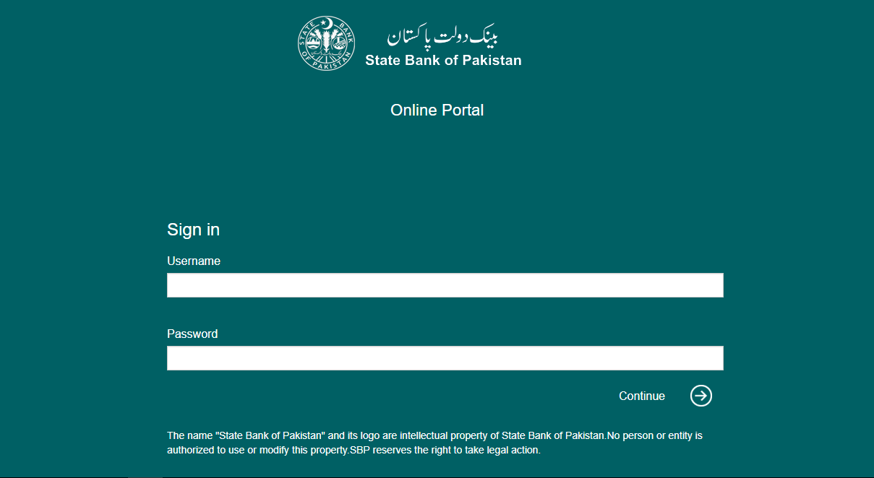
SBP Online Portal - Login Screen
Back

Slide 21
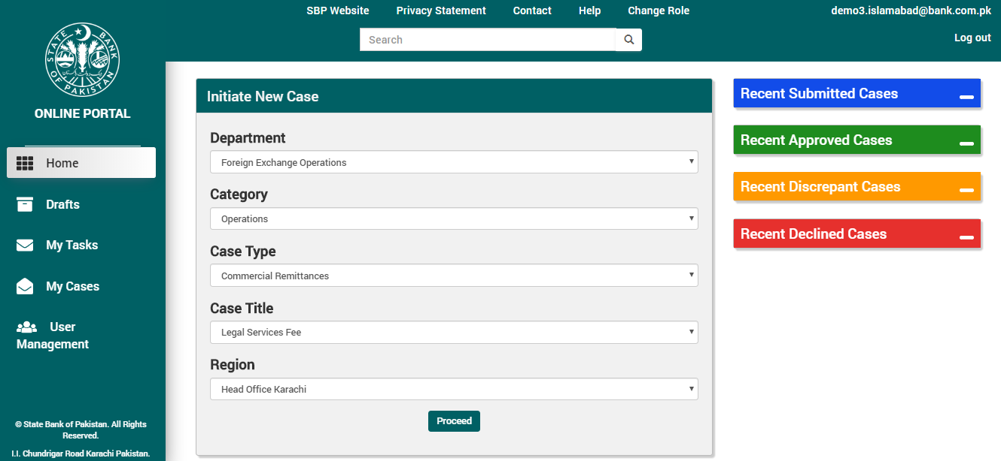
SBP Online Portal - Main Dashboard
Back

Slide 22
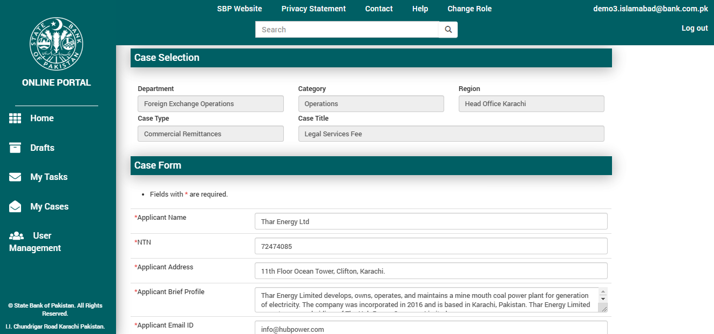
SBP Online Portal - Case Form
Back

Slide 23
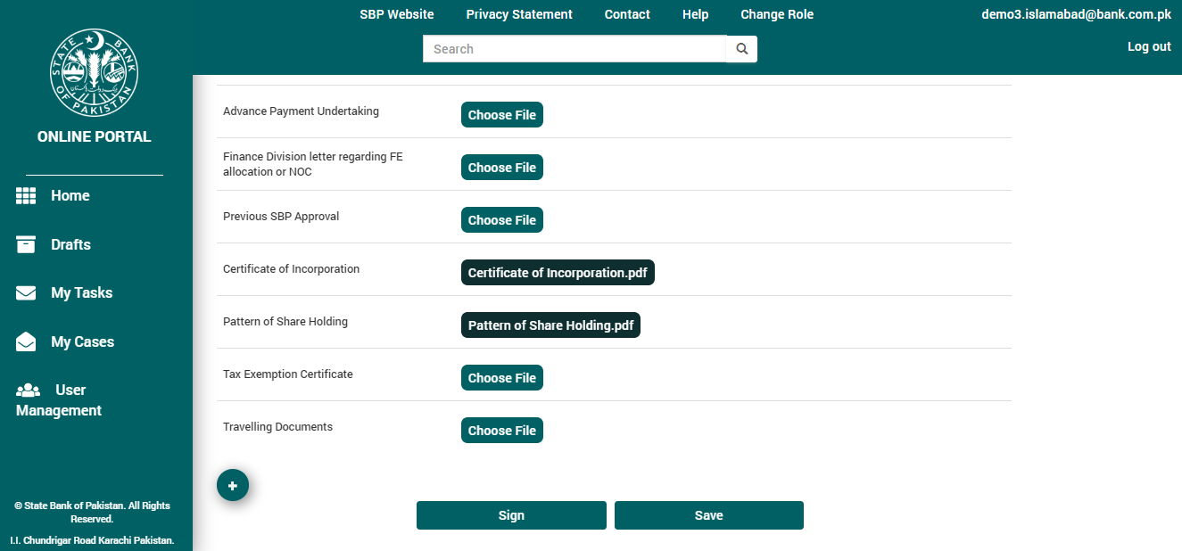
SBP Online Portal – Supporting Documents
Back

Slide 24
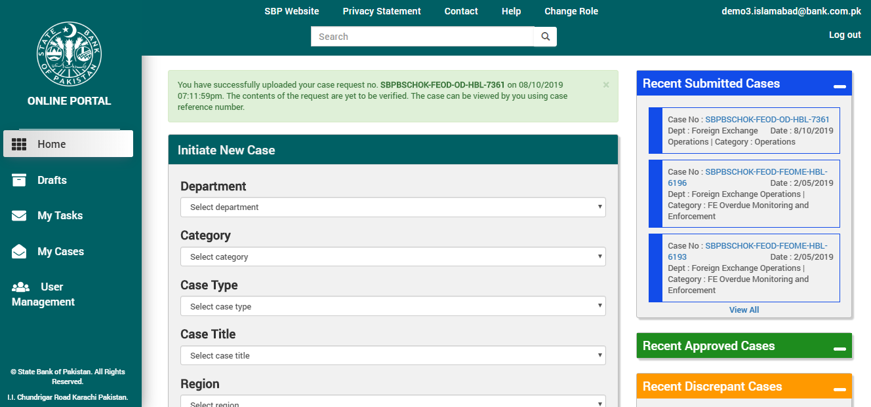
SBP Online Portal - Case Submission
Back

Slide 25
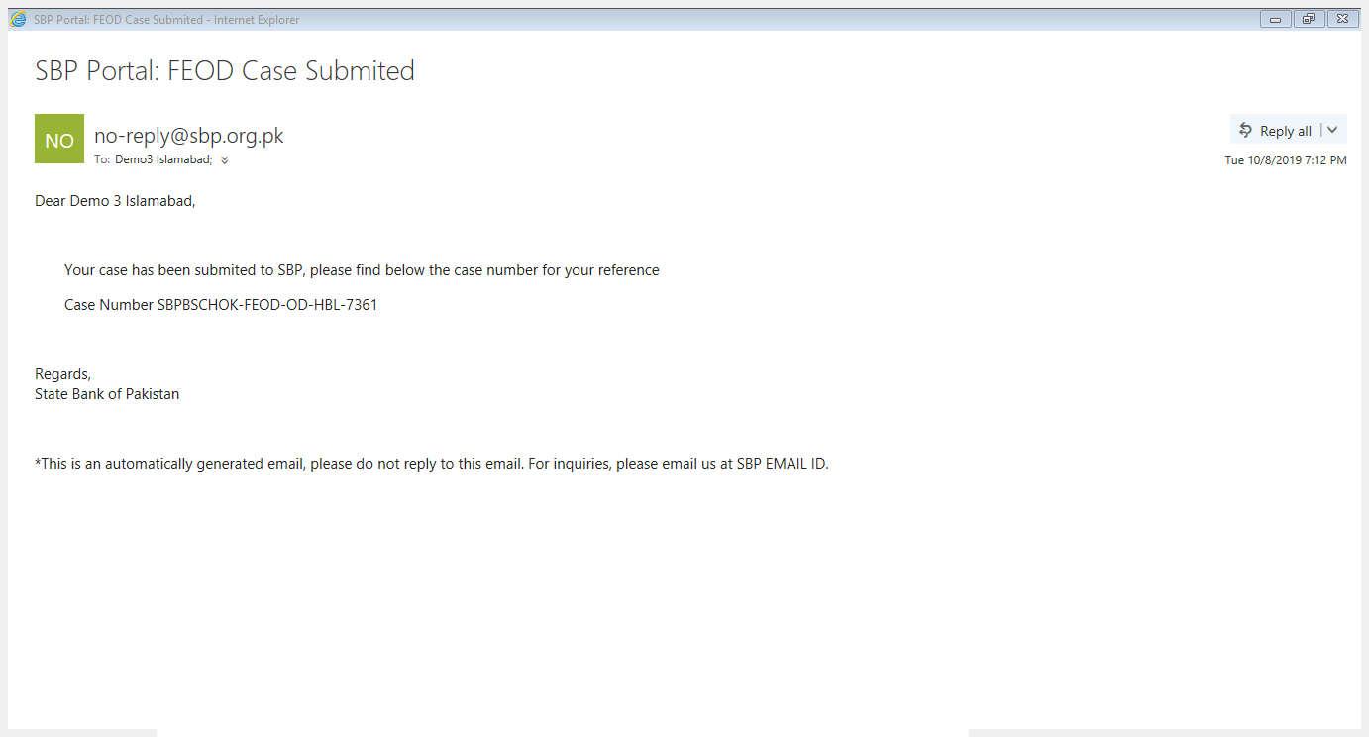
SBP Online Portal – Email to Bank
Back

Slide 26
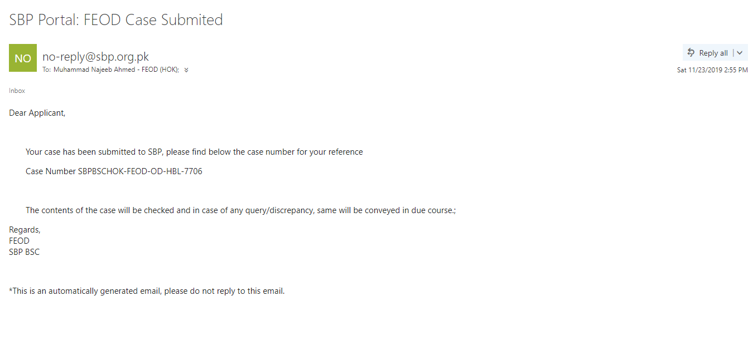
SBP Online Portal – Email to Client
Back

Slide 27
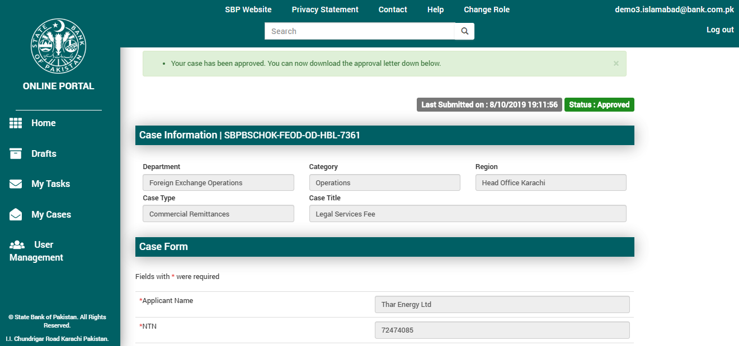
SBP Online Portal – Approved Case
Back

Slide 28
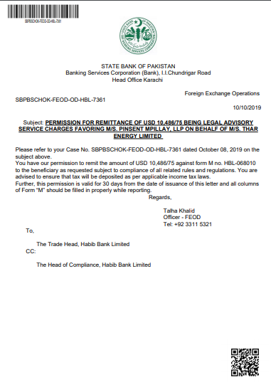
SBP Online Portal - Decision Letter
Back

Slide 29
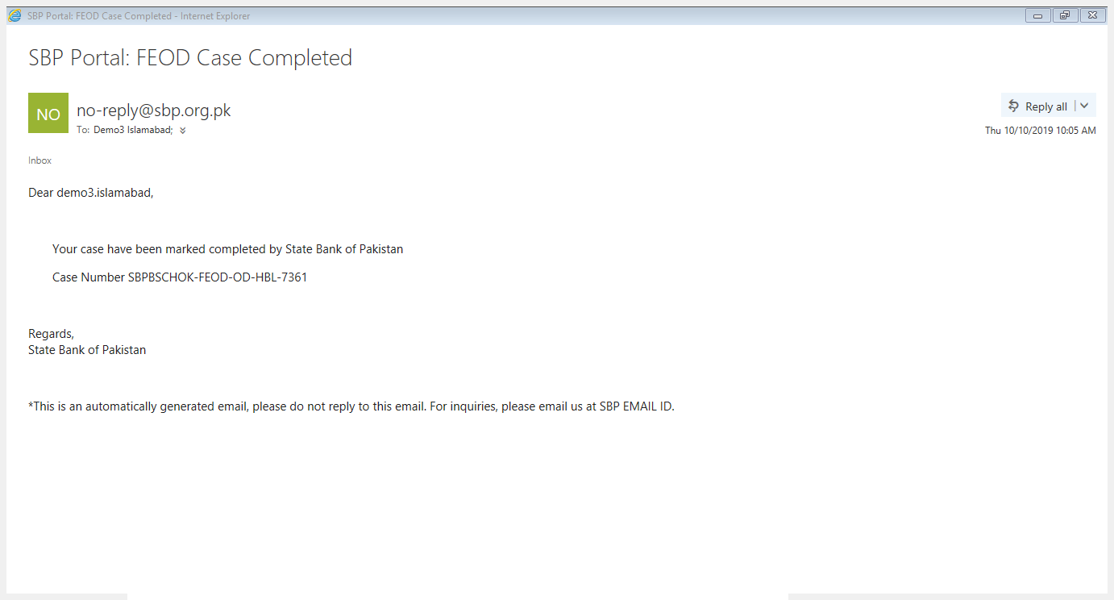
SBP Online Portal – Email to Bank
Back

Slide 30
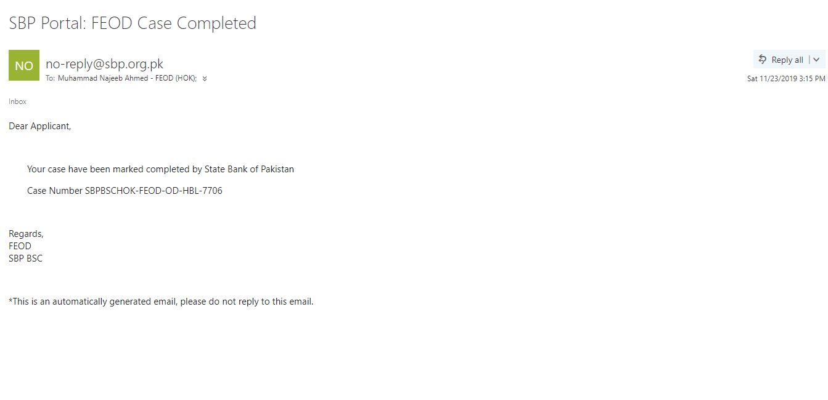
SBP Online Portal – Email to Client
Back

Slide 31
Back to Main Presentation

