Slide 1
Proposed Training Modules
Module 1
ID Creation, Selling Plans,
Sellers Registration with Amazon
Module 2
Product Listing, PDP, Categorization, UPC, Pictures and Videos, Description,
Trade Marks (Brands)
Module 3
Payment Mechanism,
Documentations
Module 4
Logistics Solutions

Slide 2
Sellers Registration Module
Rohail Nazir

Slide 3
Penalties for Non-Compliance to Amazon Policy Guidelines
Cancellation of Product Listing
Suspension or Forfeiture of Payments
Removal of selling privileges (Suspension of Seller’s Account)
Italy, Japan, France, Spain, Poland, Australia, Netherland, Germany, Sweden, USA, Canada and Mexico
Sole Proprietor can not sell in certain markets i.e UK
Markets Opened for Pakistan (Individual Account)

Slide 4
Selling Plans
Individual Selling Plans | Professional Selling Plans
0.99 $/ Item Sold | 39.99 $/ Month
One can not list products of variations | Products of variations can be listed
No brand registry | Brand Registry
No PPC Campaign | PPC Campaign
FBA /FBM Available | FBA/FBM Available
Can Add Products | Products can be added
No bulk listing (Flat file) | Bulk Listing
No inventory management reports | Inventory Management Reports
Can not qualify for top placement on Product Detail Page | Can qualify for top placement on PDP
Can not set promotions i.e. Free Shipping, Pay Offs etc | Can offer promotions
No Buy Box/ Tax Calculator | Buy Box, Tax Calculator
Both are Interconvertible (Upfront payment of 40$ n any selling plan)

Slide 5
Steps Involved in ID Creation
Create an Account (Legal Name, Email Address and Password)
Verification of email OTP
Business or Contact Address
Mobile or Telephone Number
Billing / Deposit Information
Store and Product Information
Verification

Slide 6
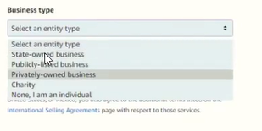
Business or Contact Address (1)
Business or Contact Address
Business Location (Country)
Business Type (Info can not be changed later)
State Owned Business
Publicly Listed Business
Privately Owned Business (Name on the Document provided by SECP)
Charity
Individual
Your Name as given on Passport (First (Given), Middle and Last Name (Surname))
Personal Information (citizenship, Country of Birth, DoB)
Proof of Identity (Passport or ID, Date of Expiration and Country of Issue)
Urdu ID card is not acceptable, Bilingual is acceptable

Slide 7
Business or Contact Address (2)
Business Address (As per Bank Statement or Credit Card Statement)
ZIP Code / Postal Code
State or Province
Street Address as per Bank Statement
Mobile Phone Number for Verification

Slide 8
Step 2: Billing Information
Credit Card Number (16 Digits)
Expires On (Month and Year)
Card Holders Name (Same as given before)
Billing Address

Slide 9
Step 3: Store and Product Information
Store Name (Any name of choice tat has not been taken already)
Amazon requires UPC (Barcode, GTIN) for all the products
GS1 sells this region wise. Each variation of a product needs a separate barcode i.e 3 colors * 3 Sizes = 9 Barcodes
250$ for 10 Products per year and then there applies a renewal fee every year
Are you’re the manufacturer or Brand Owner?
Trade Mark Registers?

Slide 10
Step 4: Uploading of Documents
Color Scanned Copy of Passport / ID cards without any cropping.
First two pages, Less than 10 MB, Un-tampered,
Screenshot is not acceptable
Document must be in supported languages i.e Chinese, English, French, German, Portuguese, Italian, Japanese, Polish and Spanish. If document is not in the given languages then provide notarized translation in any one of the given languages
Acceptable formats are PDF, jpeg, png, tif and tiff
Additional Document (Bank / Credit Card Account Statement
Received through Email, Must mention Point of Contact, Postal Code,
Must have been issued within the past 180 days

Slide 11
Account Verification Email from Amazon
Amazon will email verification email with in two days
Access to Sellers Central dashboard shall be granted

Slide 12
Cautions
Amazon advises seller to have a single account
Same IP must not be used for creating another account
Same computer must not be used for creating another account
Same documents must not be used for creating another account
Information consistency is required in any case
Account Health must be maintained
Do not allow others to act on your behalf
Use only Buyer-Seller Messages (Dashboard) to communicate with the buyers
Never manipulate customer’s reviews

Slide 13
Seller’s Account Health Matrices
Order Defect Rate (ODR) < 1% / 60 days
Negative Feedback
AN A to Z Guarantee Claim (Undeniable)
Credit Card Chargeback
Cancellation Rate (CR applied to FBM Only) < 2.5%/ 7 days
Late Shipment Rate (Applicable to FBM) < 4% /10-30 days
On-Time Delivery Time applicable to FBM (OTDR) > 97%
Valid Tracking Rate, applicable to FBM (VTR) >95%
USPS, FedEx, UPS, DHL are providing free tracking

Slide 14
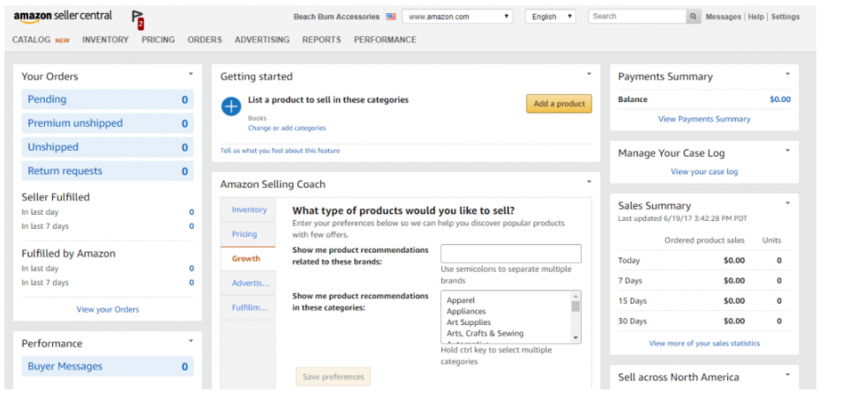

Slide 15
Updating the Seller Central Account
Deposit Method
For Pakistan, Hyper wallet
Transfer Wires, Payoneer for other countries
(One can withdraw net receipts in US also)

Slide 16
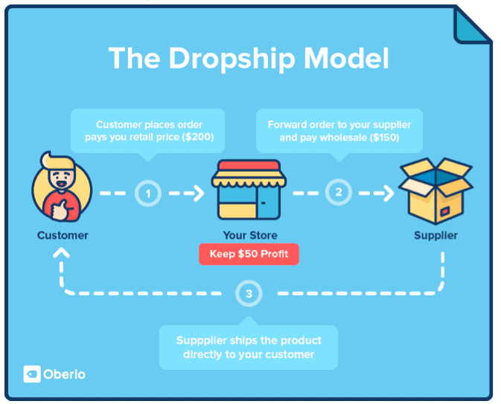
Drop Shipping

Slide 17
Question

