Slide 1
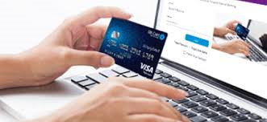
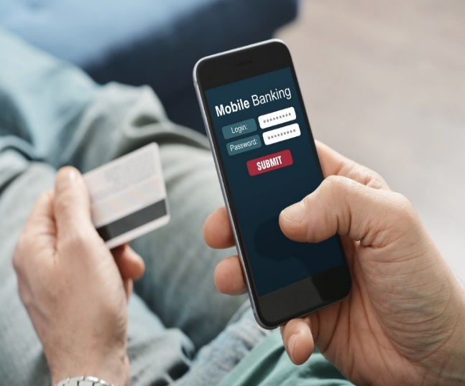
Online Collection of Government Receipts through Alternate Delivery Channels (ADC) & OTCs
State Bank of Pakistan (SBP)
SBP BSC.

Slide 2
By
Payment Procedures
Payment via Over the Counter (OTC) All Commercial Banks.
Payment via ATM.
Payment via Internet Banking .
Payment via Mobile App

Slide 3
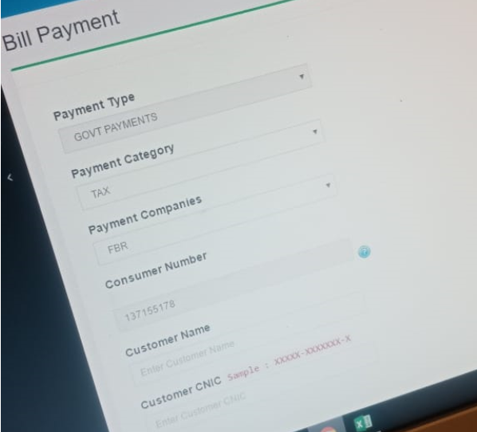
Payment via Over-The-Counter (OTC)

Slide 4
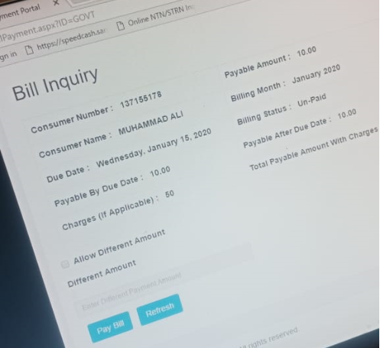
Bill Inquiry (Teller/Cashier)

Slide 5
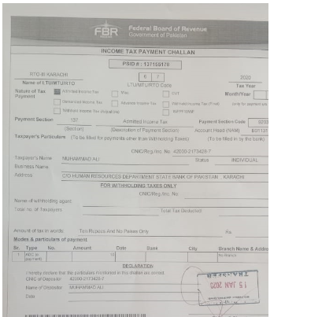
Teller Stamp after OTC payment

Slide 6
PSID used for ATM Payment

Slide 7
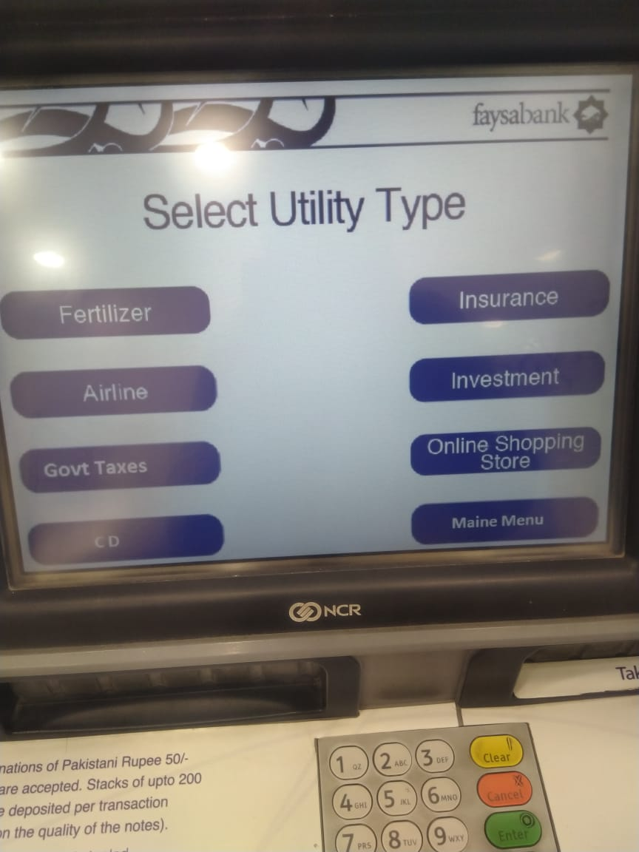
Selection of Utility (Govt. Taxes)

Slide 8
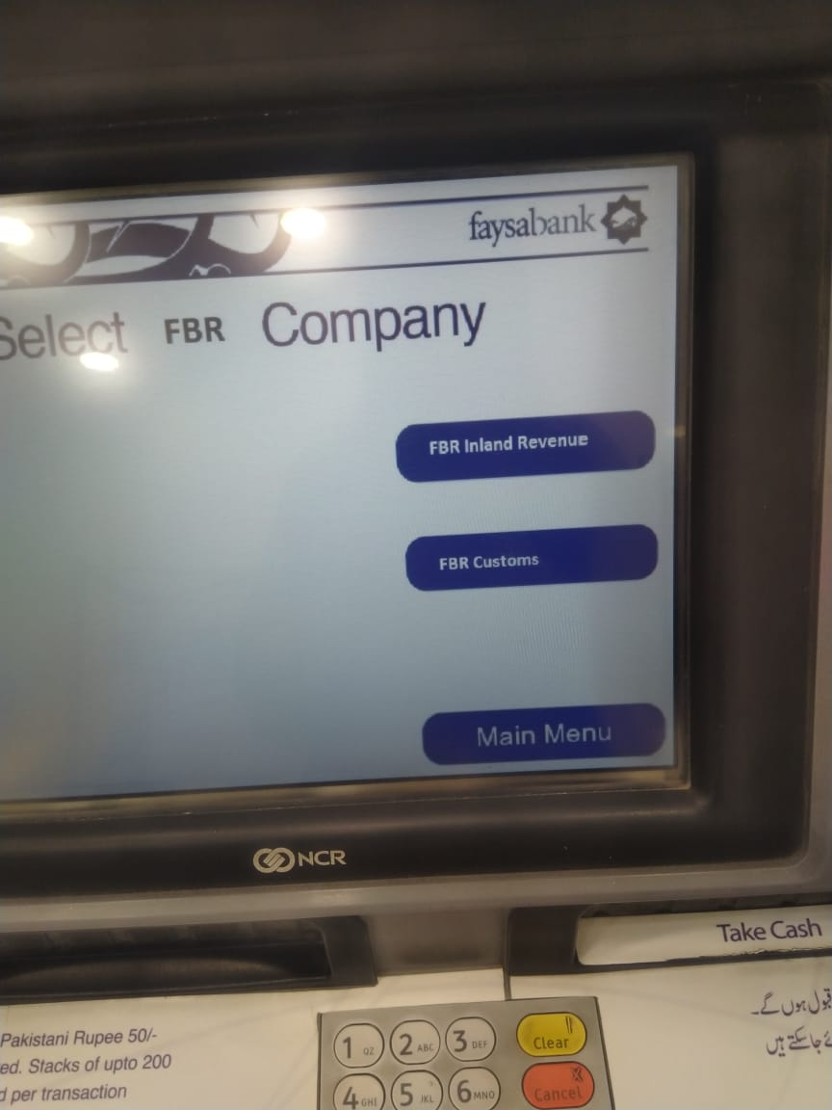
Selection of FBR Tax i.e. Customs/ IR

Slide 9
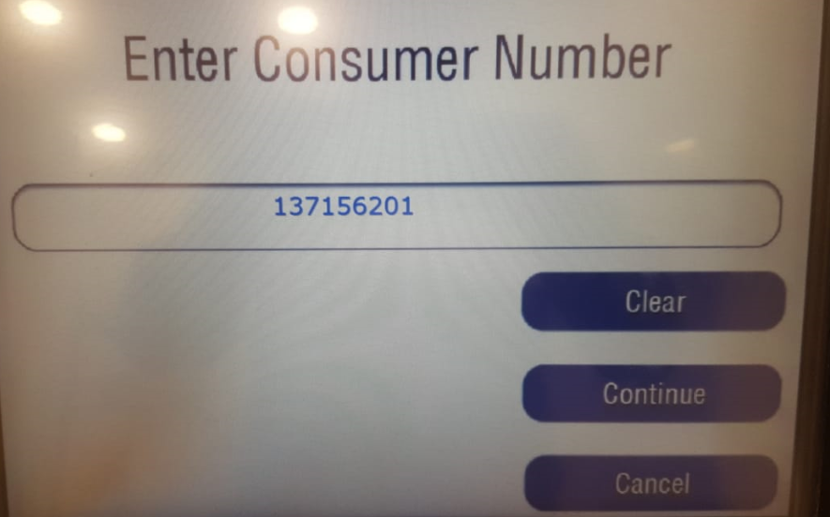
Enter PSID NO.

Slide 10
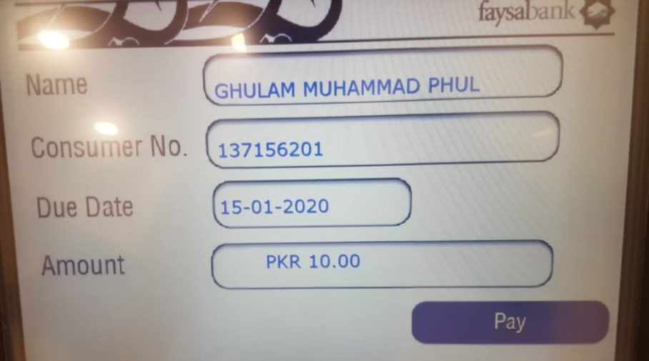
Detail Information appear

Slide 11
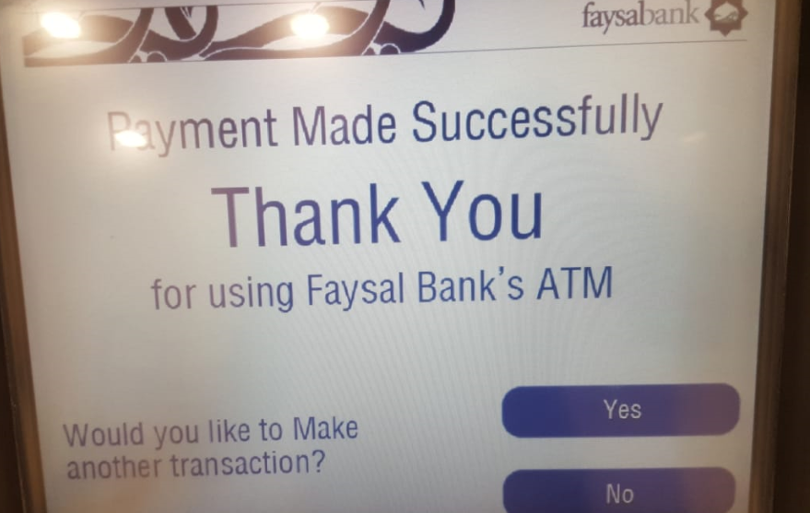
Successful Payment
6

Slide 12
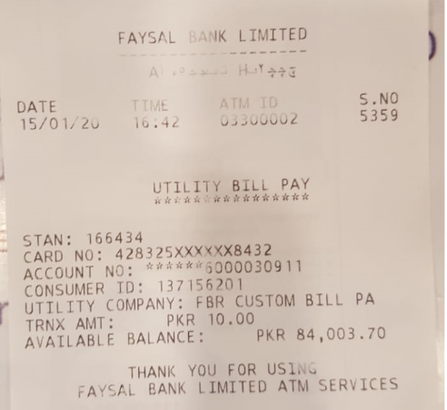
ATM Receipt
7

Slide 13
PSID used for Payment (Internet Banking)

Slide 14
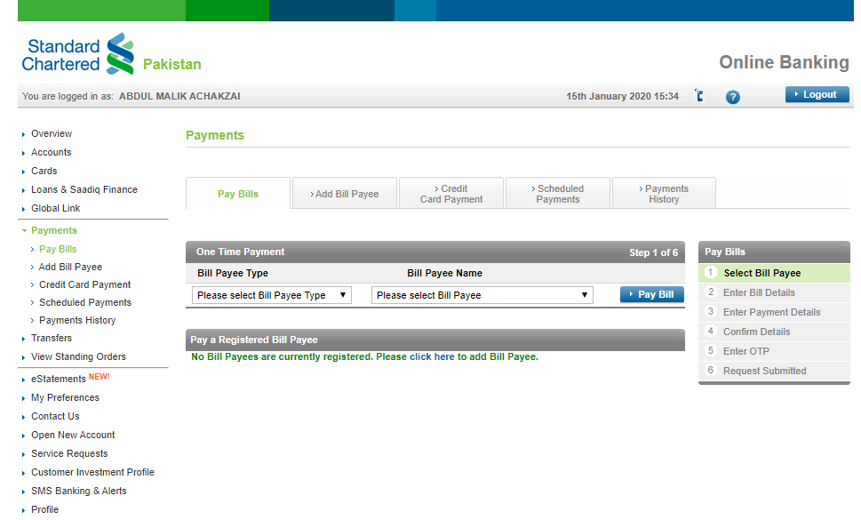
By
Payment (Internet Banking)

Slide 15
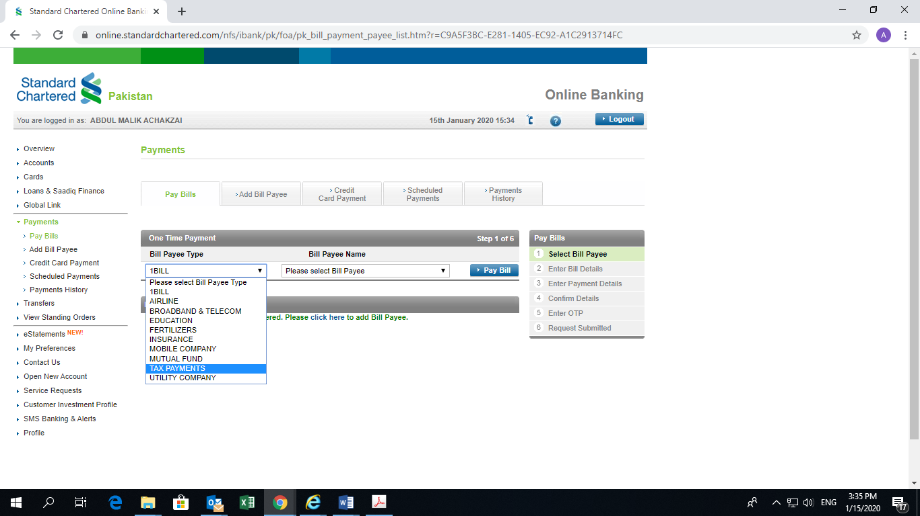
By
Select Bill Payee Type (Tax Payment )

Slide 16
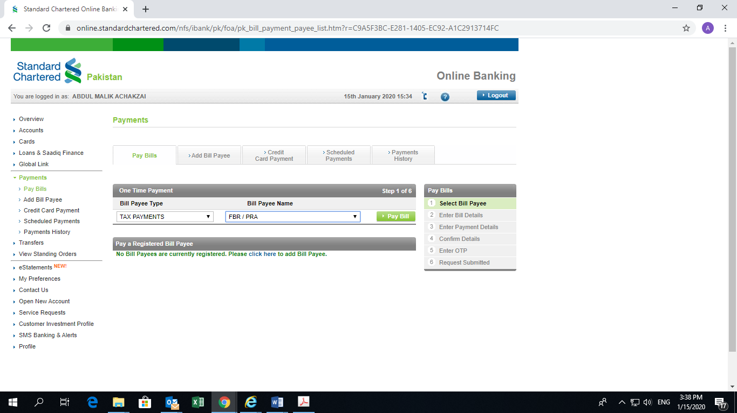
By
Select Bill Payee (FBR)

Slide 17
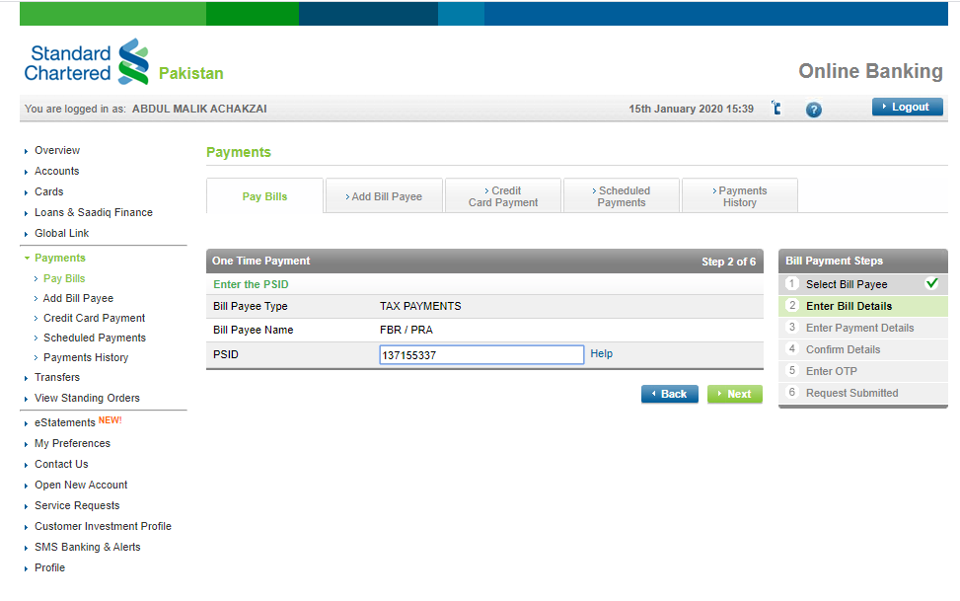
By
Enter Bill Details (PSID No)

Slide 18
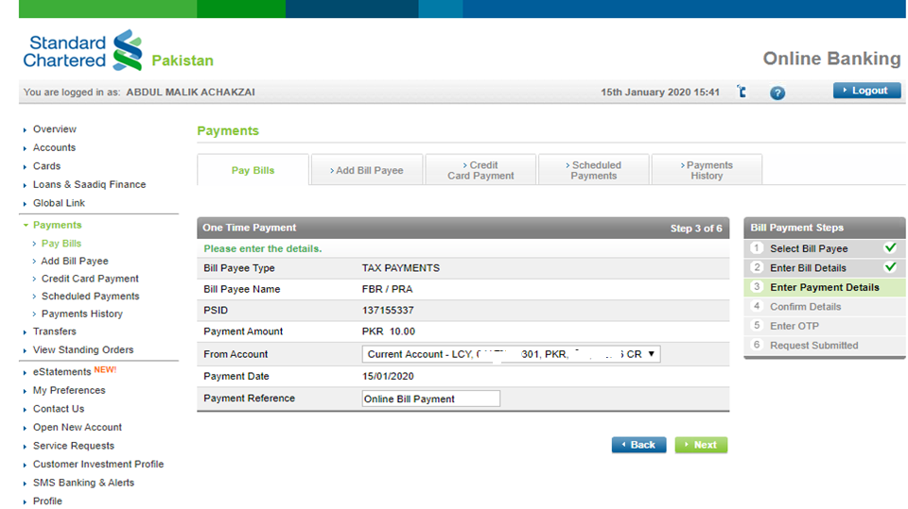
By
Enter Payment Details
6

Slide 19
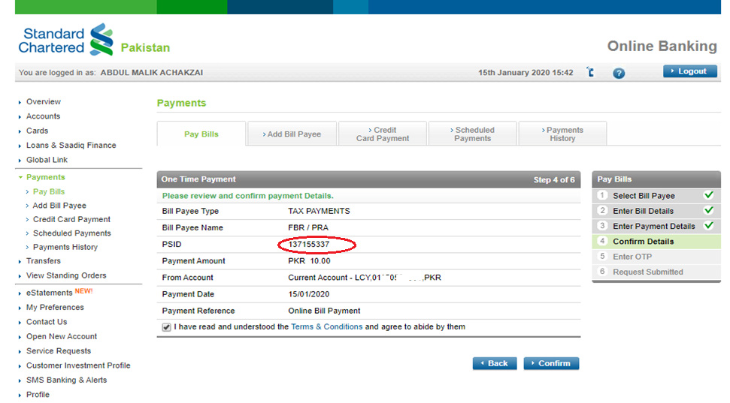
By
Confirm Details
7

Slide 20
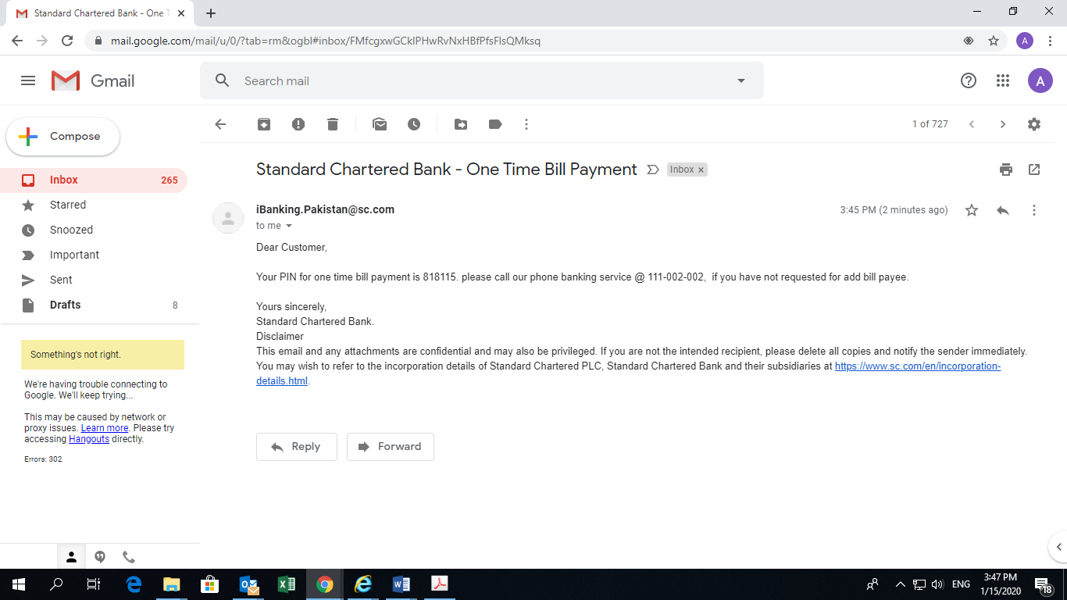
By
Pin via Email
8

Slide 21
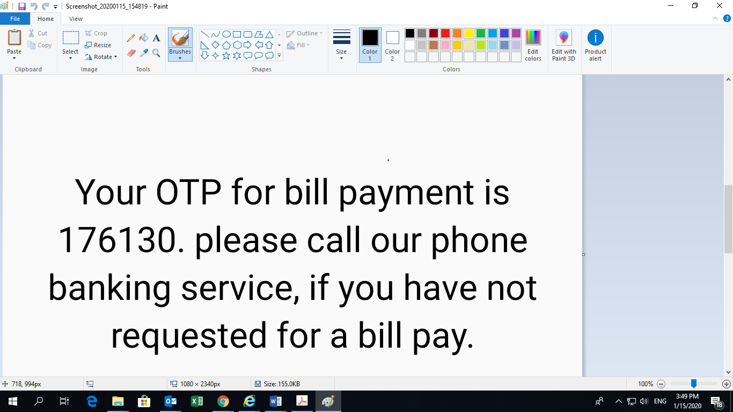
By
OTP via Mob message
9

Slide 22
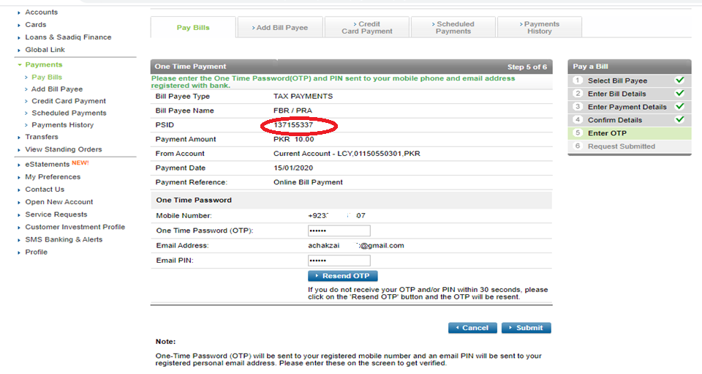
OTP/PIN Putin
10

Slide 23
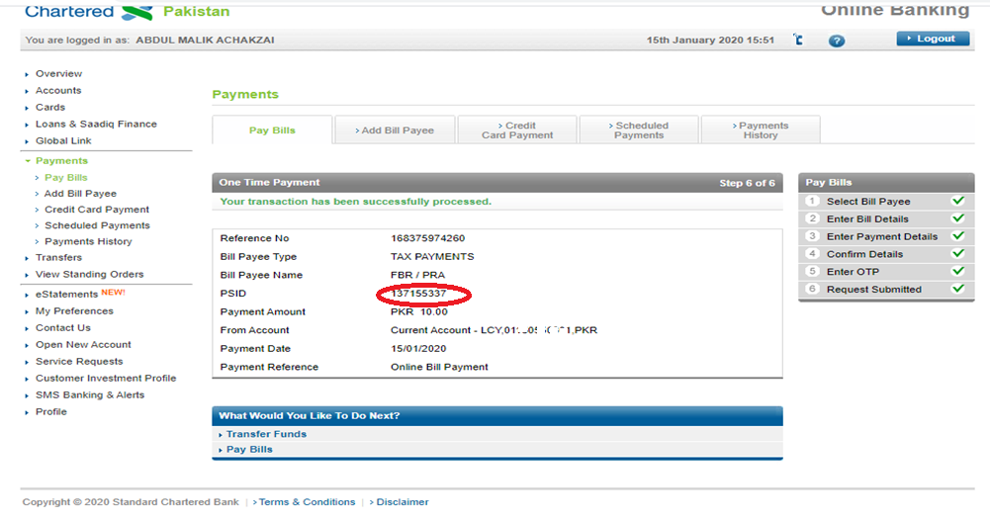
Transaction Successful
11

Slide 24
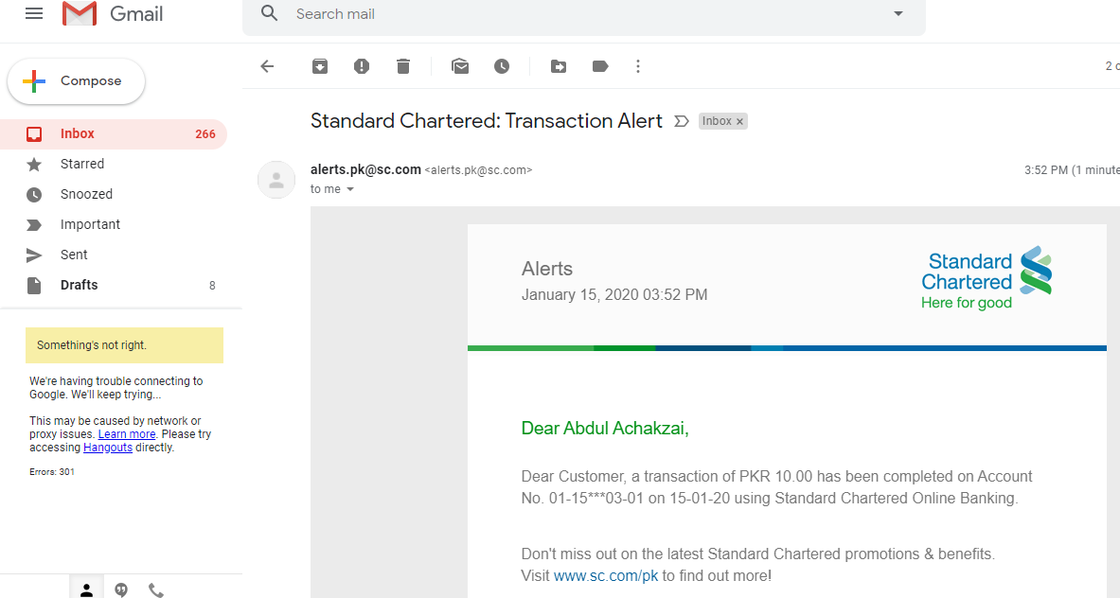
Transaction Confirmation via Email
12

Slide 25
Transaction Confirmation via Mob Message
13

Slide 26
PSID used for Payment (Internet Banking)

Slide 27
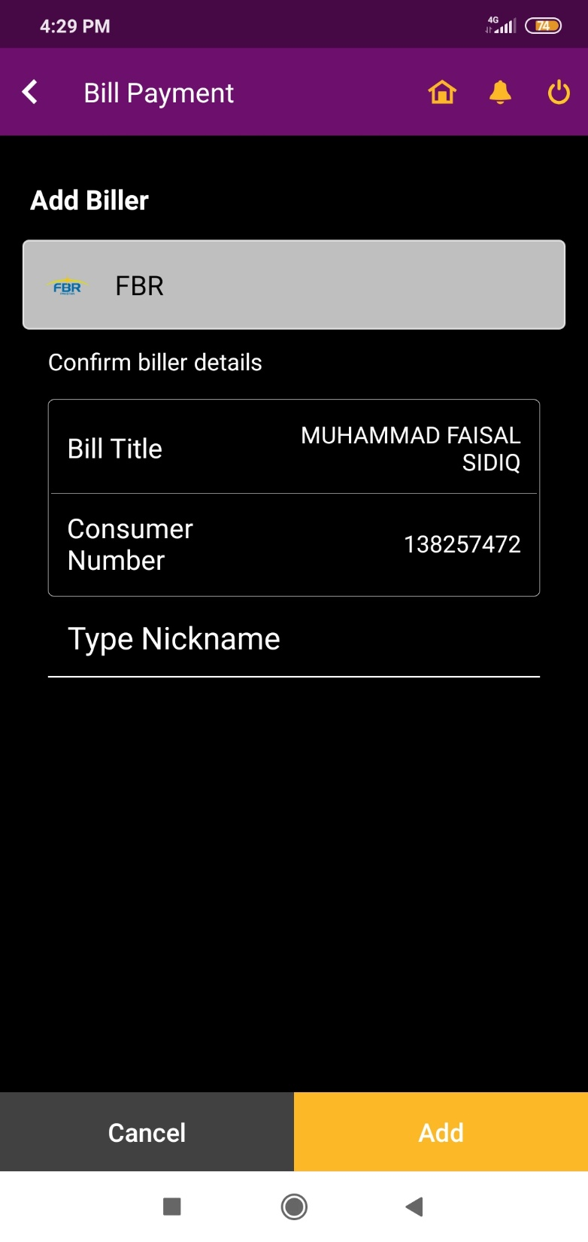
Payment via Mobile Banking (Add Biller)

Slide 28
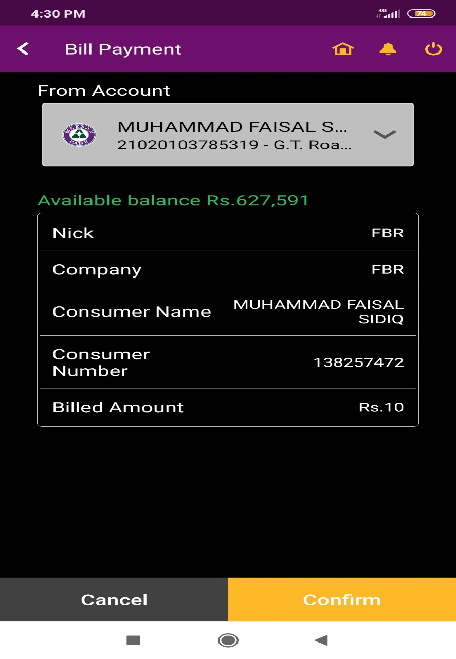
Confirm payment after reviewing details

Slide 29
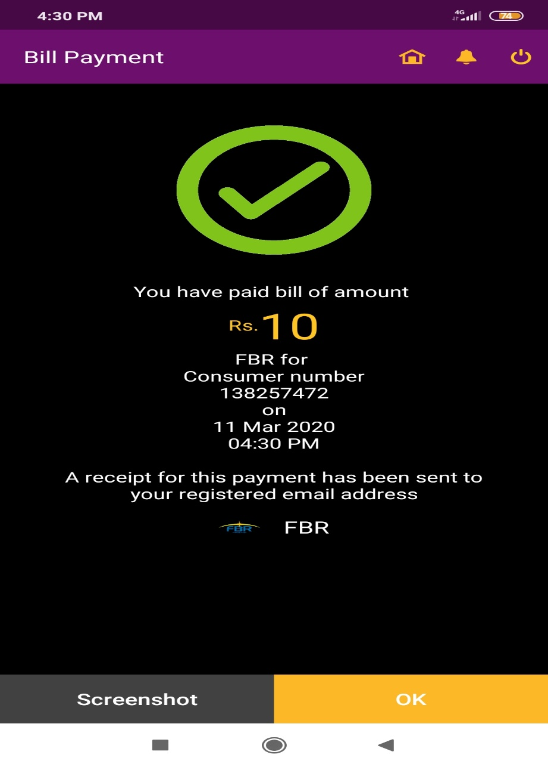
Bill Paid

