Slide 1
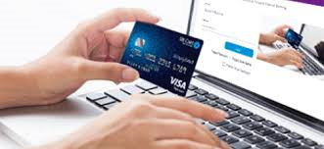
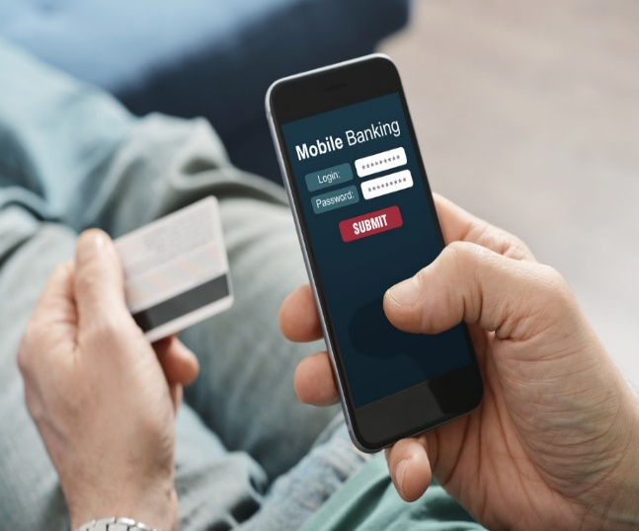
Online Collection of Government Receipts through Alternate Delivery Channels (ADC) & OTCs
State Bank of Pakistan (SBP)
February 6, 2020
Sialkot Chamber of Commerce and Industries, Sialkot.

Slide 2
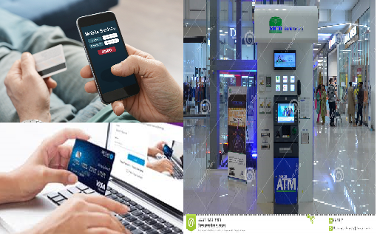
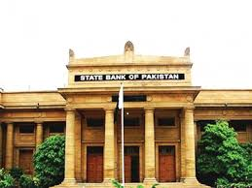
Online Government Collections: Diagrammatic Presentation
Taxpayers make payments through ADCs
Transactions Aggregator
Taxpayer Generate PSIDs
E-CPRs E-CPRs
Taxpayers fetch PSID details through Banks’ BPS
1Link fetch PSID Data from the FBR System/Payment confirmation
Banks fetch PSID Data through 1Link/ Payment confirmation
Payment Batches
E-Scrolls through DAP
Settlement through RTGS

Slide 3
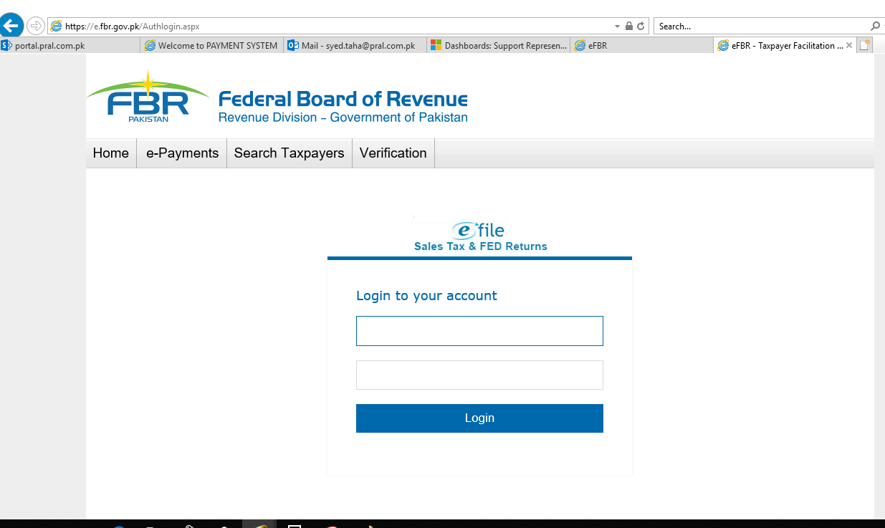
visit FBR Website https://e.fbr.gov.pk

Slide 4
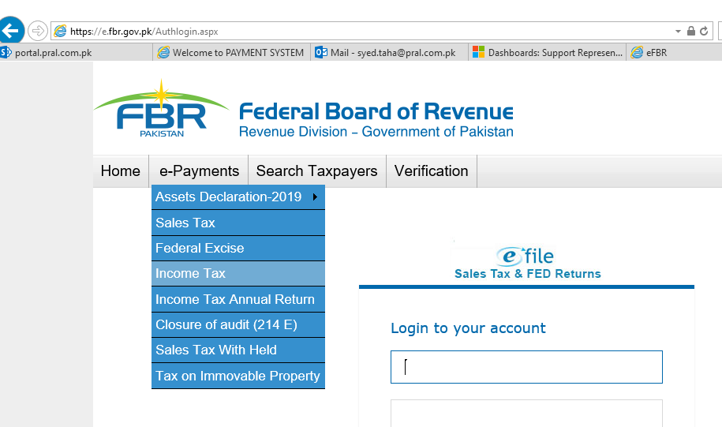
By
Generate PSID Click e-payments

Slide 5
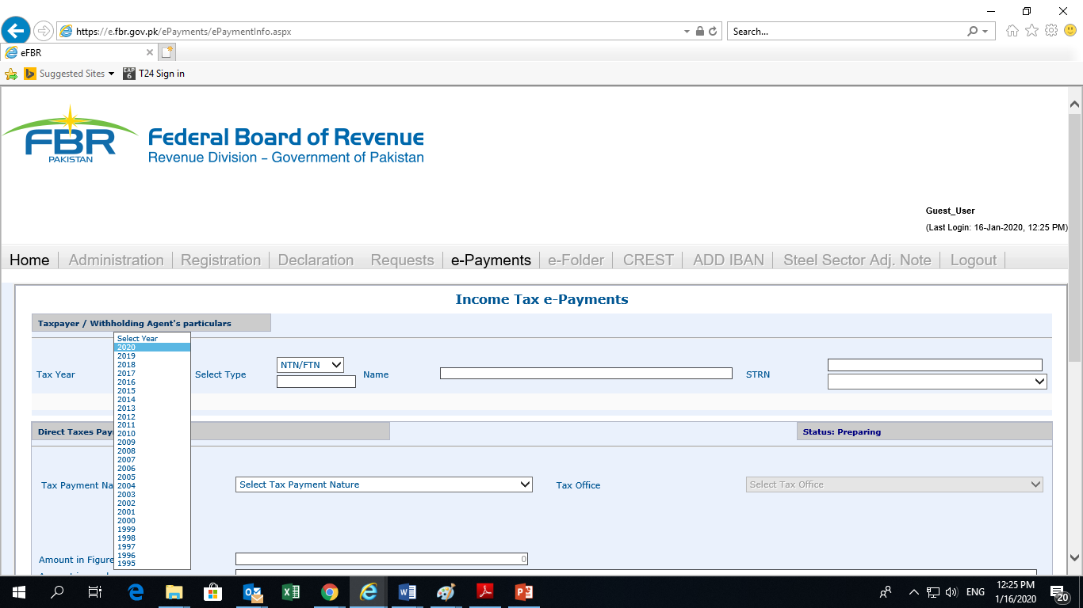
Select the Relevant Year

Slide 6
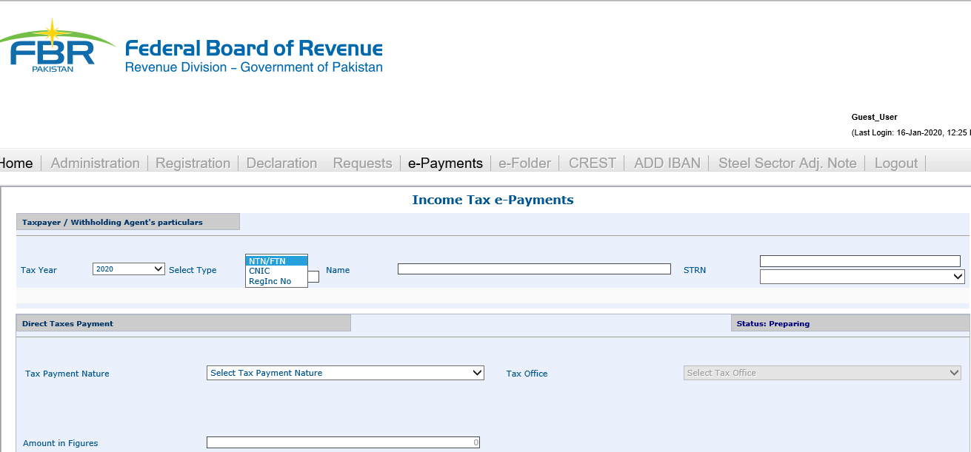
Select Your CNIC / NTN

Slide 7
Select Tax Payment Nature

Slide 8
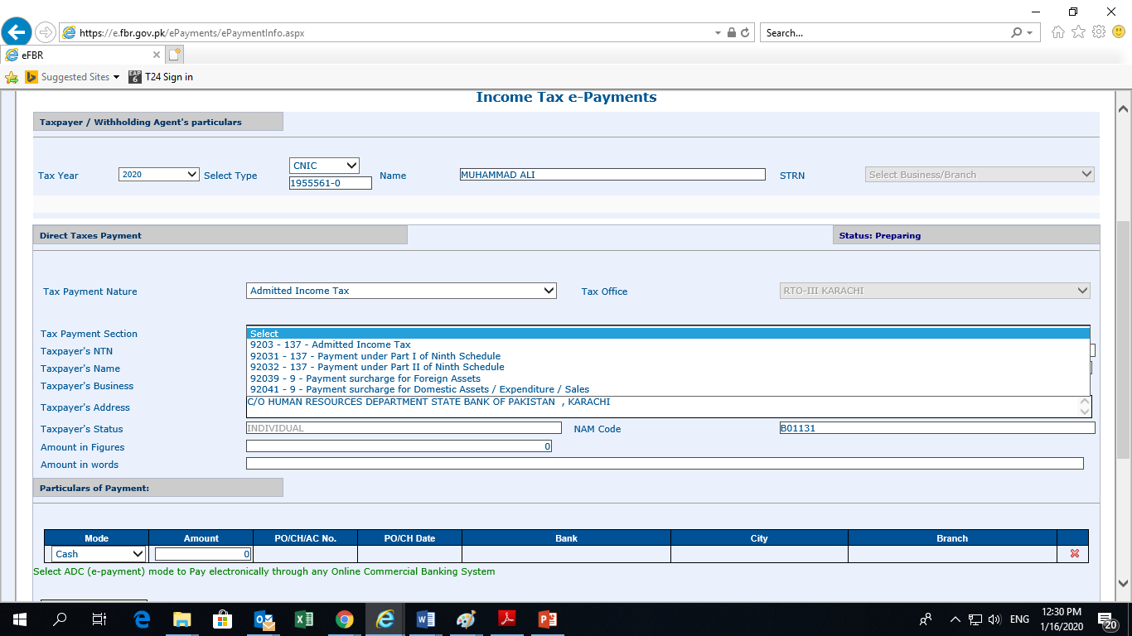
Select Tax Payment Section
6

Slide 9
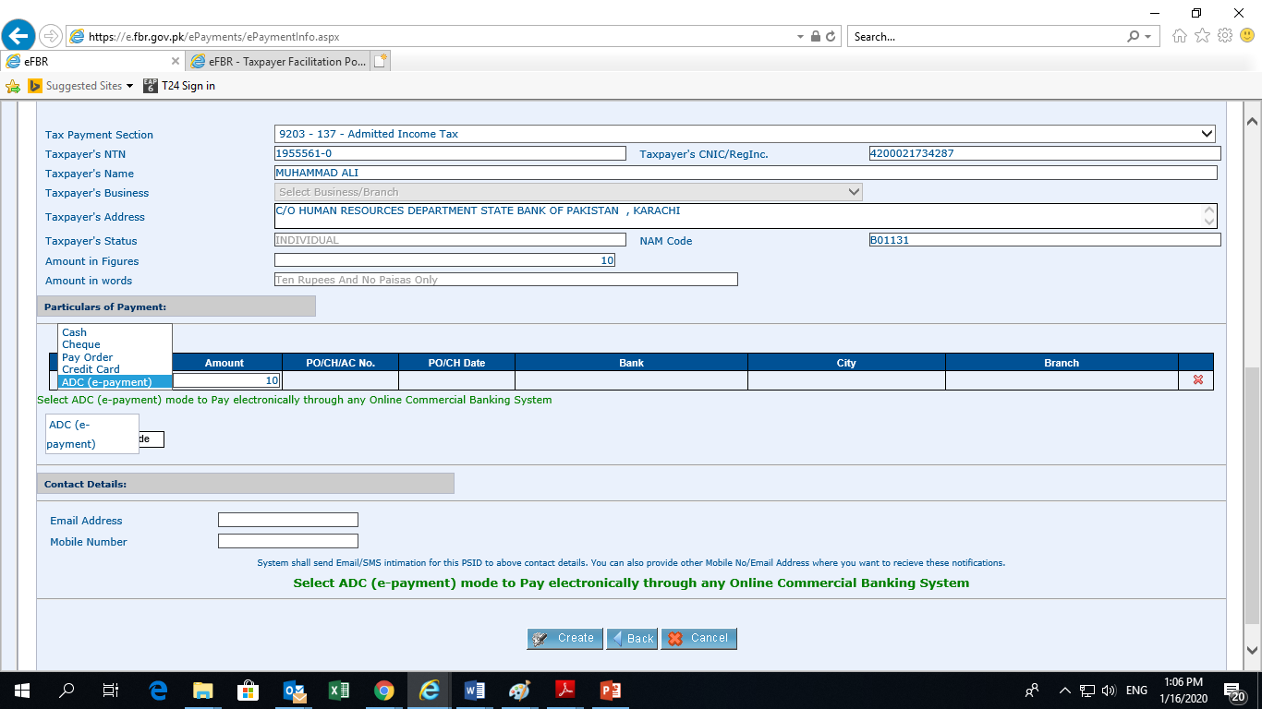
By
Select Payment Mode
7

Slide 10
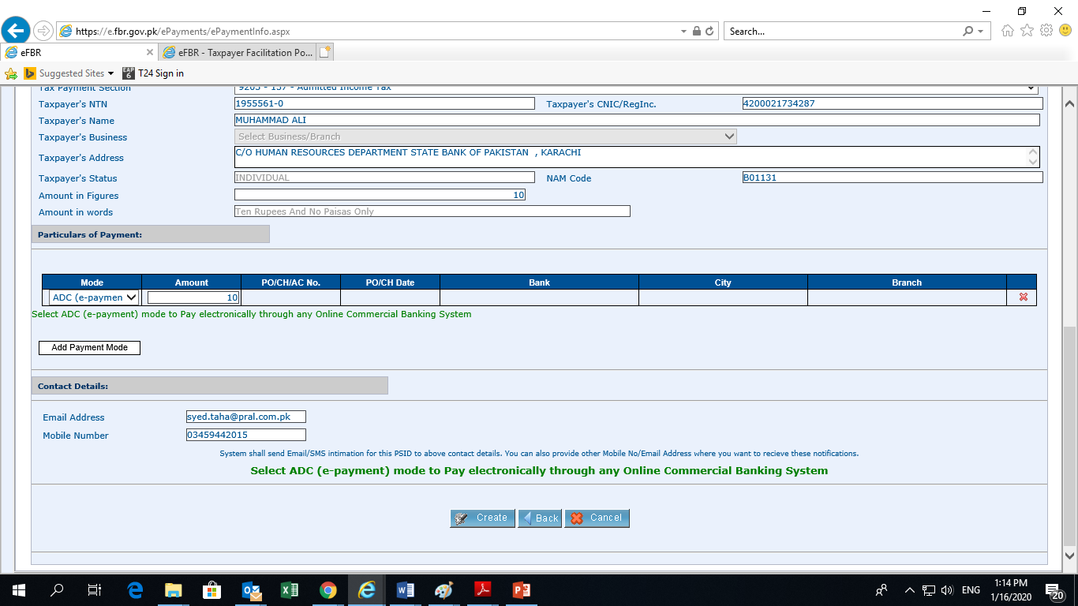
Select payment Mode (ADC) & Contact Details
8

Slide 11
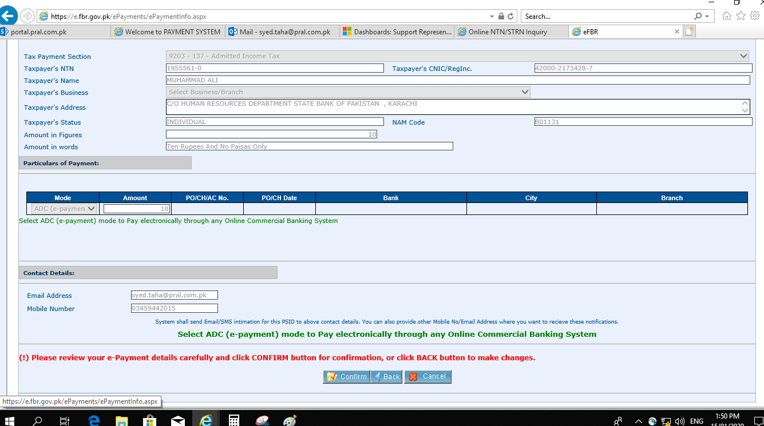
By
Review Details & Confirm
9

Slide 12
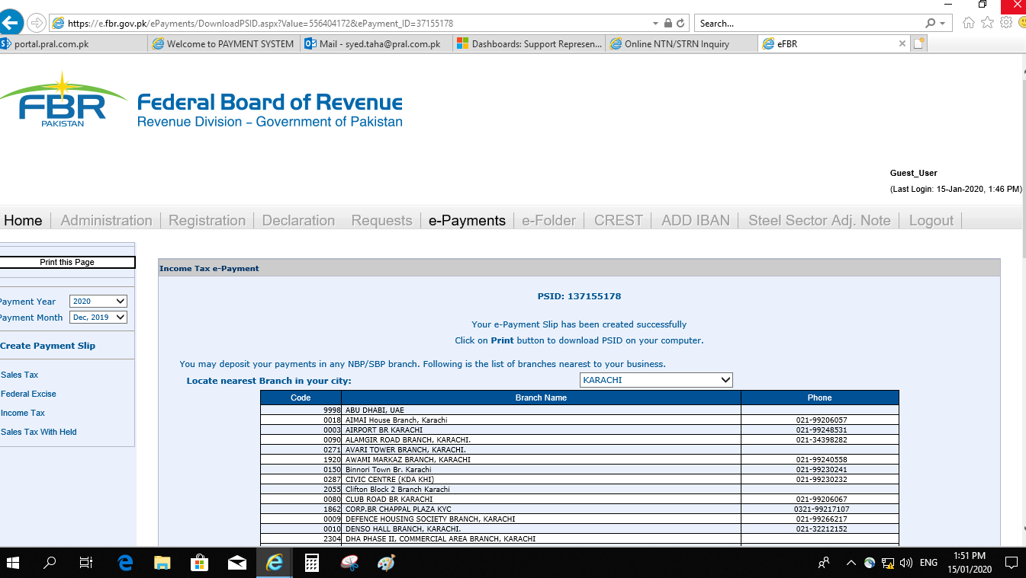
By
PSID No # is Generated (Print)
10

Slide 13
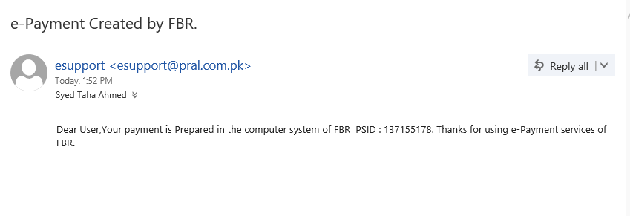
PSID Intimation through e-mail
11

Slide 14
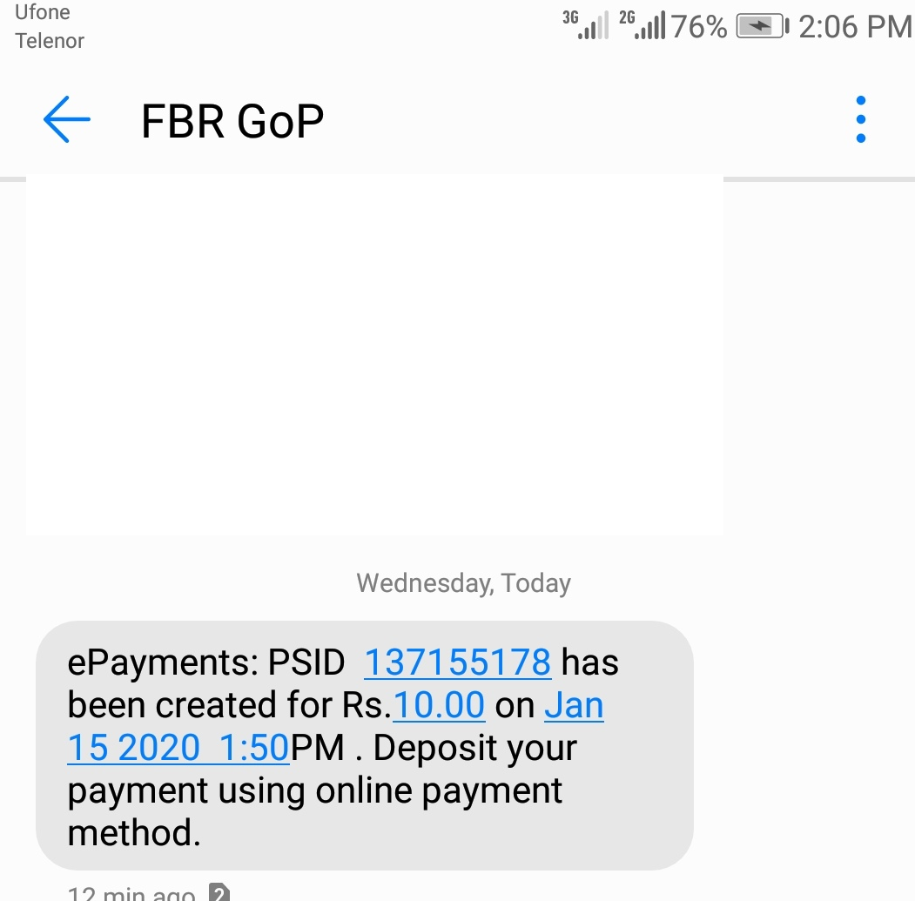
PSID Intimation through Mob Text Message
12

Slide 15
By
PSID Challan
13

Slide 16
By
Payment Procedures
Payment via Over the Counter (OTC) All Commercial Banks.
Payment via ATM.
Payment via Internet Banking .

Slide 17
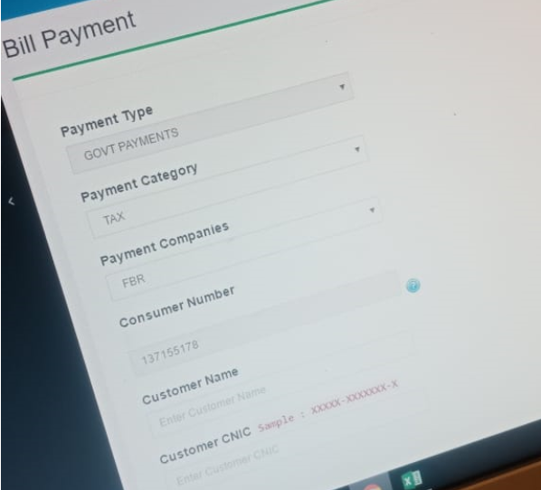
Payment via Over-The-Counter (OTC)

Slide 18
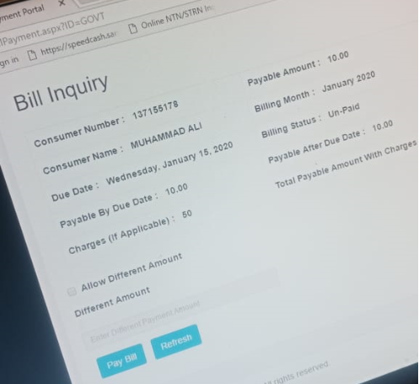
Bill Inquiry (Teller/Cashier)

Slide 19
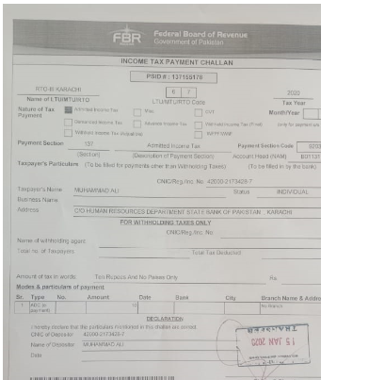
Teller Stamp after OTC payment

Slide 20
PSID used for ATM Payment

Slide 21
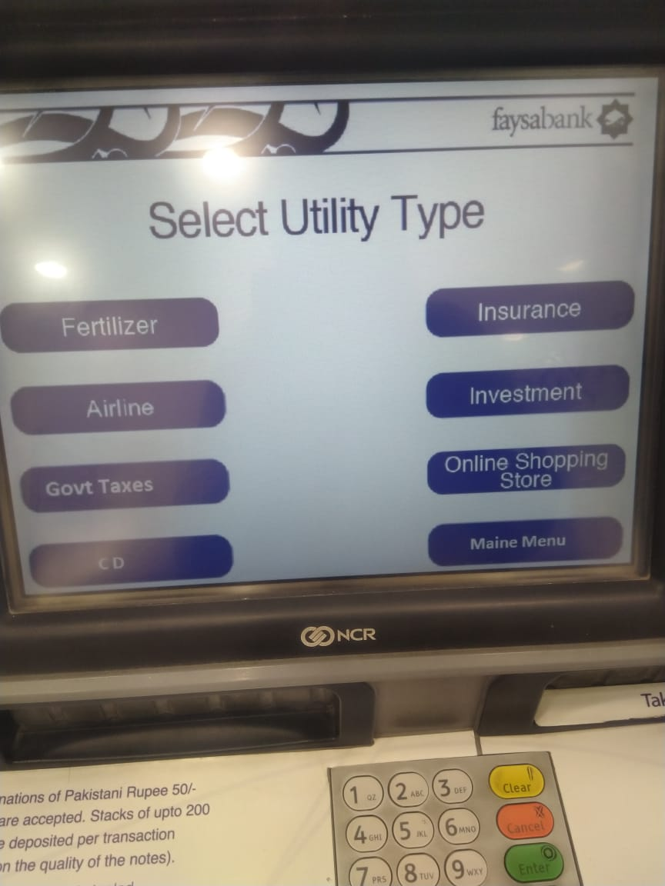
Selection of Utility (Govt. Taxes)

Slide 22
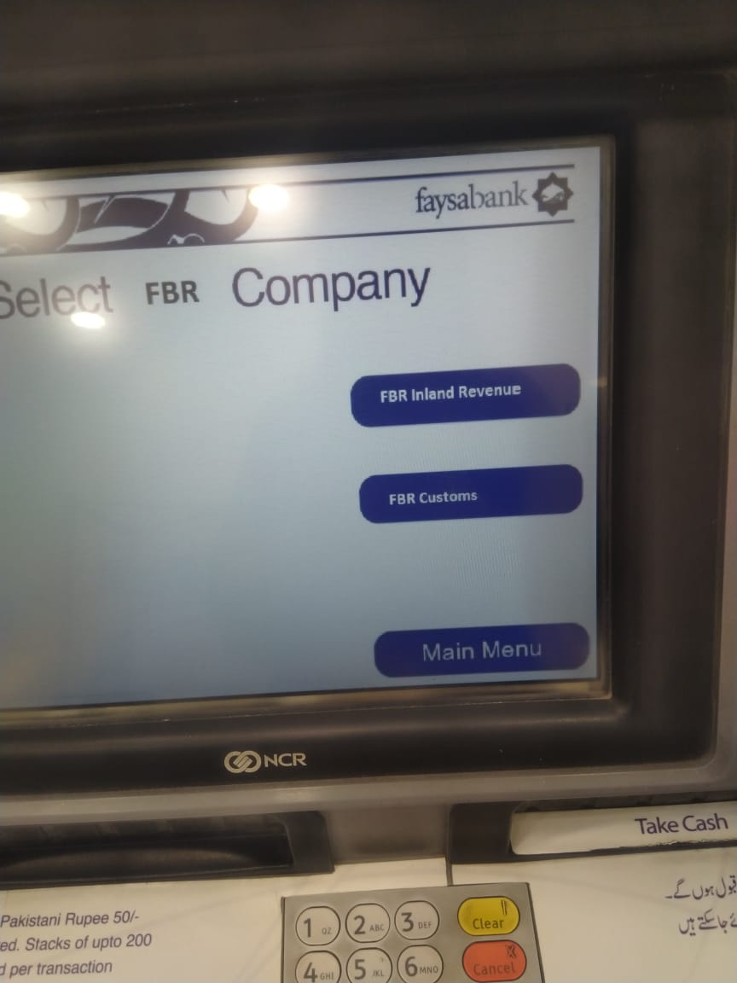
Selection of FBR Tax i.e. Customs/ IR

Slide 23
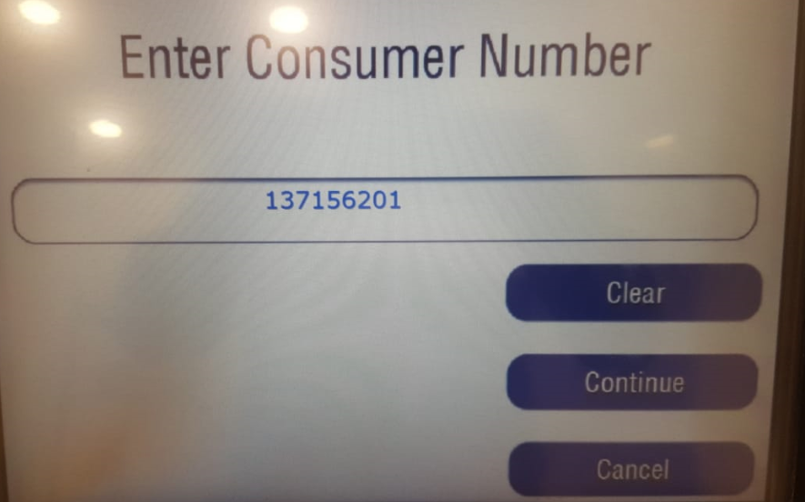
Enter PSID NO.

Slide 24
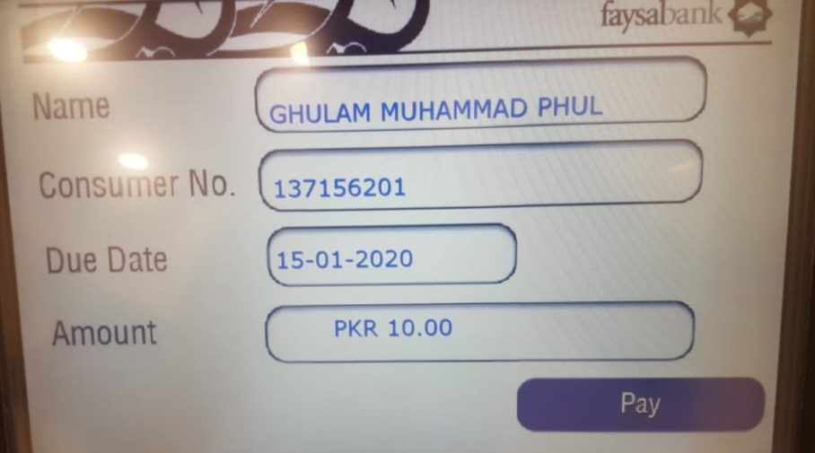
Detail Information appear

Slide 25
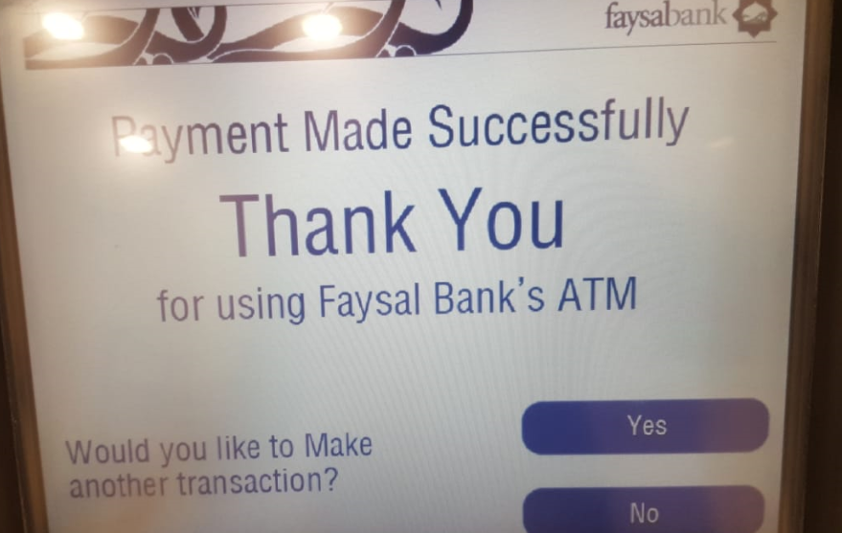
Successful Payment
6

Slide 26
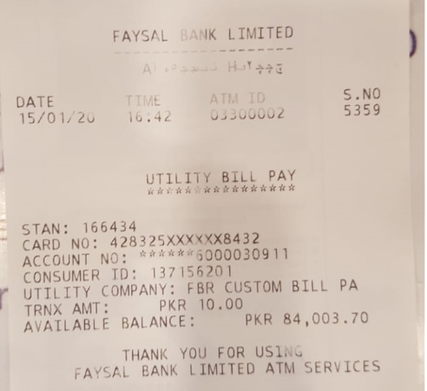
ATM Receipt
7

Slide 27
PSID used for Payment (Internet Banking)

Slide 28
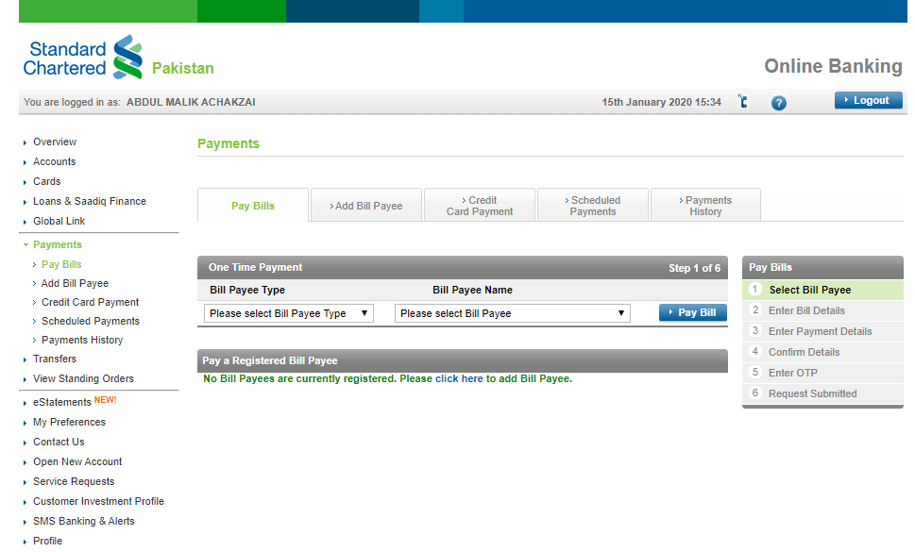
By
Payment (Internet Banking)

Slide 29
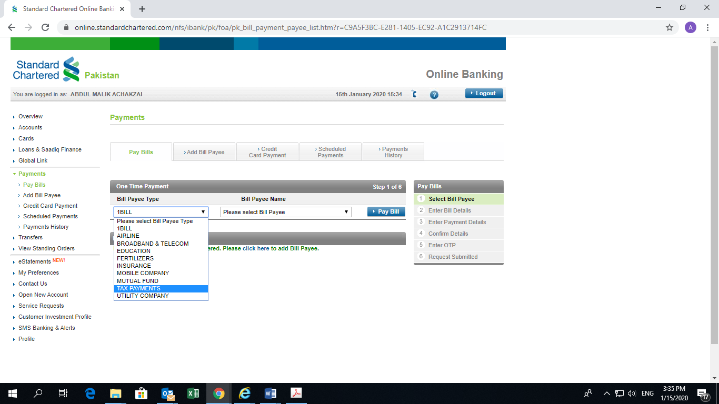
By
Select Bill Payee Type (Tax Payment )

Slide 30
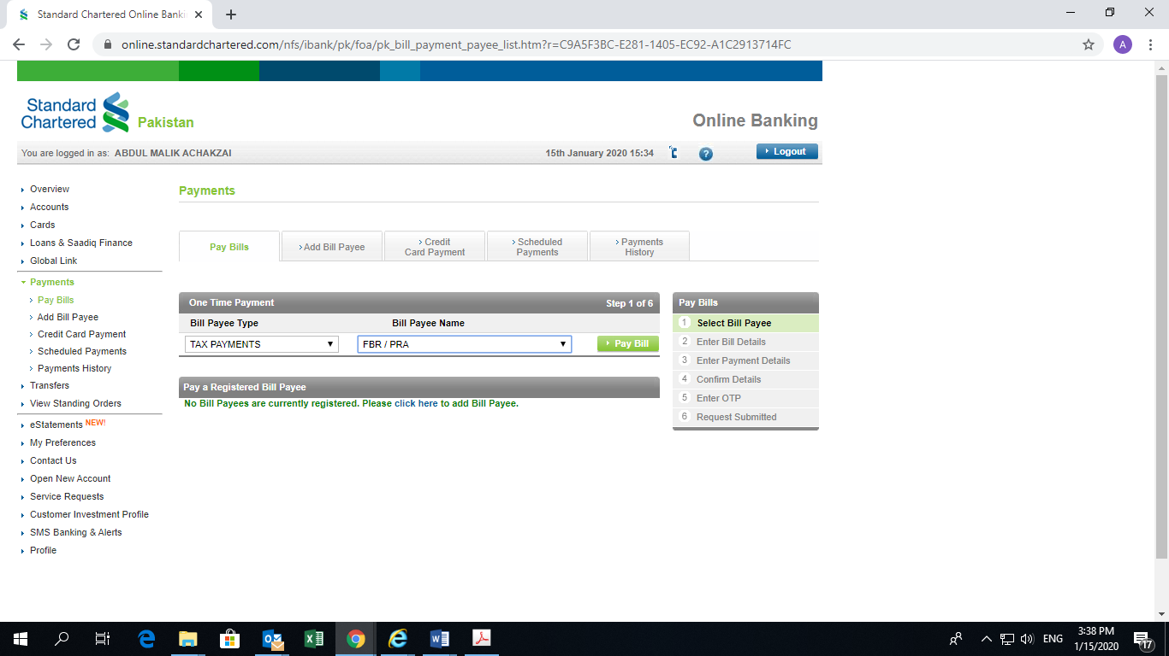
By
Select Bill Payee (FBR)

Slide 31
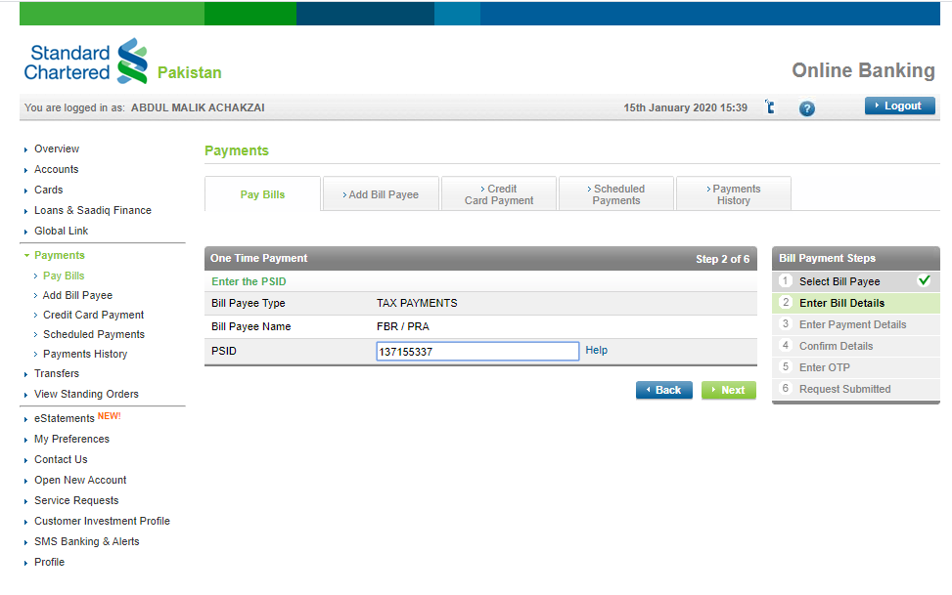
By
Enter Bill Details (PSID No)

Slide 32
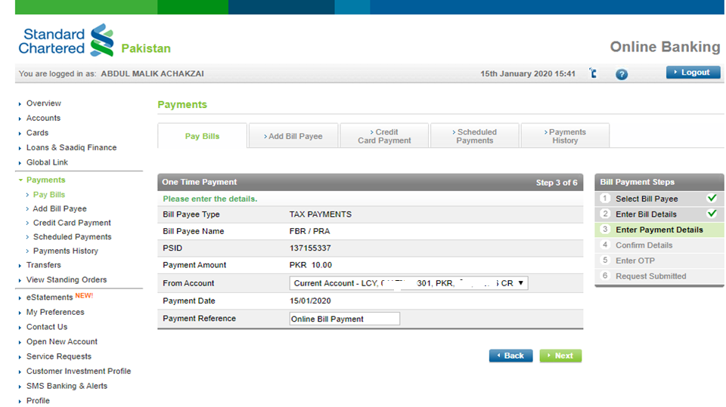
By
Enter Payment Details
6

Slide 33
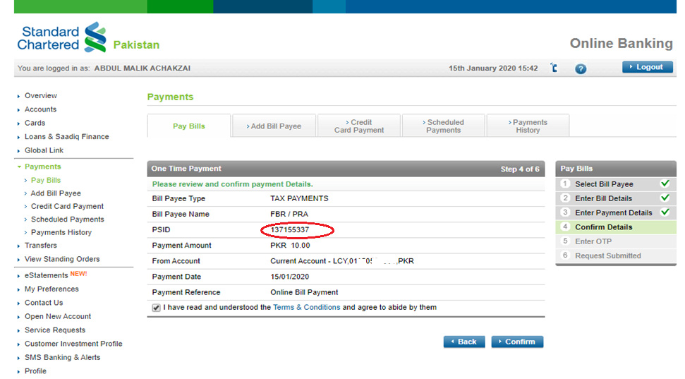
By
Confirm Details
7

Slide 34
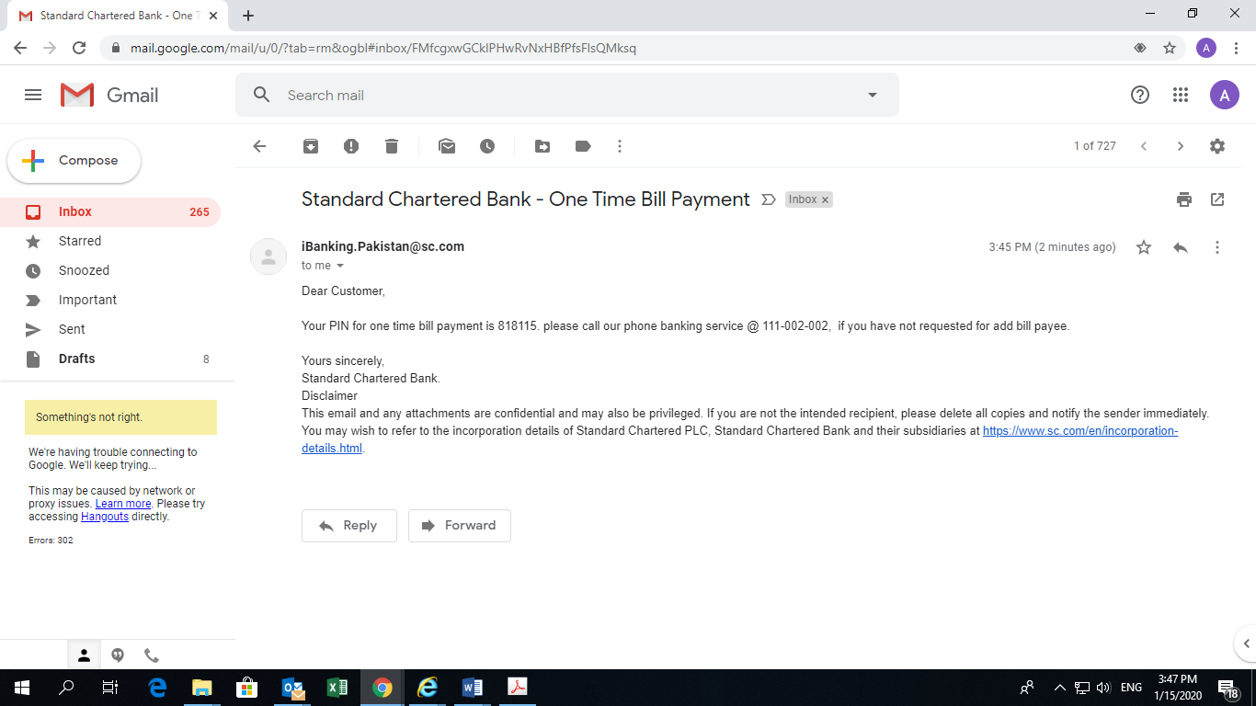
By
Pin via Email
8

Slide 35
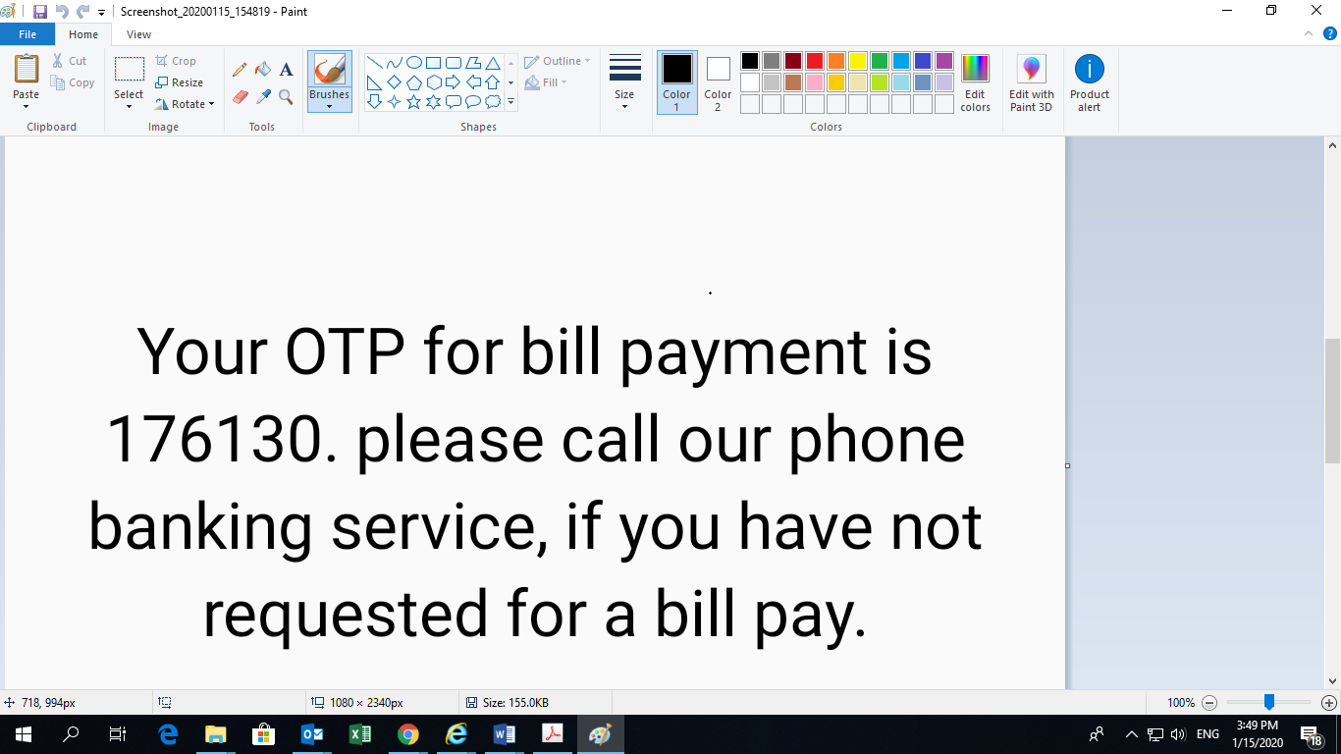
By
OTP via Mob message
9

Slide 36
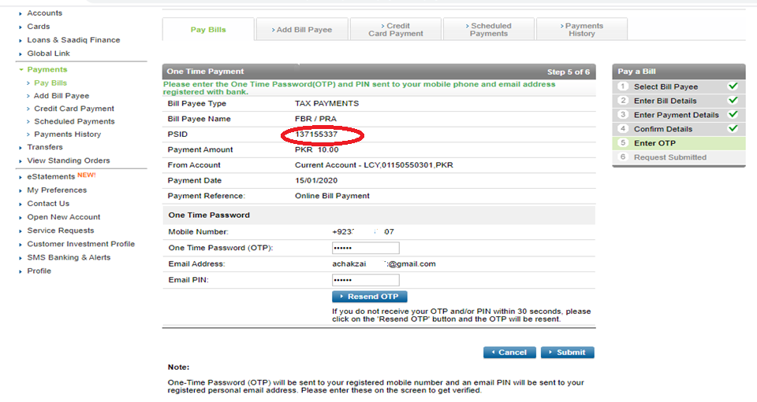
OTP/PIN Putin
10

Slide 37
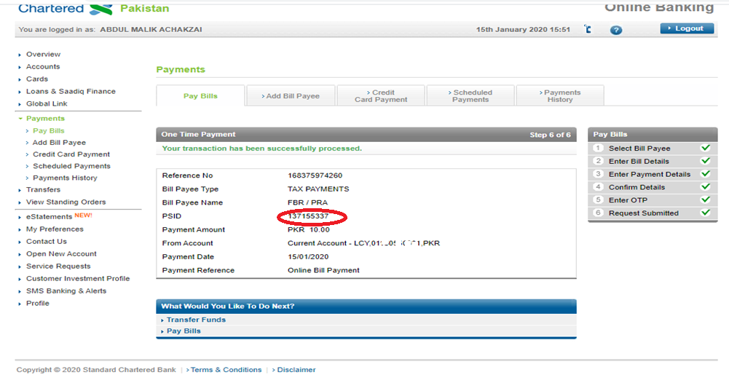
Transaction Successful
11

Slide 38
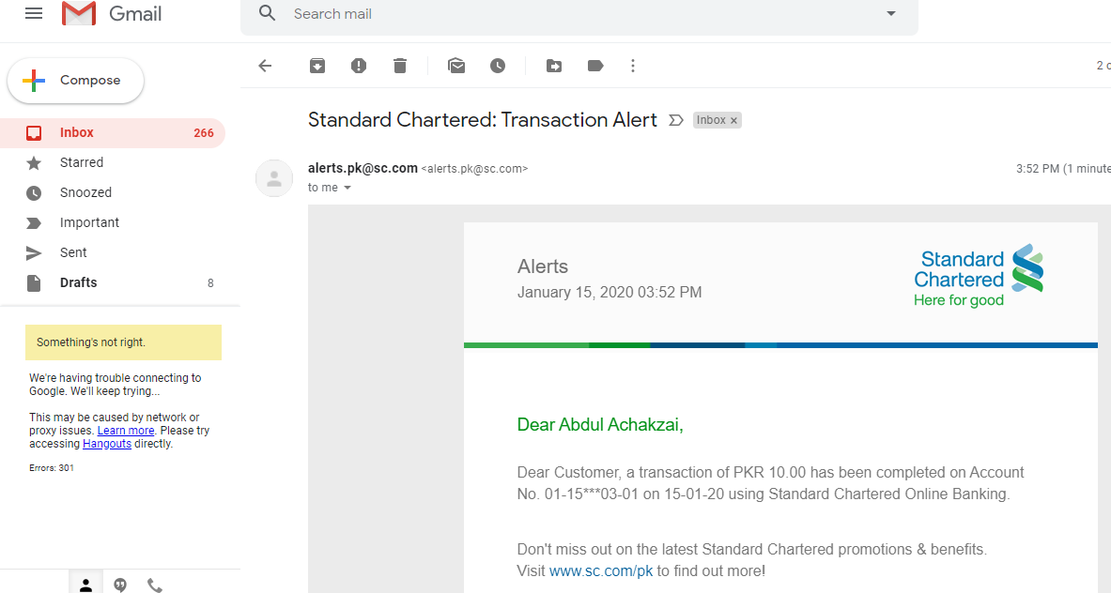
Transaction Confirmation via Email
12

Slide 39
Transaction Confirmation via Mob Message
13

Slide 40
1-Link Reporting to SBP

Slide 41
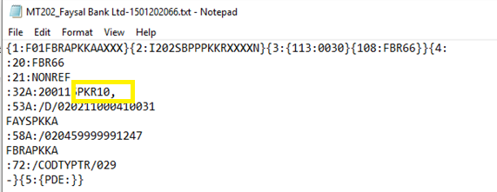
1-Link Reporting to State Bank of Pakistan (SBP)
File NO. 1-MT 202 SwIFT Message for processing at rtgs

Slide 42
1-Link Reporting to State Bank of Pakistan (SBP)
File NO. 2 FOR PROCESSING IN SBP’S CORE SYSTEM

Slide 43
Processing of Transactions at SBP

Slide 44
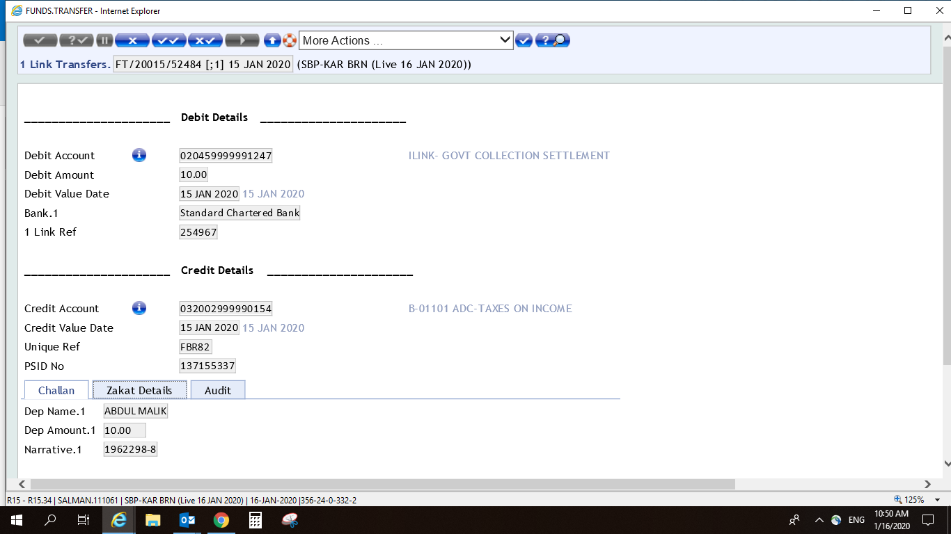
Detailed Transactions file Processing in SBP Core System

Slide 45
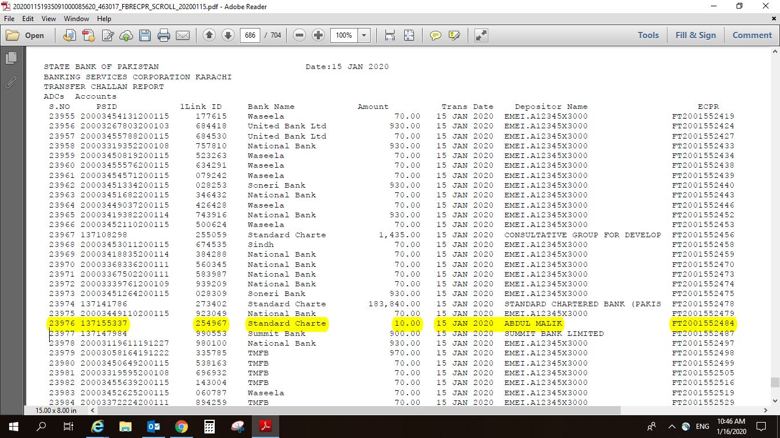
SBP Reporting to PRAL / Centralized Treasury

Slide 46
Email Generated for confirmation of CPR

Slide 47
Computerized Payment Receipt issued by FBR/PRAL

Slide 48
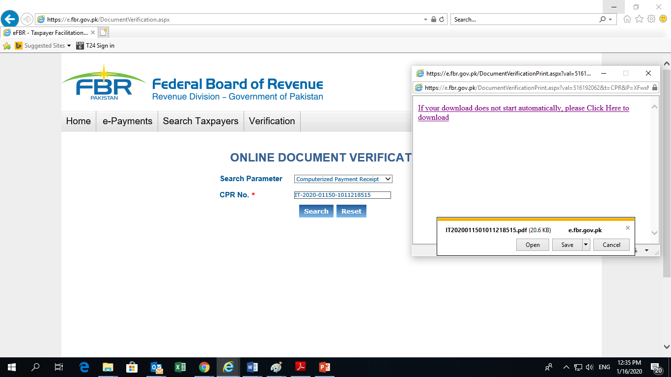
Online verification of CPR No.

Slide 49
Online Collection Since Launch

Slide 50
Benefits of online collection
Fast, secured, efficient and hassle-free 24/7 tax payment system
No need to stand in long queues, pay from the comfort of your from home / office through Internet / Mobile Banking.
Cost free (w.e.f. 1st Jan 2020 SBP has eliminated transaction fee on ADCs for tax payers).
Same-day settlement of Government’s revenue.
Automated end-to-end reconciliation between SBP and Government Treasuries through generation of e-scrolls for Govt.’s treasury.
Promotes financial inclusion.

Slide 51
Thanks

